Slide 1
Johanna Carter
Oasis London conference
30th April – 1st May 2025

Slide 2
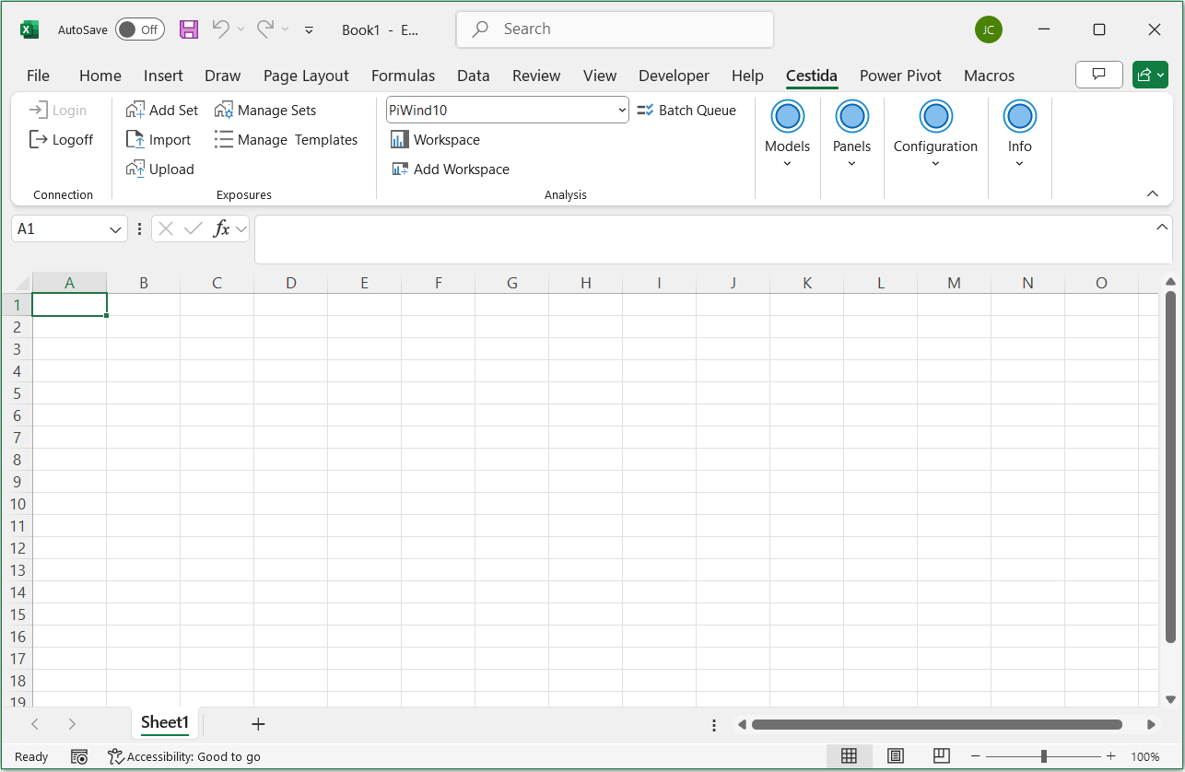
Introducing Cestida platform
Runs in Windows
Easy to install
Excel front end
Oasis standard models
Fast and lean calc engine
Designed to simplify the infrastructure needed for cat modelling
Our Excel Ribbon
One front end for all user workflows!

Slide 3
IT-friendly features
Windows Servers
Cloud compatible
User front end
User security
Data store
Easy integrations

Slide 4
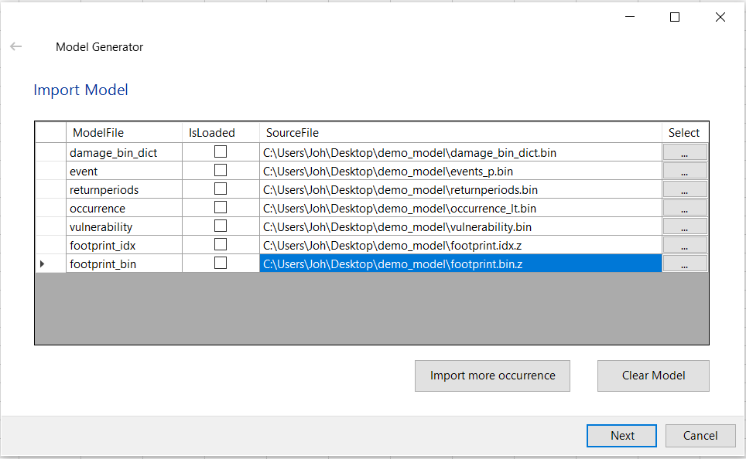
Model provider features
Wizard for importing models
Automated model deployment
Install
model
Publish
model

Slide 5
Simple software to lower the costs of cat modelling

