Slide 1
Risk Frontiers’ Models
Oasis Insight 2025

Slide 2
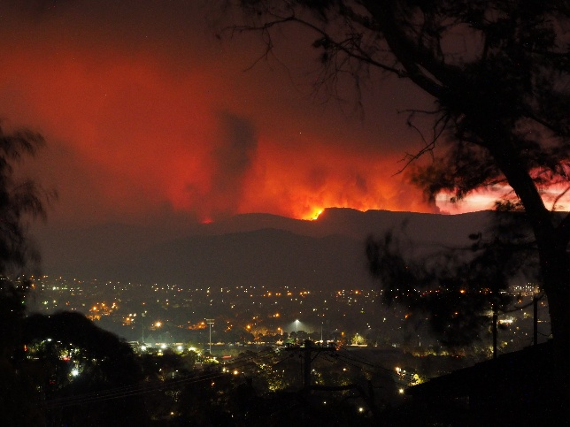
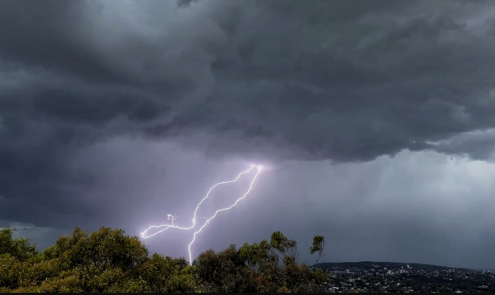
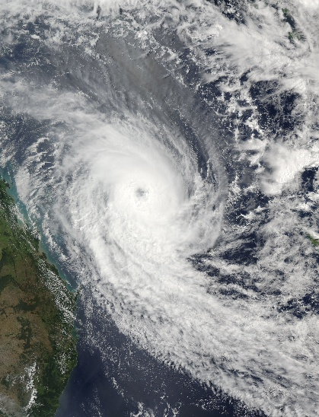
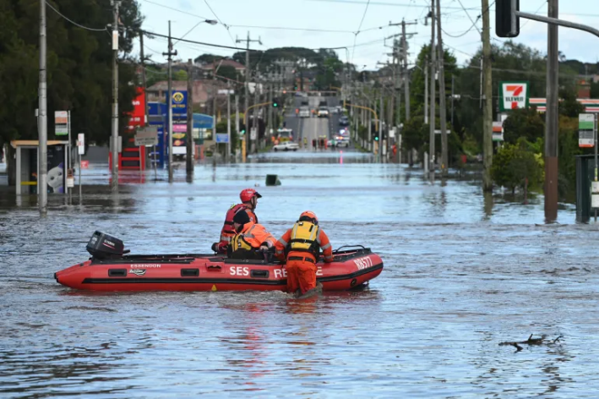
Specialist ANZ cat modellers since 1994
Cat Models Available in Oasis LMF
Black Summer 2019
HailAUS
Christmas Storms 2023
Xmas storms
Black summer
2022 flooding
Tc alfred
FireAUS
FloodAUS
CyclAUS
Tropical Cyclone Alfred 2025
Eastern Australia Floods 2022
QuakeAUS
QuakeNZ
All models are address-resolution Detailed Loss Models

Slide 3
Comprehensive Development Pipeline
2024
Mid 2025
2026 and beyond
HailAUS 8.0
All new hazard
Climatology proxy from recent literature
Radar archive availability
CyclAUS 4.0
New ML based wind model
New Vulnerability
Real Time Loss Estimation
QuakeNZ update
StormAUS
Vulnerability and new LOBs
SaaS
FireUS
FireAUS 4.0
MODIS and ML based
Learnings from Black Summer
QuakeAUS 7.0
Open quake hazard generation
NSHA 2023 Implementation

Slide 4
Event sets based on a common Climate Data Set
Peril Correlation
Climate Conditioned CAT models
FireAUS
HailAUS
Bushfire and grassfire
loss model for Australia
Severe convective storm
loss model for Australia
%
%
Sata
ERA5
Tropical Cyclone
loss model for Australia
Riverine flood
loss model for Australia
CyclAUS
FloodAUS
All now available on the Oasis LMF

