Slide 1
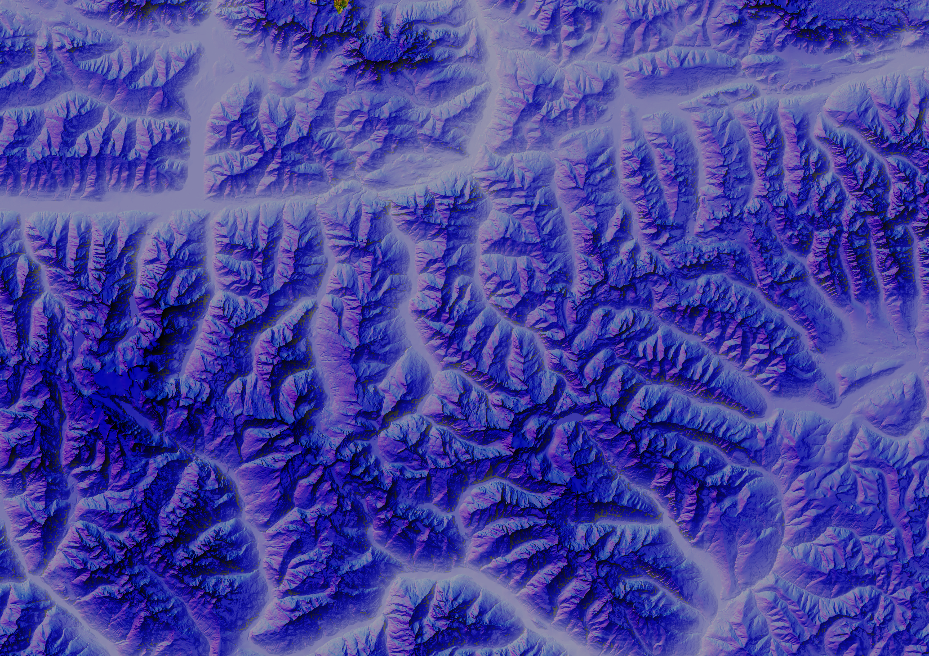

Slide 3
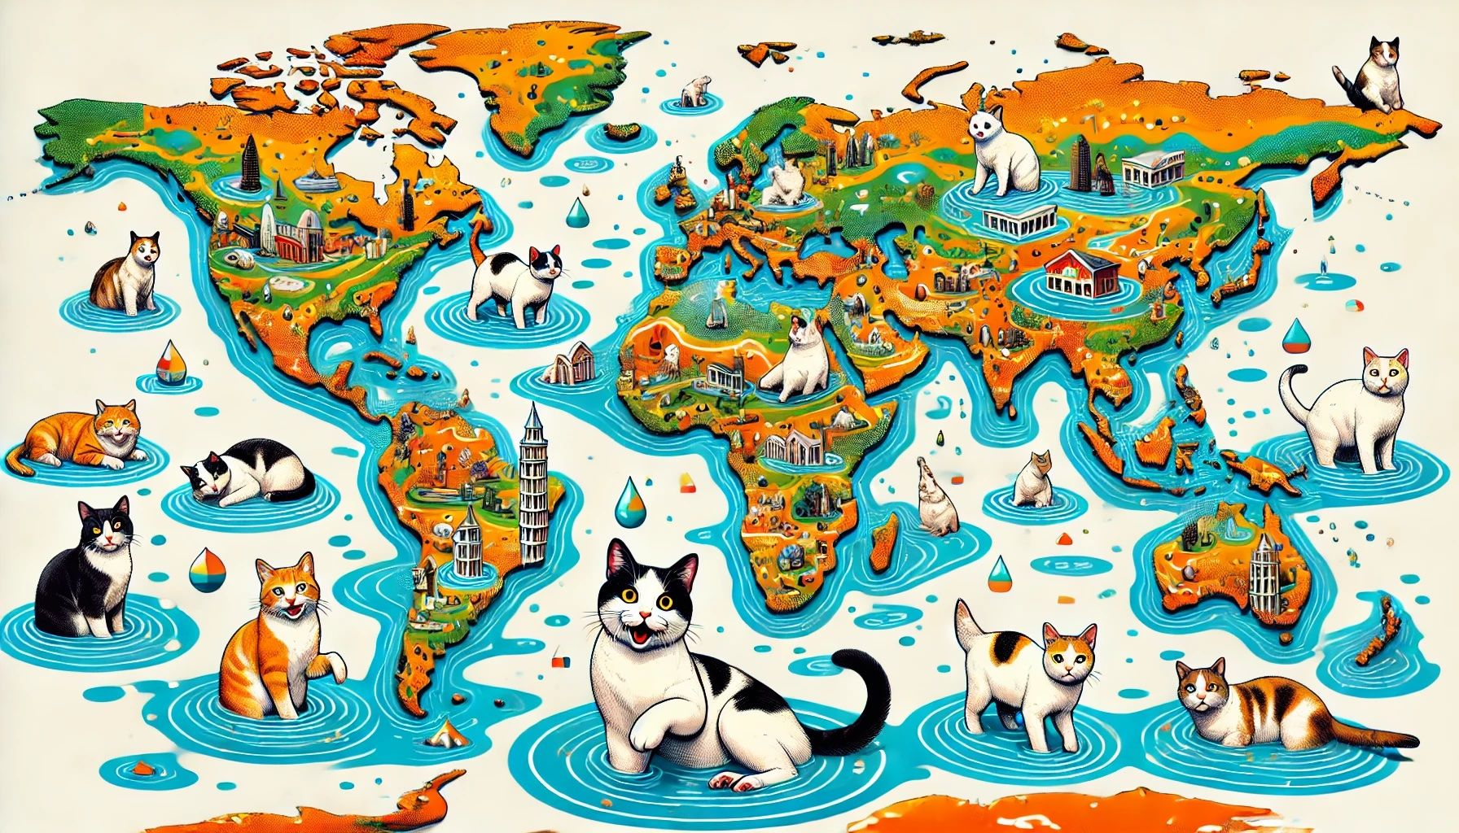

Slide 4
Why Global Flood Cat?
Best in class components
World class partners
Current climate
Good user experience
Inputs include award-winning and academically validated Global Flood Map and Global Terrain Data — FABDEM+.
Extensive feedback from industry leaders to continually improve market fit.
Conditioned to appropriately represent the current climate.
Performant model, curated set of options. Easily customizable to suit your business.

Slide 5
Fathom's Global Flood Cat — The first truly global flood catastrophe model to consider both inland and coastal perils.
Globally consistent
Major asset types / coverages
Flood coverage at 30m resolution for all major flood perils
Residential, commercial and industrial
Buildings, contents and business interruption coverages
Sophisticated risk differentiation
Aggregated data and coarse geocoding
Including custom flood defenses and risk modifiers
Using different spatial distributions for different asset types
Transparent and customizable
Comprehensive uncertainty representation
Download hazard and vulnerability Use your own vulnerability
Detailed Monte Carlo sampling
Nil and total losses
‘within-event’ uncertainty correlation

