Slide 1
Turning Unthinkable Risk into Measurable Advantage

Slide 2
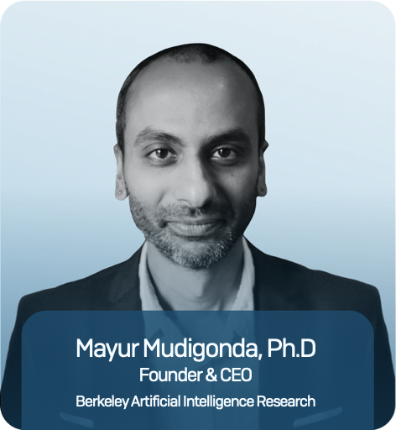
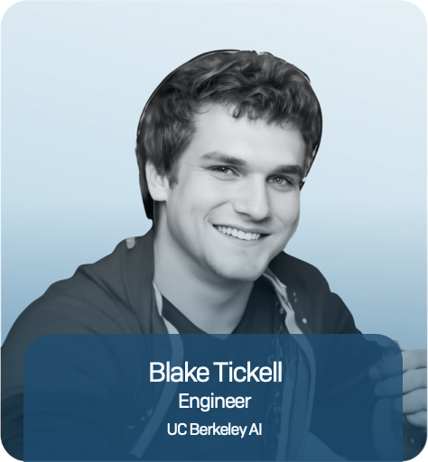
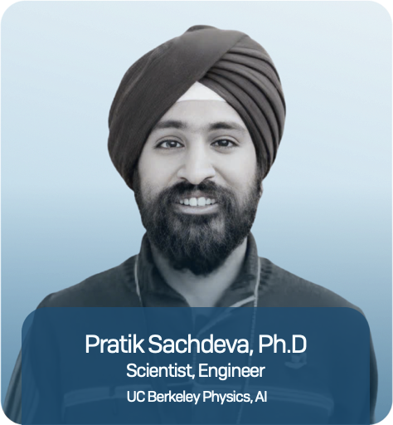
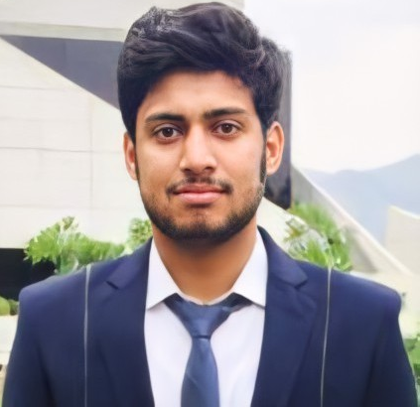
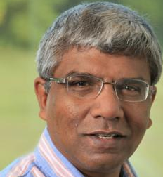
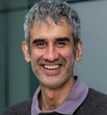
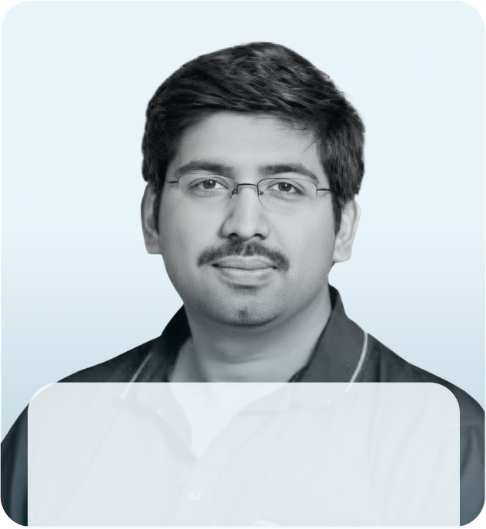
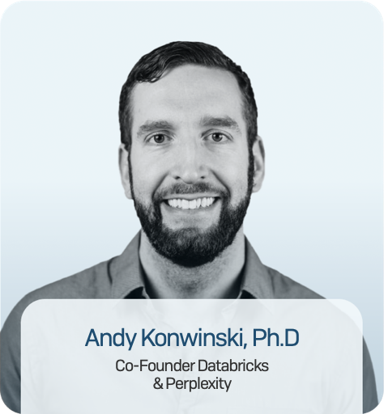
The team to deliver
Sabbih Shah
Valentine Anantharaj, PhD
AI Engineer
Staff Scientist, ORNL
Sean Spain
Ashesh Chattpodyay, PhD
Wahid Bhimji, PhD
Prabhat Ram, Ph.D
Andy Konwinski, PhD
Head of Product innovation
Assoc Prof, UCSC
Group Lead, Berkeley Lab
Partner Microsoft Azure
Co-founder Databricks & Perplexity
Deloitte, Ki Insurance, Brit Insurance

Slide 3
Vayuh → AI to Learn Atmospheric Physics for Insurance
Atmospheric Data
Vayuh Extremes Foundation Model
Task Specialization
Insurance Products
Climate model
Downscaling
ERA 5
Extreme Weather Risk Assessment (e.g., SCS)
Temperature. Pressure.
Weather Forecasting
HRRR
Wind speed. Precipitation.
Climate Assessment
Hazard Layers
Aurora
GraphCast
NCEI
PanguWeather
Event Specific Data
Prithvi WxC
Downscaling
Stochastic Event Sets
Insurance Layers
Learning Physics vs Writing Physics

Slide 4
Challenges to Hail Modelling and Vayuh’s Solution
Hail Challenge Context
Modelling Challenges
Vayuh’s Solution
Hail is a hyper local event
Numerical Weather Models struggle with the microphysics associated with hail
Learn the physics using advanced AI models
Ground truth data is challenging and noisy
Observational data for hail is sparse and biased
Combined multiple datasets, including NCEI and MRMS (radar)
Hail contributed to ~60% of cat losses in the US alone
Models often operate at insufficient resolution to forecast loss & exposure
Use AI models to downscale with high accuracy

Slide 5
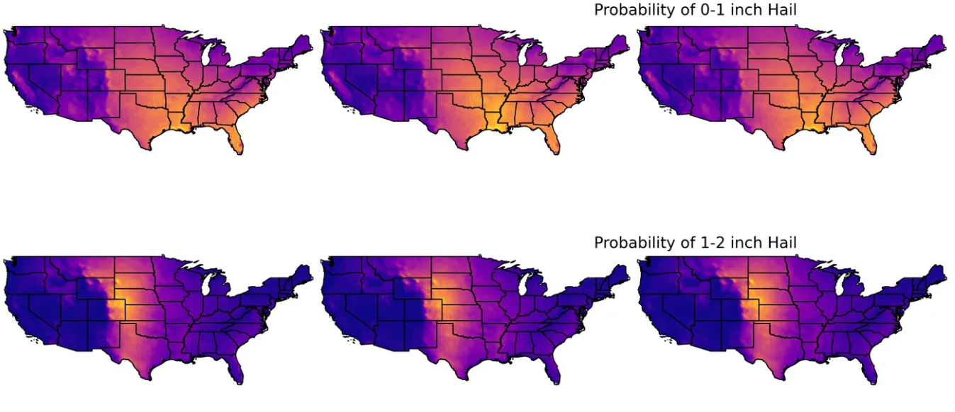
AI-Driven Hazard Layers: Hail Risk Over CONUS

Slide 6
Vayuh Hail Validation

Slide 7
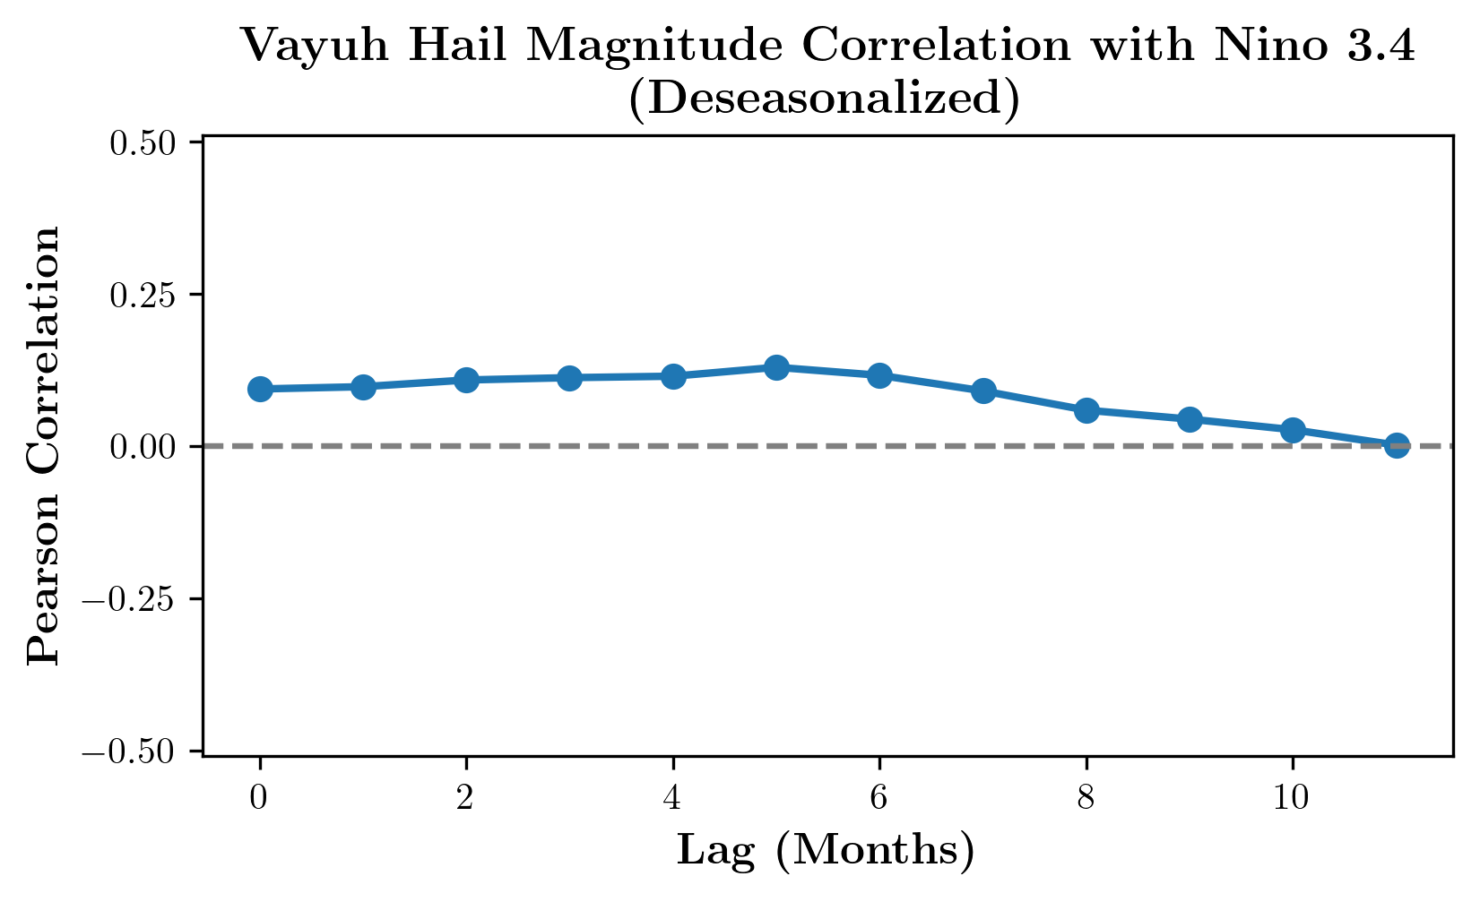
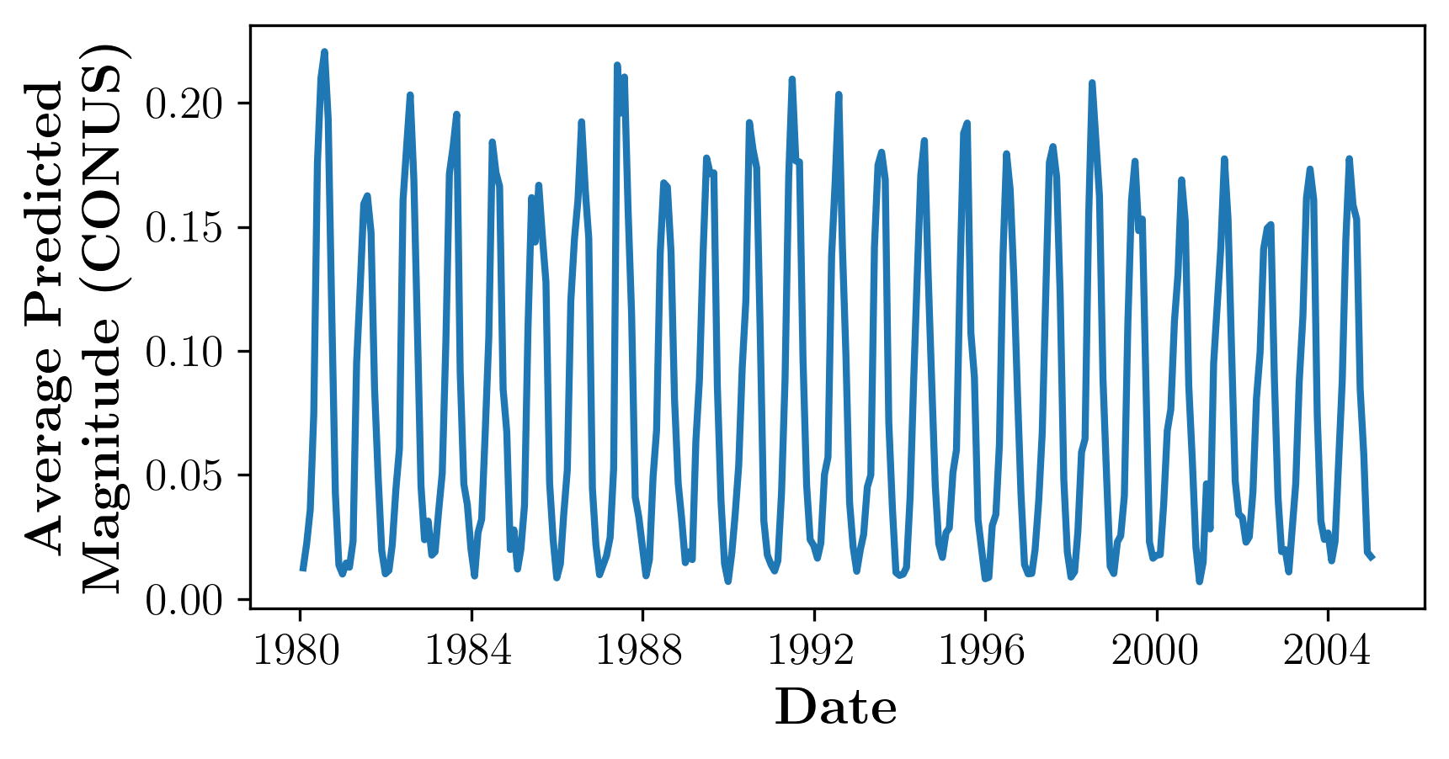
Vayuh Hail Predictions Correlate with Atmospheric Indices

Slide 8
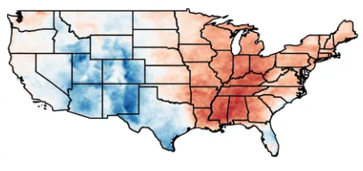
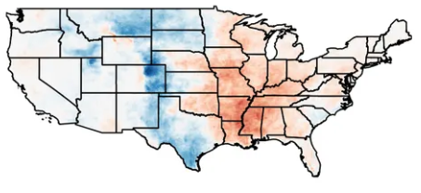
Vayuh Outputs Correspond with changes in CAPE
Change in 0-1 inch Probability
Change in 1-2 inch Probability
*Confidential

Slide 9
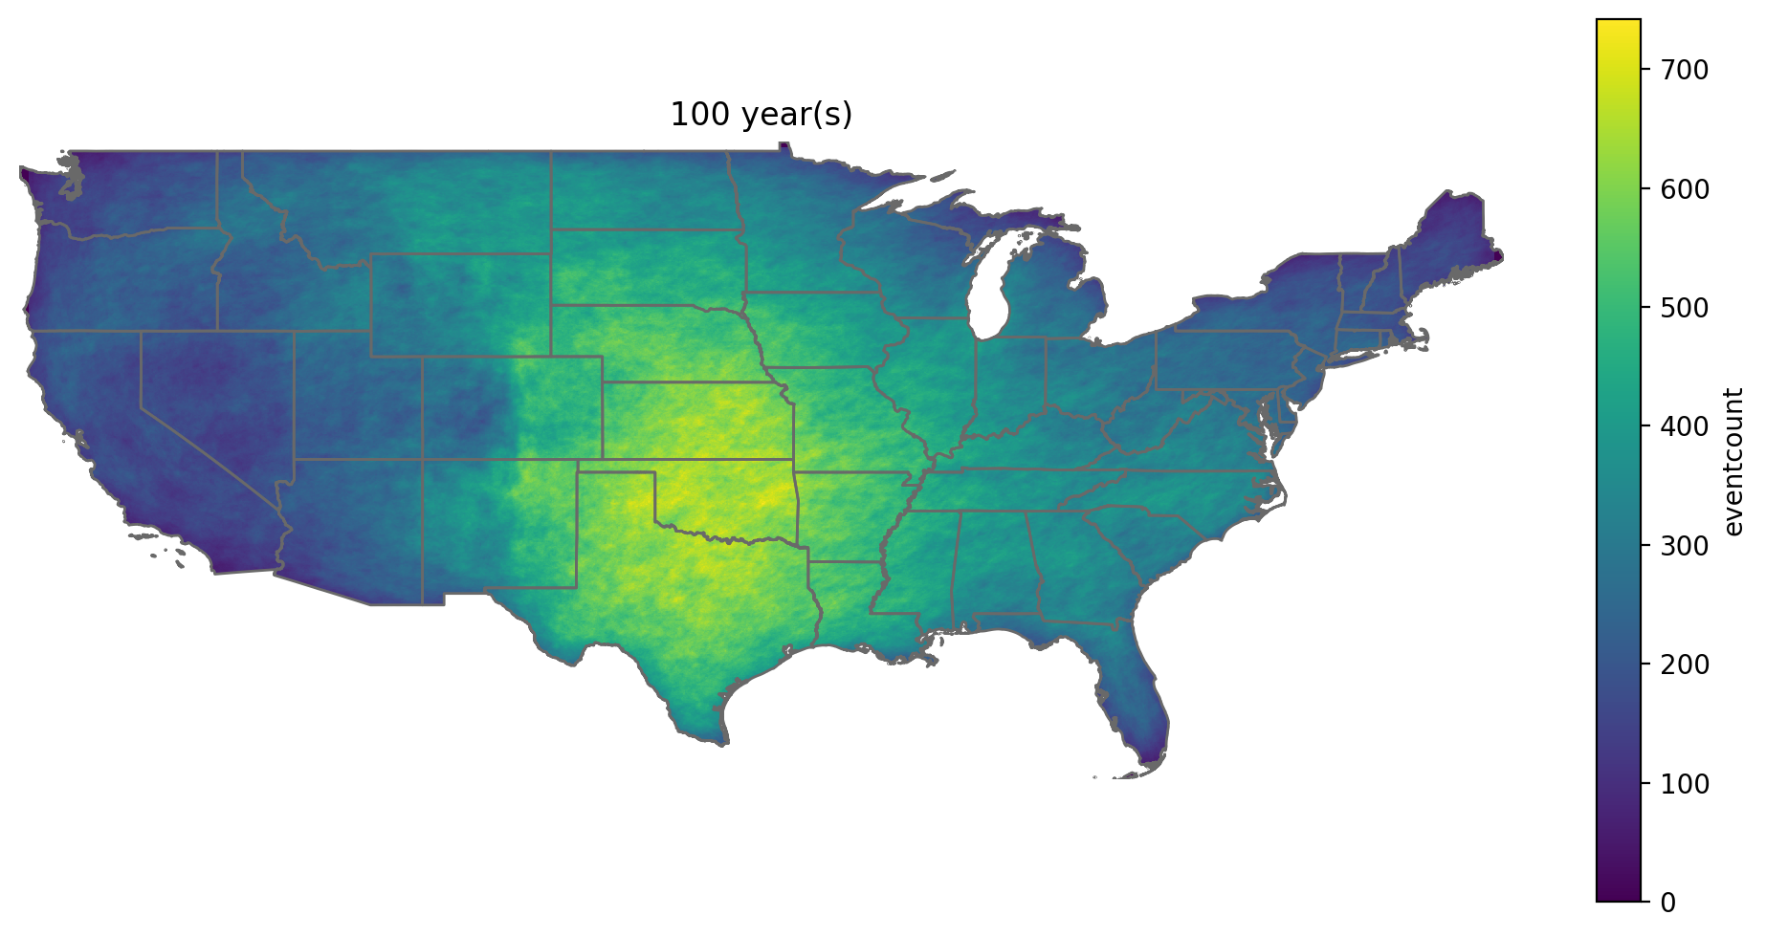
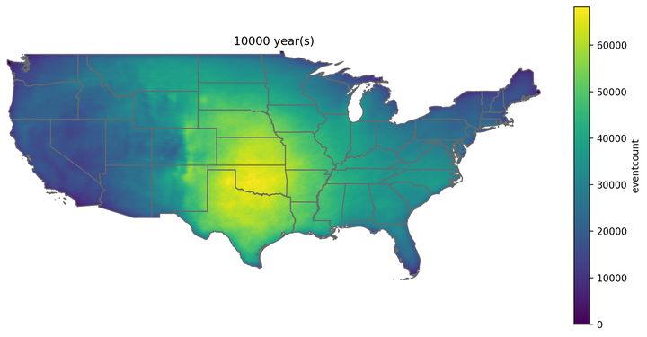
AI-Driven Construction of Stochastic Event Catalogs
100 Years
10,000 Years

Slide 10
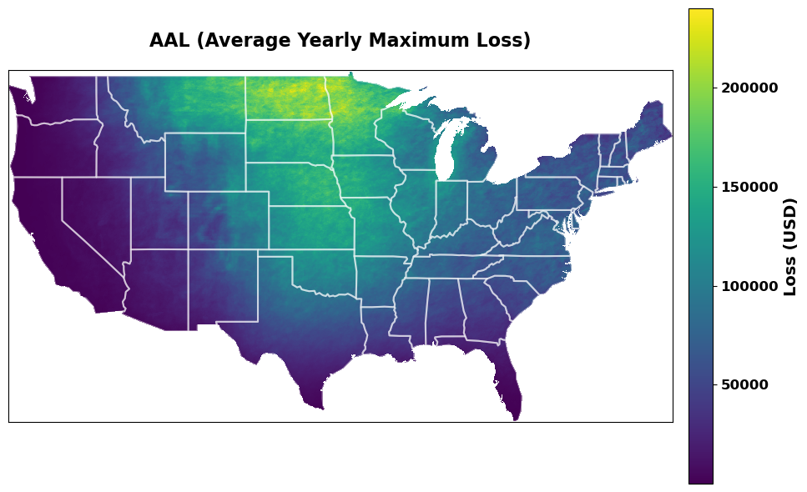
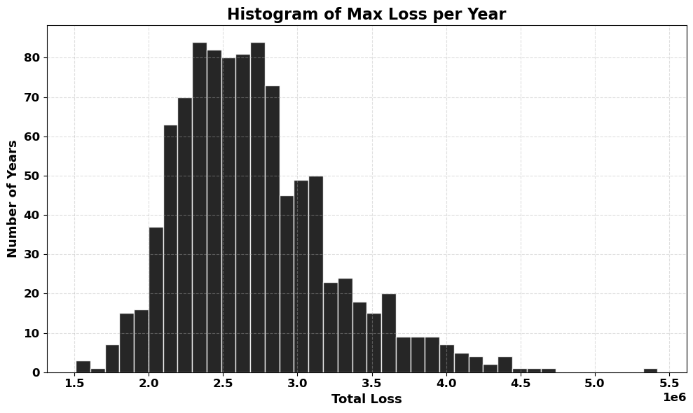
AI-driven Risk Assessment can Improve Loss Estimates

Slide 11
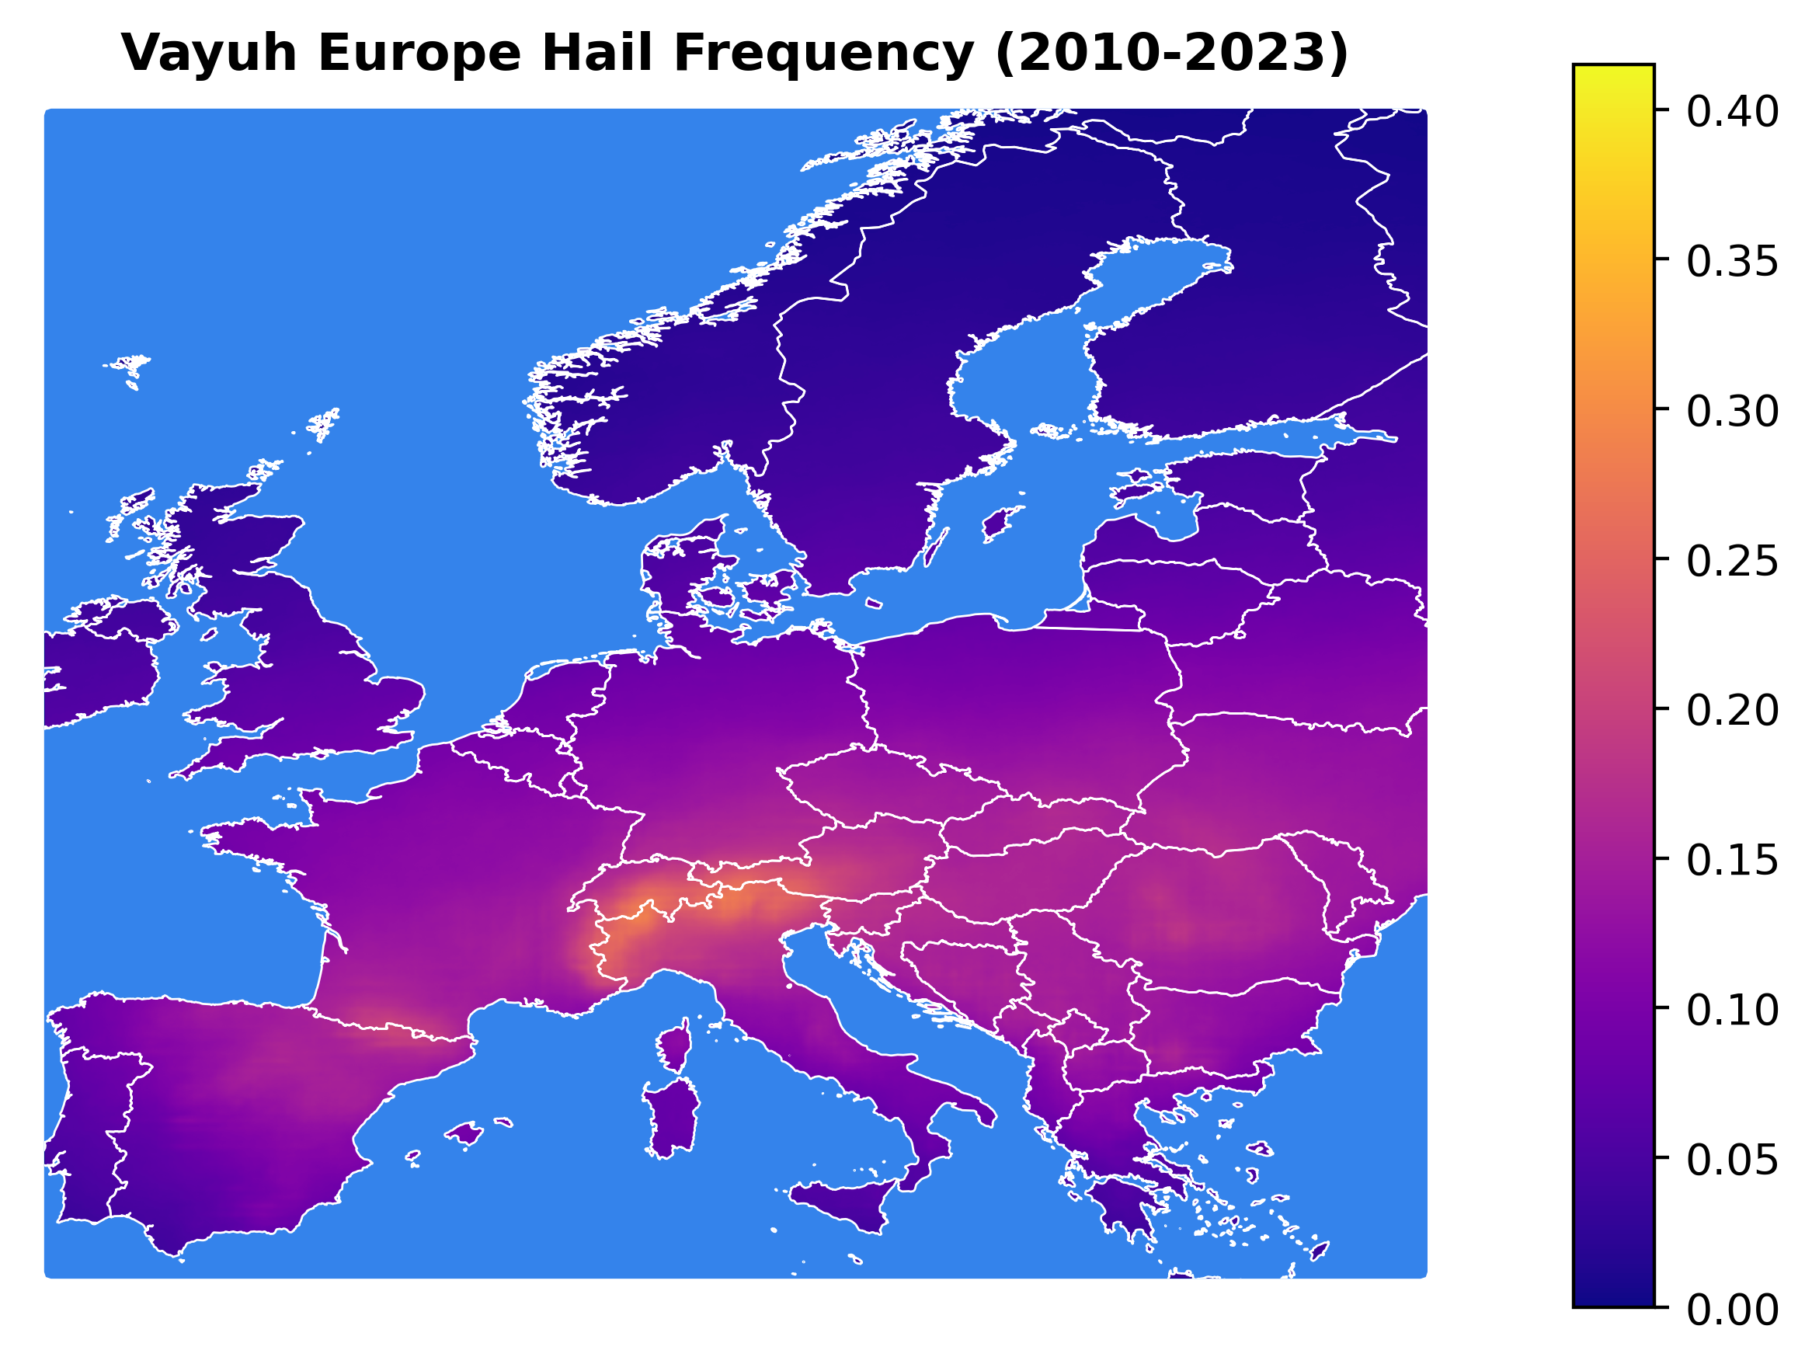
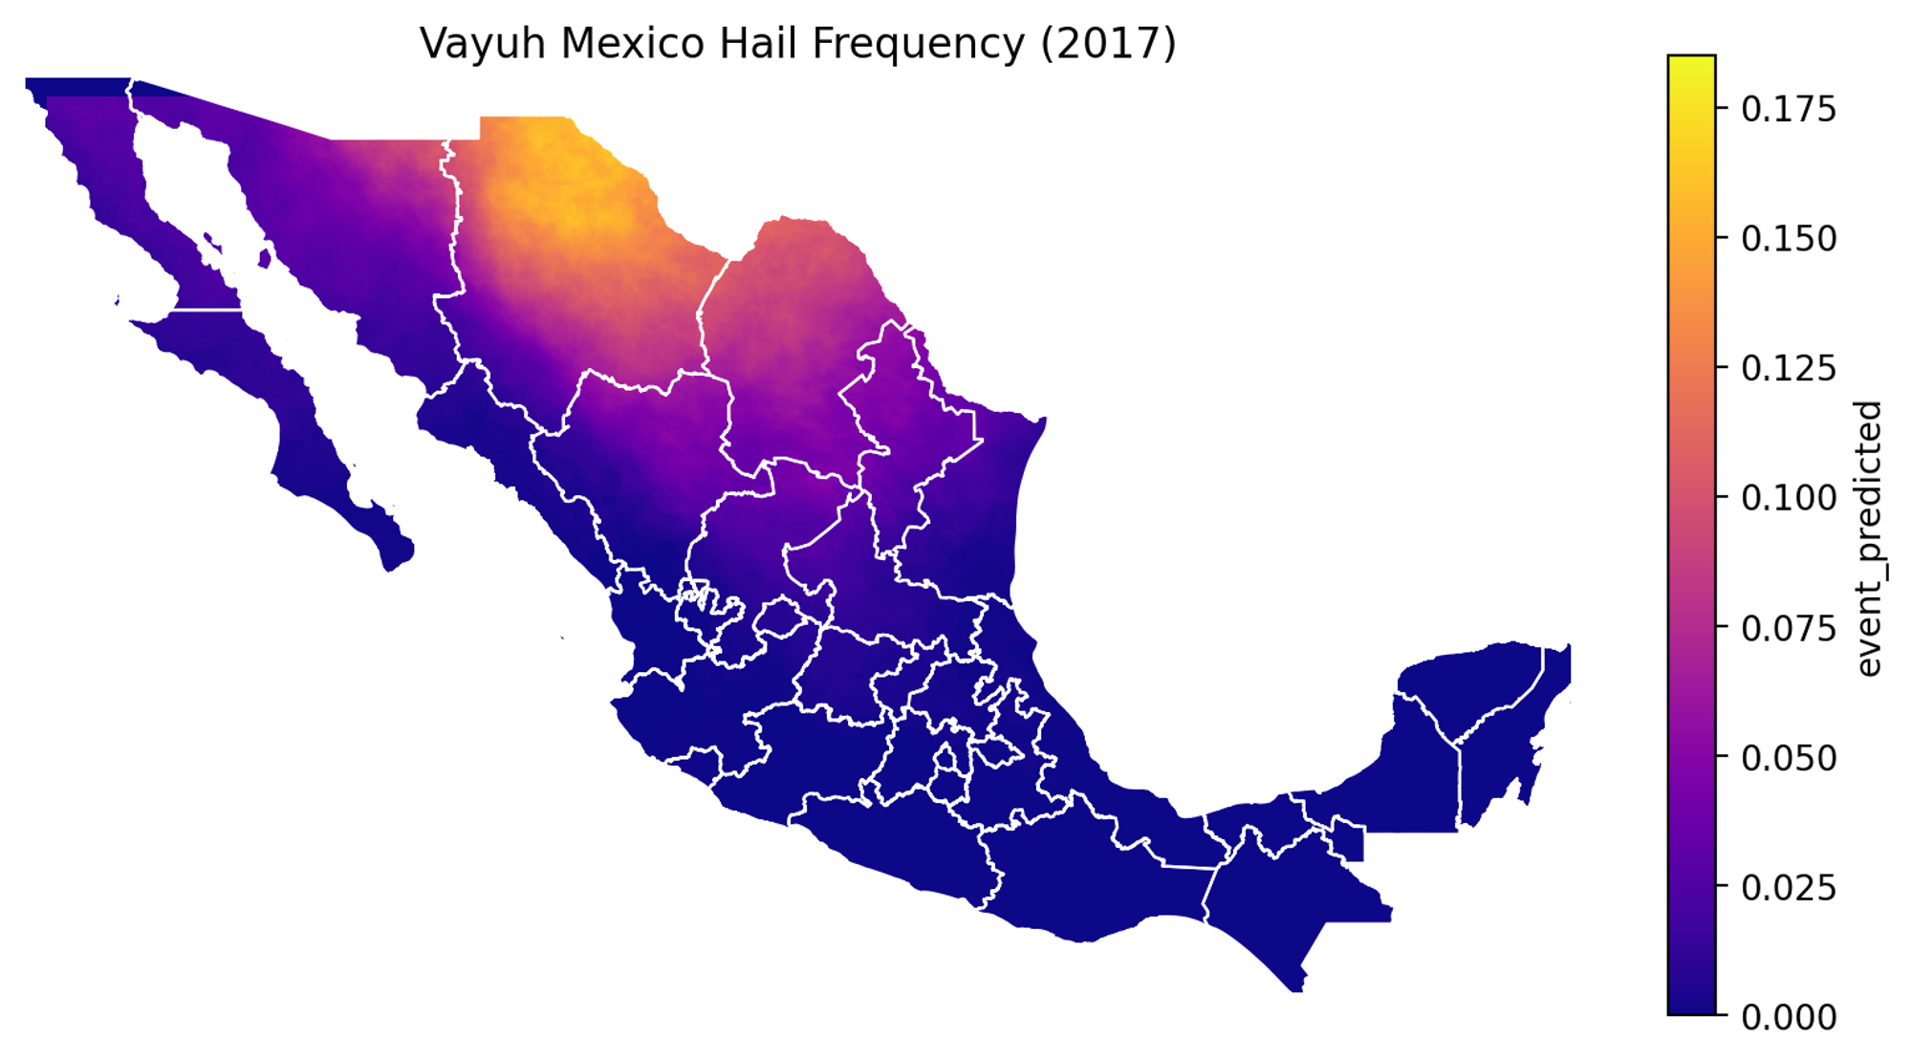
Vayuh’s AI Models Generalize to Low or No Data Geos

Slide 12
Thank You!
Please reach out to:
Mayur@Vayuh.AI or Sean@Vayuh.AI

