Slide 1


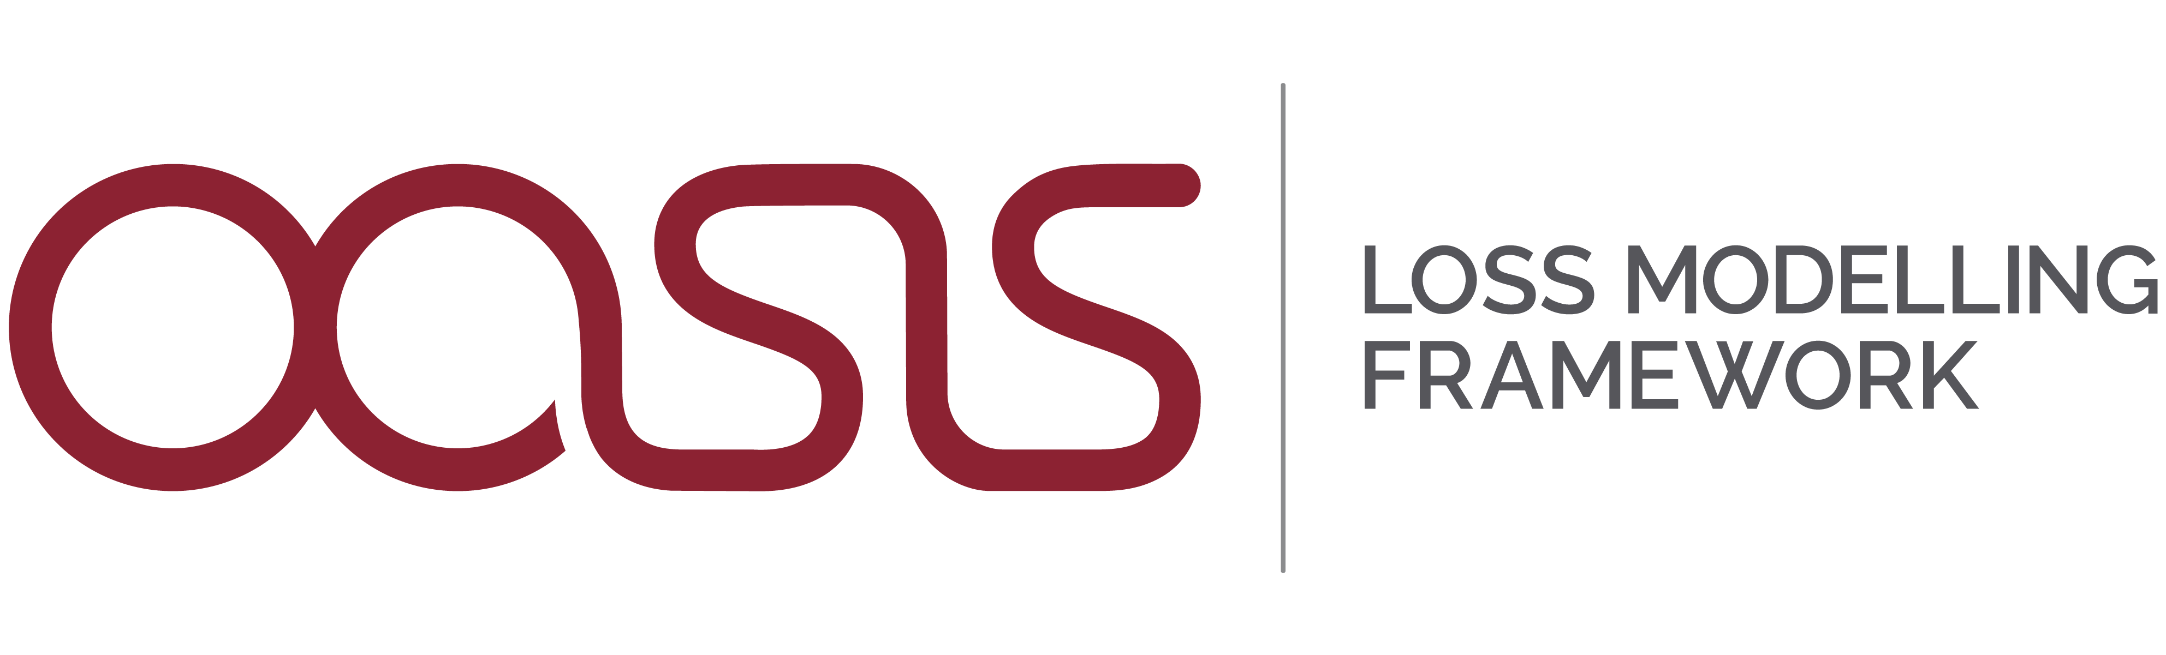
Why Renewable Energy Assets Need Custom Cat Models
George Deskos, Head of Wind Energy, Renew Risk
Oasis Conference, London 2026

Slide 2

The need for a custom model in offshore wind
Existing onshore property models weren’t designed for marine assets
Three main gaps
Hazard is onshore-only: no waves/wind-wave interaction
Vulnerability is generic/proxy-based
Exposure is aggregated to single points
Photo from Dennis Schroeder, National Renewable Energy Laboratory
Notes:
- Existing onshore property models weren't designed for marine assets
- Three gaps: (1) hazard is onshore-only, (2) vulnerability is generic/proxy-based, (3) exposure is aggregated to single points
- Consequence: material mis-pricing — losses can be 60-90% off (foreshadow the case study)
- Key message: Proxy approaches systematically misrepresent offshore wind risk

Slide 3
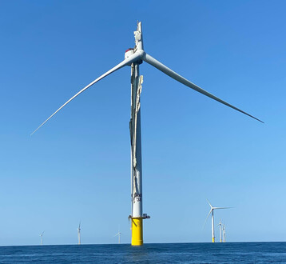
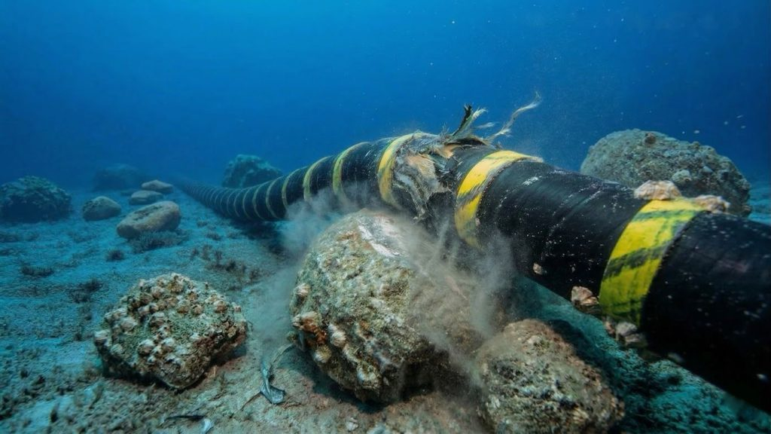
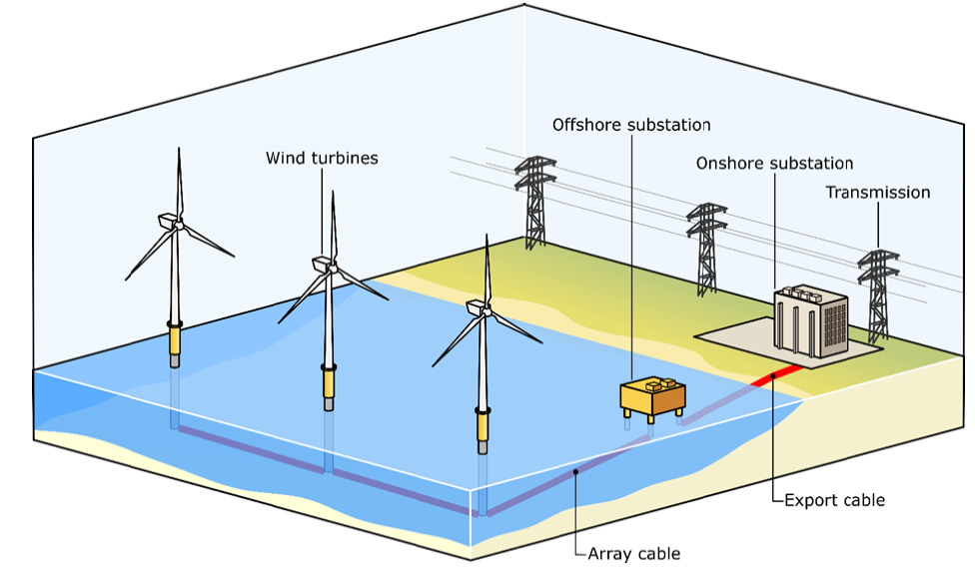
What makes a custom model “custom”?
Asset-level exposure
  Wind turbine systems
  Cables
  Substations
Purpose-built vulnerability
  Analytical fragility curves
  Expert elicitation
  Not proxy property curves
Calibrated hazard
  Site-specific
  High-resolution data
Custom models allow us to capture distinct failure modes, repair logistics, and cost structures
Notes:
---
Slide 3 — What Makes a Custom Model "Custom"? (1.5 min)
"Asset-first, physics-based, EO-driven"
Three pillars (reuse from webinar slides 7 + 10):
1. Asset-level exposure — individual turbines, cables, substations, panel-strings (not single-point aggregations)
2. Purpose-built vulnerability — 100s of fragility curves from Monte Carlo + expert elicitation, not proxy property curves
3. Calibrated hazard — site-specific wind + wave (offshore) or hail/SCS (solar) using EO data (ERA5, Sentinel, PRIMAVERA)
---

Slide 4

The Oasis Framework advantage
Building custom models on open architecture
Component-level modelling by design: e.g., OED gives us the schema to represent sub-asset detail without custom hacks.
Multi-peril, multi-asset in one run: Wind + wave + surge on the same event set, applied to different vulnerability functions per asset class, all within a single model execution. No need to bolt together separate tools.
Transparency that insurers require: Model logic is auditable. Clients can inspect the ground-up loss calculation, trace from hazard intensity through vulnerability to financial loss.
Extensibility — same framework, new perils: The same Oasis architecture that runs our offshore wind model now extends to onshore solar (hail/SCS). One framework, multiple custom models, no rebuild.
Notes:
"You all know Oasis — so I won't explain what it is. What I want to highlight is why it's the right architecture for renewable-energy CAT models specifically.
These assets are fundamentally different from property. A wind farm isn't a building at a postcode — it's 88 turbines, kilometres of cable, substations onshore and offshore. OED lets us represent that without flattening it. The kernel handles component-level vulnerability natively— we don't have to force offshore wind into a schema designed for commercial property.
The multi-peril capability is critical. Offshore, you have co-occurring wind and wave on the same event. Oasis runs that in one pass with different fragility functions per asset class.
And for our clients — the insurers — the transparency is the point. They can trace every loss from intensity measure through to ground-up and insured loss. That's what gets you through Lloyd's model validation.
Finally — and this is why we're here — the framework scales. The same architecture running our offshore wind model is now being extended to European onshore wind and solar hail. One codebase, new perils, same open standard."

Slide 5
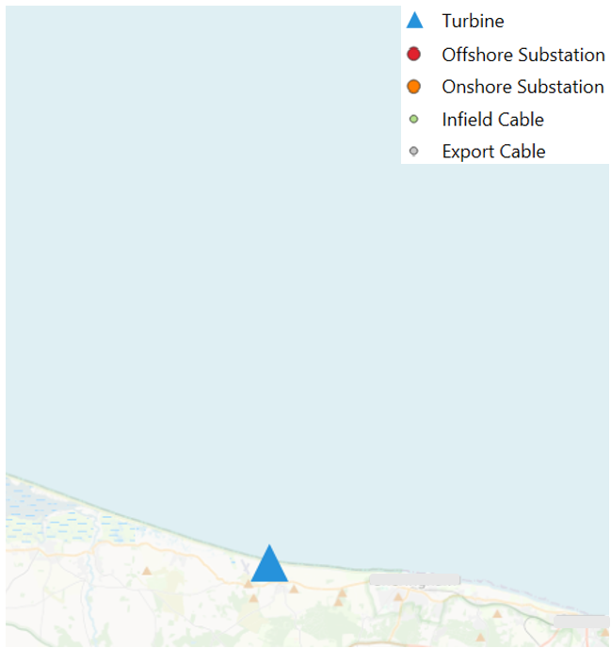
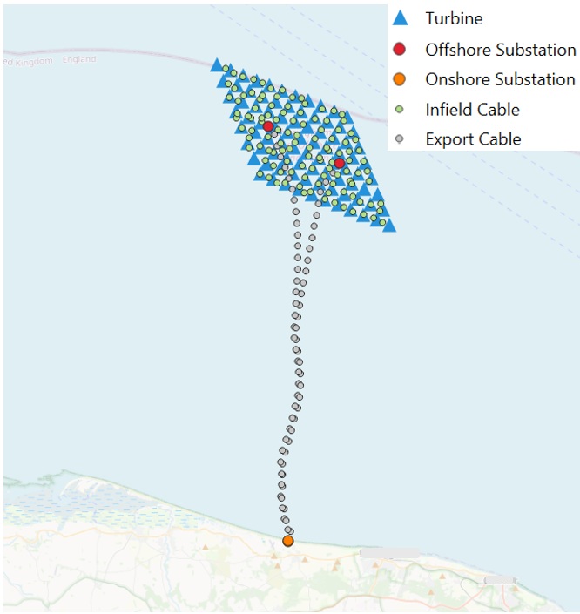
1GW North Sea windfarm
Limited & inconsistent exposure data
Tight turnaround time
Need for pricing & aggregation view
Case study set-up
Aggregate all exposure components to single location (turbine)
Move onshore
Ignore turbine layout & spread
Disaggregated exposure
  88 turbines
  2 export cables
  2 offshore / onshore SS
True locations (offshore & onshore)
Renew Risk IED
Approach A
Approach B
Same risk
Different modelling choices
Different risk views
Notes:
"Let me show you what this means in practice.
A real submission lands on an underwriter's desk: 1 GW North Sea wind farm. The exposure data is
messy — limited, inconsistent, tight turnaround. Sound familiar?
Approach A is what most of the market does today. You take the whole farm, collapse it to a single lat-lon, shift it onshore because your model doesn't have offshore hazard, apply a generic property vulnerability curve, and get a number out. It's pragmatic. It's fast. And it's wrong — but we'll get to that.
Approach B is what we built. Same submission, but we disaggregate: 88 individual turbines at their true offshore coordinates, 2 export cables, 2 offshore substations, 2 onshore substations. Each one gets its own vulnerability function. The hazard includes both wind AND wave — because offshore, the ocean matters. Every component has distinct failure modes and distinct repair costs.
Same asset. Same premium question. Two completely different views of risk.
So what happens when you run them both?"

Slide 6
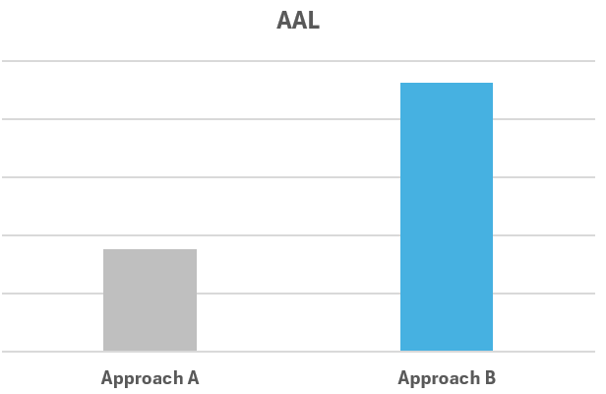
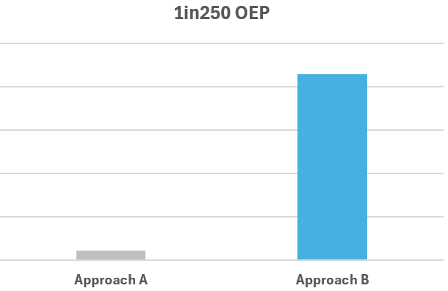
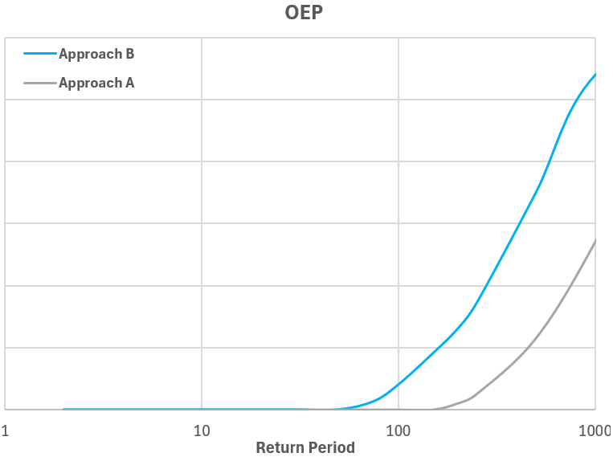
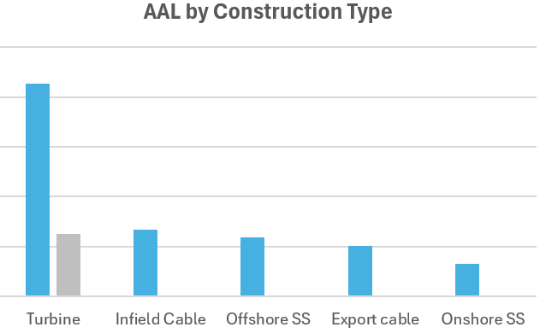
Same asset, different outcomes
Proxy ~60% lower
Proxy ~90% lower
Purpose built (Renew Risk model and exposure):
💰 Pricing – Better view of losses for more accurate premiums
📊 Portfolio aggregation – Clearer picture of where risk is concentrated
🛡️ Reinsurance – Enables more precise coverage and terms
✅ Decision-making – More confidence in risk assessment and capital
Notes:
"Here's what comes out.
On the left: Average Annual Loss. On the right: tail risk — the 1-in-250 year loss that drives
your capital.
The proxy approach gives you a number that's roughly 60% lower on AAL. Sixty percent. That's not a
rounding error — that's a fundamentally different view of whether this asset is profitable to
insure.
On the tail, it's worse. The proxy underestimates the 1-in-250 by about 90%. So your PML, your
aggregate — everything built on that tail number — is wrong by almost an order of magnitude.
Now, why? Three things compound:
First, you've lost the wave hazard entirely. Offshore, wave loading can dominate structural damage
— the proxy simply doesn't see it.
▎ Second, you've homogenised the vulnerability. A turbine, a cable, and a substation fail in
completely different ways at different intensities. One generic curve can't represent all three.
▎ Third, by aggregating to a single point, you've destroyed the spatial correlation structure. In
reality, a storm hits different parts of the farm at different intensities. One point means the
whole farm either survives or doesn't — binary, not graduated.
▎ The practical consequence? If you're pricing on Approach A, you're either leaving money on the
table or building up unrecognised accumulation in your book. Neither is a good outcome."

Slide 7
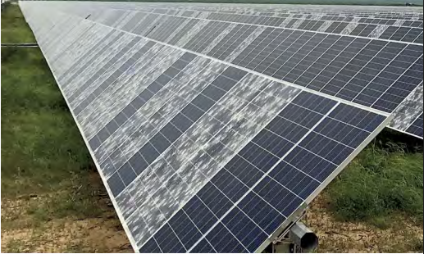
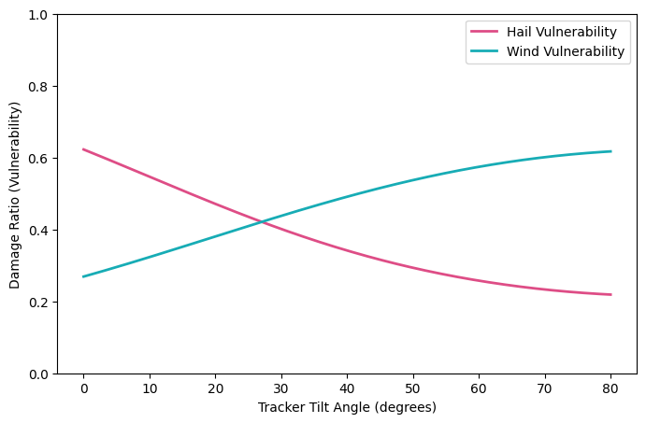
Extending custom models to onshore solar
Same custom-model philosophy applied to: onshore solar (hail/SCS)
Same architecture: asset-level exposure, bottom-up physics-based vulnerability, site-specific calibrated hazard
Market opportunity: ~€120M European renewable-energy cat analytics (growing at 7% CAGR)
Notes:
- European hail occurrences: 11,808 in 2024 (up 104% from 2022/23)
- Same custom-model philosophy applied to: onshore wind (windstorm), solar (hail/SCS)
- Same architecture: asset-level exposure from Sentinel-2, physics-based vulnerability,
EO-calibrated hazard
- Pilot with Convex, Aviva, Beazley underway
- Market opportunity: ~€120M European renewable-energy CAT analytics (growing at 7% CAGR)

Slide 8

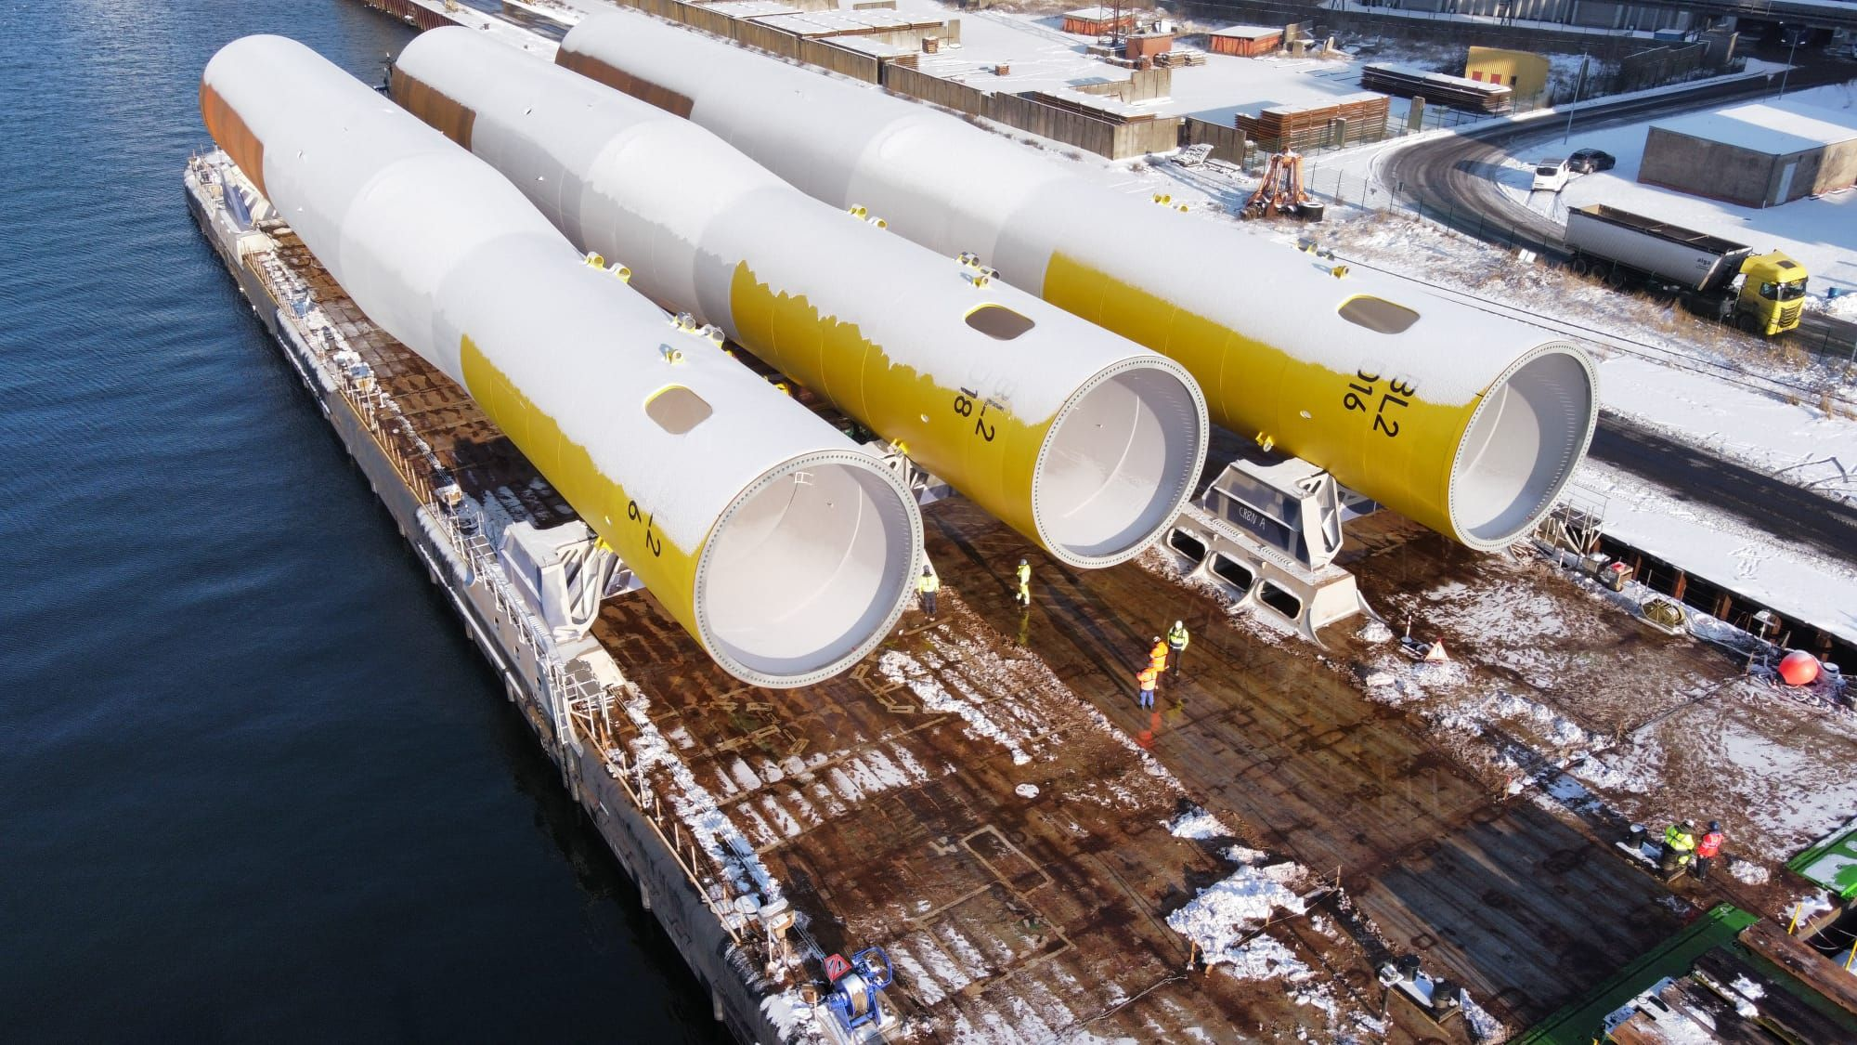
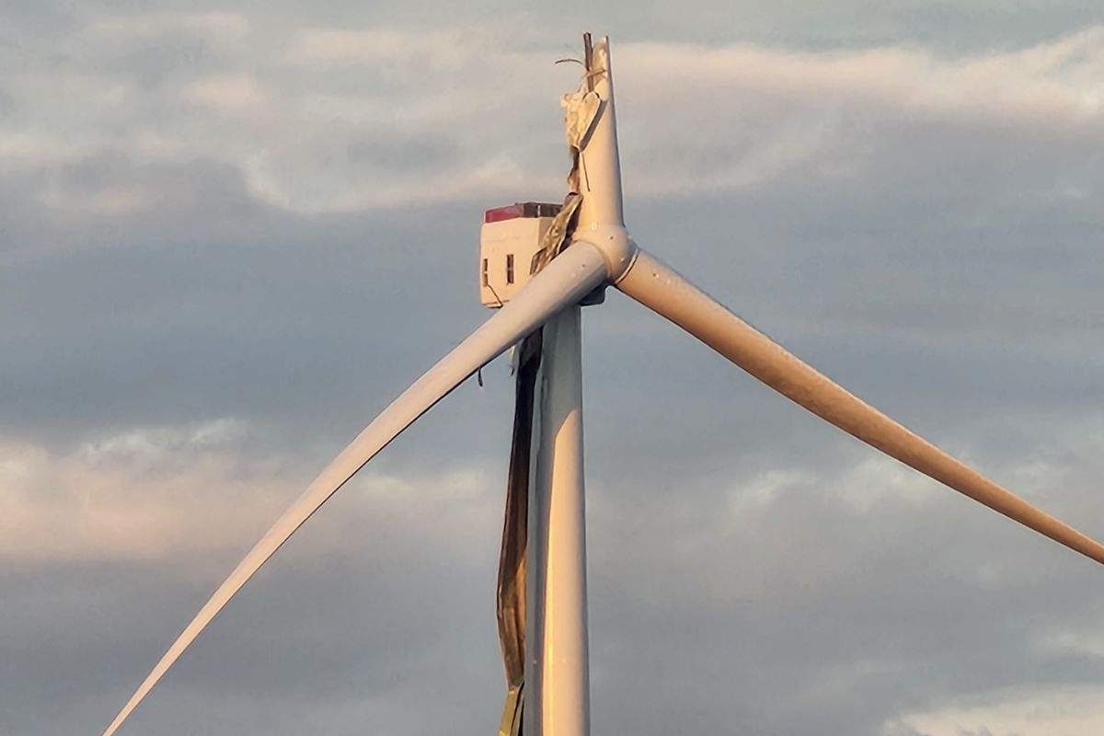
Conclusions
Proxy approaches systematically misrepresent offshore wind losses: Depending on assumptions, losses can be 60-90% lower or 40-50% higher. The error isn’t conservative, its unpredictable!
Every layer of a custom model matters: Exposure granularity, offshore hazard (wind + wave), asset-specific vulnerability, and realistic repair costs each independently change outcomes.
Custom modelling enables better decisions: More accurate pricing, clearer aggregation views, more precise reinsurance terms, and greater confidence in capital allocation.
Integration with Oasis Loss Modelling Framework: Native tools integration, standard OED inputs.
Notes:
"Four things I'd like you to take away.
One — proxy error isn't random. It's systematic and it goes in both directions. You can't hedge it
by being conservative.
Two — every layer matters. Fixing the hazard but keeping a proxy vulnerability still gives you the
wrong answer. You need the full stack.
Three — this isn't academic. Custom models change what underwriters actually do — how they price,
where they see accumulation, how they structure reinsurance.
And four — Oasis is what makes this possible at scale. Same framework, component-level resolution,
open standard, multiple perils. We're proving it on offshore wind and extending it to onshore.

Slide 9

Questions?
Get in touch
info@renew-risk.com
Sign up to our newsletter

