Slide 1
In our industry, we are very good at generating scenarios.
We are less good at generating decisions from them.

Slide 2
Exploratory scenarios often come with multiple levels of expert judgement.
This can make business decision-making difficult.
Catastrophe Model
Emission Pathways
Climate Models
Downscaling
Impacts Modelling
Non-Hazard Factors (e.g. Adaption)

Slide 3
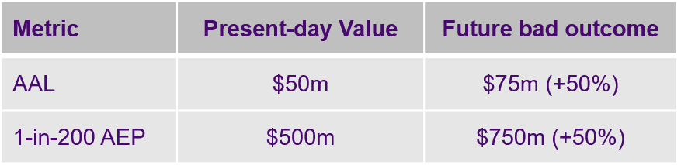
Normative scenarios offer an alternative that is built around your key business metrics
(e.g. AAL, Capital, Growth)

Slide 4
Normative scenarios offer an alternative that is built around your key business metrics
(e.g. AAL, Capital, Growth)

Slide 5
“Where we rely more on expert judgement, it is likely that models with not-too-much complexity will be the most intuitive and informative, and reflect their own limitations most clearly”
Thompson and Smith (2019), Escape from model-land, Economics: The Open-Access, 13 (2019-40): 1–15.

Slide 6
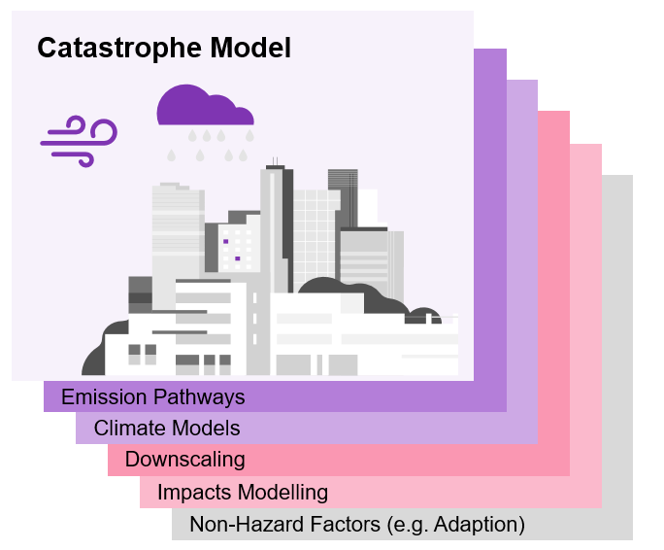
Business decision-making
Vs

