Slide 1
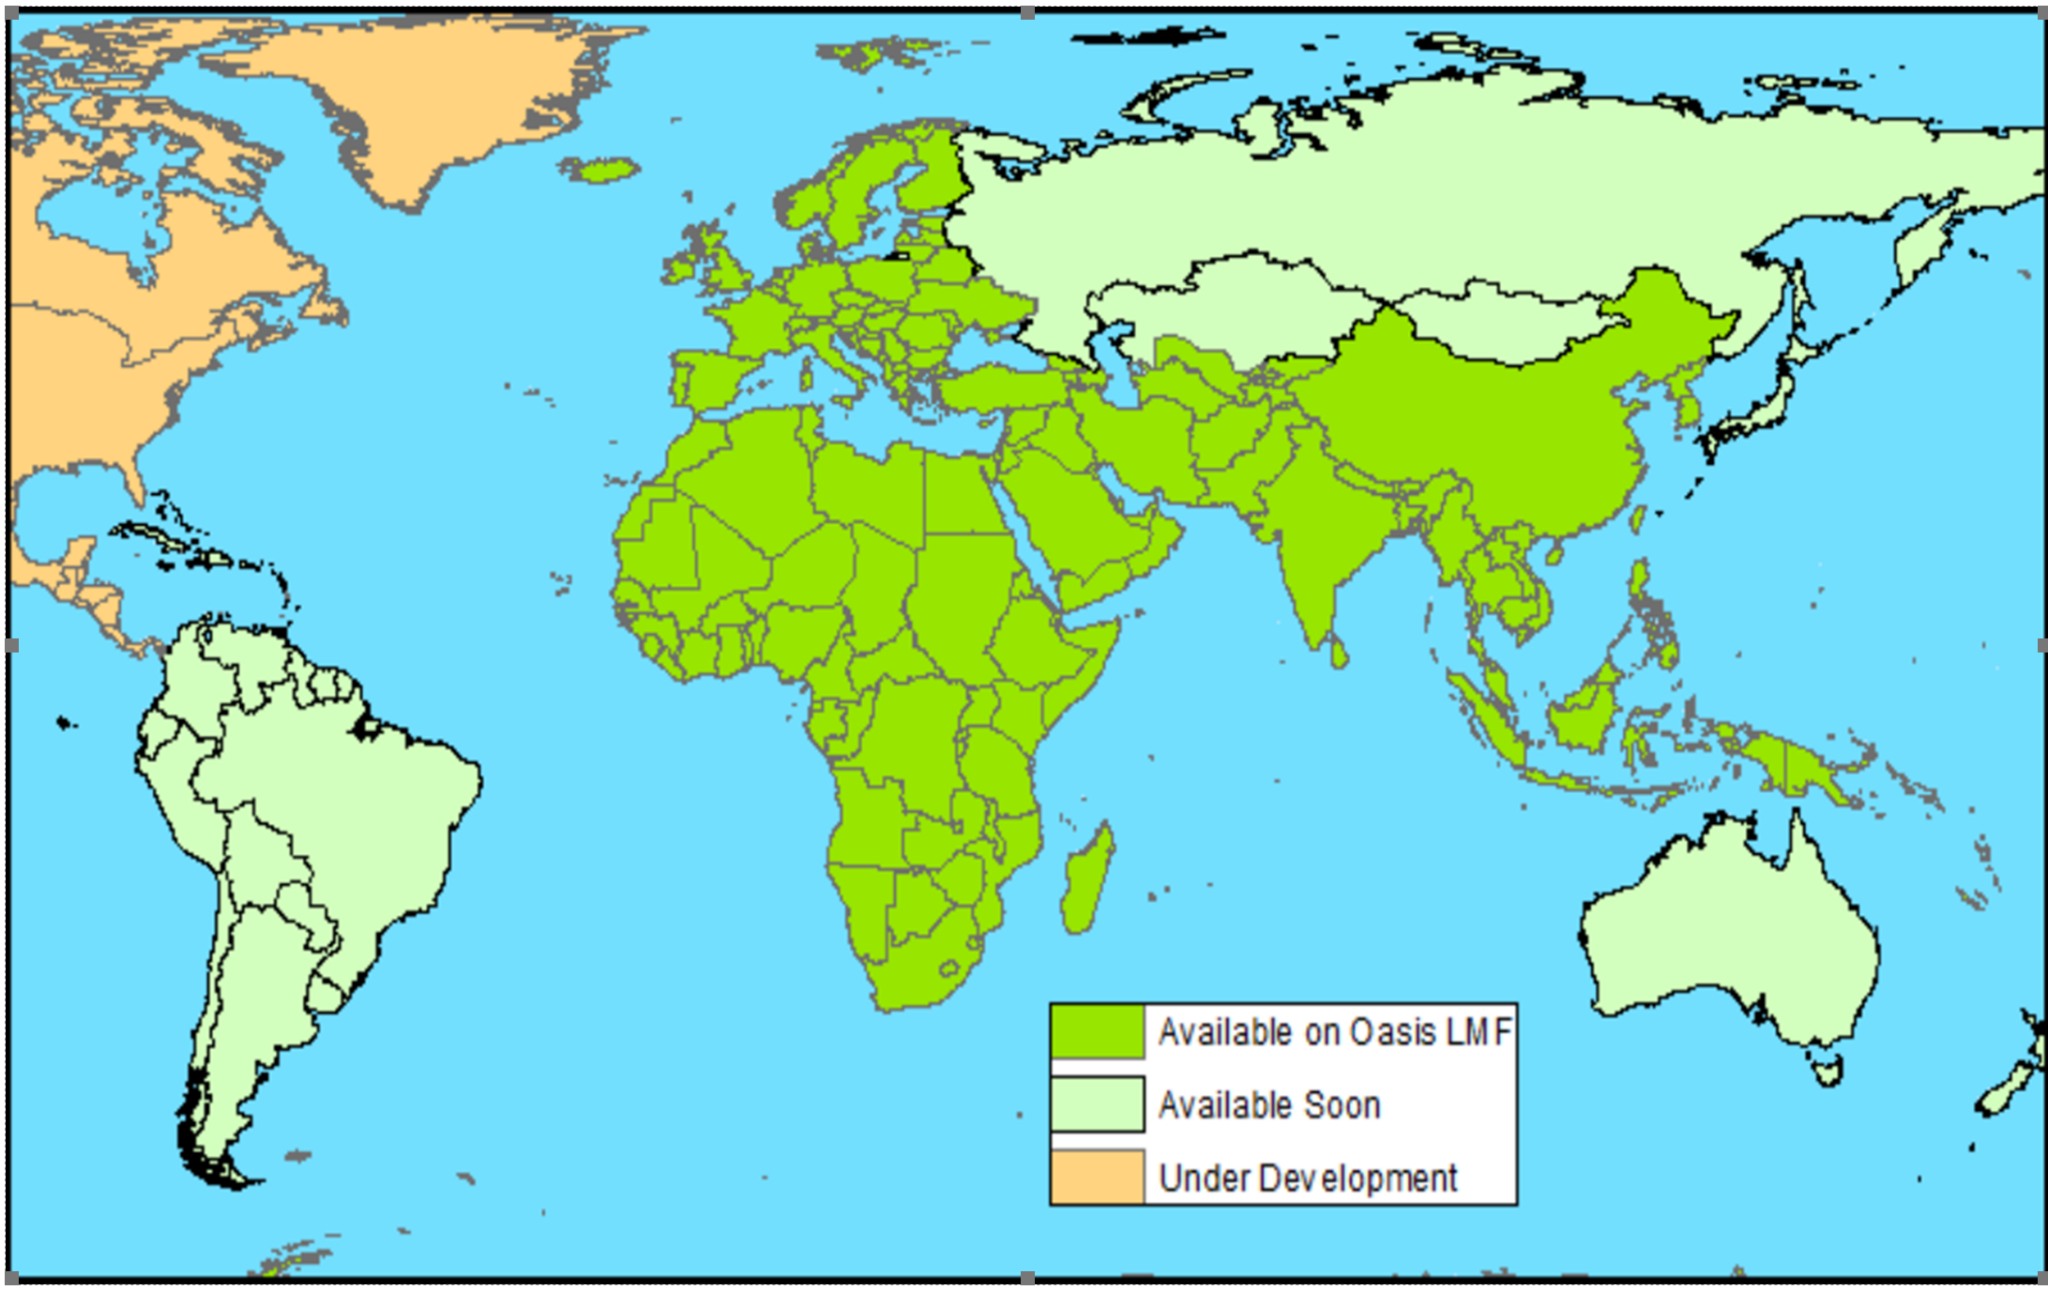

Catrisk Solutions Ltd
  Earthquake Loss model for more than 155 countries in Asia, Africa and Europe towards a Global EQ model

Slide 2
Our Missions
  Full probabilistic Global Earthquake Loss Model
  Cat risk solutions through licensable model as well as consulting services
  Plug-and-play model benefiting from the industry ecosystem initiated by OasisLMF
  Filling the gap for new and uncovered perils/territories
  Reaching emerging market and small companies with limited cat exposure
  Various training and educational course to introduce cat risk modelling to new users
  Customized pre-processing tools for Exposure enhancement
  Alternative and more affordable Cat Risk Solutions compared to mainstream vendors

Slide 3















Our Greatest Assets, Our Clients
  We serve our clients in various business models, including yearly license package, consulting and PAYG services
  We are a client-centric company and client satisfaction in quality, transparency, functionality, technical documentation and support punctuality derive our business

Slide 4
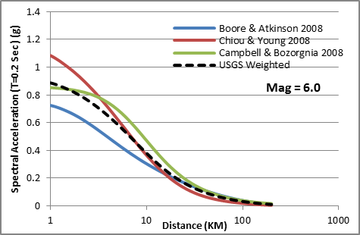
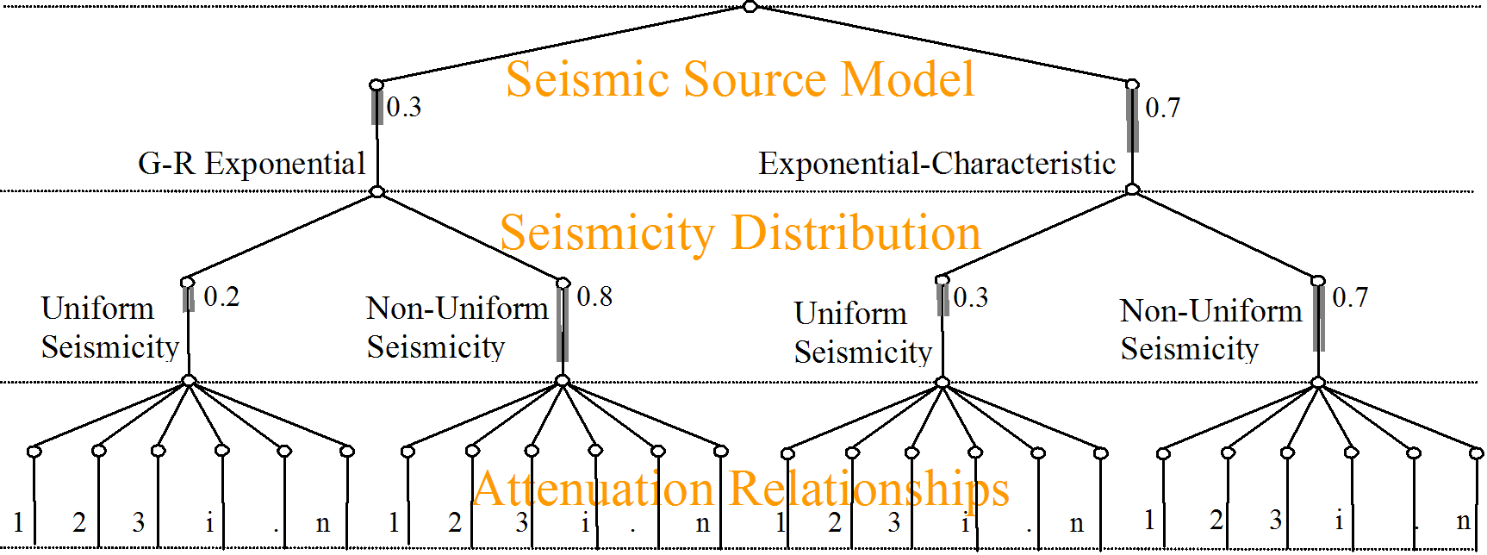
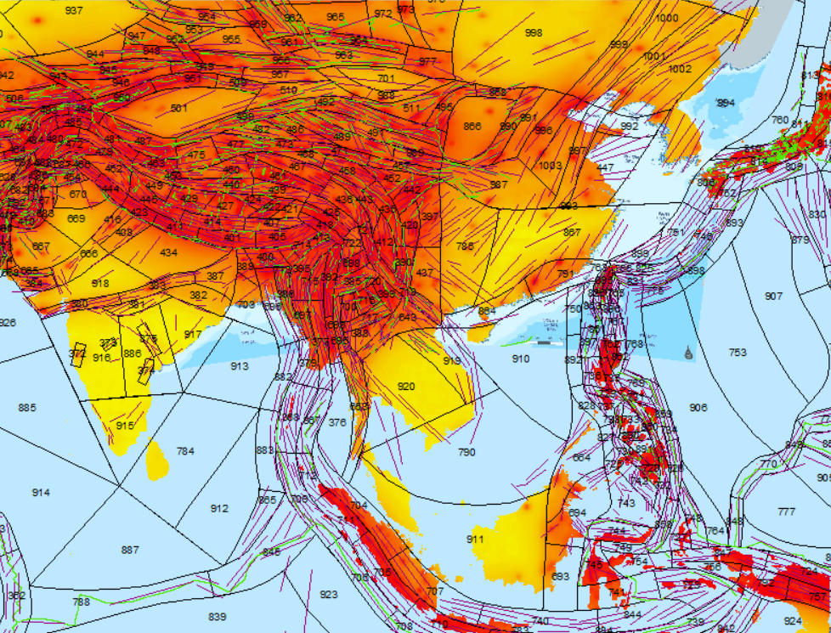
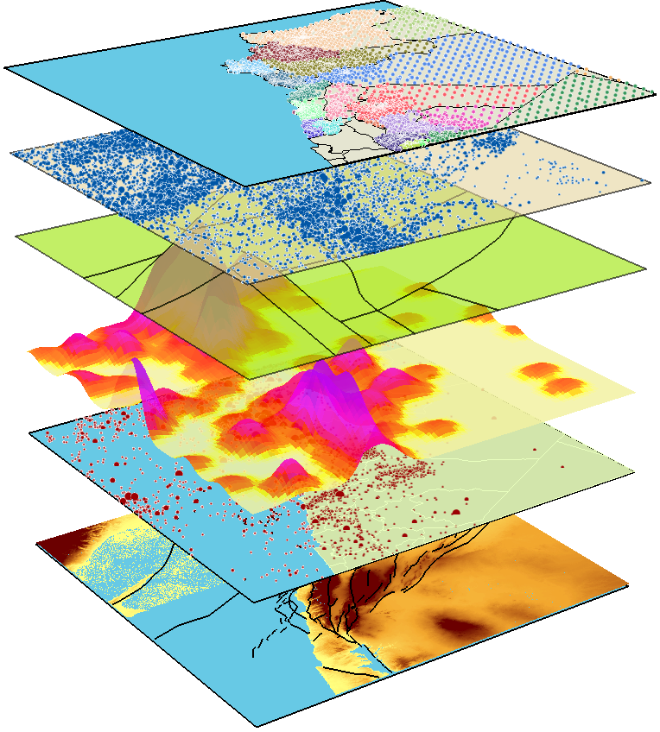
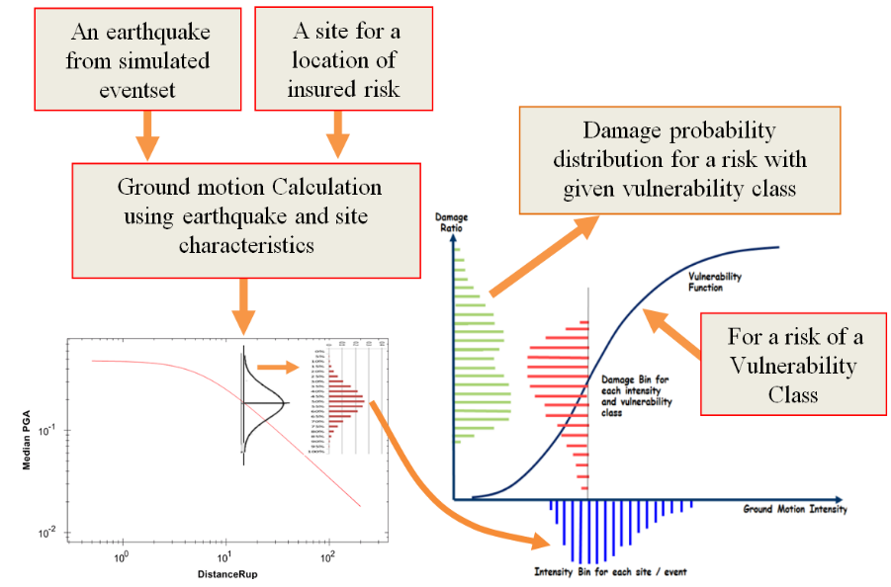
Oasis-compatible model components with interoperability functionalities

Slide 5

Our modelling approach and
Oasis full probabilistic engine
Location and Policy Aggregation
Events
Coverage Location Policy Portfolio
Event 1
Event 2
Event 3
………
………
………
Event _{i}
………
………
………
Event n
Building
Contents
Site 1
BI
Building
Portfolio 1
Contents
Site 2
Policy 1
BI
Event Aggregation
Event Loss Table (ELT)
Building
Contents
Site 3
BI
Policy 2
Portfolio 2
Program
Building
Contents
Site _{j}
Portfolio _{l}
BI
Policy _{k}

