Slide 1
Oasis MODEL customisation
28 / 29 April 2026
Ian Millinship, Head of Analytics, JBA Risk Management
3 examples across 3 different projects in 10 minutes!
Notes:
Hi
Ambitious – 3 examples of Oasis Model Customisations with 3 different projects in 10 mins – so pretty high level
For each –
- Describe the project – so what’s the client ask
- What do we need – from a modeller’s perspective what’s the change or new thing that’s required
- How we achieved the customisation in Oasis – tried to keep that in simple language so we can all follow it
- And what were the client outcomes, what were they able to do

Slide 2


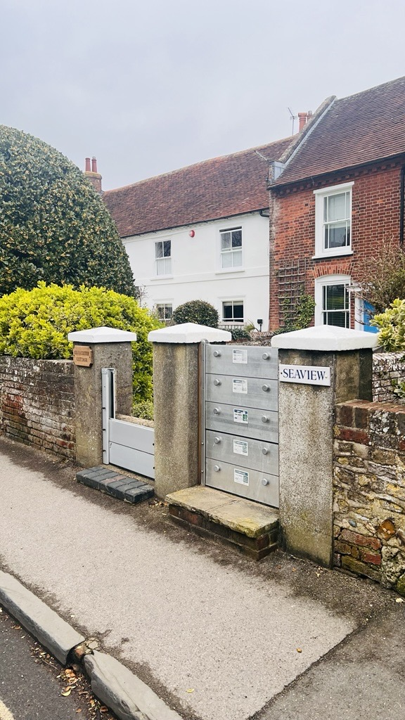
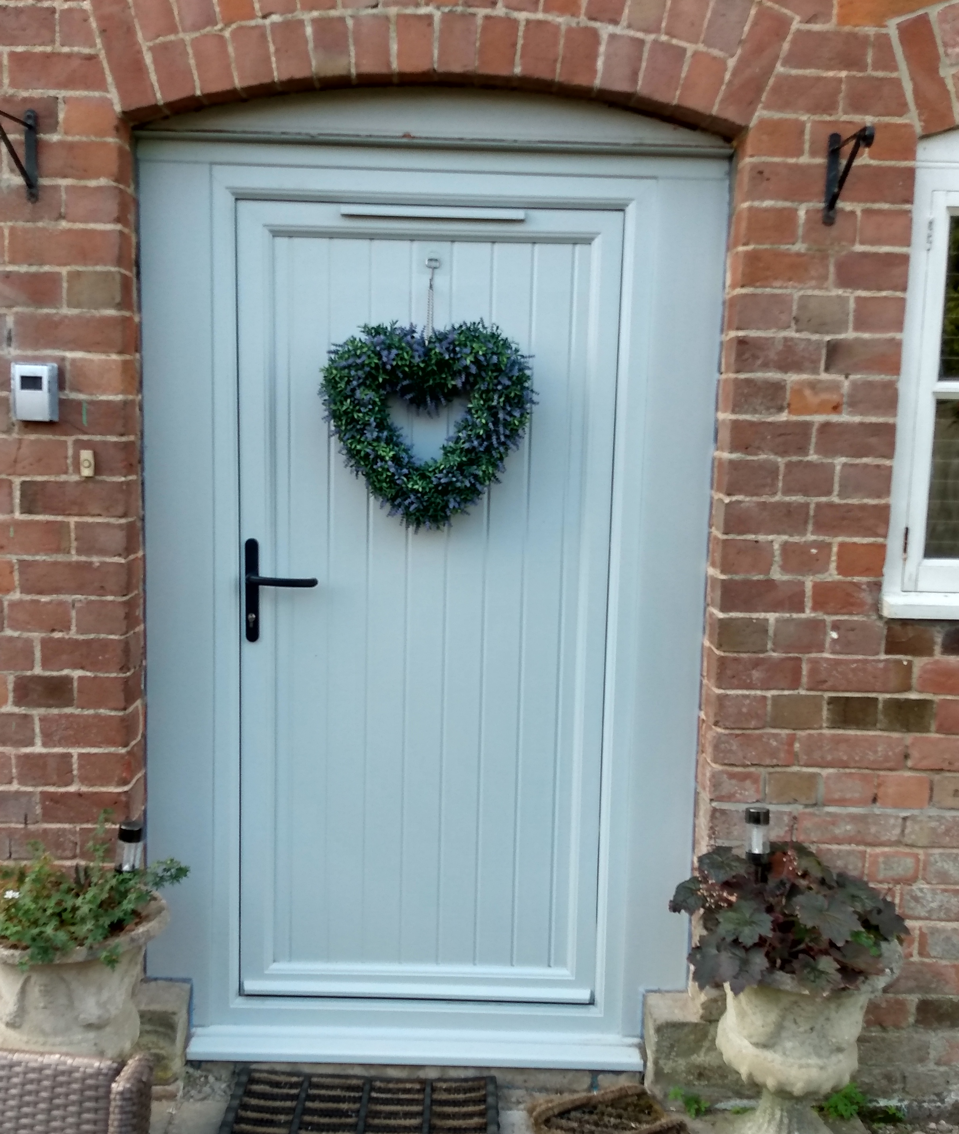
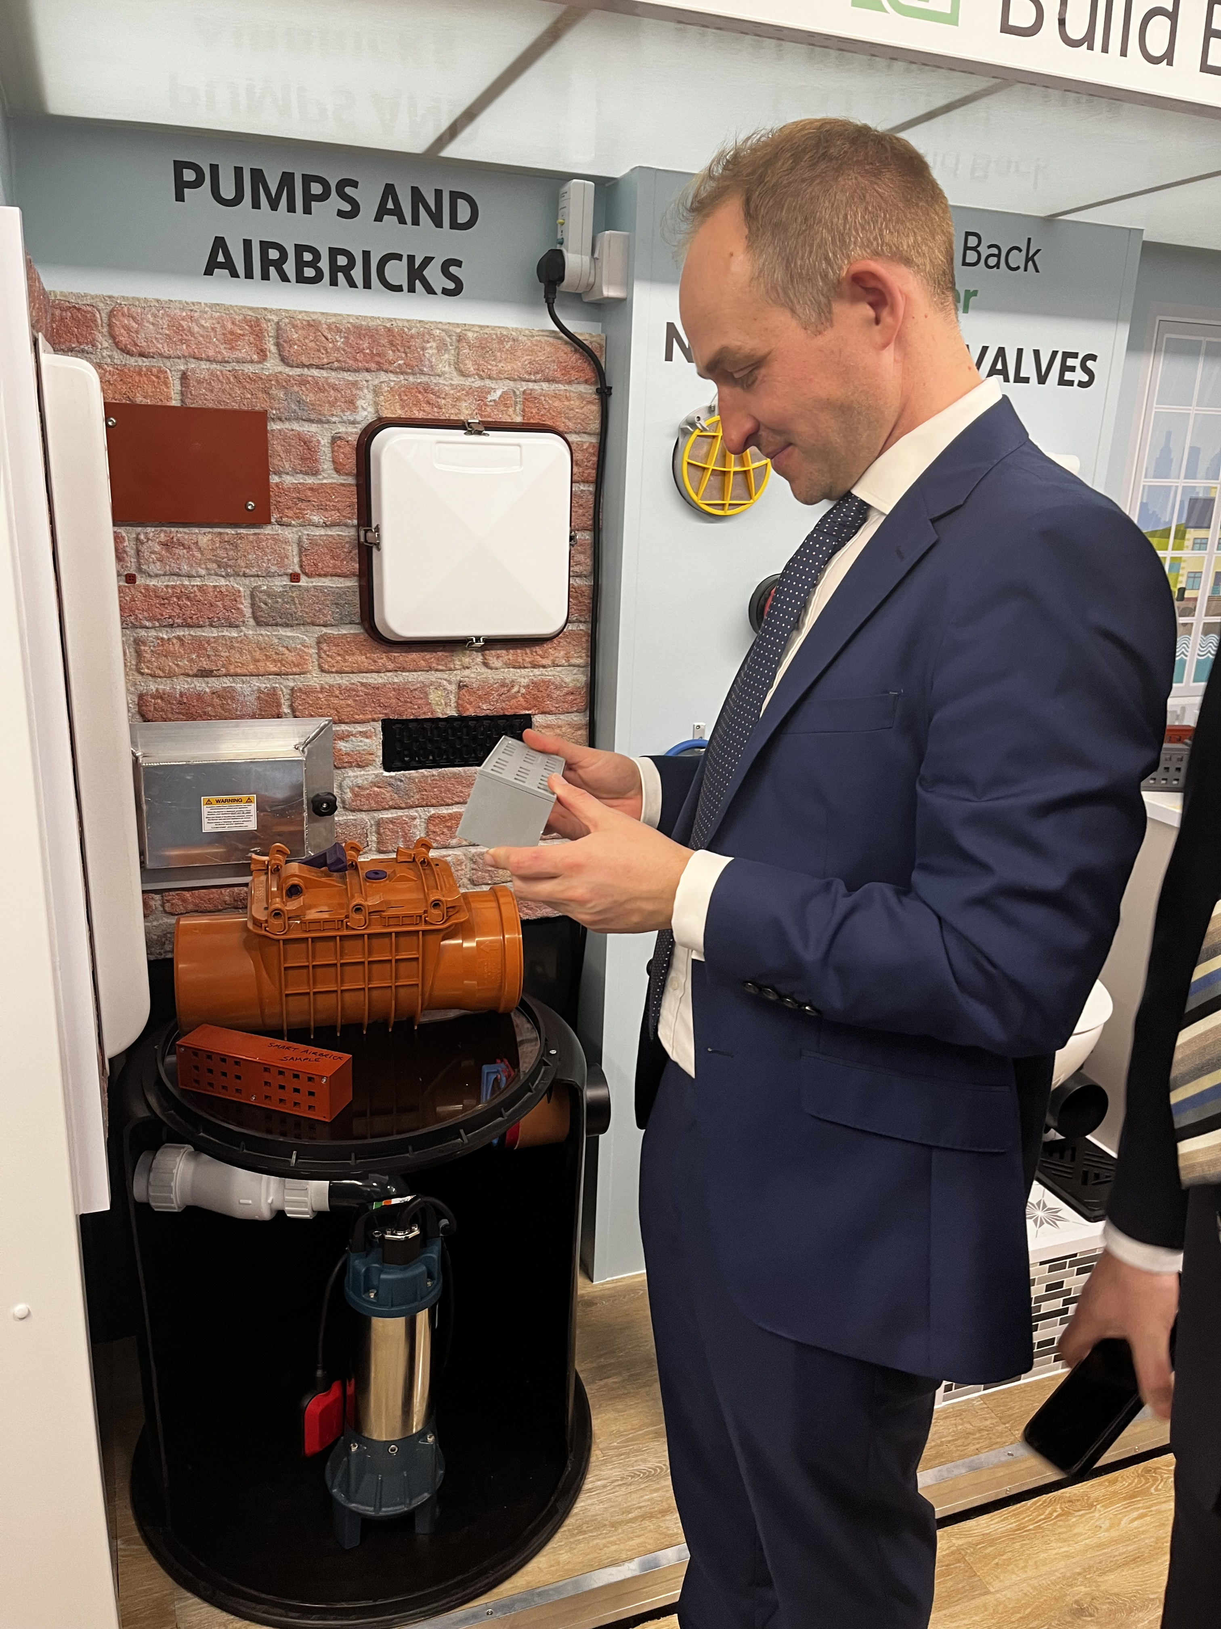
PROJECT:
Modelling the potential benefit of Property Flood Resilience (PFR) – UK
MODEL:
JBA UK Flood Model
WHAT DO WE NEED?:
Bespoke vulnerability curves by property type
Notes:
2025 Flood Re came to us -
What does the client want?
They want to understand which homes are most suitable for PFR measures, what they might cost and if implemented, what would be the potential benefit or change in flood risk, per property and nationally under a range of uptake scenario?
Not sure what Property Flood Resilience means? – here some examples – traditionally we’re thinking what’s on the left, yes barriers but we’ve moved on now to less aesthetically intrusive products, watertight doors, airbrick covers, sump pumps etc.
Our JBA Consulting colleagues work widely in this area, so we understand which intervention measures work for different types of homes and what those measures cost.
In terms of the model What do we need?
Set of Bespoke Vulnerability curves, varied by property type, and reflect a range of different PFR measures fitted.

Slide 3

OASIS CUSTOMISATION:
  Oasis vulnerability curve format easy to adapt outside of the model
  Modify / add new vulnerability curves based on property attribute
  Uploaded new set of curves within the Model Exchange User Interface
  Rerun the analysis
PROJECT:
Modelling the potential benefit of Property Flood Resilience (PFR) – UK
MODEL:
JBA UK Flood Model
WHAT DO WE NEED?:
Bespoke vulnerability curves by property type
  OUTCOMES:
  Losses for every property in the UK without and with PFR of varying type
Notes:
In terms of Oasis Customisation – how did we achieve this?
Adapt – excel or with some simple scripting
Adjusted to reflect PFR options by property type
Set of vulnerability curves are then uploaded within the Model Exchange UI
Rerun the analysis
Outcomes:
Losses for every property across the UK, without PFR
Then with PFR under a range of uptake scenarios which we could then consider against cost and determine return on investment.

Slide 4

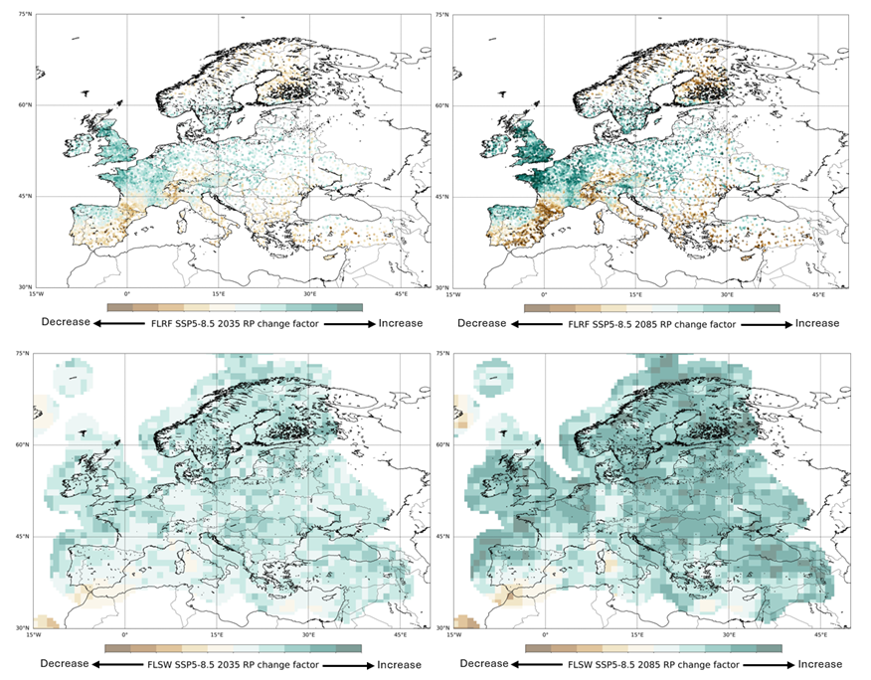
PROJECT:
Future flood risk analysis for risk management framework - EU
MODEL:
JBA Global Flood Model
WHAT DO WE NEED?:
SSP5-8.5 for 2085 climate change event set
River flow change factors (top) and surface water change factors (bottom) for SSP5-8.5 at 2085 for Europe
Green hues denote increasing change factors, whilst brown hues denote decreasing change factors.
Notes:
Why did the client need it?
As part of BNP Paribas’ – Risk management framework they are keen to assess their exposure to flood risk for a particular climate change scenario the SSP5-8.5 for 2085 time horizon.
We have a range of CC scenarios within our models – including a RCP8.5 but not this particular warming and time horizon based– image on the right here is an illustration of this extreme scenario with projected changes to river flows top and rainfall bottom.
So from the modellers perspective we needed to develop an event set for this scenario, add it to the model and make it available to the client.

Slide 5
OASIS CUSTOMISATION:
  New Stochastic event set for SSP5-8.5 warming climate change scenario for 2085
  Make available as an “additional asset”
  Push to the client
  Client is able to select the new event set from a drop-down box to run the analysis
PROJECT:
Future flood risk analysis for risk management framework - EU
MODEL:
JBA Global Flood Model
WHAT DO WE NEED?:
SSP5-8.5 for 2085 climate change event set
  OUTCOMES:
  New CC Scenario available for portfolio analysis
Notes:
In terms of Oasis Customisation – how did we achieve this?
We developed a new stochastic event set based on this particular CC scenario
Make available as an “Additional Asset”
Oasis has this concept of an Additional Asset - the way I see it is as a data file[s] which can be added to the model and used in the analysis, without changing the “Approved” core model components.
Create the Asset – in this case the new event set, that gets added to the model’s additional assets folder, update the model settings so the new data is available in the drop down lists in the UI.
And indicate whether you want this to go to all clients or specific clients.
Run the UATests – make sure you’ve not broken anything, ask Model Exchange to push to the client side, that takes about a day, and new assets is available in the UI for analysis.
Outcomes – new CC scenario is available for portfolio analysis – this gives the bank what they need.

Slide 6



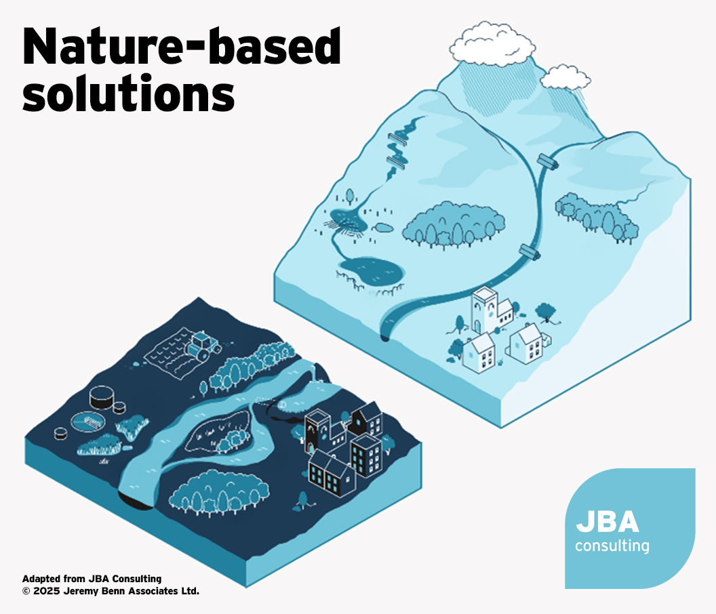
PROJECT:
Modelling the benefit of Nature Based Flood Solutions - USA
MODEL:
JBA US Flood Model
WHAT DO WE NEED?:
Bespoke flood hazard maps for probabilistic loss assessment
Notes:
What does the client want?
Howden’s Risk and Resilience team are collaborating with JBA, UC Berkeley and Ecolinks to understand the societal and economic benefits of the change in flood risk from nature-based flood solutions.”
What are NBS - techniques that aim to work with natural hydrological and geomorphological processes, manage the sources and pathways of ﬂood waters to reduce flooding.
Effectively in the headwaters they slow rainfall becoming runoff – leaky dams, reforestation of the catchment, Downstream its about making space for water, restoring the floodplain by removing embankments, creating wetlands.
Think of them as an alternative to hard engineering, flood walls, barriers etc.
Again in terms of what do we need?
Develop bespoke hydraulically modelled flood maps pre and post NBS, get those into the probabilistic model so we can quantify change in risk.

Slide 7
OASIS CUSTOMISATION:
  Hazard maps exist in their raw format and are queried directly by the cat model at run time
  Therefore, we can develop a set of bespoke design return period maps representing river flood hazard pre and post NBS implementation
  Configure the model to use the bespoke maps at runtime
PROJECT:
Modelling the benefit of Nature Based Flood Solutions - USA
MODEL:
JBA US Flood Model
WHAT DO WE NEED?:
Bespoke flood hazard maps for probabilistic loss assessment
OUTCOMES:
  Able to run Probabilistic loss assessment pre and post NBS implementation and quantify change in loss.
Notes:
In terms of Oasis Customisation – how did we achieve this?
Within our interpretation of Oasis – Flood hazard maps exist within the model in their unadulterated form – 5m raster depth grid,
There’s no pre build or summarising, they are accessed at runtime.
So we can create a custom set of maps, this case pre and post NBS, add those maps to the model folders and alter the configuration to simply point to a different folder, rerun the analysis.
And Finally outcomes,
We can run probabilistic analysis on our pre and post NBS scenarios, quantify the change in loss.

Slide 8
FURTHER READING
https://www.floodre.co.uk/wp-content/uploads/JBA-Flood-Re-Phase-1-Report.pdf
https://www.floodre.co.uk/wp-content/uploads/JBA-Flood-Re-Phase-2-Report.pdf
https://www.jbarisk.com/sectors/property-lending/
https://www.jbaconsulting.com/2025/06/16/what-are-nature-based-solutions/
Notes:
3 examples, 3 different model components, 3 happy clients –
hopefully you can see that with a bit of vision,
bit of behind-the-scenes knowhow,
the oasis formats are open and models easy to customize.
Further reading there – you can click the links when the slides are sent round later.

