Slide 1
From Generic to Bespoke: Customising Cat Models for Insurers
  Impact Forecasting
    28 April 2026
Notes:
From Generic to Bespoke: Customising Cat Models for Insurers
This session explores practical approaches to customizing catastrophe models using your own exposure and claims data. We will show how to better capture local risk drivers, increase the relevance of model outputs, and realize the benefits of enhanced model performance to support more confident reinsurance decisions and regulatory capital requirements.

Slide 2

Agenda
Why customise a model?
Which components can we customise?
Custom model development process
What else can we do?

Slide 3
Agenda
Why customise a model?

Slide 4
Why customise a model?
Dealing with uncertainty
Unmodelled Peril Regions
Your model doesn’t cover specific areas or perils
Windstorm Kristin in Portugal
Canada model coverage
3
Claims history and View of Risk
You have very detailed claims data
Your model doesn’t reflect this
You want to customise the model
2
Customising Event Response
Stochastic event ID’s don’t represent reality
Hazard based exposure look-ups don’t incorporate damage
You want early warning of losses
1
Models are not a ‘one-size-fits-all’ solution, everyone’s ‘uncertainty’ is different.

Slide 5
Agenda
2. Which components can we customise?

Slide 6

Building Blocks of a Custom Model
Which components can we customise?
Exposure
    Use OED as an exposure data input format
    Use OED to standardise construction / occupancy modifiers
    Share updates to OED with Oasis to ensure we all benefit
Loss
    Adjust model outputs based on frequency
    Adjust events of a given size
    e.g. > M7.5
    Adjust events of a given frequency e.g. to include climate change impacts for Europe SCS/hail
Custom
Model
Hazard
    Work together to develop a model … cooperate to innovate!
    Impact Forecasting and Fathom in Canada
    Partner Re and Impact Forecasting for Europe Windstorm
  .
Vulnerability
    Adopt different construction/occupancy schemes including OED
    Modify damage curves with specific claims data for your portfolio

Slide 7
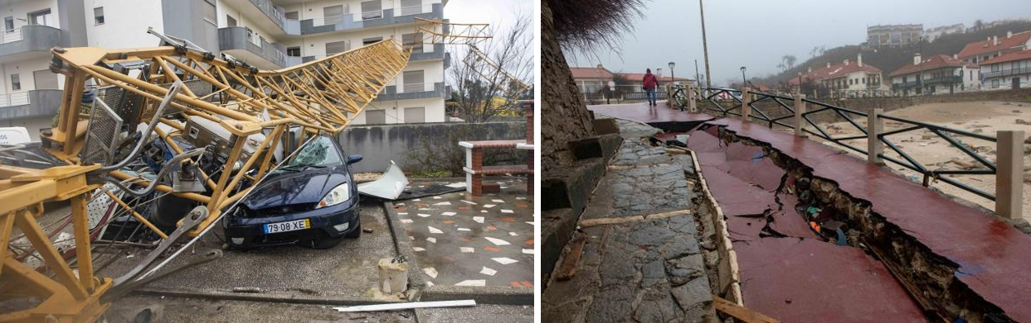
Windstorm Kristin – Event Recap
    Storm Kristin underwent rapid intensification consistent with explosive cyclogenesis (“bomb cyclone”), with a rare sting-jet structure, a mesoscale descending wind feature capable of producing locally extreme surface gusts.
    The sting-jet signature has previously been observed during Storm Leslie (2018) and Storm Xola (2009).
    Peak observed gusts reached 208.8 kph (129.7 mph) in the Coimbra district on January 28. If verified by the national meteorological agency (IPMA), Kristin may represent the strongest storm recorded in Portugal since systematic national observations began, exceeding the previous record of 176.4 kph (109.6 mph) held by Storm Leslie.
    The storm also produced coastal waves up to 14 meters (46 ft), heavy rainfall and snowfall, locally the heaviest in two decades, resulting in rapid river level rises and flash flooding due to already saturated soil.

Slide 8
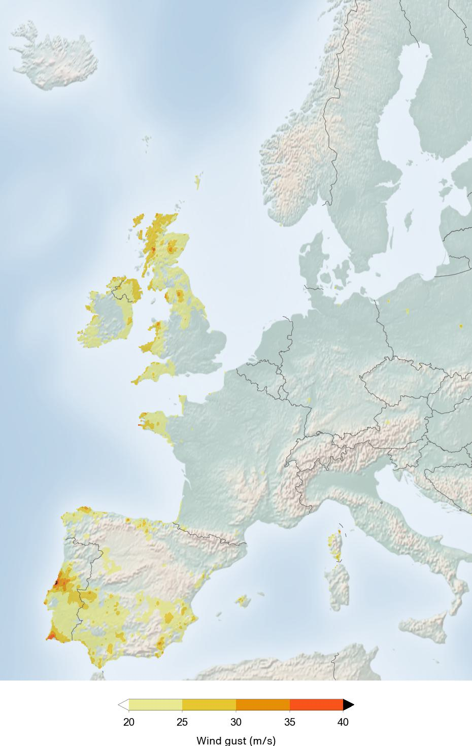
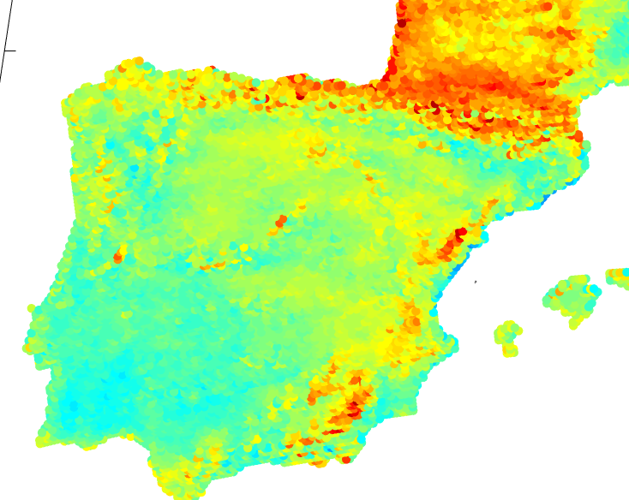
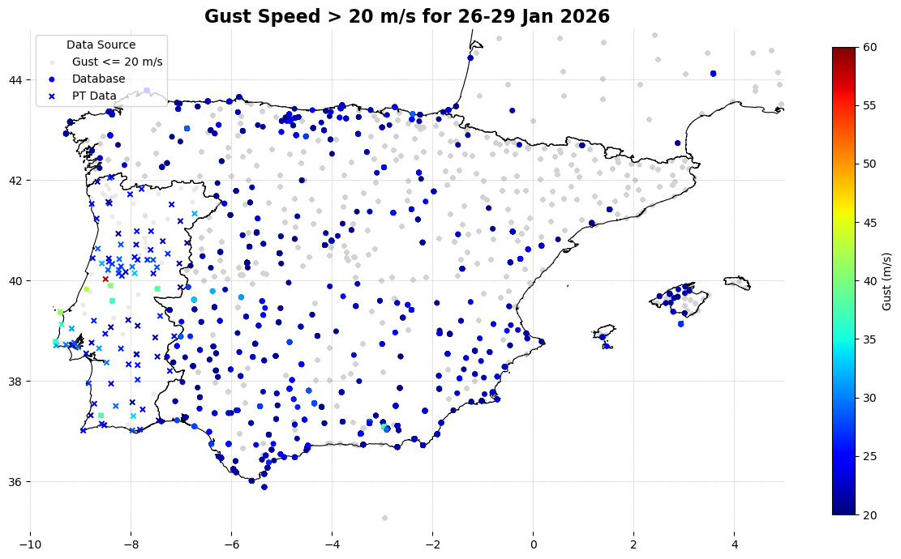
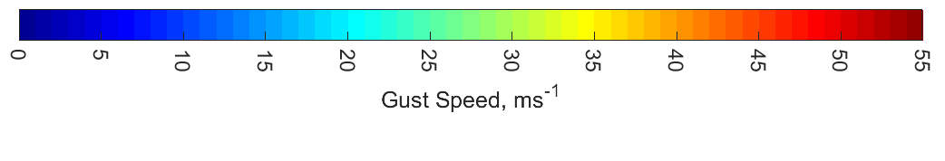
Windstorm Kristin – Comparing Gusts to Probabilistic Hazard
Wind speeds from the Automated Event Response service
Probabilistic Hazard
Wind gust speeds at 50yrs
return period
Stations with reported wind gusts. Grey are stations with gust below 20 m/s (damaging gust). Crosses are manually added data.

Slide 9
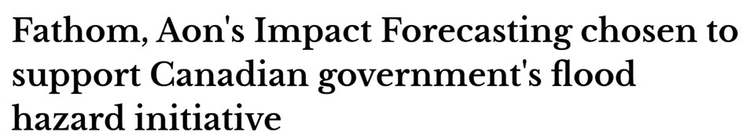
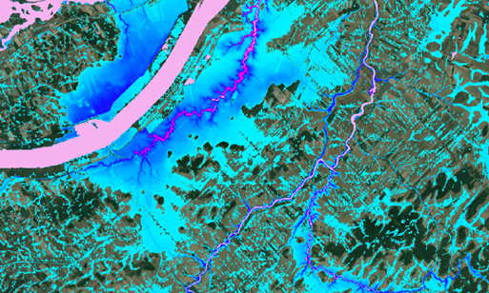
Working with The Government of Canada
Supporting Canada’s Journey to Become More Flood Resilient
    Requirements:
      Public Safety Canada wanted to assess flood risk
      Seek to protect residential homeowners in peak flood risk zones
      Focus on communities who are prone to recurrent flooding
    Collaboration between Impact Forecasting and Fathom
      IF providing the model for ~98.5% of Canadian population
      Fathom covering the entire remaining territory)
    Outcomes:
      Multi-year project to provide flood hazard data and updates
      Helping to assess flood risk and potential future schemes
    In the media: Fathom and Aon’s Impact Forecasting chosen to support Government of Canada’s flood hazard initiative, Reinsurance News, Insurance Business

Slide 10
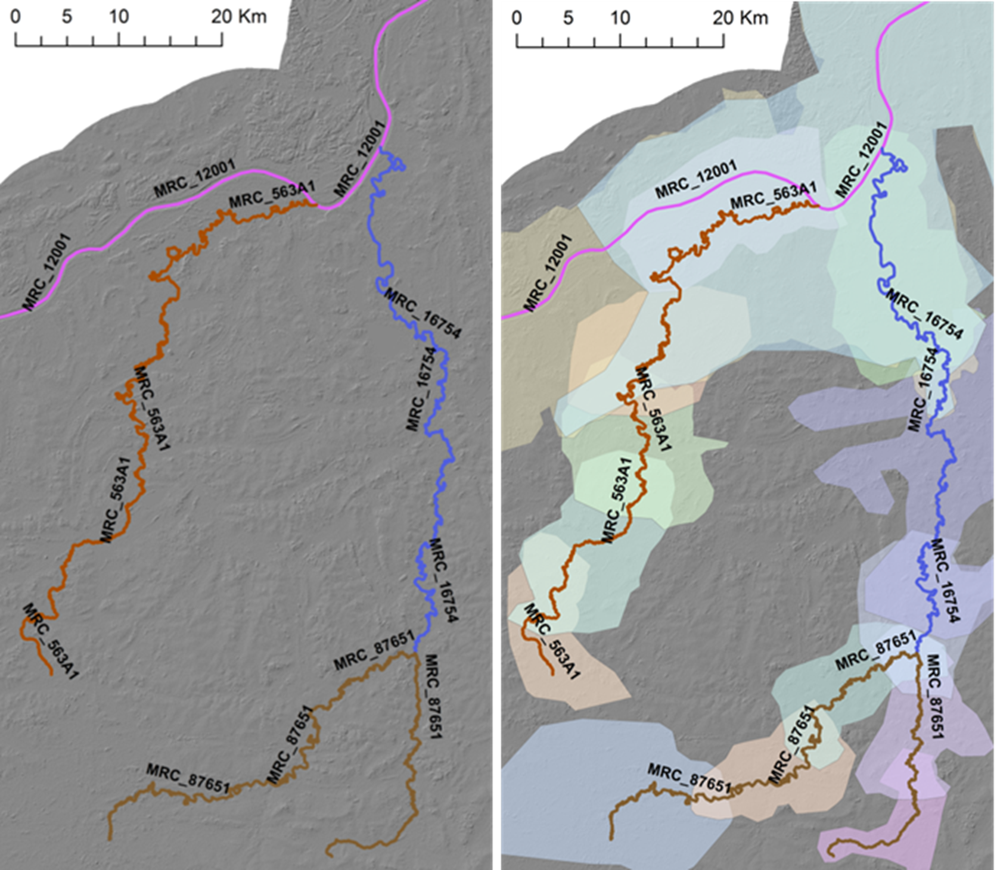
Impact Forecasting and Oasis cooperation on flood hazard optimisation
    IF Fast Flood and the Oasis Dynamic Footprint
    High resolution flood models are too large to run/store in standard Oasis format
    Rather than run a pre-computed footprint, footprint is built on the fly, during run time
    More fast and efficient flood hazard calculation
    Worked with Oasis development team to implement this functionality into the Oasis engine
    Functionality is now available to the community, for use in flood models and beyond

Slide 11
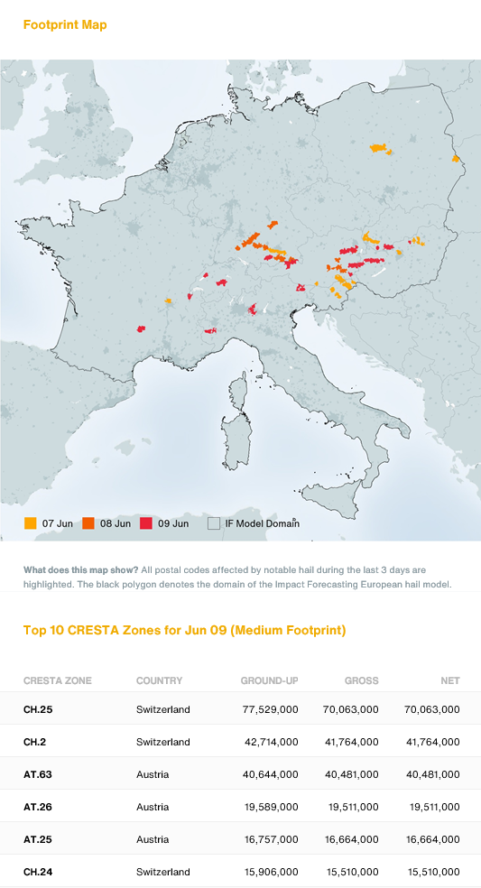
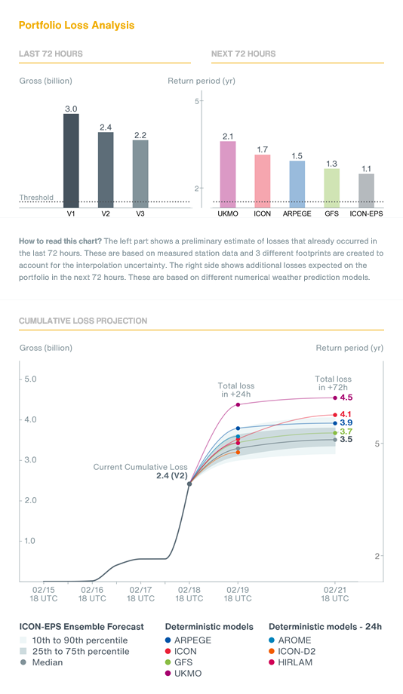
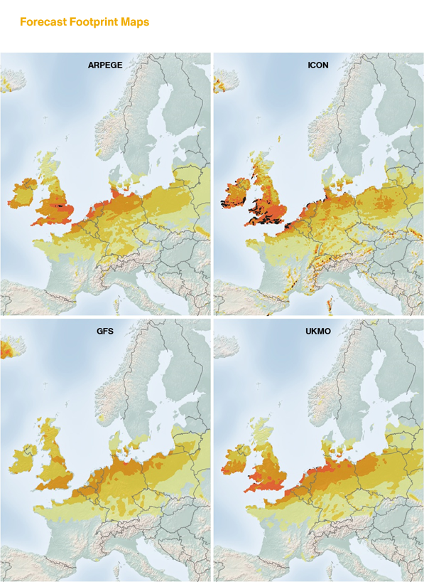
Supporting Clients With Event Response
Automated loss projections delivery
  Requirement:
    Need for estimates of potential losses and claims activity for windstorms and hail activity
    Solution:
    Load exposure data and set threshold > monitor forecasts > model event (hazard, damage and loss) > provide loss projections
    Solution integrated with clients’ claims operations to provide advance warning to adjustors
    Benefits:
    Timely loss projections
    Automated and customised event response

Slide 12
Agenda
3. Custom model development process

Slide 13
Bespoke Model Development
We build custom models based on your claims experience
Market model
Portfolio investigation
and analysis
Historical
event
analysis
Back-test with events unused in calibration
Customised and documented model
Insurer’s claims and exposure data
2
Damage function
calibration
1
3
4
Outcome: a model based on your specific claims experience and your view of risk.

Slide 14
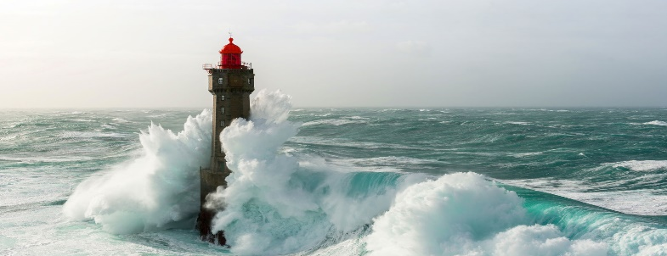


Bespoke Model Development
Helping quantify Europe Windstorm risk
Requirements
Available Data
Process
Insurer’s claims history not matching modelled losses
Helping with Solvency Capital Requirements and Reinsurance Purchase
Tailor the vulnerability component of Impact Forecasting Windstorm Model
Using extensive database of claims data spanning from 2007 until now
Focus on all occupancy classes, coverage types and for all regions in Germany
~100,000 property claims
95% of claims are residential
Per storm:
  Kyrill: 40%
  Dudley-Eunice-Franklin: 25%
  Friederike: 20%
  Sabine: ~10%
Exposure data available for the last 10 years
Updates to damage functions focused on:
  Losses
  Property sum insured
  Property location
  Number of damaged properties
  Number of insured properties
Subset of claims for calibration and validation
Transparently documented

Slide 15
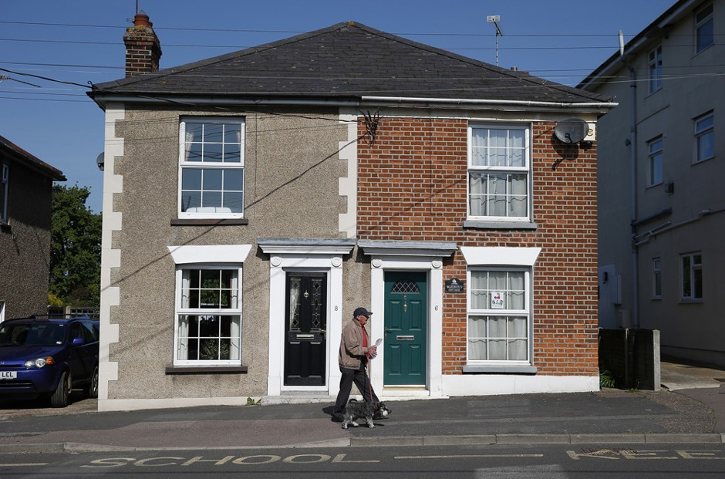


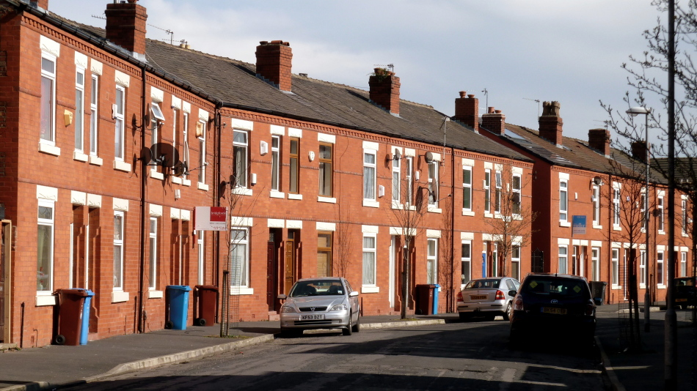
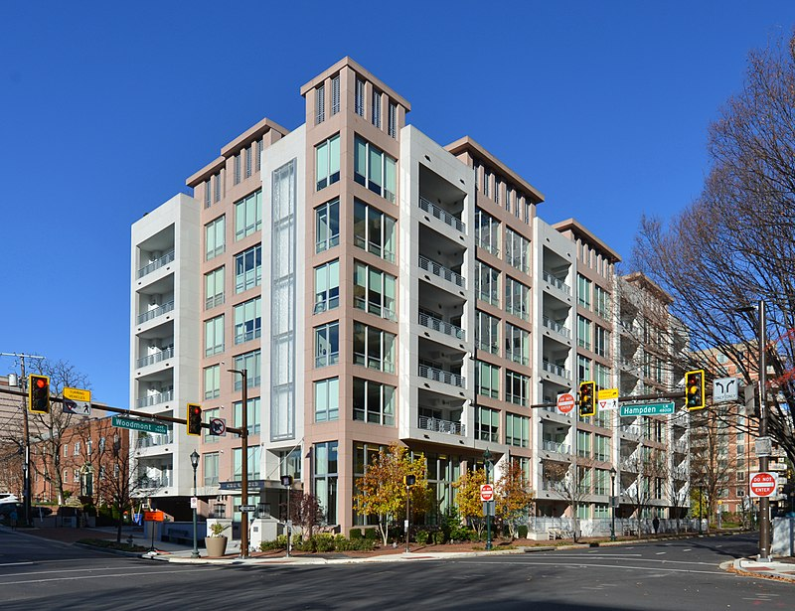
Adopting OED Occupancy Schemes in IF models
OED – Location
“Residential”: code range 1050 – 1099
1051: Permanent dwelling: single-family
1071: semi-detached house
1050: General residential
200+ occupancy codes, designed to be expanded
1056: Mid-Terraced Housing
1055: Apartment/Condo

Slide 16
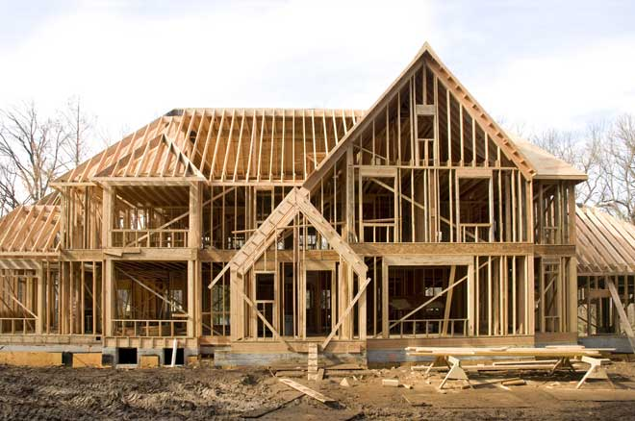
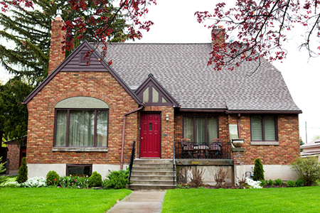



Adopting OED Construction Schemes in IF models
OED – Location
5050: Wood frame
5100: Masonry
5101: Adobe
5000: Unknown
350+ construction codes, designed to be expanded
5150: Reinforced concrete
5200: Steel

Slide 17
Agenda
4. What else can we do?

Slide 18
Helping you make the most of OED and Oasis
Enabling interoperability with Open Data Standards
Easier to run different models
Ability to run multiple models for a given region/peril
Efficient modelling and pricing workflow
Aon developing Property Data Repository based on OED
Helping to understand of what’s at risk with Open Exposure Data
Enabling easier conversions to OED with Impact Workbench
Standardisation of construction/ occupancy schemes within IF models with OED
OED used in ELEMENTS for JBA, ERN and COMBUS models
Sharing OED/ORD data with insurers and reinsurers
More efficient placement processes
UK & I catastrophe analytics teams sharing OED for the last 3 renewals
Expanding to other markets – which regions/perils are most useful?

Slide 19
Options to Access IF Models
Catastrophe Models (IF, ERN, JBA, COMBUS)
Run in IF financial engine
Run in Oasis financial engine
In ELEMENTS
(default for running IF models)
In ELEMENTS
Verisk Model Exchange
Moody’s IRP
On premise
Hosted on Aon’s AWS
On premise
Hosted on Aon’s AWS
Client’s Oasis system
Any option possible
Run in another financial engine
In Oasis

Slide 20
Increasing choice using the Oasis Loss Modelling Framework
Access to IF and 3rd party models in the Oasis LMF platform of your choice
    IF models in Verisk Model Exchange
      Europe Windstorm
      Europe SCS
      Manhattan Blast
      Canada flood
      various Europe and Asia flood models
    Aon and IF supporting Oasis SaaS
      Allows Moody’s IRP Risk Modeler to connect to Oasis Loss Calculation Engine
    IF models in Oasis LMF in-house
      Baloise using IF models for Europe in their in-house Oasis instance
Oasis LMF engine in ELEMENTS
      ERN Latin America models for hurricane and earthquake
      JBA UK flood
      COMBUS Australia models
Supported by Impact Workbench which converts exposure to OED input format
Notes:
Helping to support the Open Cat Modelling community
Supporting wider initiatives to decrease protection gap
IF models and components available for non-commercial / academic use through Oasis Risk Explorer and Oasis LMF

Slide 21

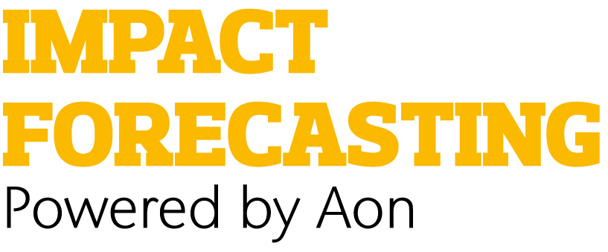
Equipping for Multi-Peril Ascents with Oasis & Impact Forecasting
        Oasis: Proven & Flexible Core
        Leverages known framework, established processes, and internal expertise and ensures full control multi-peril integration via component reuse
        Impact Forecasting: Expert Peril Models
        Provides cost-efficient, state-of-the-art models for key perils (floods, hail, storms, earthquake) as in-house development of complex physical models is difficult and open alternatives are scarce
The core goal of understanding risk remains, but our increasingly precise tools complement our expertise in this ongoing arms race.
Notes:
25:00
Make tools work: need OASIS
Compare vendor-models:
Can be done, but
Hard to integrate
Cost a lot of money
Black-box: hard to understand
Remark: yes, can reverse engineer by a proxy modelling approach creating dummy portfolios, grid of footprint etc.
(laborious + often not allowed by terms-of-use)
Baloise can rely on established processes. Re-use components (cost-effective & fast deployment)
OASIS = empty hull (need peril models to make the process work)
IF comes into play: Expertise + cost-effective
Important to us: high-quality open-models (like earthquake) not readily available for other perils
Internal implementation is infeasible
Sum-up: not new, not reinventing wheel. But it is an “arms race” for better models and tools reflecting reality to create business value.

Slide 22
Impact Workbench, ELEMENTS and Oasis LMF integration
Impact Forecasting
Oasis Platform
(Model)
Impact Workbench
Model worker
Input Validation
OED
ELEMENTS
Oasis API
Import summary
Analysis Results
Input validation logs
Analysis run logs
Output from Oasis Platform
IF_OASIS_EXP IF_OASIS_RES
OED Files
Import summary
Analysis Results
Input validation logs
Analysis run logs
Oasis FM
Analysis Run
(Oasis)
You can run JBA’s flood models, ERN’s hurricane and earthquake models, and COMBUS’s Australia models

Slide 23
From Generic to Bespoke: Customising Cat Models
    Use your claims data to update the model and reflect your view of risk
    Other use cases for your model e.g. event response
New Regions
Using Claims
Event Response
Open Modeling
    Customised models can help you explore new regions and perils
    Consider where you can run your catastrophe model – many options with Oasis LMF and Impact Forecasting!

Slide 24


Thank you!
Nat Cat Revealed, London
Thursday 4th June!
Chris Ewing
  Head of
  Business Development,
Impact Forecasting
chris.ewing@aon.com

Slide 25
Nat Cat Revealed, London
Thursday 4th June!

Slide 26


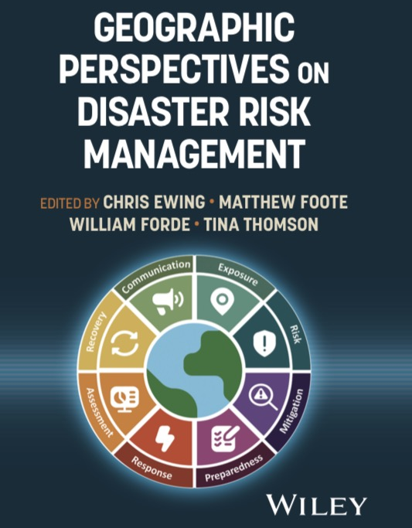

Geographic Perspectives on Disaster Risk Management
New Book Launching in May 2026!
Wiley
Amazon
RGS Webinar Series – 7th May onwards

Slide 27
Thank You

Slide 28
Disclaimer
Legal Disclaimer
Aon’s Reinsurance Solutions business, part of Aon UK Limited (for itself and on behalf of each subsidiary company of Aon plc) (“Aon”) reserves all rights to the content of this report (“Report”). This Report is for distribution to Aon and the organisation to which it was originally delivered only. Copies may be made by that organisation for its own internal purposes but this Report may not be distributed in whole or in part to any third party without both (i) the prior written consent of Aon. and (ii) the third party having first signed a “recipient of report” letter in a form acceptable to Aon. Aon cannot accept any liability to any third party to whom this Report is disclosed, whether disclosed in compliance with the preceding sentence of otherwise.
To the extent this Report expresses any recommendation or assessment on any aspect of risk, the recipient acknowledges that any such recommendation or assessment is an expression of Aon opinion only, and is not a statement of fact. Any decision to rely on any such recommendation or assessment of risk is entirely the responsibility of the recipient. Aon will not in any event be responsible for any losses that may be incurred by any party as a result of any reliance placed on any such opinion. The recipient acknowledges that this Report does not replace the need for the recipient to undertake its own assessment.
The recipient acknowledges that in preparing this Report Aon may have based analysis on data provided by the recipient and/or from third party sources. This data may have been subjected to mathematical and/or empirical analysis and modelling. Aon has not verified, and accepts no responsibility for, the accuracy or completeness of any such data. In addition, the recipient acknowledges that any form of mathematical and/or empirical analysis and modelling (including that used in the preparation of this Report) may produce results which differ from actual events or losses.
The Aon analysis has been undertaken from the perspective of a reinsurance broker. Consequently this Report does not constitute an opinion of reserving levels or accounting treatment. This Report does not constitute any form of legal, accounting, taxation, regulatory or actuarial advice.
Limitations of Catastrophe Models
This report includes information that is output from catastrophe models of Impact Forecasting, LLC (IF). The information from the models is provided by Aon Benfield Services, Inc. (Aon) under the terms of its license agreements with IF. The results in this report from IF are the products of the exposures modelled, the financial assumptions made concerning deductibles and limits, and the risk models that project the pounds of damage that may be caused by defined catastrophe perils. Aon recommends that the results from these models in this report not be relied upon in isolation when making decisions that may affect the underwriting appetite, rate adequacy or solvency of the company. The IF models are based on scientific data, mathematical and empirical models, and the experience of engineering, geological and meteorological experts. Calibration of the models using actual loss experience is based on very sparse data, and material inaccuracies in these models are possible. The loss probabilities generated by the models are not predictive of future hurricanes, other windstorms, or earthquakes or other natural catastrophes, but provide estimates of the magnitude of losses that may occur in the event of such natural catastrophes. Aon makes no warranty about the accuracy of the IF models and has made no attempt to independently verify them. Aon will not be liable for any special, indirect or consequential damages, including, without limitation, losses or damages arising from or related to any use of or decisions based upon data developed using the models of IF.
Additional Limitations of Impact Forecasting, LLC
The results listed in this report are based on engineering / scientific analysis and data, information provided by the client, and mathematical and empirical models. The accuracy of the results depends on the uncertainty associated with each of these areas. In particular, as with any model, actual losses may differ from the results of simulations. It is only possible to provide plausible results based on complete and accurate information provided by the client and other reputable data sources. Furthermore, this information may only be used for the business application specified by Impact Forecasting, LLC and for no other purpose. It may not be used to support development of or calibration of a product or service offering that competes with Impact Forecasting, LLC. The information in this report may not be used as a part of or as a source for any insurance rate filing documentation.
THIS INFORMATION IS PROVIDED “AS IS” AND IMPACT FORECASTING, LLC HAS NOT MADE AND DOES NOT MAKE ANY WARRANTY OF ANY KIND WHATSOEVER, EXPRESS OR IMPLIED, WITH RESPECT TO THIS REPORT; AND ALL WARRANTIES INCLUDING WARRANTIES OF MERCHANTABILITY AND FITNESS FOR A PARTICULAR PURPOSE ARE HEREBY DISCLAIMED BY IMPACT FORECASTING, LLC. IMPACT FORECASTING, LLC WILL NOT BE LIABLE TO ANYONE WITH RESPECT TO ANY DAMAGES, LOSS OR CLAIM WHATSOEVER, NO MATTER HOW OCCASIONED, IN CONNECTION WITH THE PREPARATION OR USE OF THIS REPORT.

