Slide 1
Why are we here?
Enabling the success of our members and the Market in leading global insurance
Purpose
How do we deliver value?
Advocacy
Value Proposition
Technical expertise
Technical training
Culture
What is our focus?
Influence policy via technical expertise
2025 Goals
Simplify & digitize
Regulatory
Advocacy
Training & talent
What is our culture?
Values
Inclusive Trusted Passionate Bold United
2025 Strategy & Goals

Slide 2
Exposure Management Working Group
Membership
Chair Laura Freeman (Apollo), Deputy Chair Vanessa Jones (Dale)
Representation of 19 Lloyd’s Managing Agents
Recent activity
Lloyd’s EDS production
Model Validation
Supporting the PRA with Dynamic Stress Test Preparation
Market research to inform 2025 working items
Practical Management of Cyber Exposures and Aggregations paper
Select focus areas for 2025
Casualty working group
Supporting Lloyd’s Cyber RDS refresh
Lloyd’s reporting
Navigating model upgrades

Slide 4
In 2022 the EM Survey asked: It would be interesting to view the relative usage of models across the market: Please select the primary product utilised to model the LCM5 regions/ perils Key take away: Unsurprisingly, RMS and AIR were the predominant models of choice for the LCM5.

Slide 5
In 2024 the EM Survey asked: We are looking to understand the relative usage of models across the market. Please select the primary product utilised to model the LCM5 regions/ perils. Key take away: AIR is being used as the primary product for the LCM5 for 50% of respondents (an increase from 2022).

Slide 6
In 2025 the EM Survey asked: We are looking to understand the relative usage of models across the market. Please select the primary product utilised to model the LCM5 regions/ perils. Key take away: From the syndicates who provided responses, we are starting to see Risk Modeller and NGM already utilised for the LCM5 however we are seeing a drop from the 50/50 RMS/AIR split we had in 2024 with 30-40% now for each and a larger portion of "Other" in the mix.

Slide 7
When are you intending to adopt Risk Modeller HD / AIR Touchstone NGM for use in pricing/capital setting? Key take away: Syndicates are moving towards adoption of Risk Modeller and NGM. The majority are doing so towards late 2025 or 2026.

Slide 8
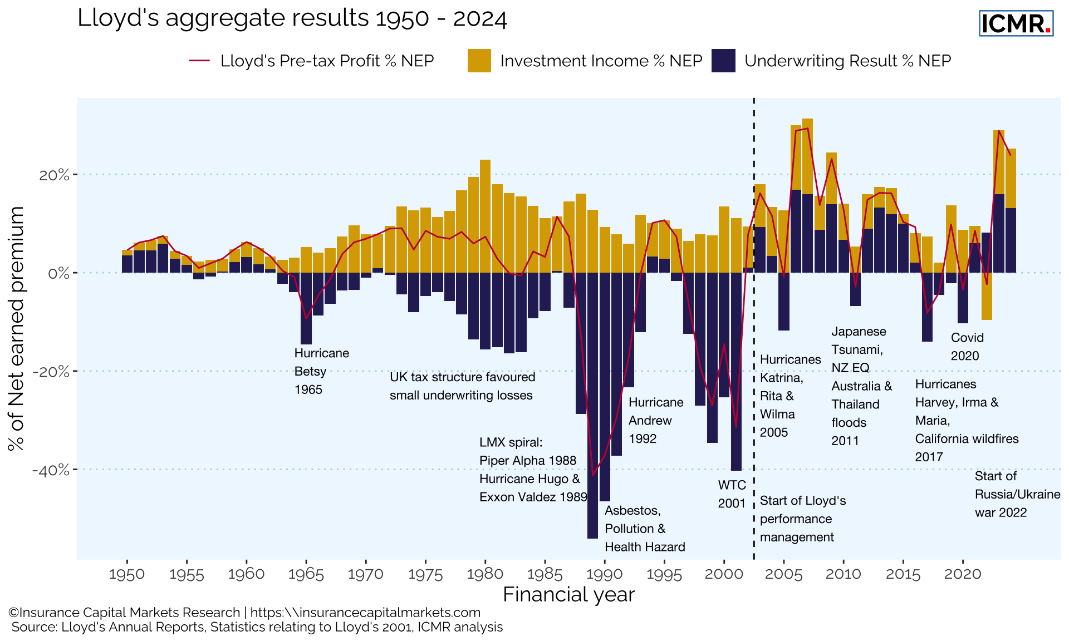
Lloyd’s Aggregate Results 1950 - 2024

Slide 9
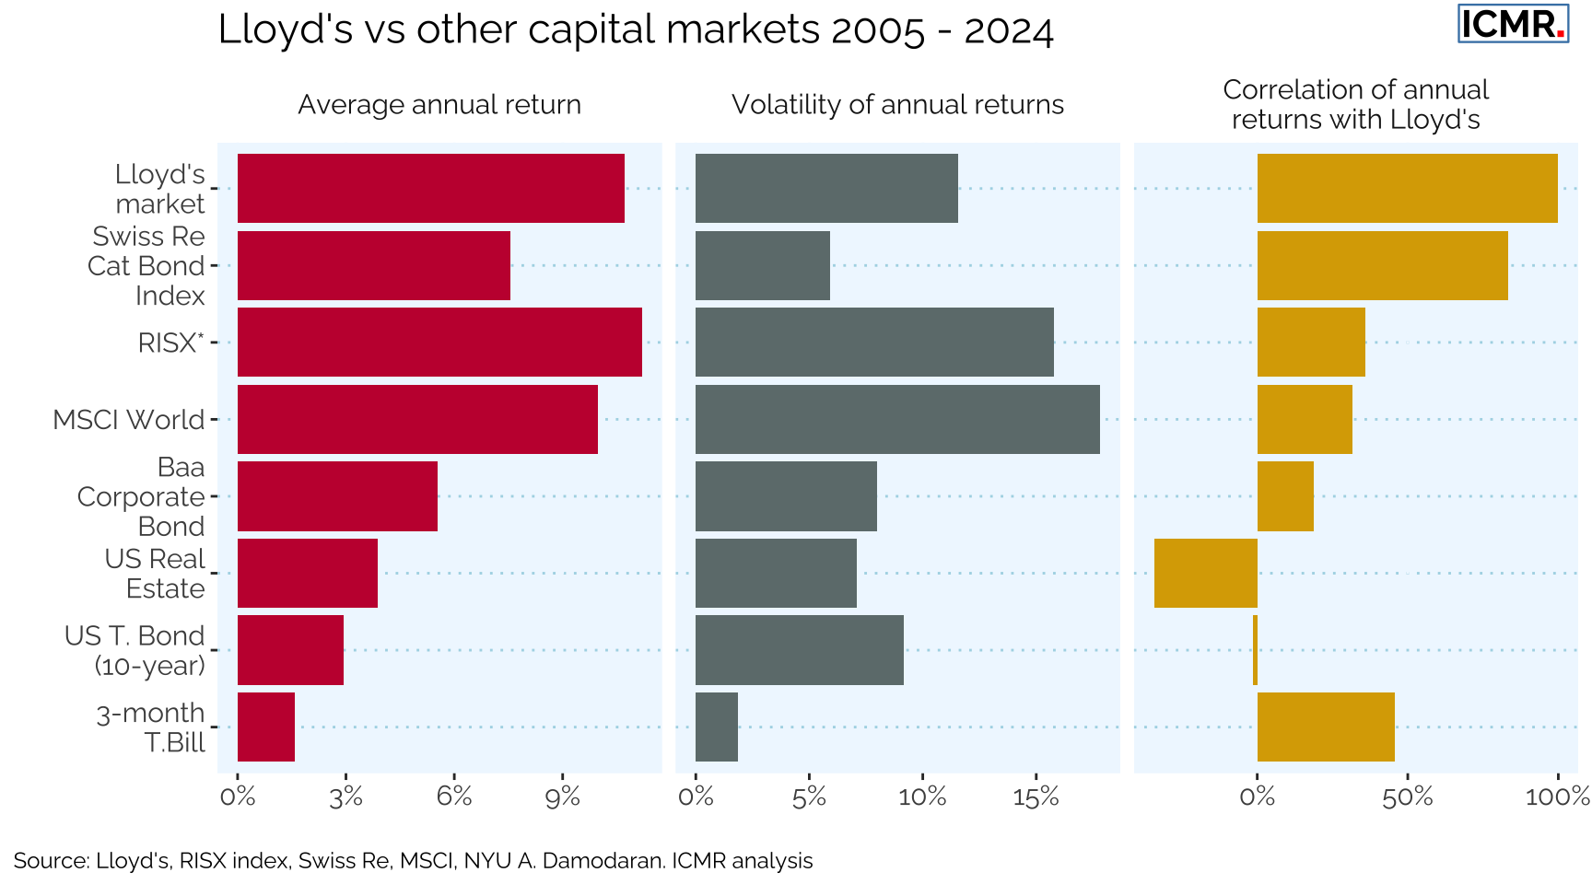
Lloyd’s vs Alternative Investments 2005 - 2024

Slide 10
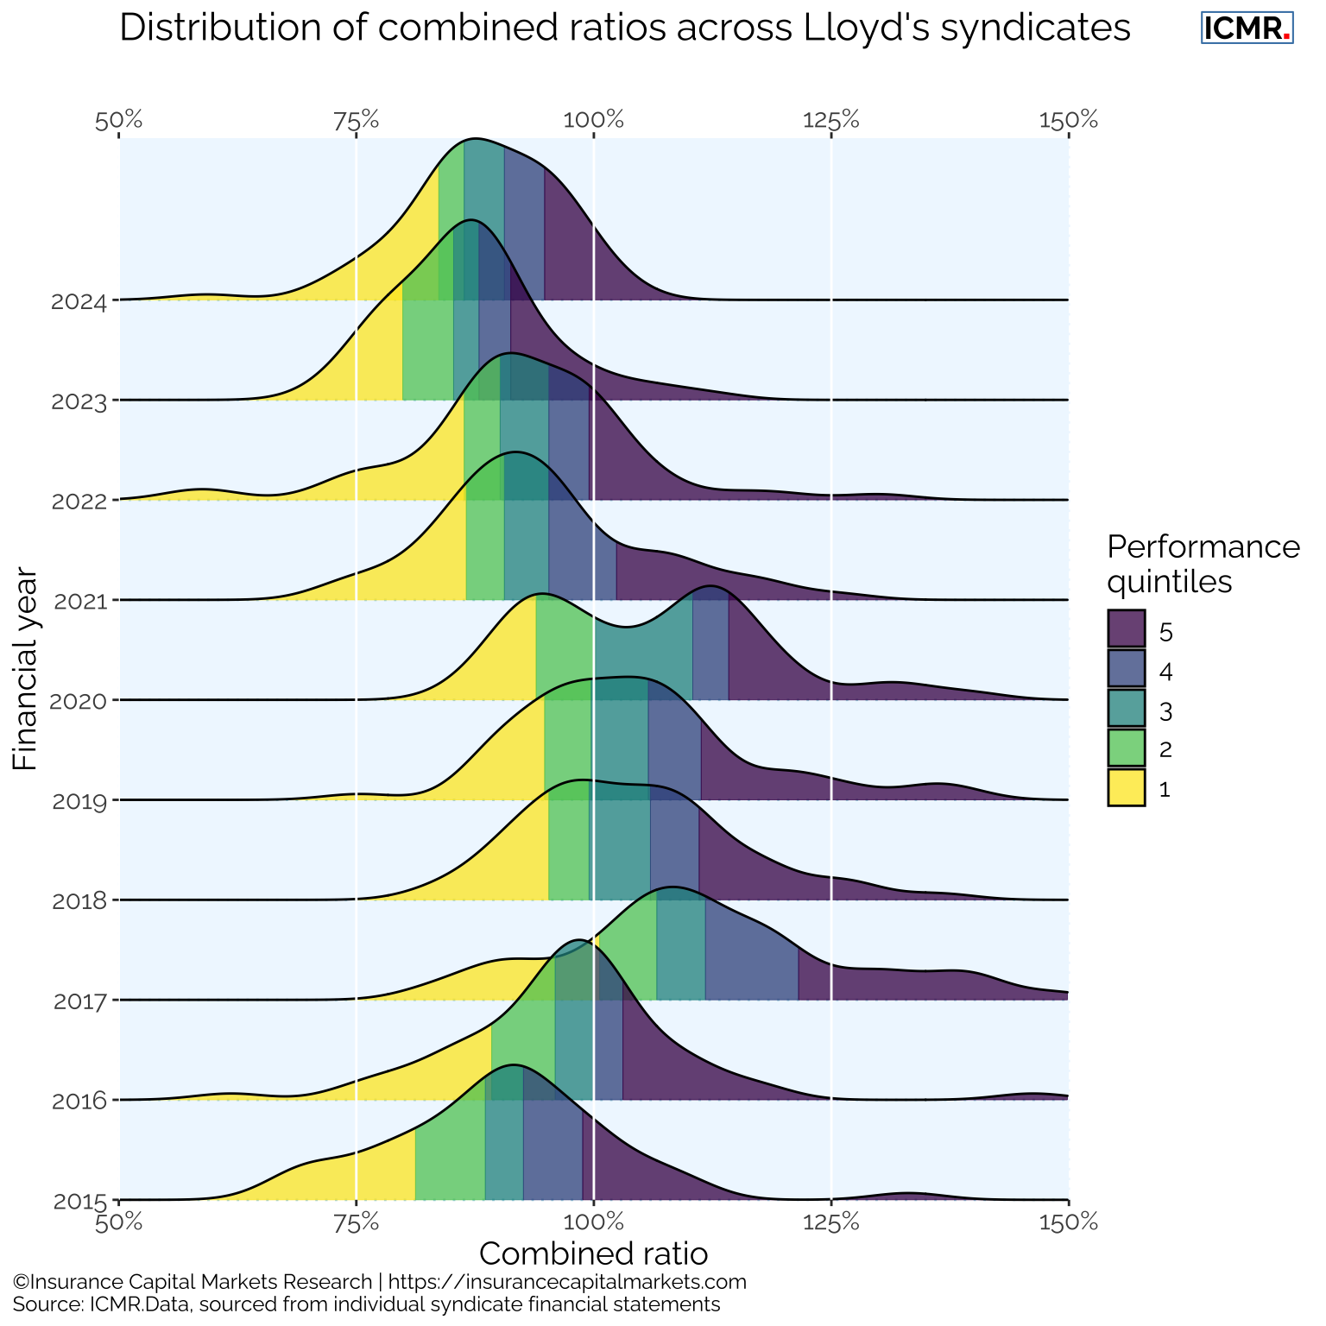
Distribution of Combined Ratios across Lloyd’s Syndicates

