Slide 1
ELEVATING OUR PROFESSION
Networking
Credentialization
Continuing Education
Information Sharing (through ISCM website)

Slide 2
Credentialization – Proven Experience
Certified Specialist in Catastrophe Risk (CSCR)
Certified Catastrophe Risk Management Professional (CCRMP)
Best Practice Experts
Gain and demonstrate knowledge of practical applications in catastrophe modeling
Property / Cat Insurance Market Standards
Understanding Best Use of Catastrophe Models
Proven knowledge & support of Property Cat (re)insurance value chain
How:
4 courses & exams + Ethics Course (waivers for exam 1)
Joint endeavor between ISCM & iCAS
Recognized Subject Matter Experts
Demonstrate advanced applications and methodologies of catastrophe risk management or development/delivery of models
Customized / Advanced Applications
Tailoring Own View of CAT Risk
Capable of Critical Assessments
Trusted Advisor to Senior Stakeholders
How:
Experienced Industry Professional Pathway available by nomination
Technical pathway available
No exams yet
Over 300 credentialed professionals
Proof & recognition of expertise
Industry defined competencies
For more information visit www.catmanagers.org/accreditation
and www.catriskcredentials.org

Slide 3
ISCM Website
Resource Library
Reference documents by peril, company,
White papers
Industry reports
Accreditation
Description of various credentials and pathways
Value proposition
Templates for candidates and managers
ISCM Archive
Member only access to past presentation slide decks / webinar recordings
Other
ISCM event postings & registration
Membership subscriptions

Slide 4
Get Involved
ISCM Committees
Technology
Manages the website containing events calendar; resource library; ISCM archive; membership database.
Education
Plan virtual and in person sessions for all levels in the field.
Marketing
Messaging current happenings and web content. Promoting ISCM and the Cat Credentials.
Credentialization
Development and maintenance of exams, review of Experienced Industry Practitioner applications.
Membership
Define membership value, understand our membership demographics, and build our membership.
email us: info@catmanagers.org

Slide 5
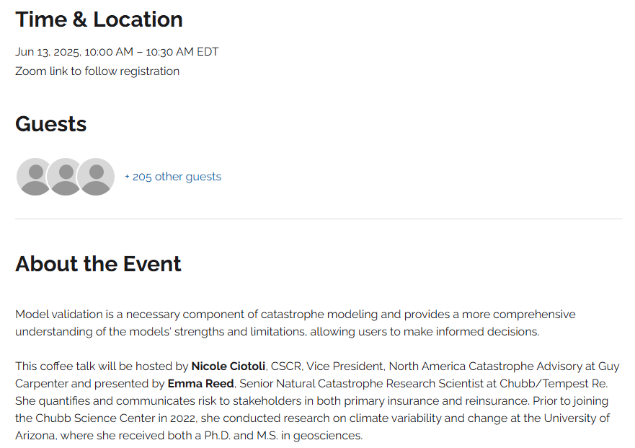
ISCM Coffee Talk Series
15 minutes of content and 15 minutes of Q&A
Coffee Talks will bring key industry topics for experienced catastrophe management professionals into an accessible setting for discussions.
Mail campaigns will be sent when registration is available.
Recent ISCM Coffee Talk
Looking for Leaders:
If you would like to lead a coffee talk topic, please send a brief description of your proposed topic to Emily Sambuco at emily.sambuco@libertymutual.com.
All non-marketing topics welcome!
Notes:
In 2021 the ISCM is enhancing the opportunities to expand connections within our international professional community.
Committee volunteer opportunities, participation in workshops, or forum discussions, expands opportunities to connect with other professionals without geographic restrictions.
We have introduced monthly coffee talks in 2021 as a networking opportunity in our remote working environment.

Slide 6
What’s happening in Zurich?
“Pure” networking drinks not supported anymore by ISCM, thus no spring gathering in 2025. Any ideas around new casual networking formats that contain some educational element are welcome.
ISCM Zurich 2025 event likely on the 23rd of September. Topic still being discussed, any input welcome. Updates via email will follow soon.
After 8 years driving ISCM activities in Zurich together with an amazing group of volunteers, I’ll reduce my involvement going forward, more information will follow. Under new leadership, we’ll certainly also look for new volunteers to help foster our community!

