Slide 1
LMA introduction
April 2026

Slide 2






Why are we here?
Enabling
our members’ & Market’s leadership
in global insurance
Purpose
How do we deliver value?
Advocacy
Culture
Digital
Value Proposition
Technical
expertise
Technical training
What is our focus?
2026 Objectives
Underwriting & claims trends
Technical expertise
Regulatory
advocacy
Simplify & digitise
What is our culture?
Values
Inclusive Trusted Passionate Bold United
LMA 2026 Strategy

Slide 3
Recent LMA publications
LMA AI Adoption Toolkit
  To support managing agents in building practical, governance-led approaches to AI implementation
  Follows recent LMA research which shows that AI adoption has more than doubled across the Lloyd’s market over the past 12 months
Lloyd’s 2026 Insights Report
  Analysis of the drivers and trends underlying Lloyd’s performance. It reveals that, with individual syndicates delivering strong results, Lloyd’s remains well positioned as a compelling proposition to investors.
Podcast: What are the Challenges Facing Casualty Exposure Management?
  The podcast examining the key issues challenging the casualty market, from regulation to data.
Notes:
How to use this slide layout:
Type your text into the placeholders on the slide

Slide 4
Exposure Management Working Group
Chair: Vanessa Jones (Dale) | Deputy Chair: David Singh (Beazley)
  Lloyd’s reporting
Casualty working group
  Cyber RDSs
AI use cases in exposure management
Model evaluation guidance
Model change and vendor management
Notes:
How to use this slide layout:
Type your text into the placeholders on the slide

Slide 5
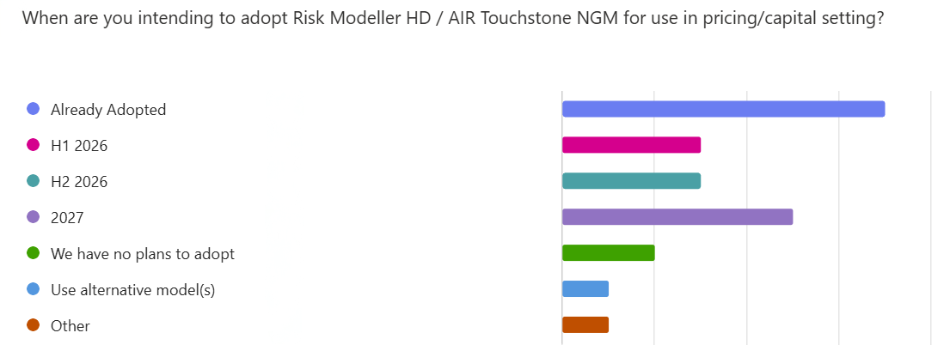
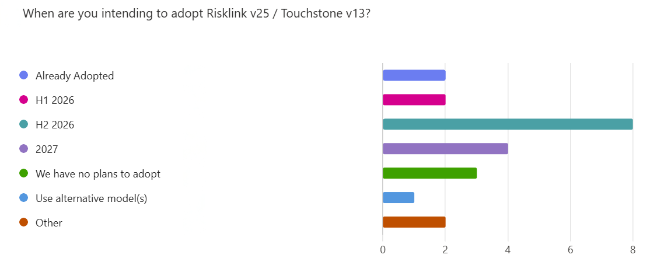
Lloyd’s Market Exposure Management Survey
Notes:
How to use this slide layout:
Type your text into the placeholders on the slide

Slide 6
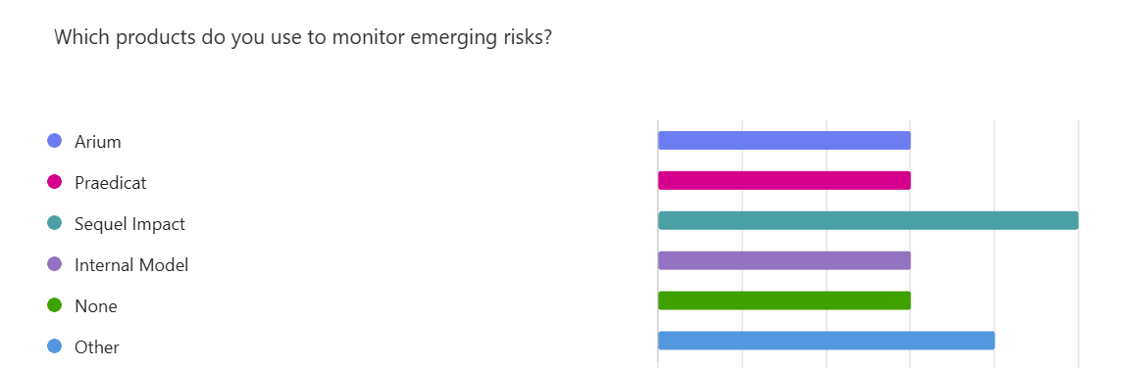
Lloyd’s Market Exposure Management Survey
Top risks mentioned: AI, climate change, geopolitics, data centres, cyber, PFAS, greenwashing, inflation, pandemic
Monitoring methods: emerging risk committees, scenario analysis, underwriting and claims intelligence, vendor models
Data used: internal loss and reserving data, reinsurance analysis, external sources, firmographics and vendor outputs.
Notes:
How to use this slide layout:
Type your text into the placeholders on the slide

Slide 7
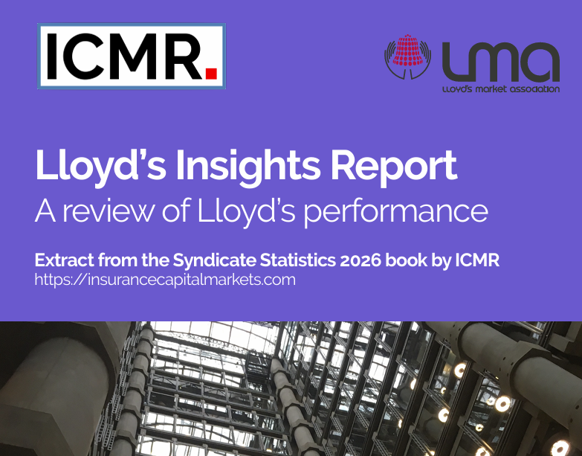
Lloyd’s 2026 Insights Report

Slide 8
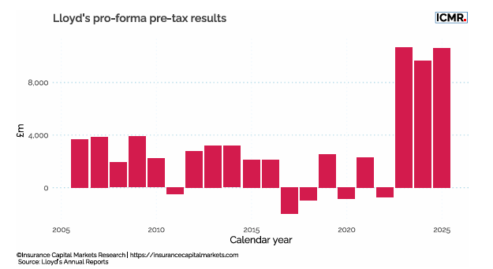

Slide 9
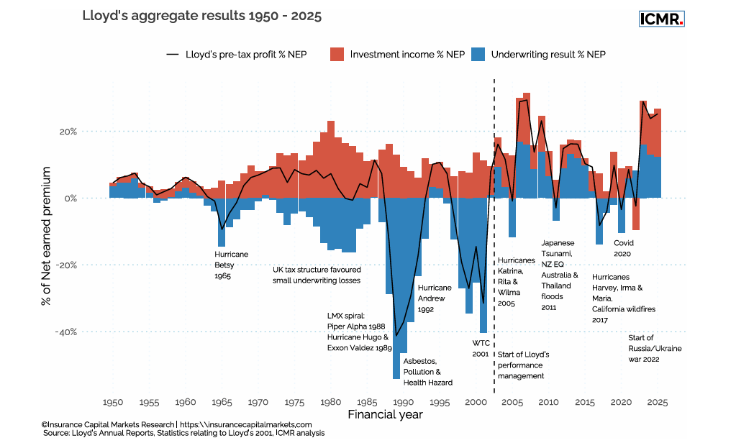

Slide 10
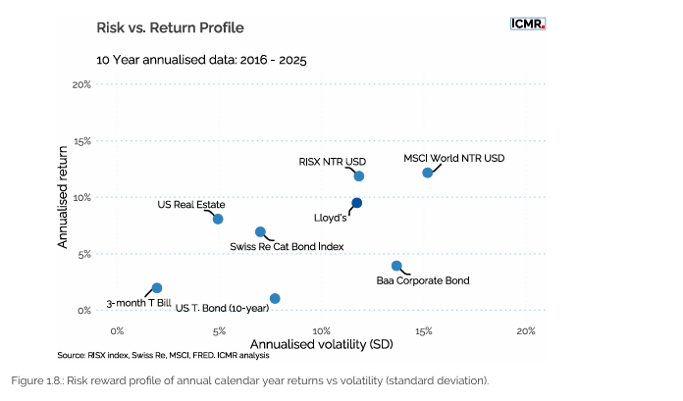
Lloyd’s vs Alternative Investments 2016 - 2025

Slide 11
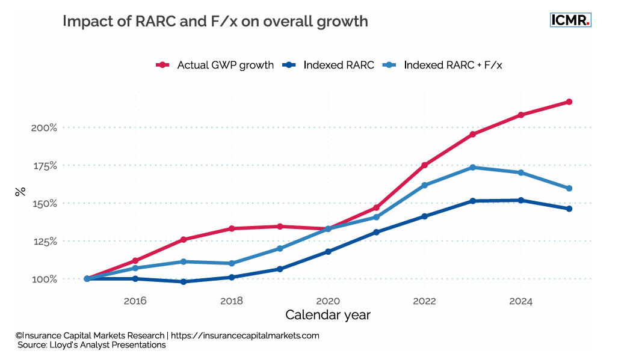

Slide 12
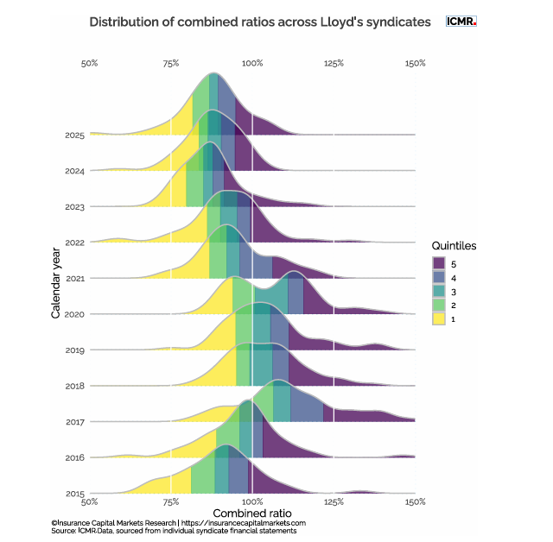

Slide 13
Sanjiv.Sharma@lmalloyds.com
Lmalloyds.com

