Slide 1
Why Climate Extremes Just Got Worse—But the Impact of Climate Change Isn’t as Bad as We First Thought
Steve Jewson
1st May 2025

Slide 2
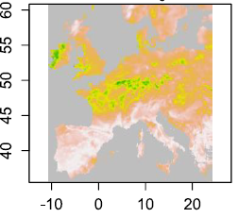
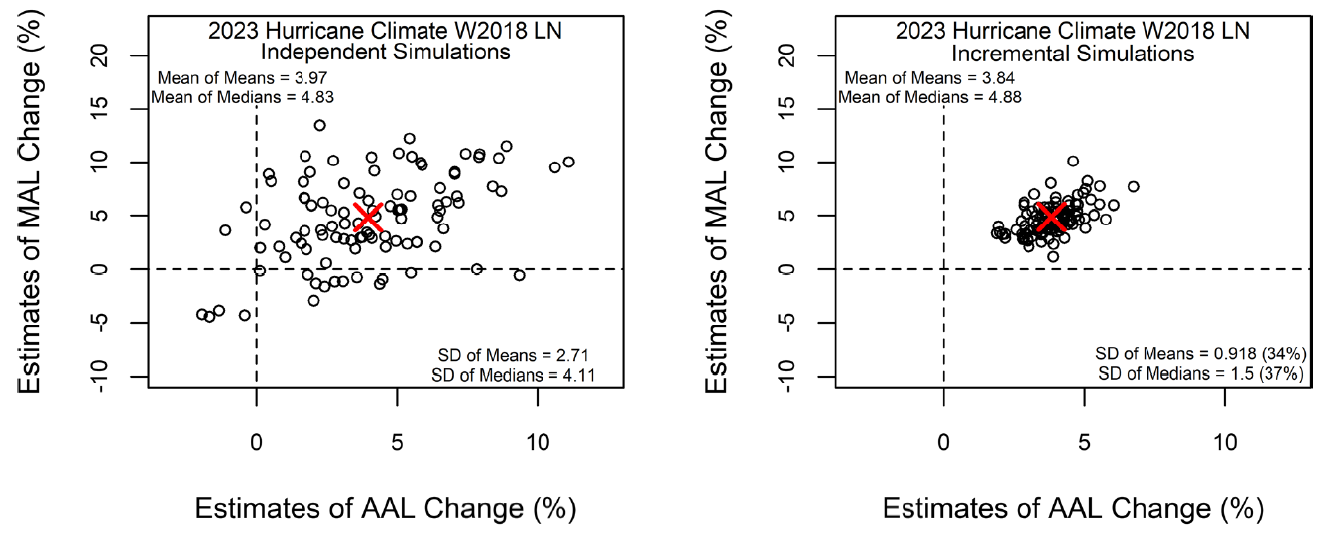
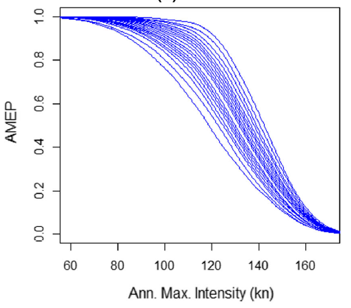
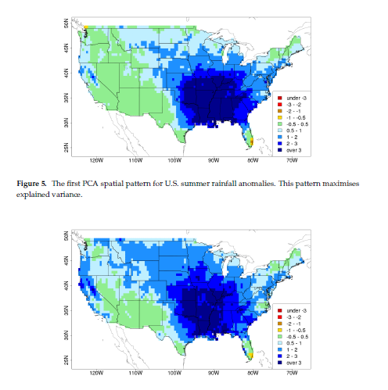
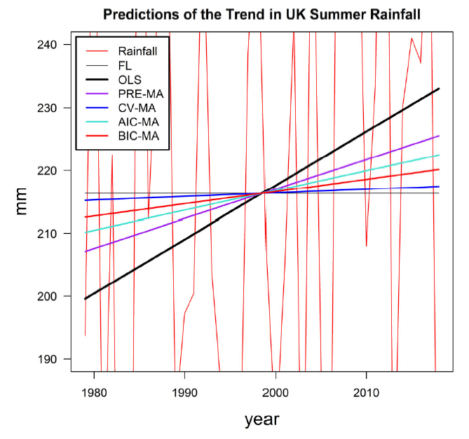
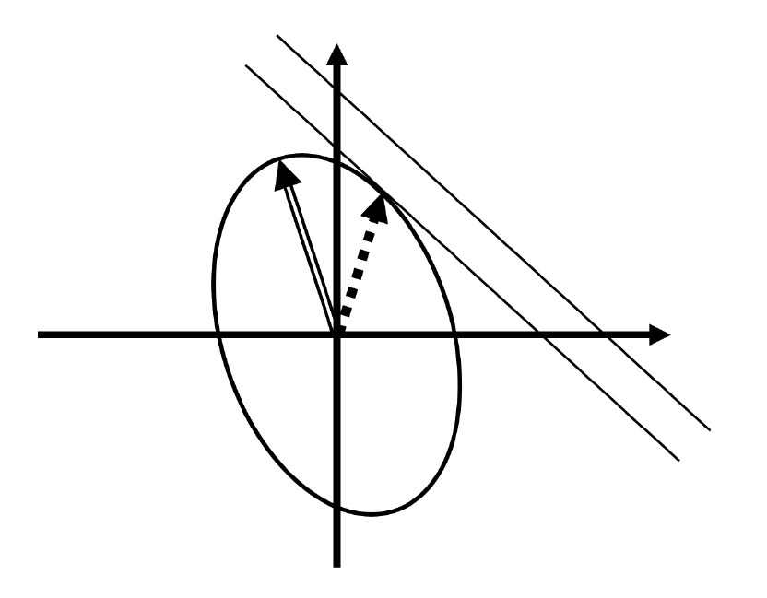
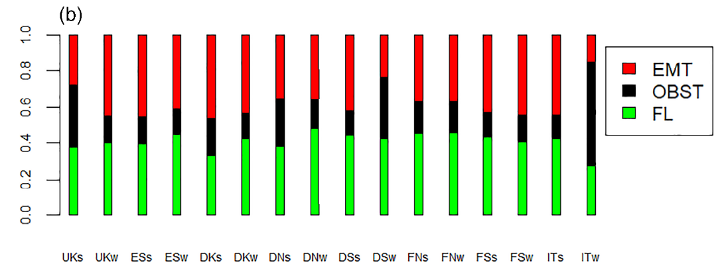
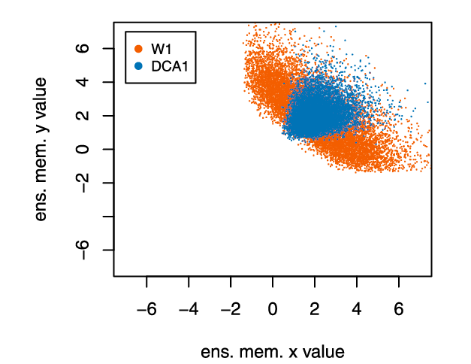
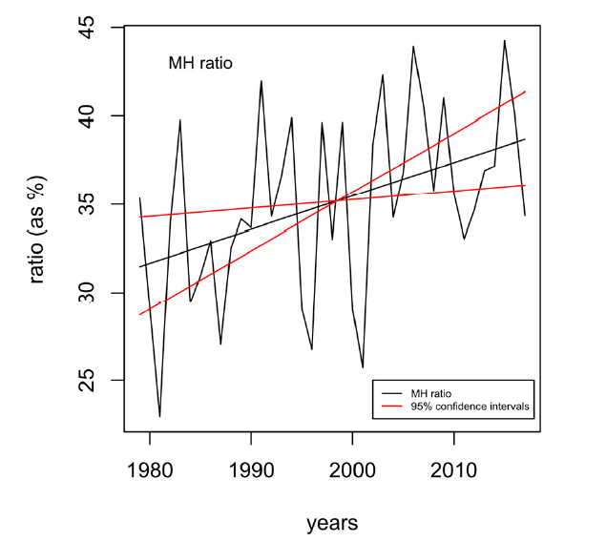
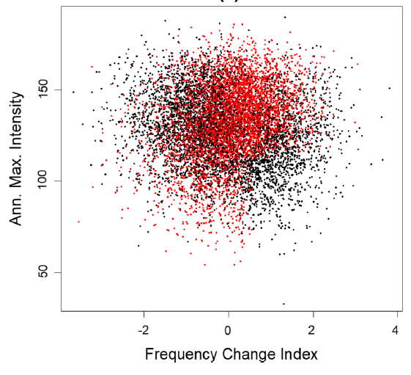
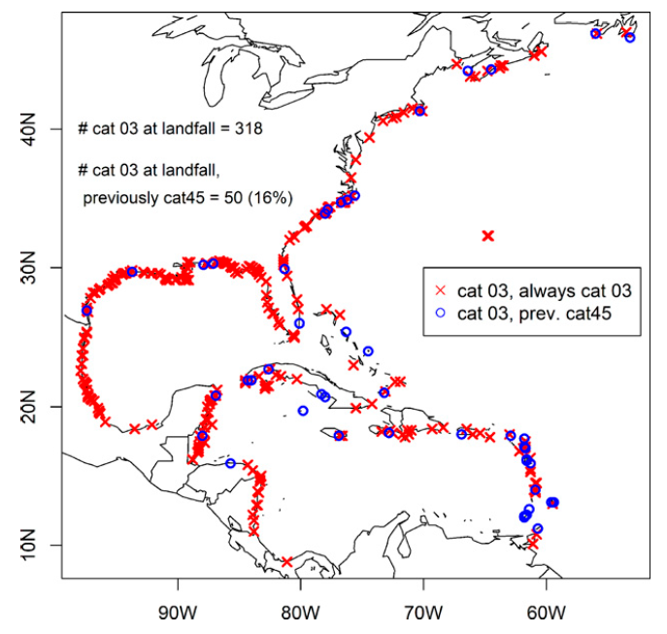
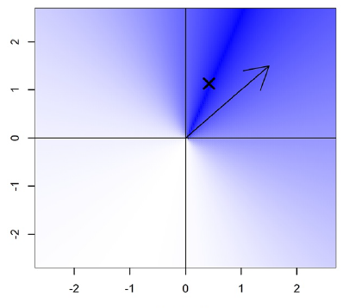
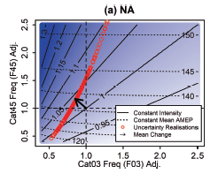
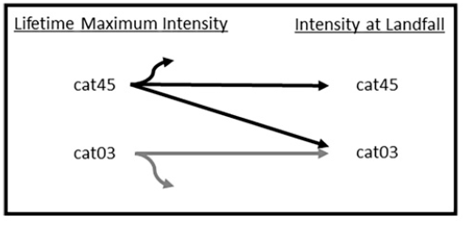
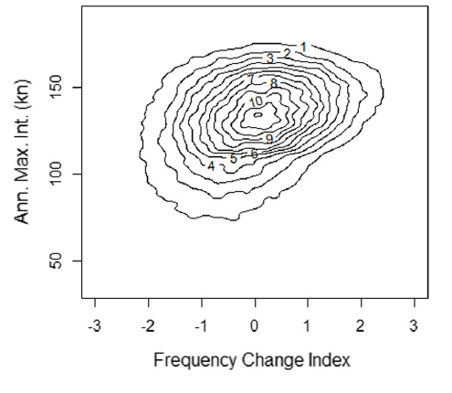
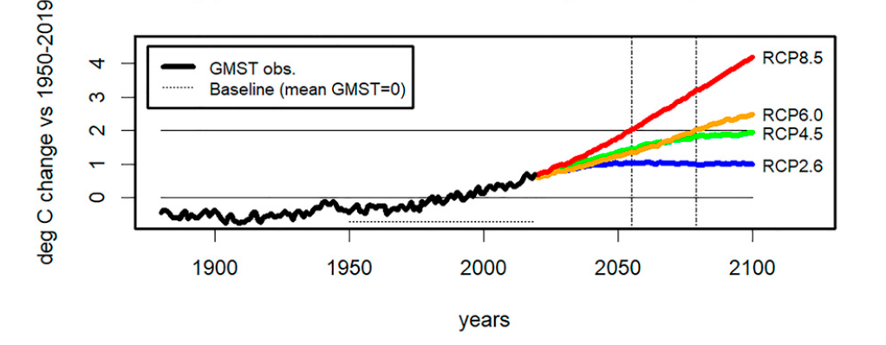
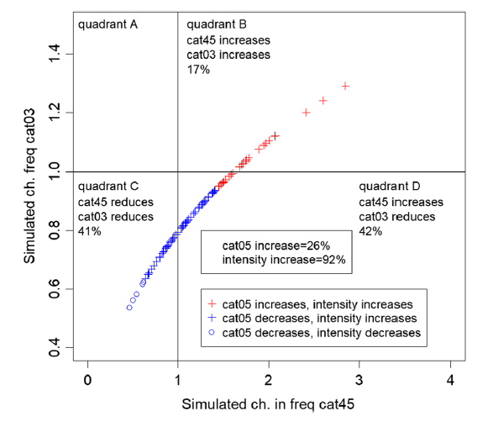
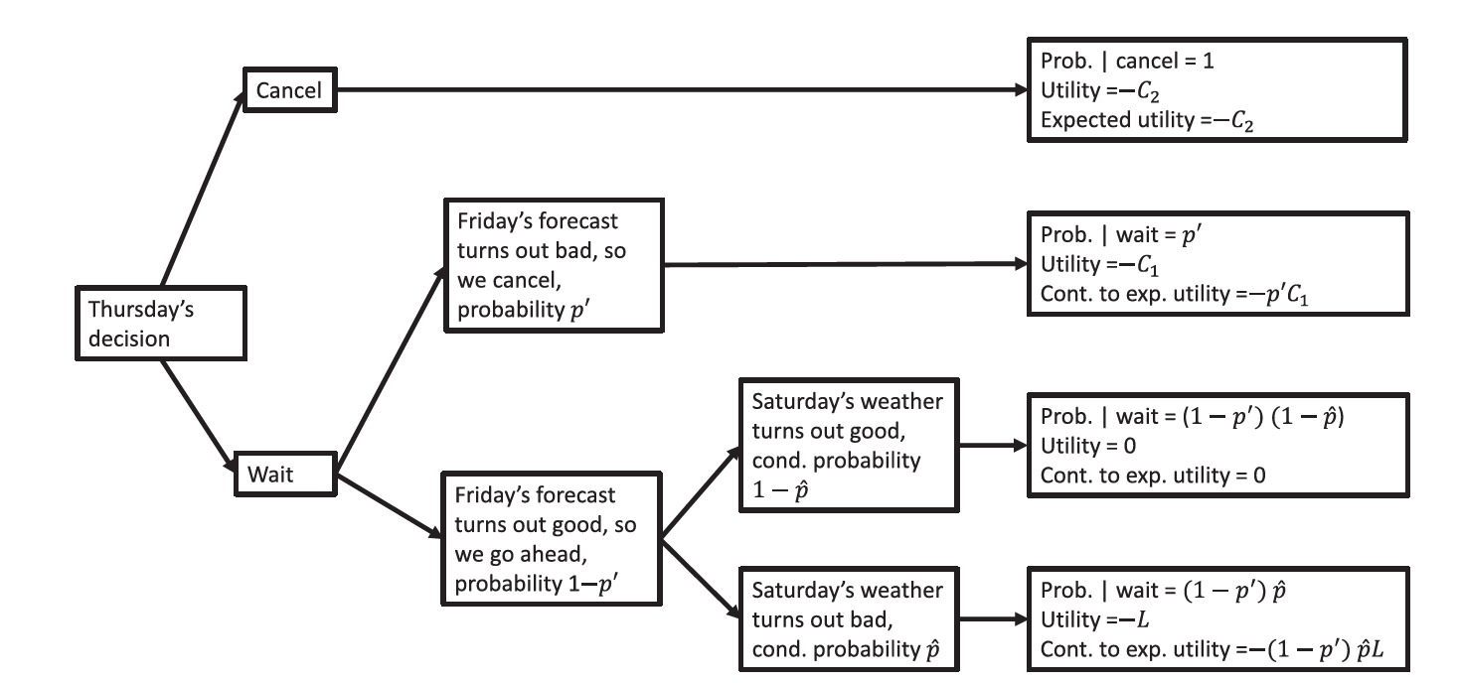
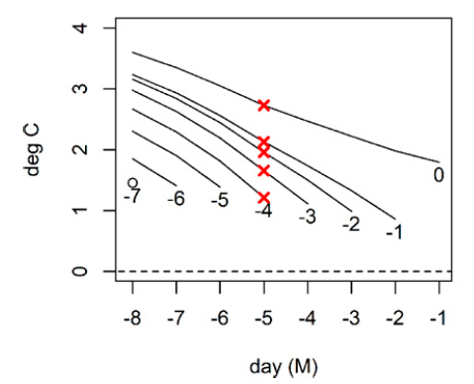
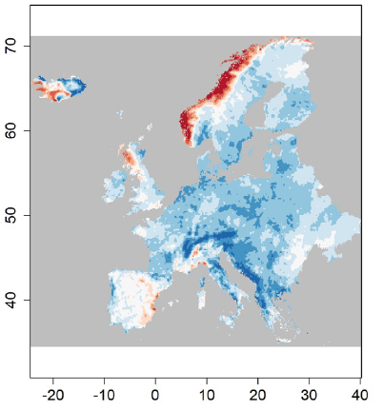
Lambda Climate Research
Climate Modelling
Cat Model Simulation
Peer-reviewed, published research into cat risk, climate and statistics for the insurance industry
Flood modelling
Trend
Estimation
Statistical Modelling
Hurricanes and TCs
Decision making
stephen.jewson@gmail.com // publications at www.stephenjewson.com // research updates on Linkedin.

Slide 3
Understanding Extremes using Statistics
Lots of people use statistics to estimate extremes, and the impact of climate change
(images removed for copyright)

Slide 4
Publications on Climate Extremes
100s of academic papers
Whole academic journals
Several well-known text-books
National and international reports
(images removed for copyright)

Slide 5
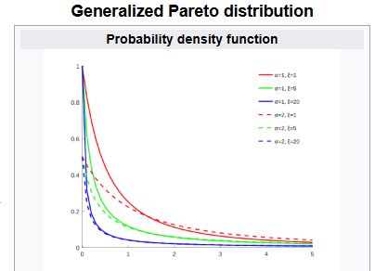
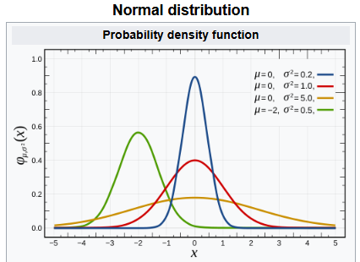
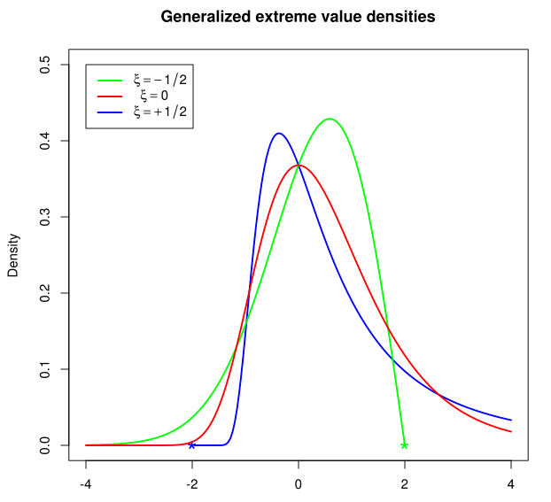
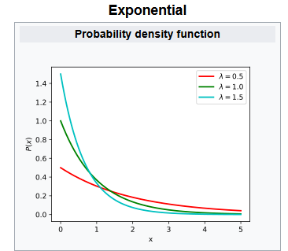
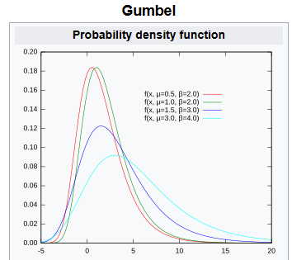
Distribution Types
Most studies in this area use one of the following statistical distributions:
GPD
GEV

Slide 6
Maximum Likelihood
And most studies fit those distributions using a method called maximum likelihood
which fits the data as well as possible
(images removed for copyright)

Slide 7
Does it work (for our purposes)? Let’s test it
One million sets of testing data
One million sets of training data
VS
Question: does the 1 in 100 year event we calculate really occur 1% of the time?

Slide 8
The results are in (normal, n=10)
What maximum likelihood says the probability is | What the probability actually is | Conclusion
10% | 13.8% | Huh.
1% | 3.2% | Hang on.
0.1% | 1.0% | Ouch.
It turns out, maximum likelihood doesn’t work for extremes.

Slide 9
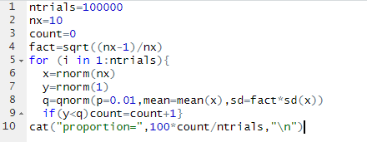
The code for that test…

Slide 10
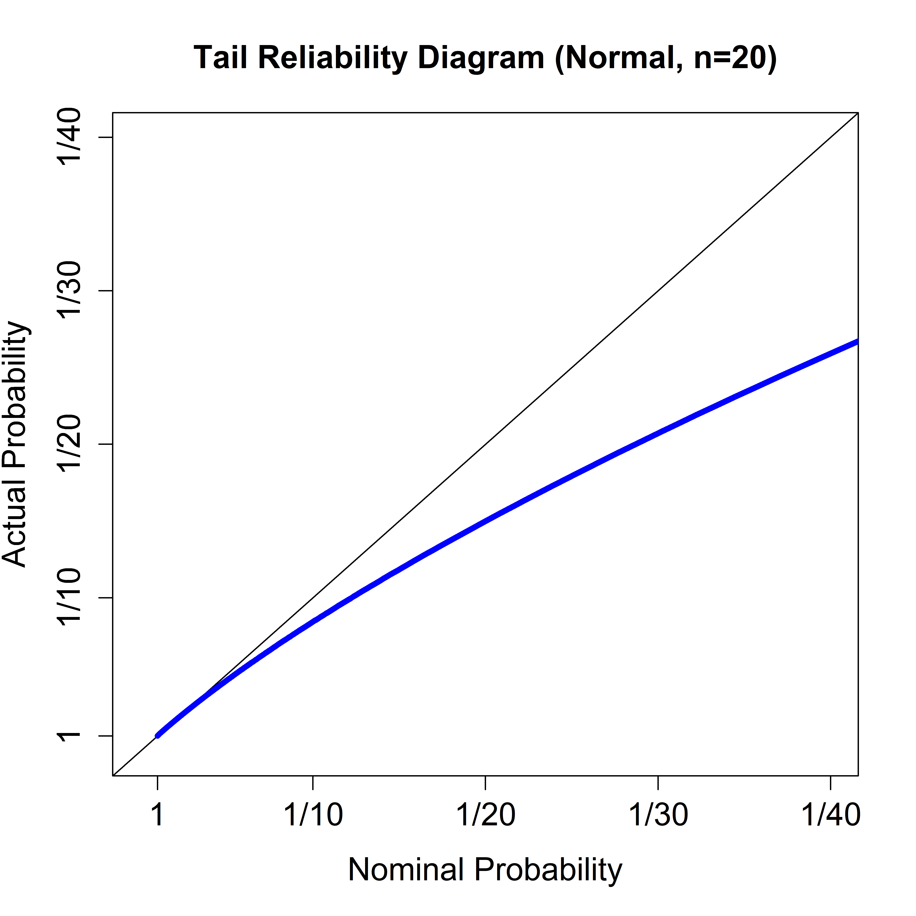
Extremes using statistical methods
This is the problem
What you got
What you asked for

Slide 11
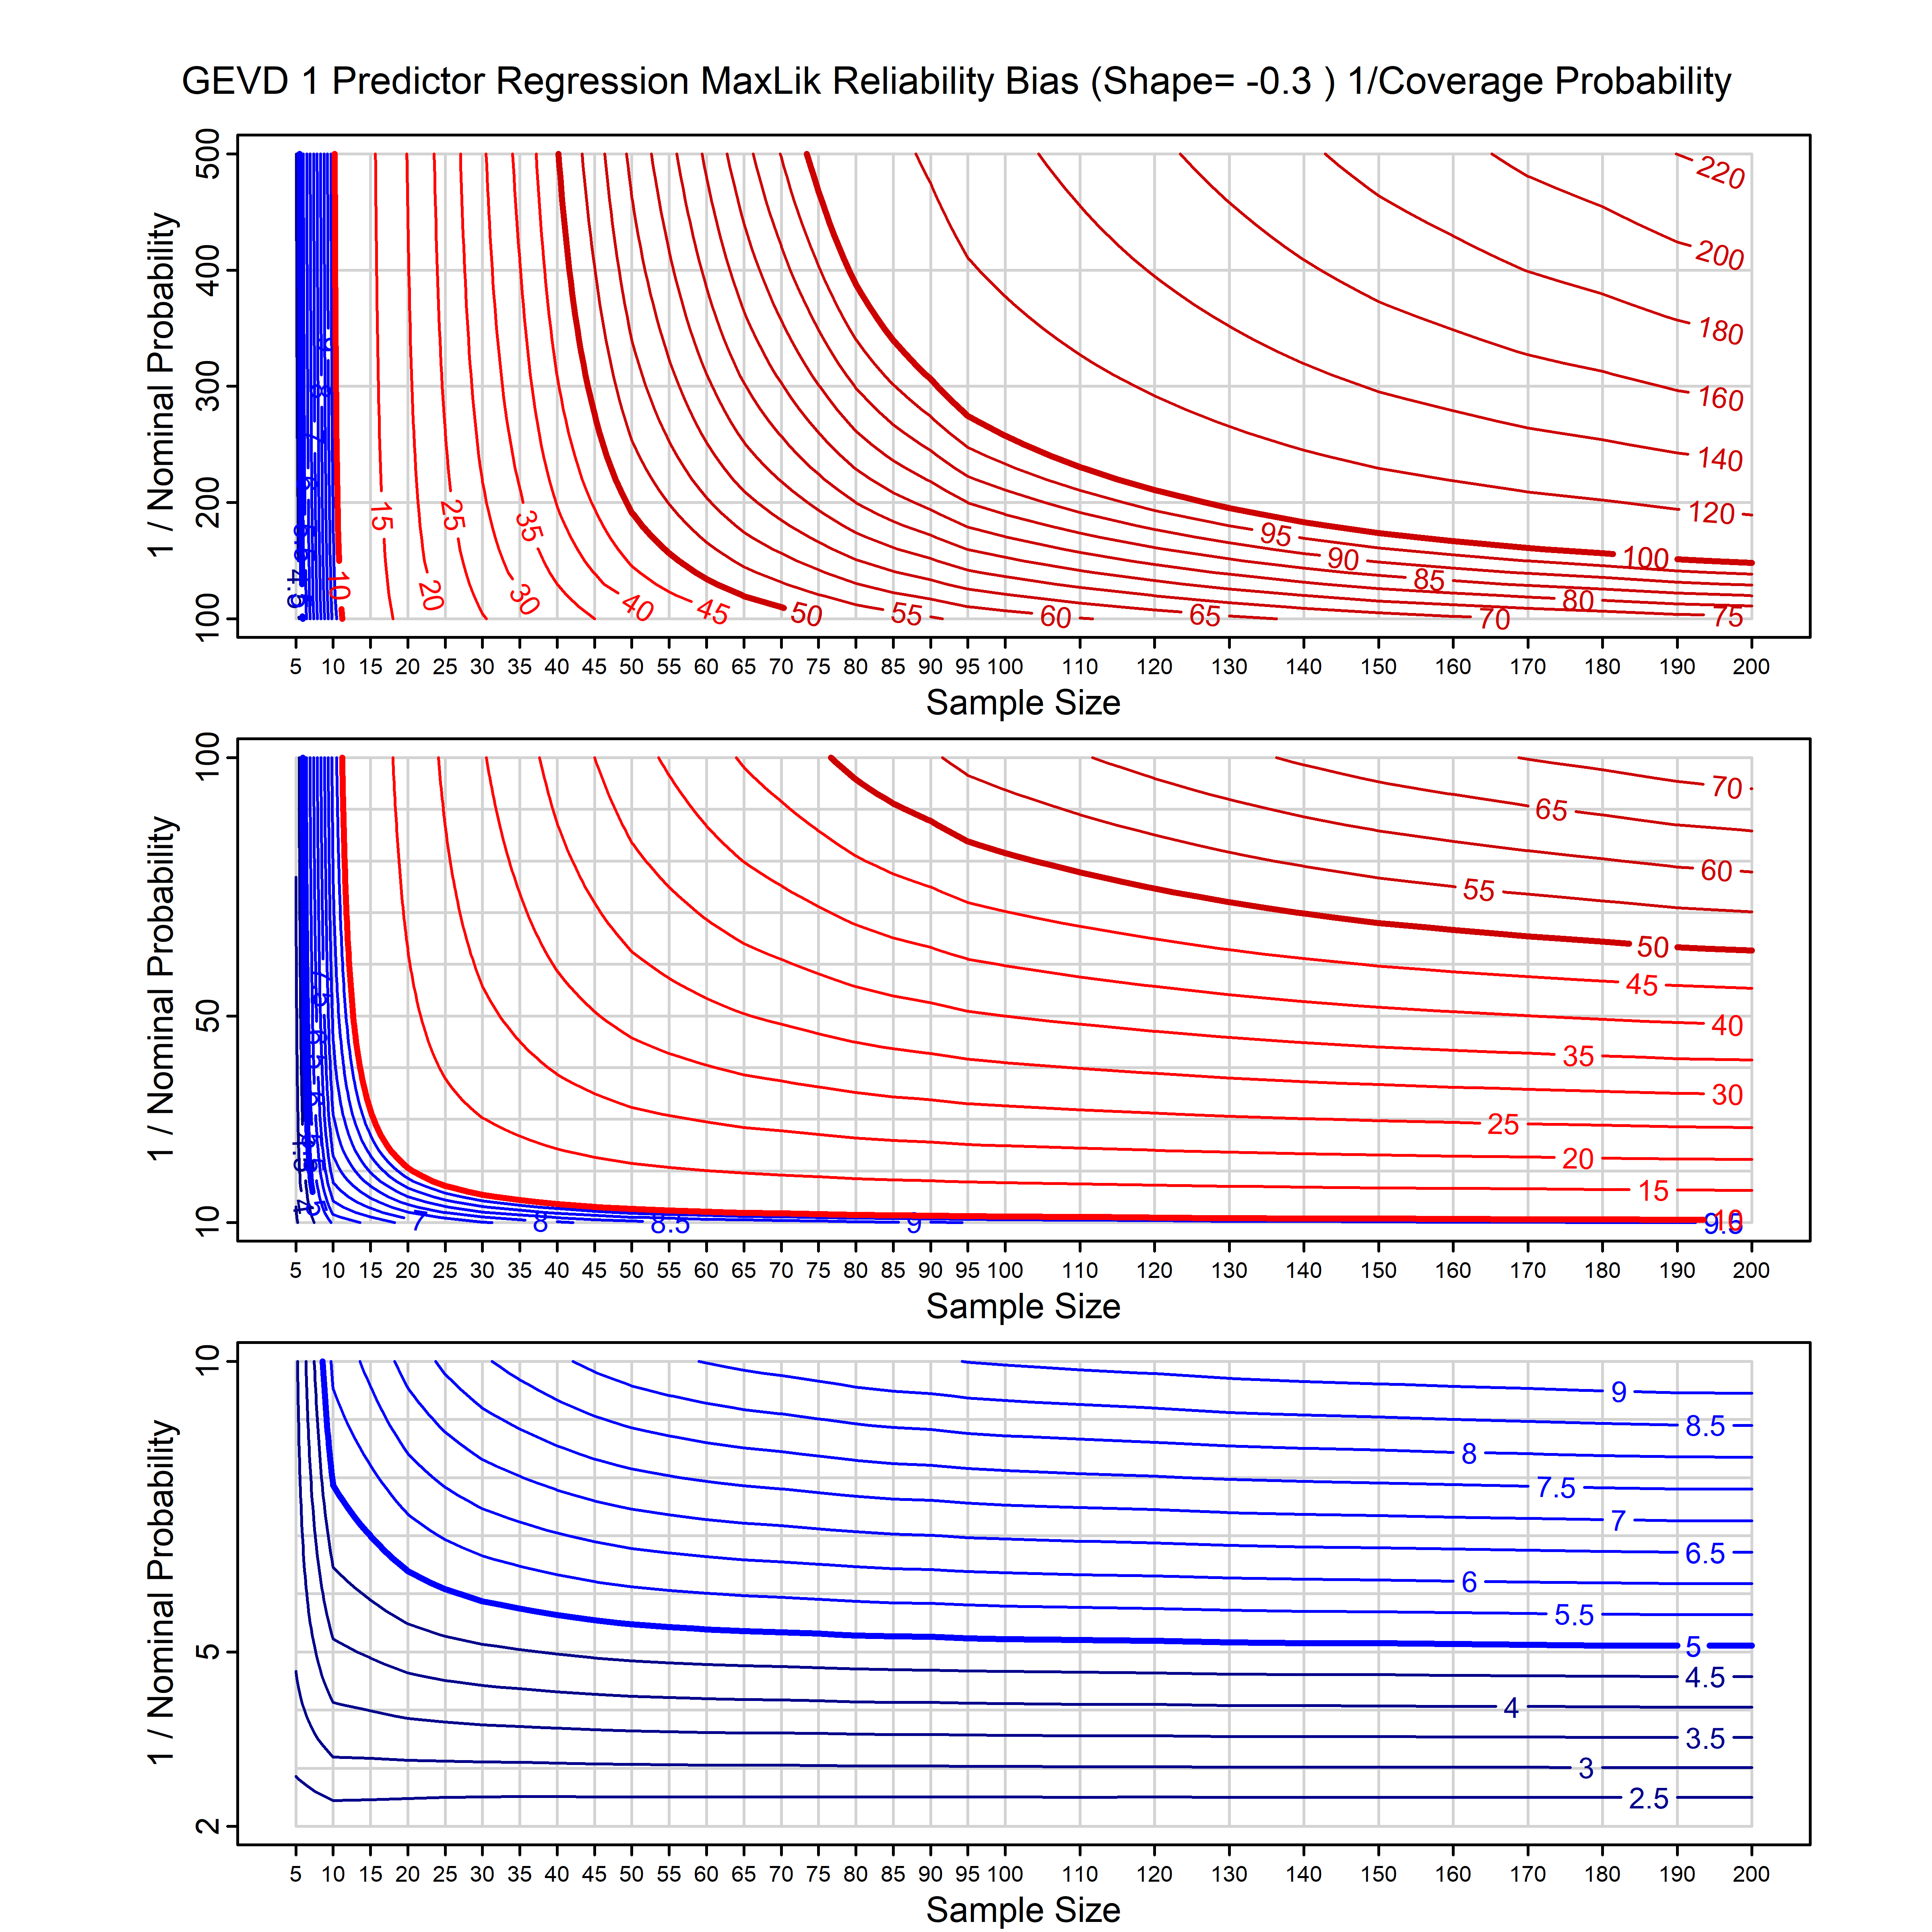
Extremes using statistical methods
The worst situations are when:
You don’t have much data
Your model has lots of parameters
You look at the tail
Charts allow you to figure out bad it is
GEV1: 50 data points: 200yr RP is actually the 50yr RP
Ouch.

Slide 12
Our solution: calibrating prior prediction
Technical Details
Bayesian
And choose the prior to try and fix this

Slide 13
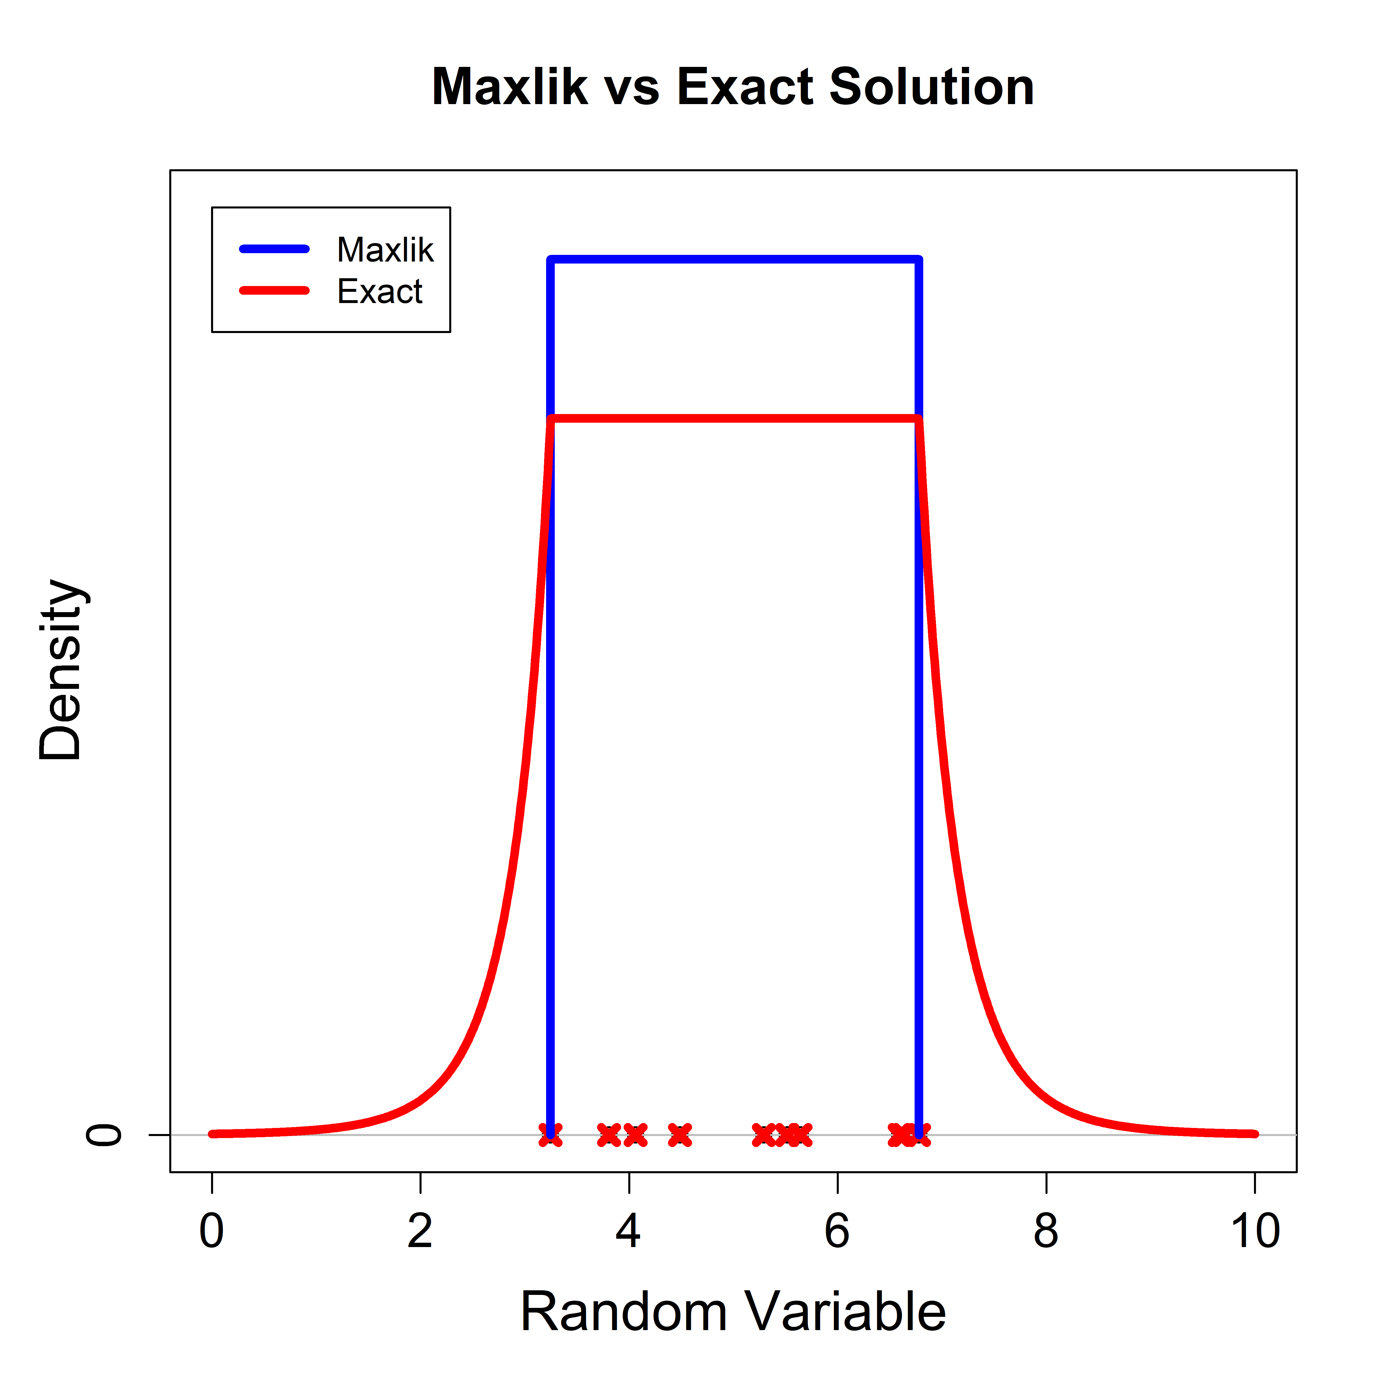
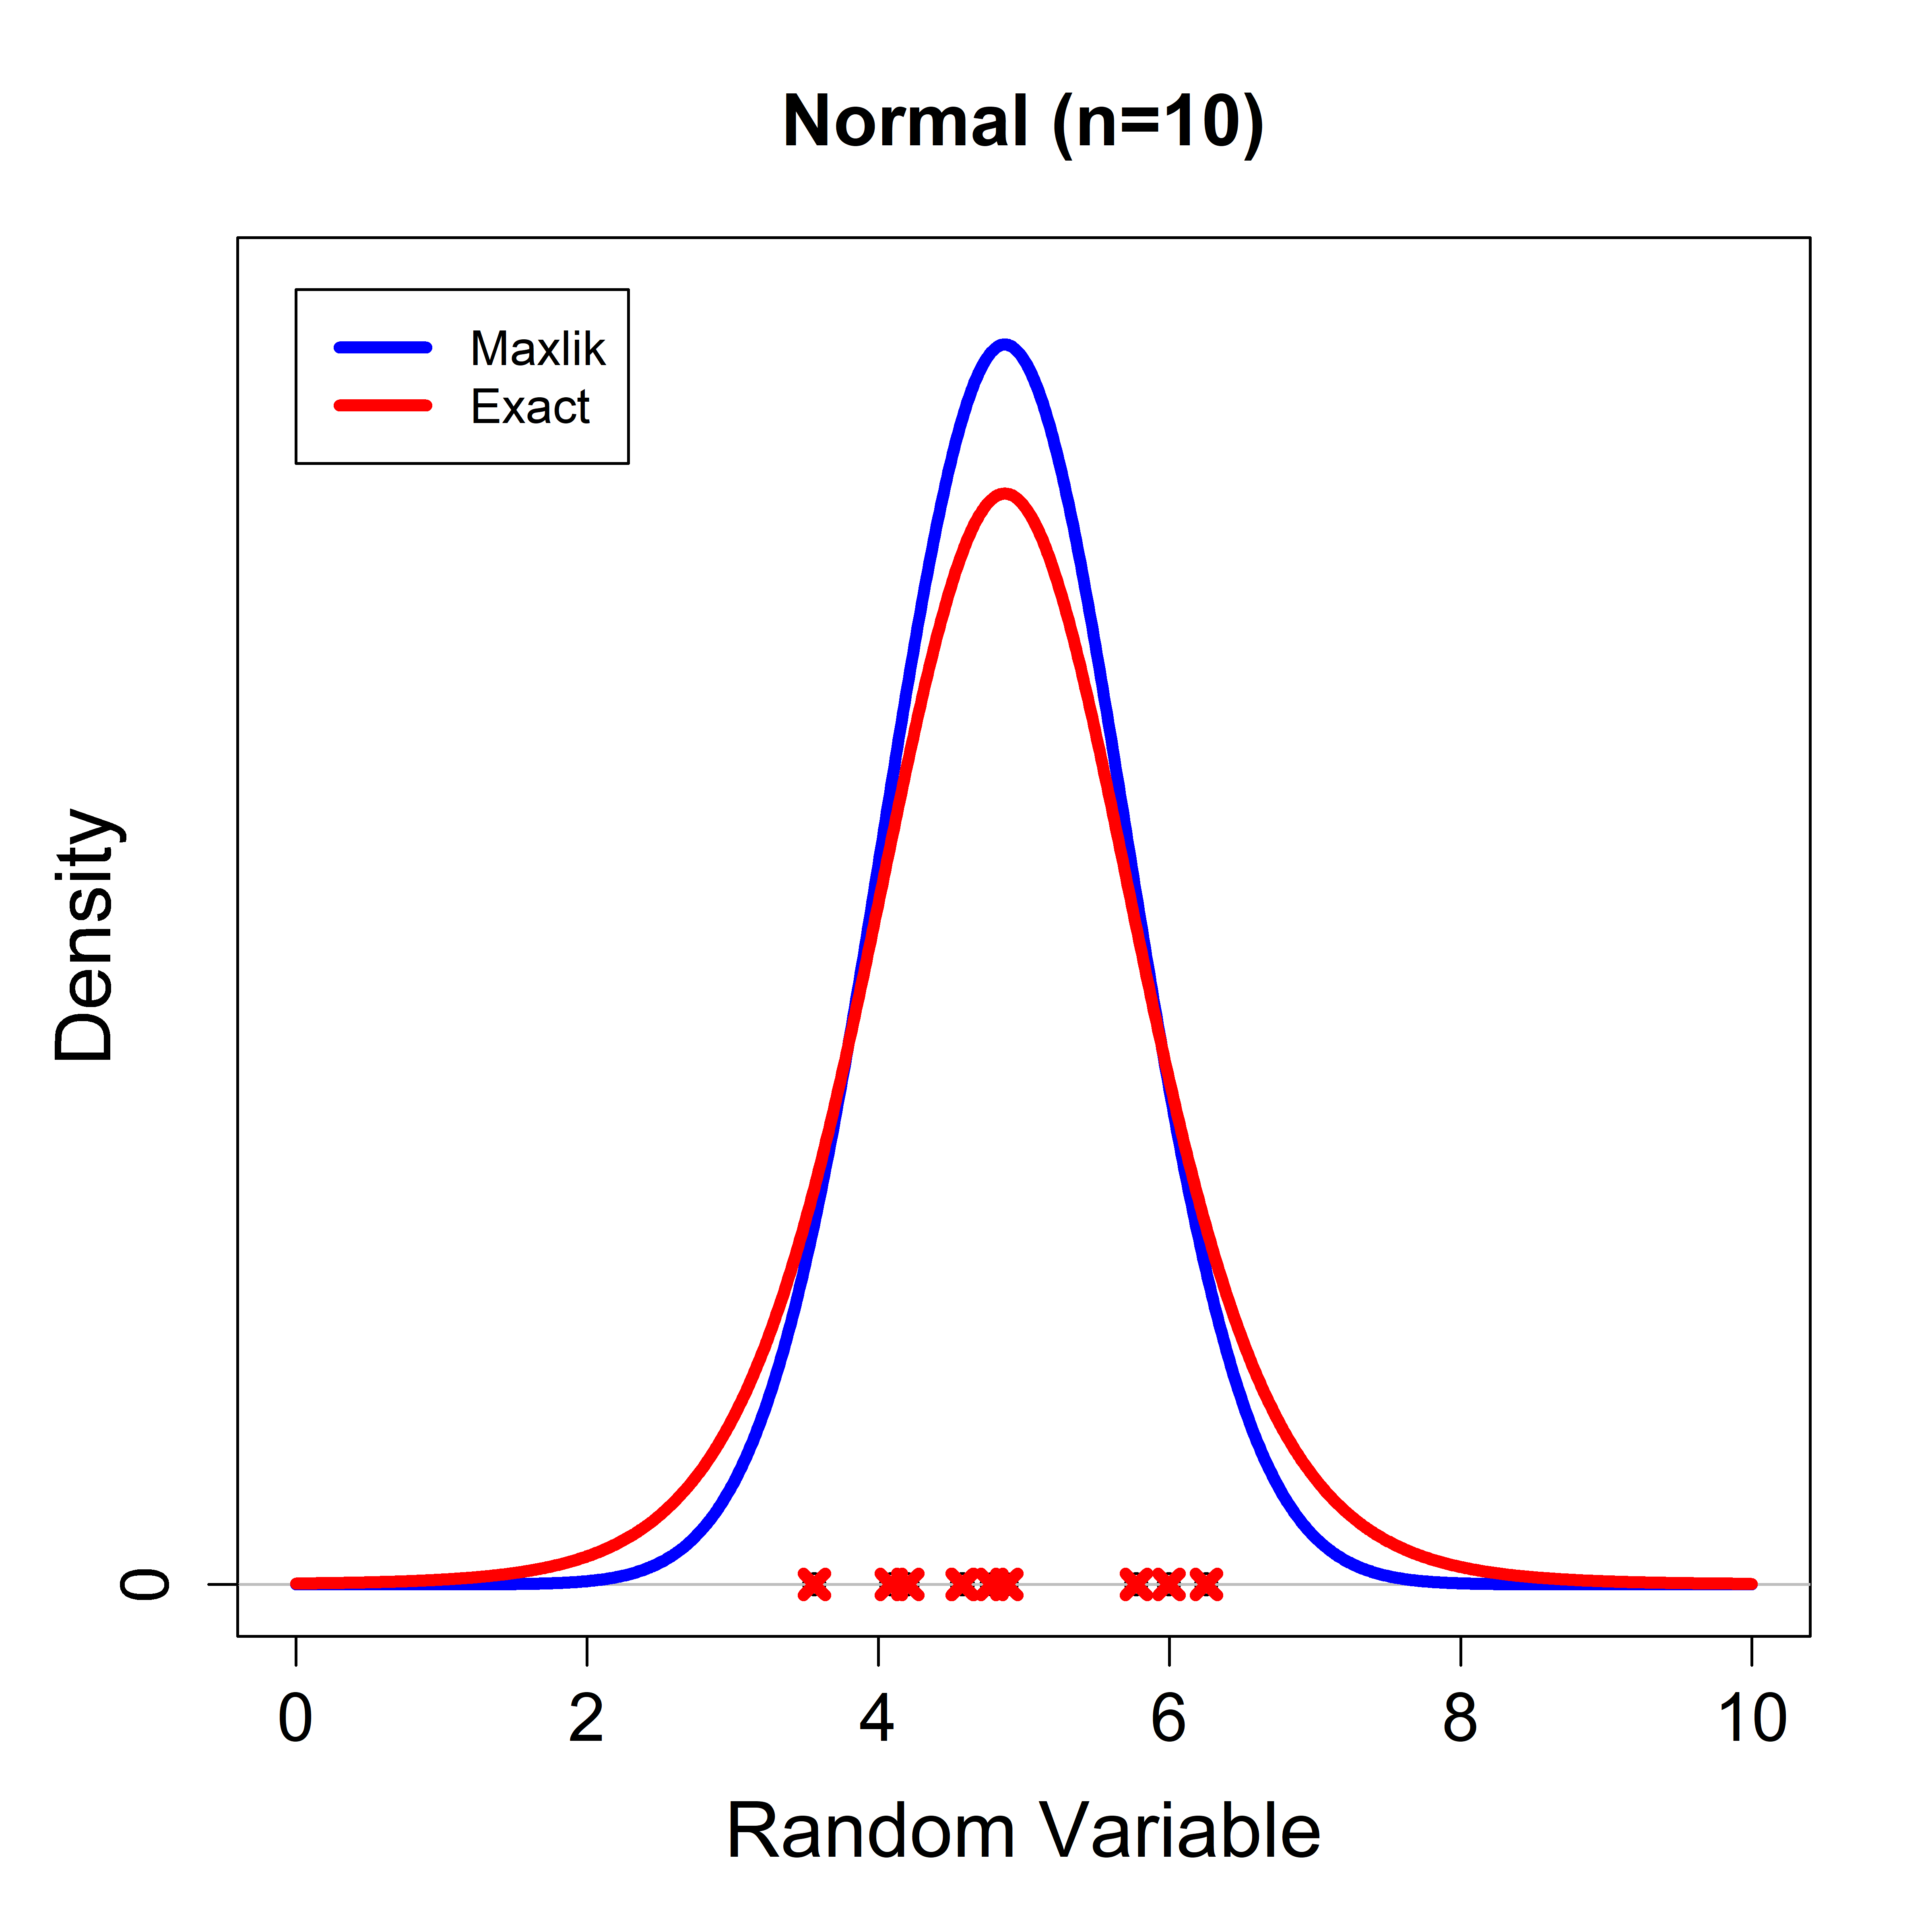
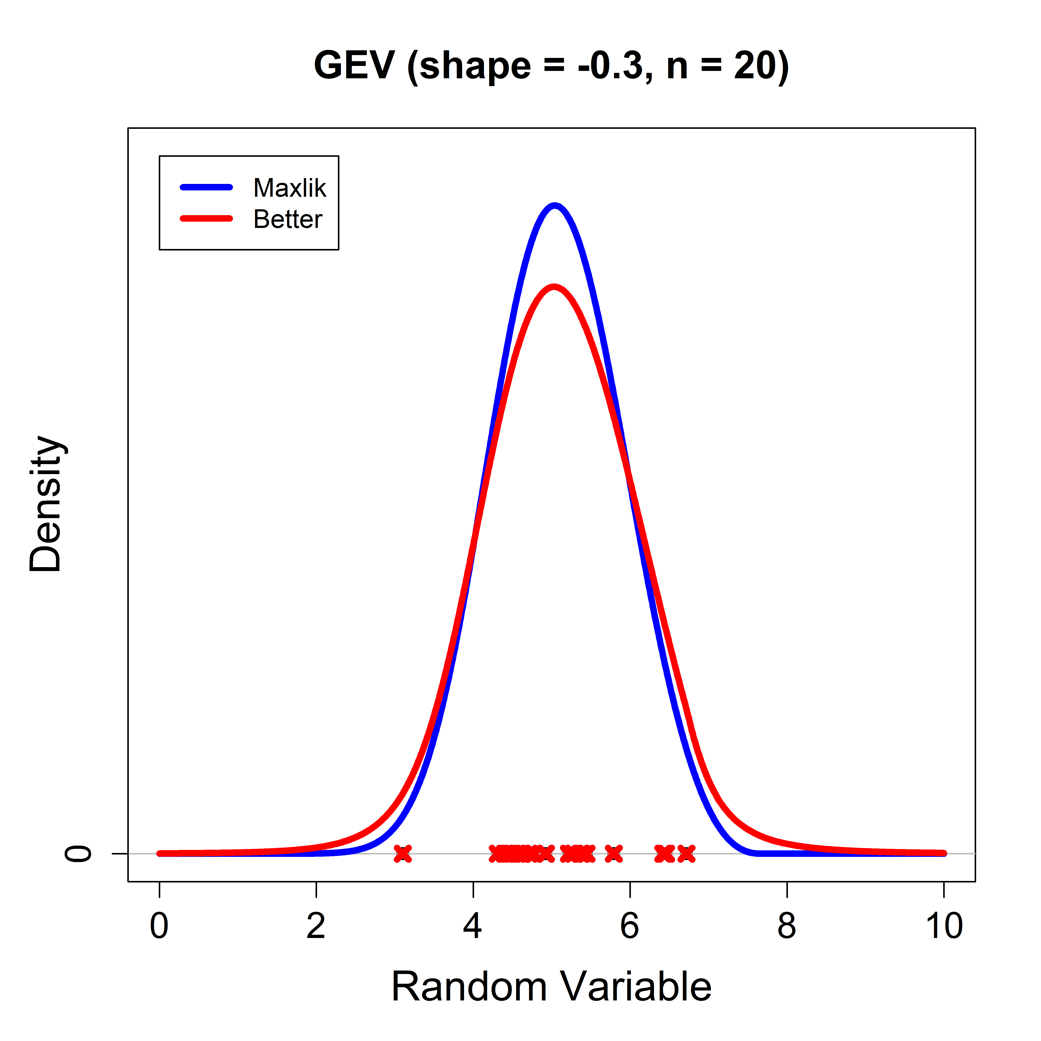
Examples
Uniform
Normal
GEV

Slide 14
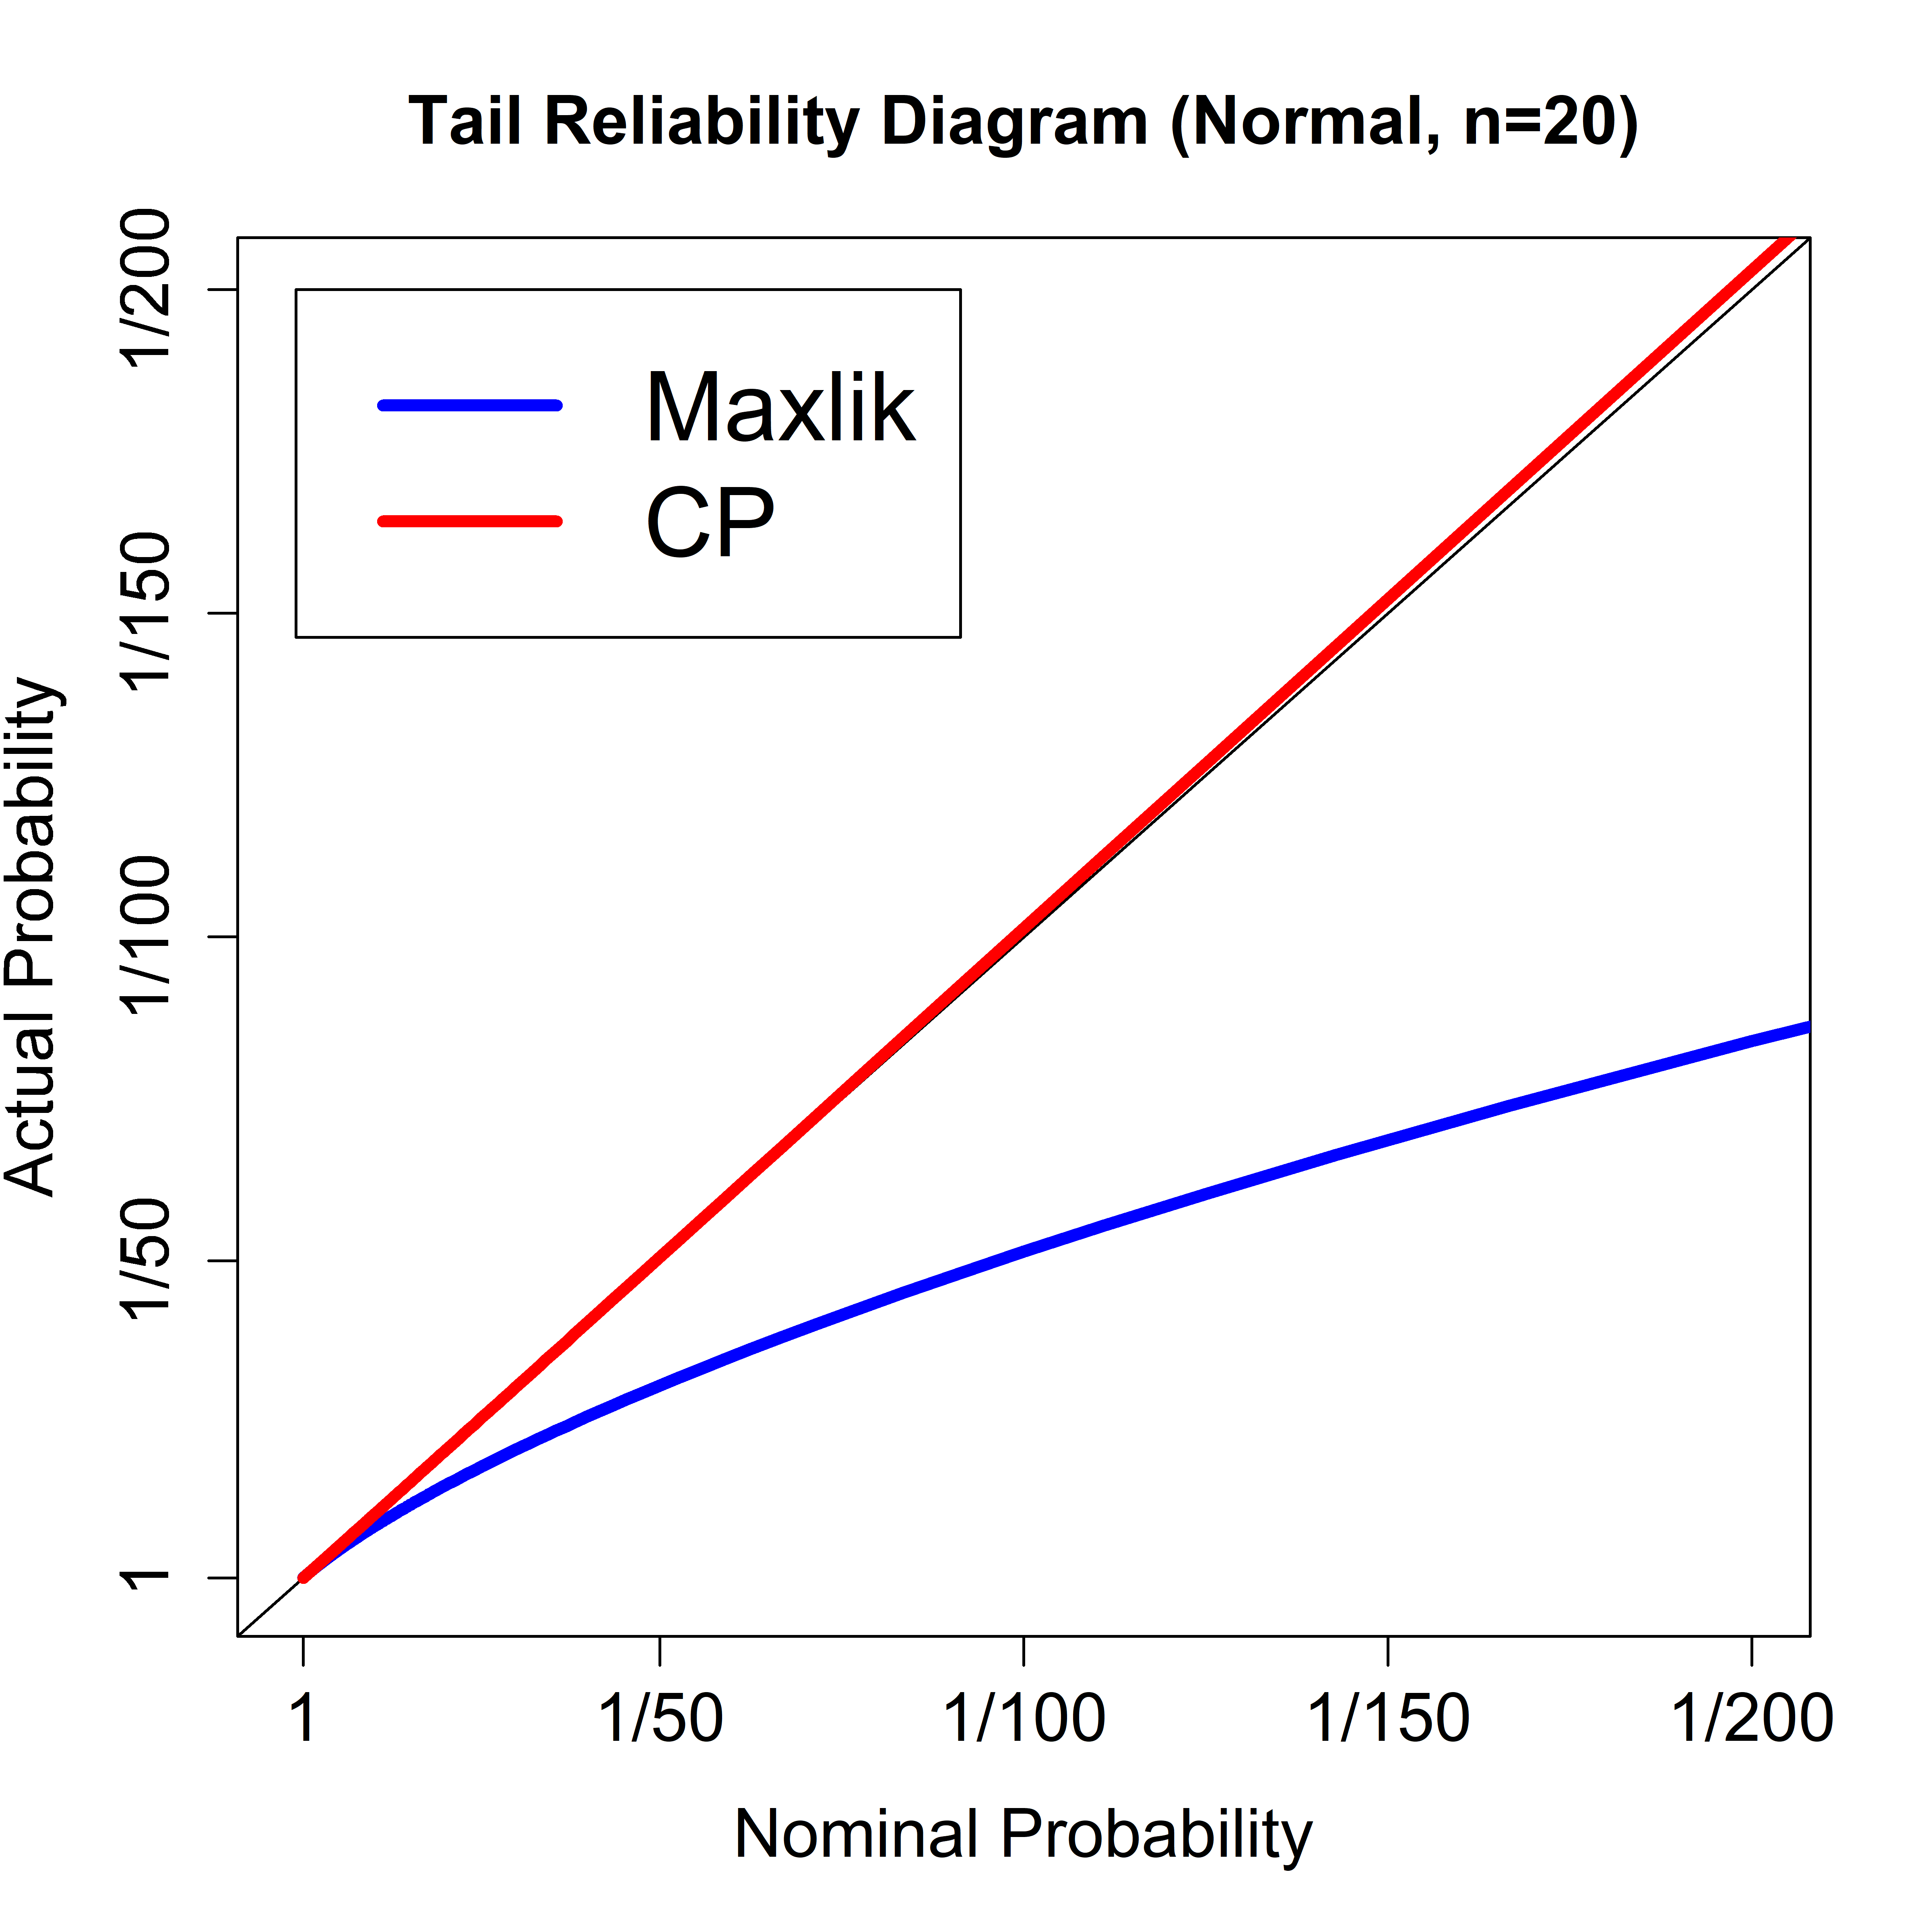
Example 1: Fixing the Normal Distribution
What you got
What you asked for

Slide 15
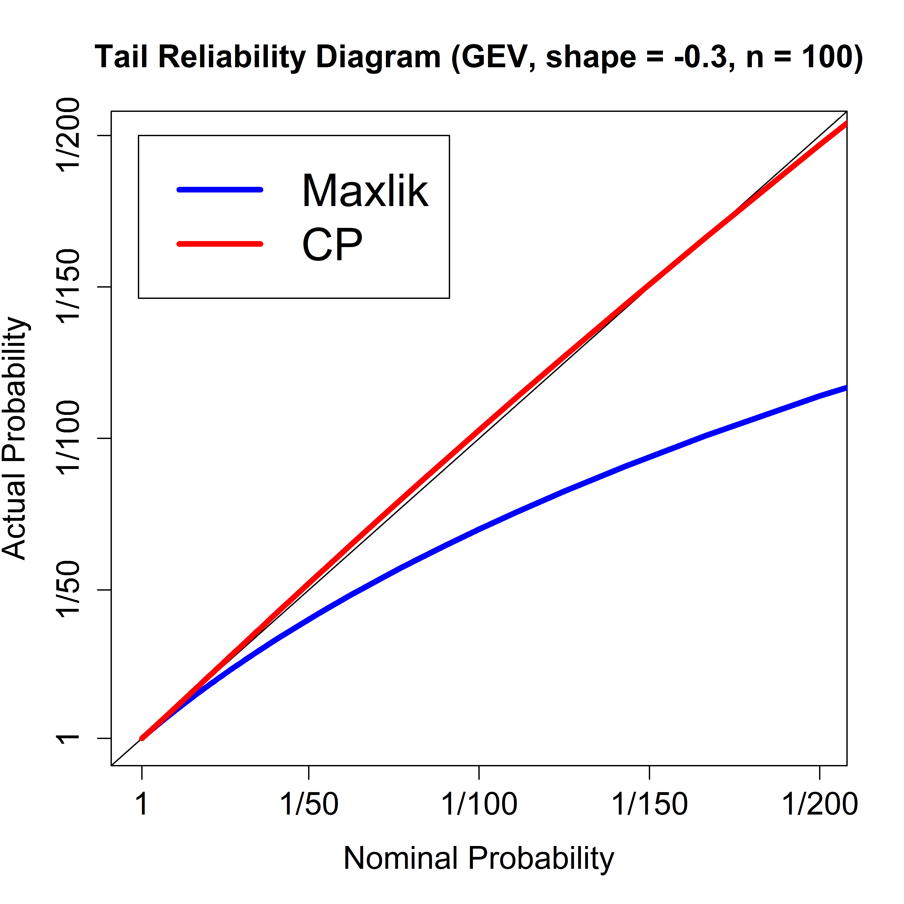
Example 2: Fixing the GEV Distribution
What you got
What you asked for

Slide 16
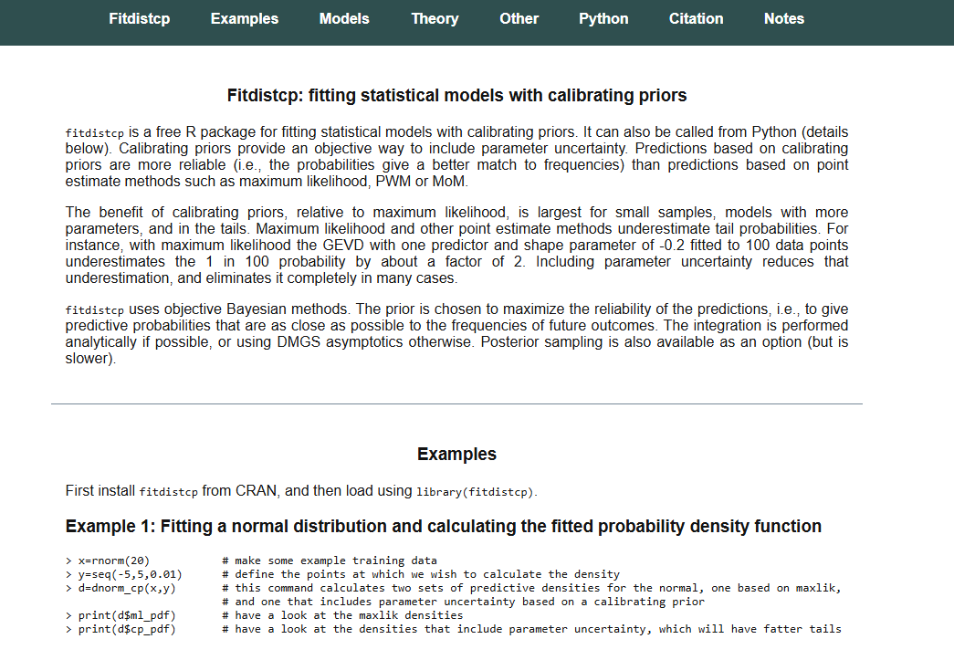
Fitdistcp software package
https://fitdistcp.info
Python version due summer 2025

Slide 17
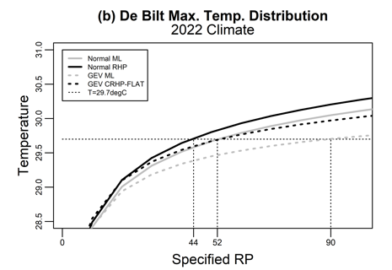
Case Study
De Bilt 2018 heatwave temperature EP curves
Calibrating prior
Maxlik

Slide 18
Examples
De Bilt 2018 heatwave: impact of climate change
 | RP without climate change | RP with climate change | Impact of climate change
Maximum likelihood | 1 million yrs + | 90 yrs | 10,000+ times more likely
Calibrating prior | 4000 yrs | 50 yrs | 80 times more likely

Slide 19
Conclusion
Maximum likelihood underestimates extremes, overestimates climate change.
So don’t use maximum likelihood
And ignore studies that used maximum likelihood.
Use calibrating prior prediction instead.

Slide 20
End

