Slide 1


"In today's complex and fast-moving world, what we need even more than foresight or hindsight is insight"
Established as a not-for-profit Company in 2012

Slide 2

Harriet Smith​
Head of Community Engagement
Wifi: Glaziers-Hall-Wifi
Passkey : event123
Exhibitor booths
Food and Refreshments
Emergency Exits
Toilets
Slido and App
Chatham House Rules
Anti- competitive trust policy
https://oasislmf.org/anti-competitive-trust-policy)

Slide 3
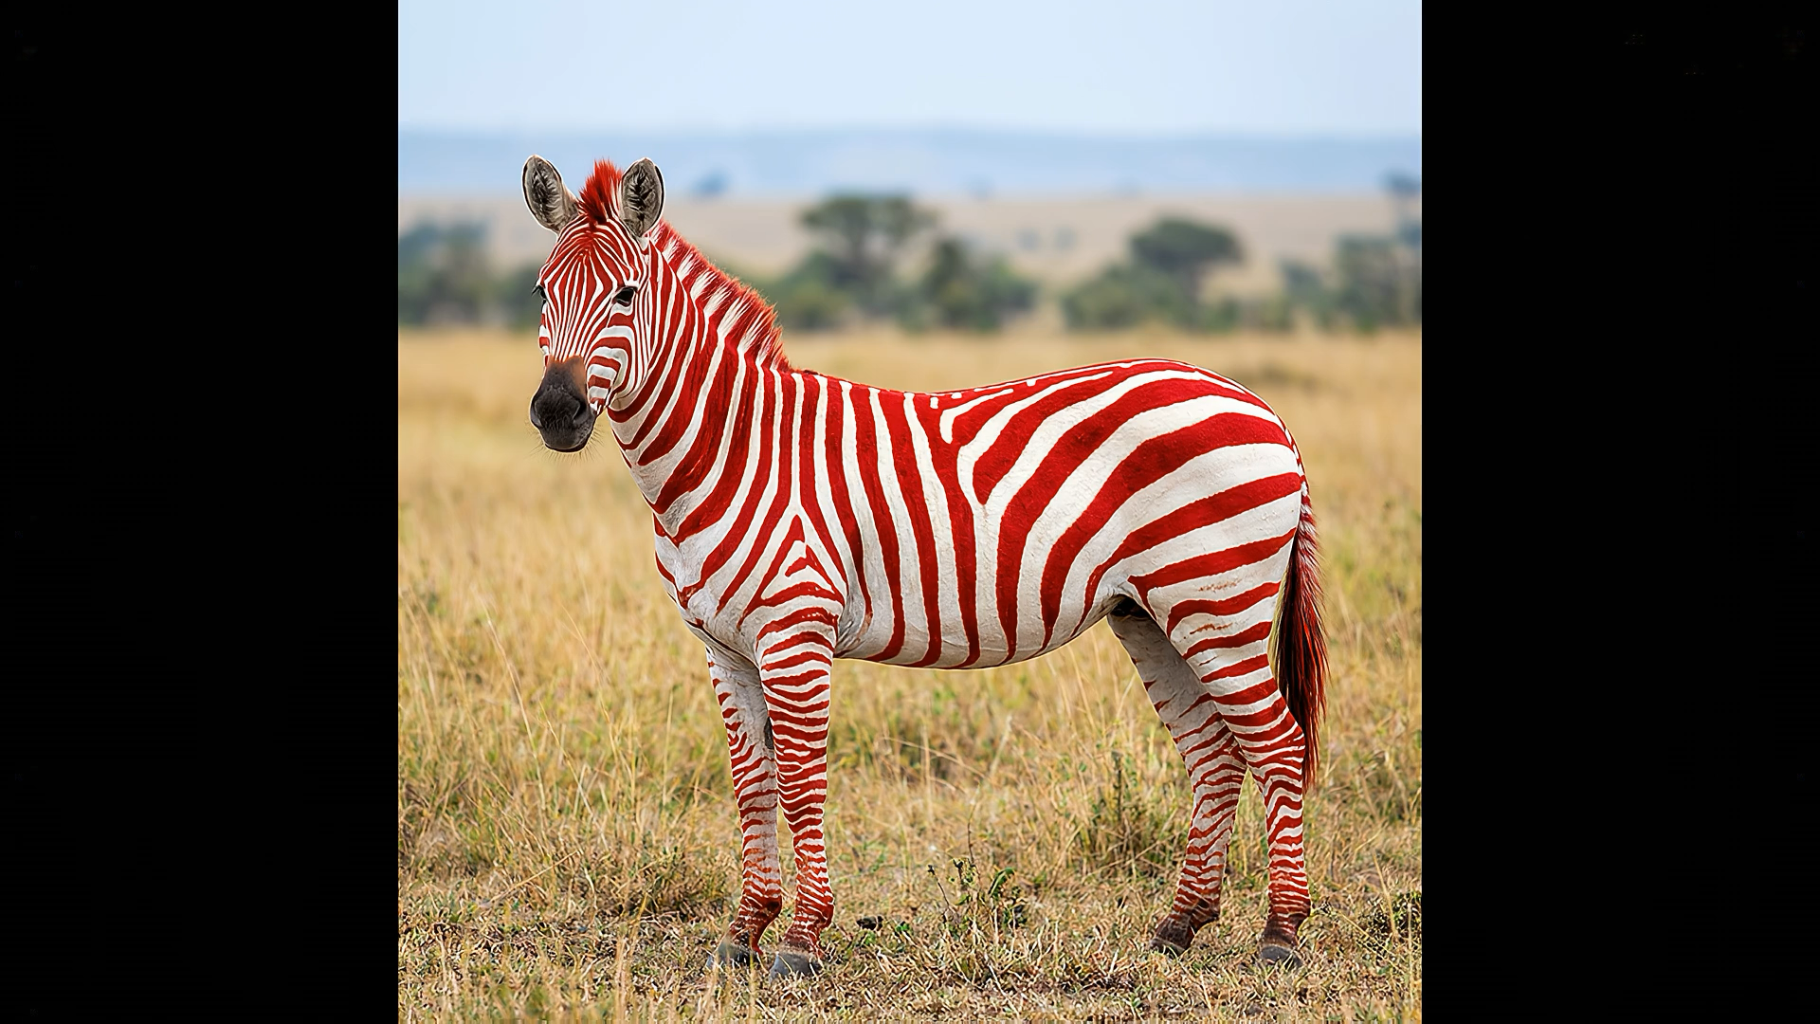
The 3 Questions we all ask……

Slide 4



The 3 Questions we all ask
To find our sense of purpose, solve real problems, and drive meaningful innovation
What are the key challenges we need to resolve?
What are the key opportunities we would like to grasp?
What role should we take — and who else should we involve?
Identifying the barriers and friction points that hold the industry back from progress
Discovering the possibilities that innovation and new thinking can unlock
Defining our place in the ecosystem and building the right partnerships

Slide 5



The Power of Collaboration
Cross-Industry Collaboration
Working together with reinsurers, insurers, modellers, and academics to tackle shared challenges
When we do this collaboratively with others across the industry, we unlock the power of pre -competitive collaboration — the best way to realise innovation for complex problems.
Shared Innovation
Pooling knowledge and resources to solve complex problems none of us could solve alone
Reducing Barriers
Breaking down silos and removing obstacles to entry so the best ideas can flourish

Slide 6




A Catalyst for Change- with Oasis LMF
Oasis started with a goal to be a catalyst for change, to reduce barriers to entry and to be a vehicle for change.
Driven by purpose not profit and to be a focus for others, for you, to change the industry we work in… before someone else does."
Catalyst
for Change
Reduce
Barriers
Vehicle for
Innovation
Focus for
Collaboration

Slide 7
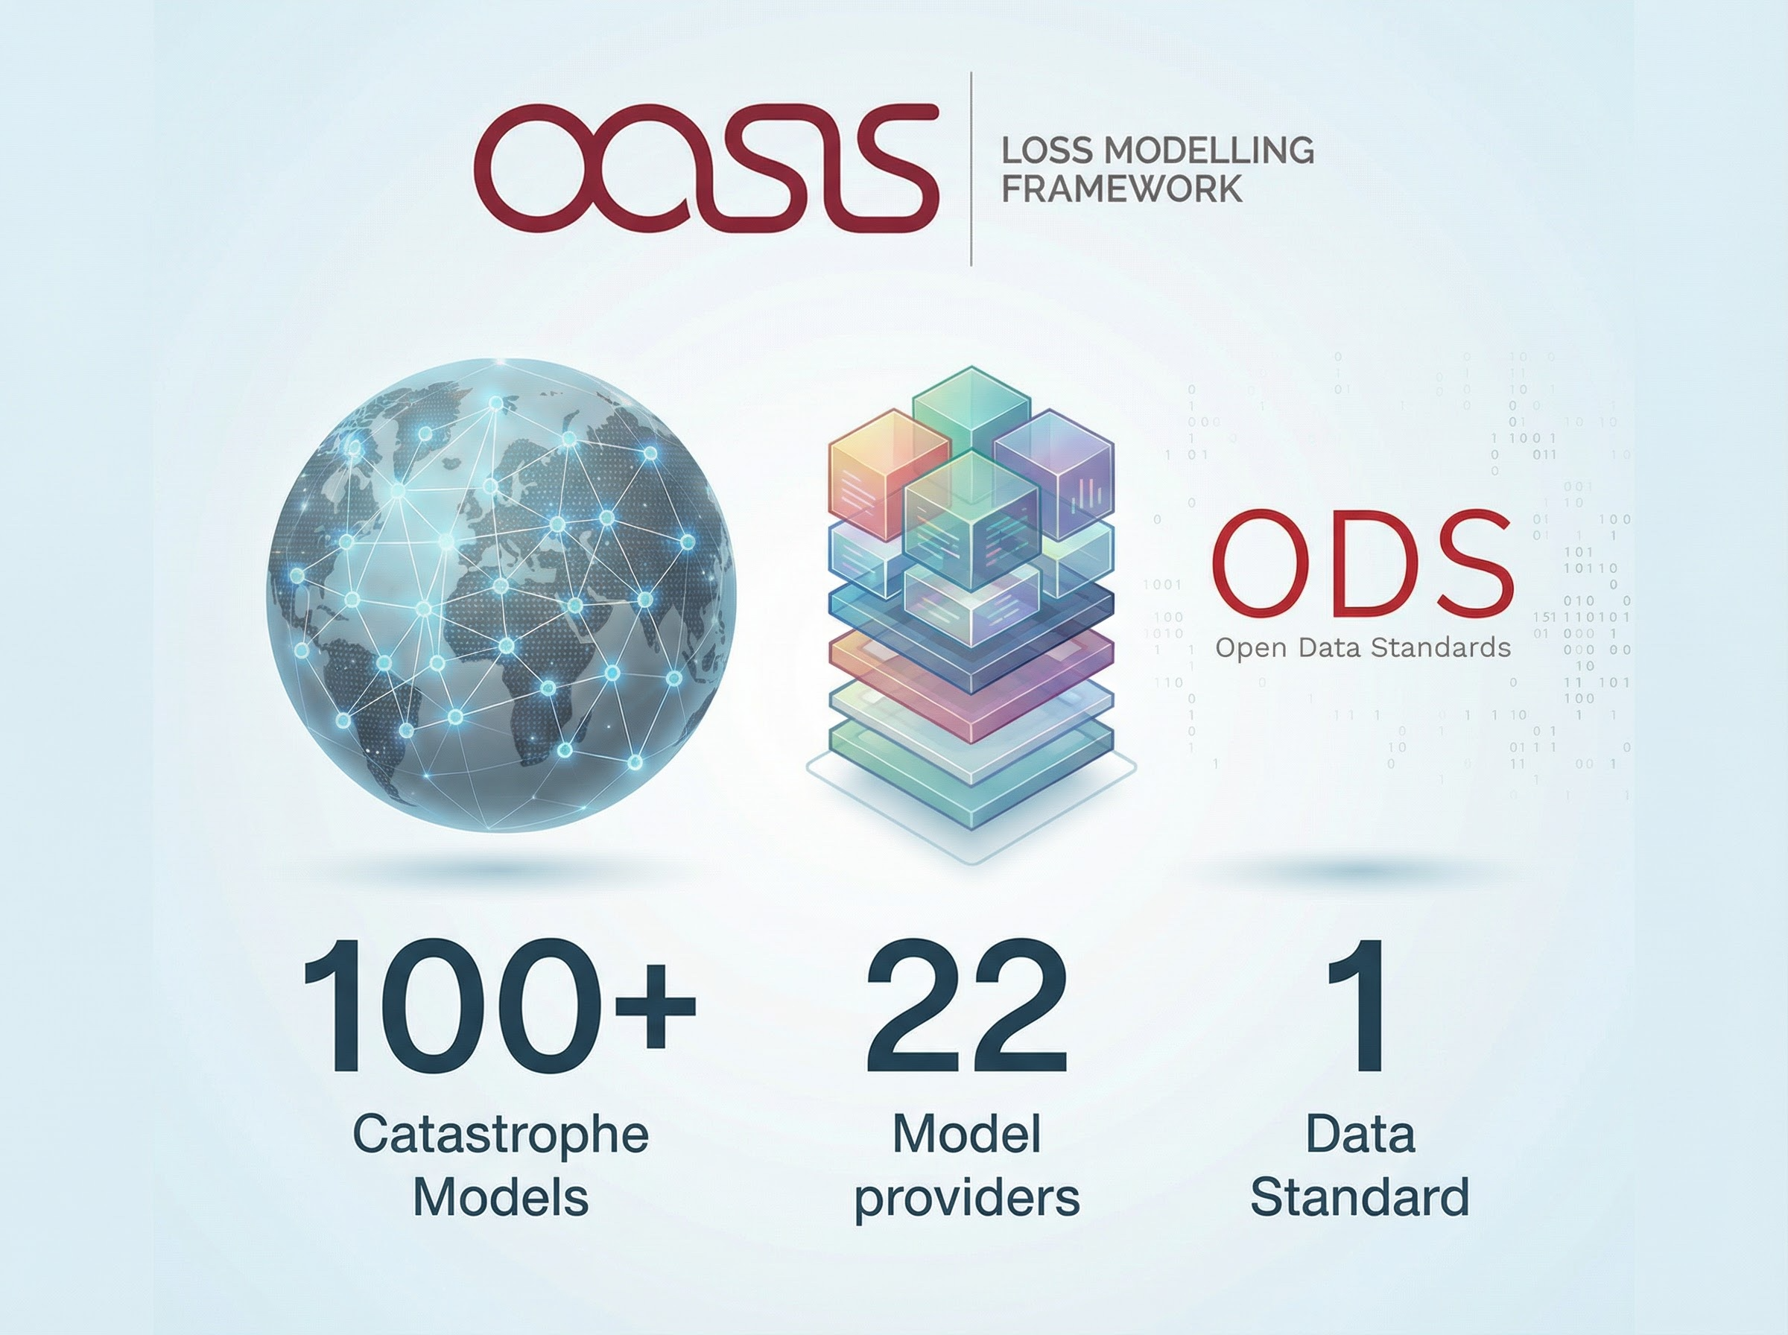
One open exposure data standard for all modelers
There are multiple ways to deploy Oasis..
Notes:
In the 14 years since we started Oasis we have over 100 models from 22 and one data standard ..deployed in most systems.

Slide 8
PURPOSE
over Profit
1
Sense of purpose — knowing why we exist and what drives us forward
2
Solving problems — addressing the real challenges facing our industry
3
Driving innovation — doing things differently, together, before someone else does
Change the industry we work in… before someone else does.

Slide 9
























Slide 10

Changing the landscape of catastrophe modelling
OASIS MEMBERSHIP
Established as a not-for-profit Company in 2012

