Slide 1
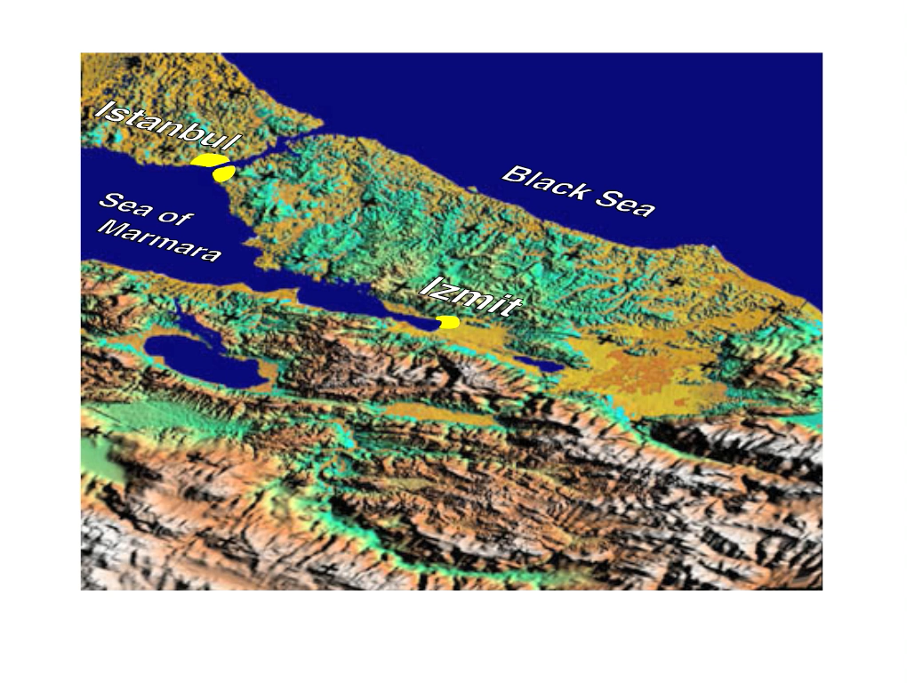
Let me explain how one quake can promote or inhibit other quakes

Slide 2
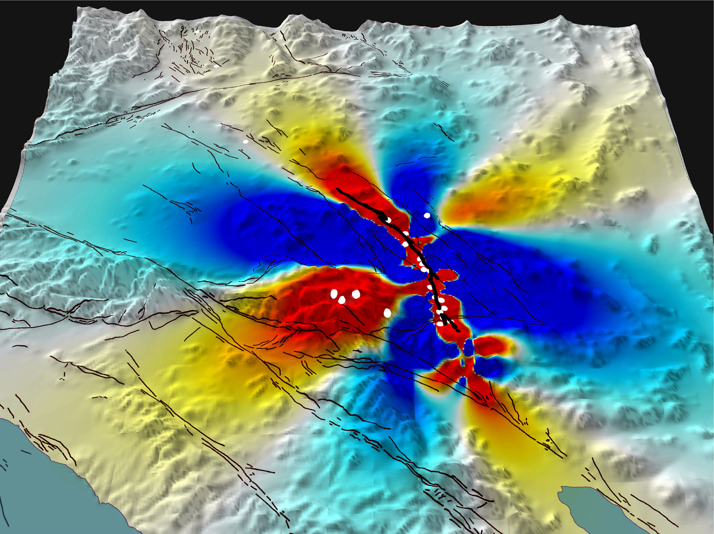
Earthquakes converse by
the transfer
of stress
1992 M 7.3 Landers shock
increases stress
at Big Bear
SAN ANDREAS
1992 M 7.3 Landers
Big
Bear
Los
Angeles
First 3 hr of Landers
aftershocks
plotted
SAN ANDREAS
from
Stein (2003)

Slide 3

Earthquakes converse by
the transfer
of stress
Over time scales of minutes to decades
1992 M=7.3 Landers shock
promotes the M=6.5 Big
Bear shock 3 hr later
1992 M 7.3 Landers shock
increases stress at
Hector Mine
SAN ANDREAS
Landers
1992 M 7.3 Landers
Big Bear
Big
Bear
M 6.5
3 hr later
Los
Angeles
Los
Angeles
First 3 hr of Landers
aftershocks
plotted
SAN ANDREAS
from
Stein (2003)
from
Stein (2003)

Slide 4
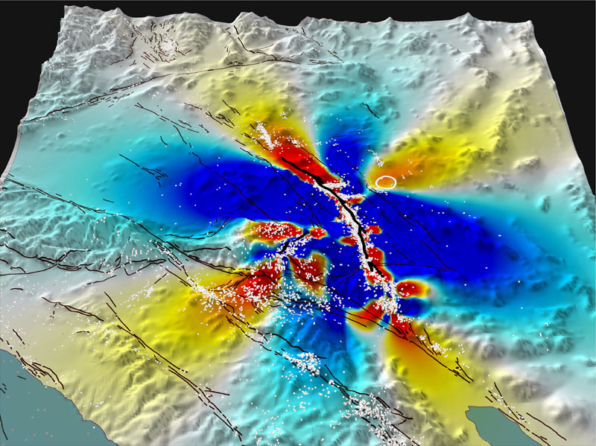
M 7.1 Ridgecrest
27 years later
Earthquakes converse by
the transfer
of stress
Over time scales of minutes to decades
As seen in aftershocks and
in progressive mainshocks
1992 M 7.3 Landers shock
increases stress
at Ridgecrest
M 7.1 Hector Mine
7 years later
SAN ANDREAS
Los
Angeles
SAN ANDREAS
from
Stein (2003)

Slide 5
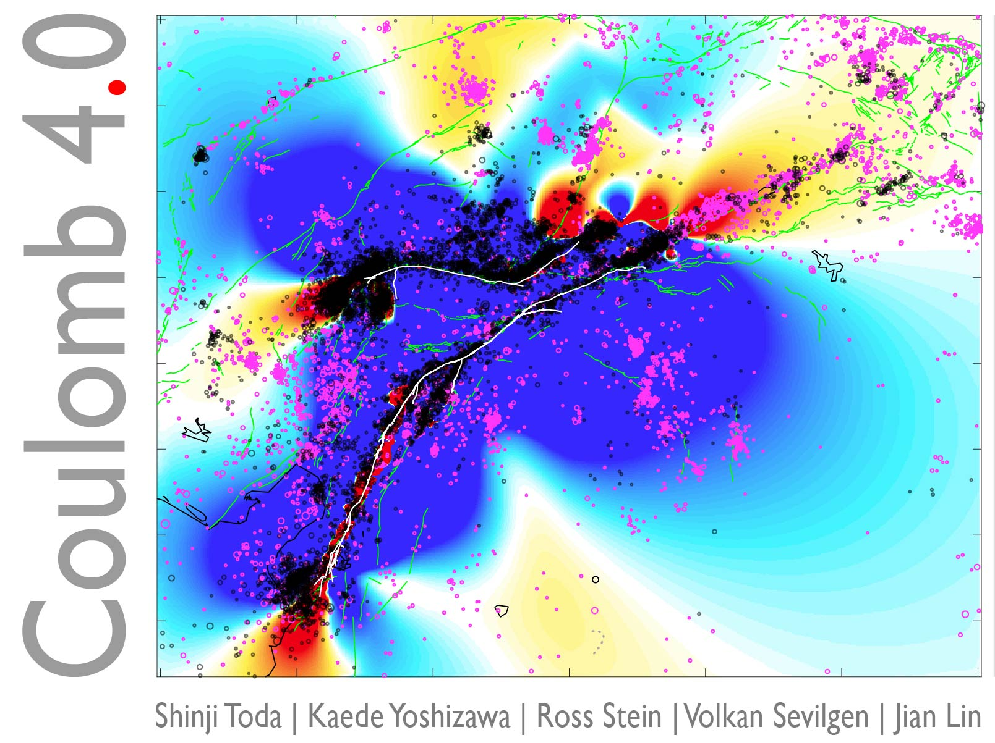
M 7.1 Ridgecrest
27 years later
Earthquakes converse by
the transfer
of stress
1992 M 7.3 Landers shock
increases stress
at Ridgecrest
M 7.1 Hector Mine
7 years later
Temblor publishes open source s/w
SAN ANDREAS
Los
Angeles
SAN ANDREAS
from
Stein (2003)

Slide 6
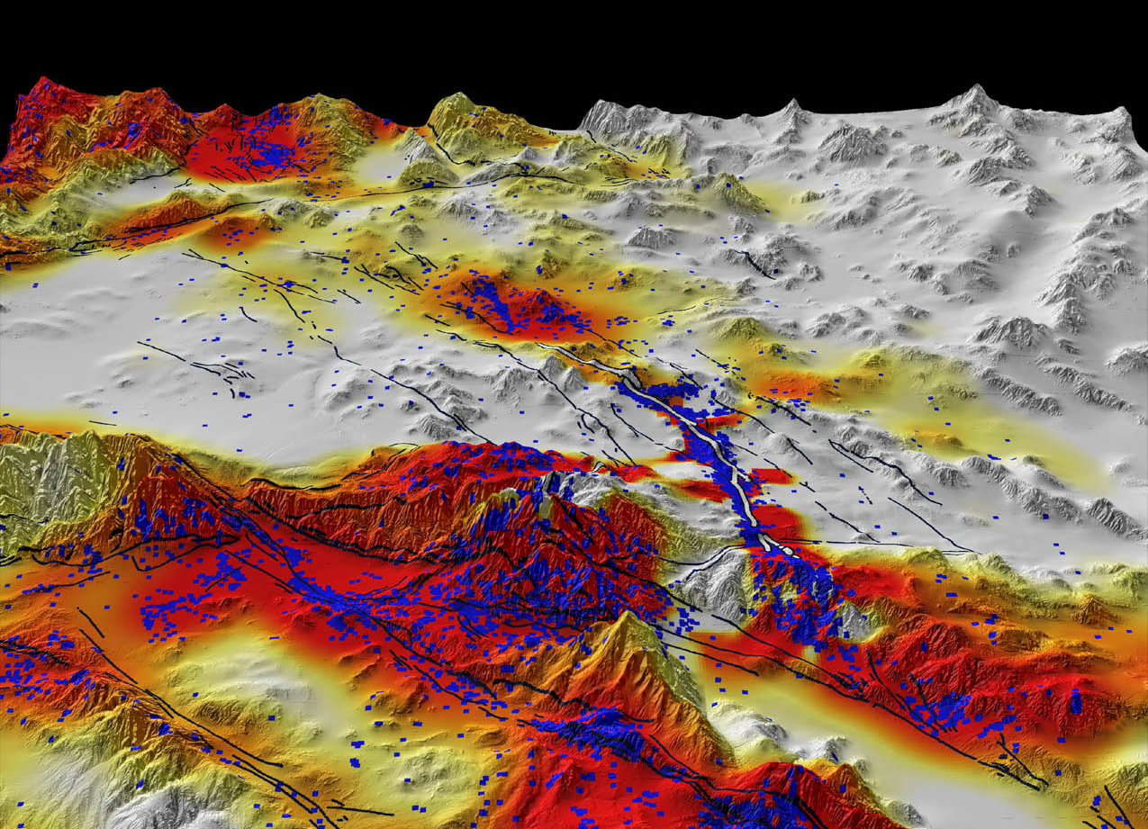


Temblor transforms stress changes into time-dependent seismicity forecasts
Forecast seismicity
High
Moderate
Low
Fault rupture
Aftershocks

Slide 7

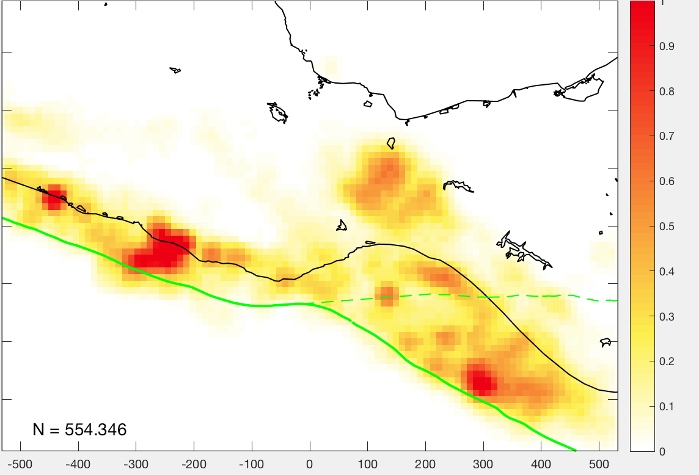
Background rate (quake rate before M 8.2 Tehuantepec shock)
Mexico
City
M≥4.0
2017 M 7.1
Number of shocks per cell per yr
Mexico
km
Notes:
First, every one of those focal mechanisms start out with some background rates.
>
Then it gets stress imparted by the main shock.
So some turns red, and some turns blue.
>
Then we run this through in seismicity rate equation in rate/state friction developed by Jim Dietrich and then what we get out of it is new rate.
All of those rates originally started out with one and have gotten modified.
Some are higher those of the red ones ,some are lower those of blue ones.
And these phenomena, the effect of those stress changes fade with time.
Aftershock behavior is represented by ta which is aftershock duration, and the stress effect which is represented by the Coulomb stress change, divided by Asigma which are rate/state constitutive parameters.

Slide 8
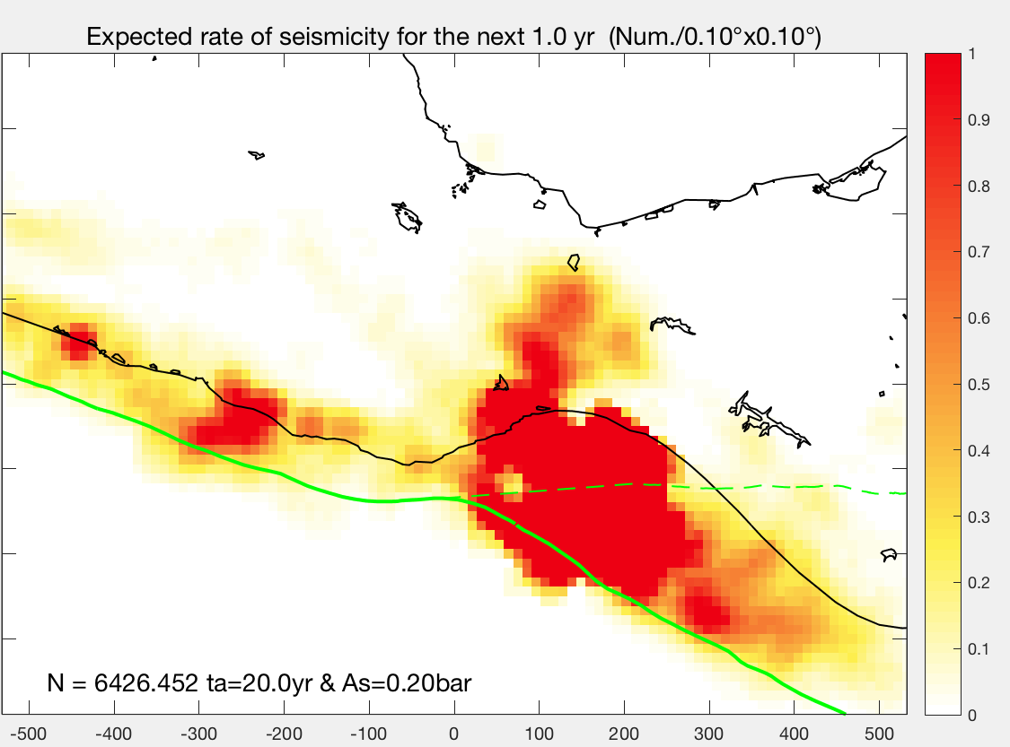
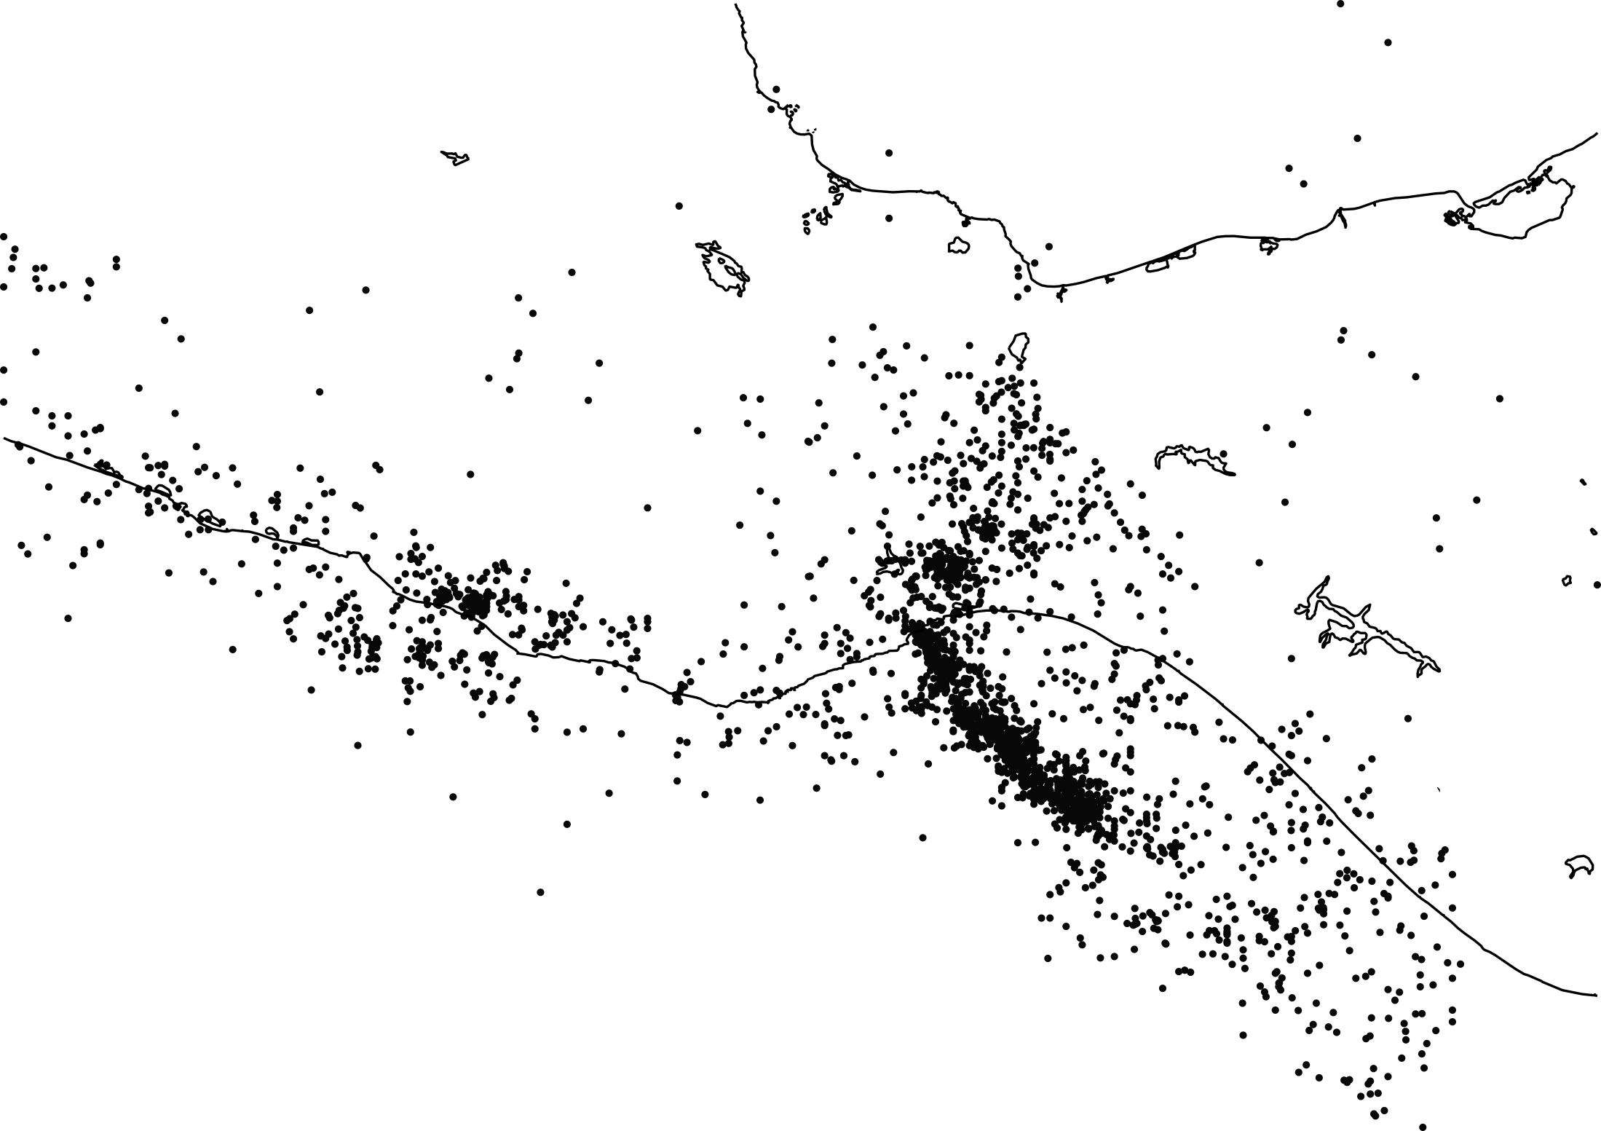

2018 Forecast rate incorporating stress transfer
M≥4.0
Mexico
City
M≥4.0
2017 M 7.1
Subsequent quakes are
consistent with forecast
Number of shocks / 0.1°x0.1° / yr
2017 M 8.2
Mexico
N-obs in 2018 = 2564 (UNAM catalog)
km
Notes:
Here is the modified seismicity rate now as a result of occurrence of the 2017 main shock.
You can see here, not surprisingly, there are increases around the site of the source, but some of them extends way inland and elsewhere along the coast that’s important.
When we show earthquakes, there is a good correspondence where earthquakes actually occurred after this forecast was submitted.
> So how do we actually test our forecast?
> That is what we want to focus on next.

Slide 9
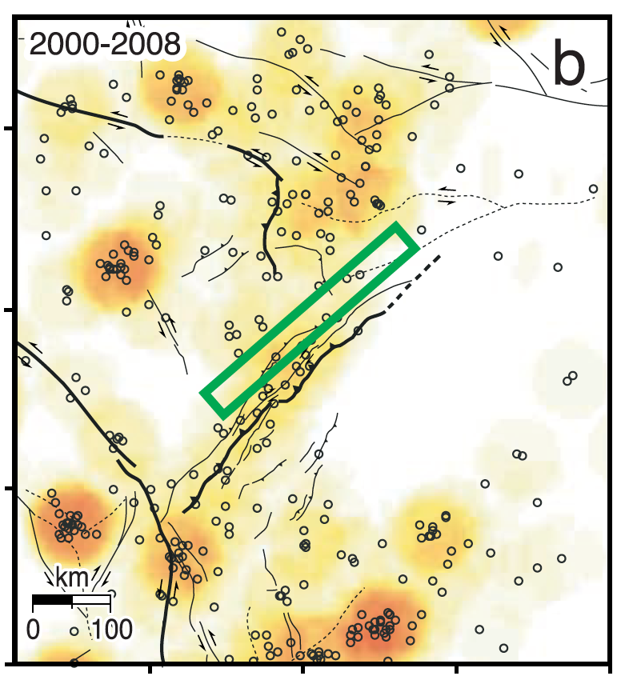
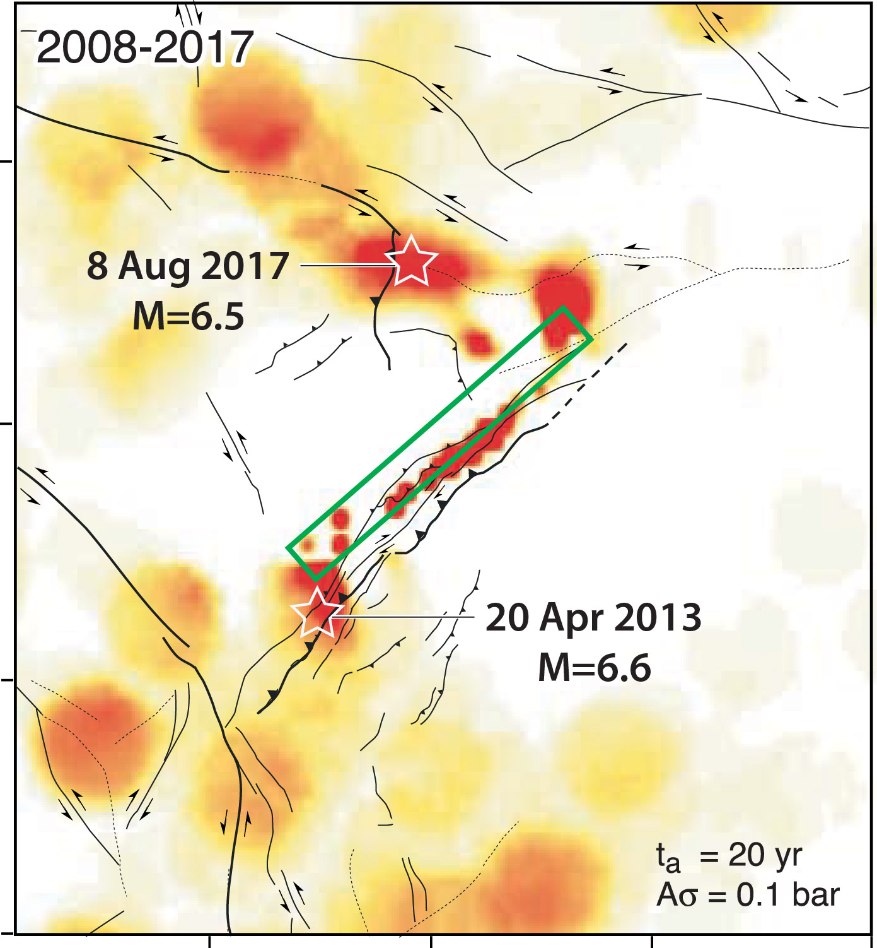
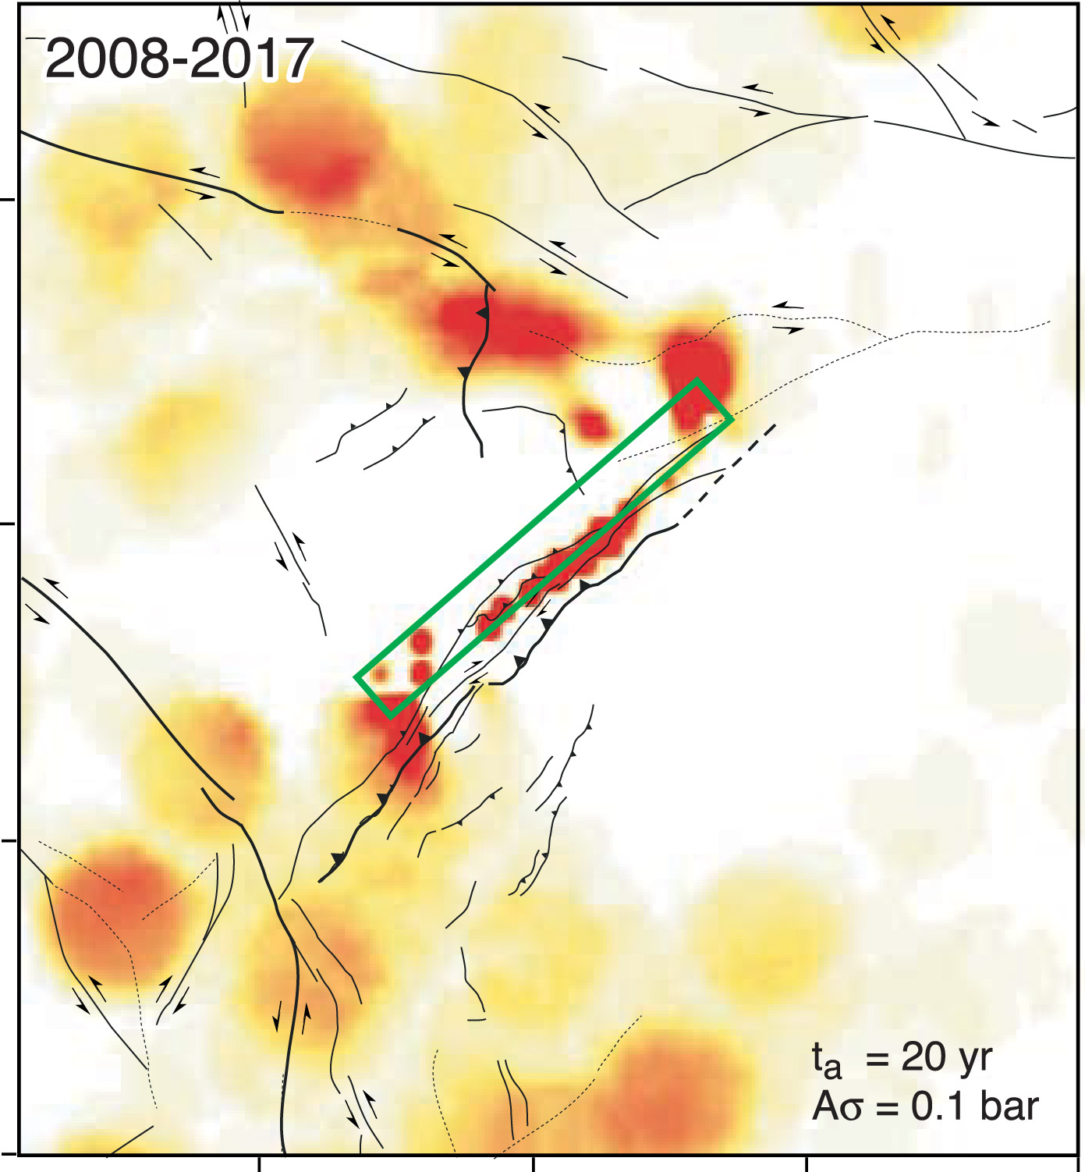
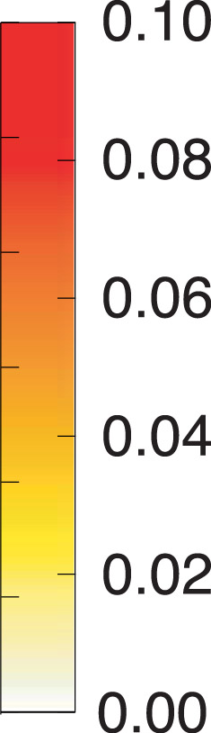
10-yr M≥6 forecast published in 2008 consistent with M 7.9 Wenchuan, China, aftershocks
Forecast without M=7.9 Wenchuan quake
Forecast with 2008 M=7.9 Wenchuan quake
M≥6.0 quake rate
for 10 years
2008 M=7.9
rupture
Toda, Lin, Meghraoui and Stein (GRL, 2008)

Slide 10
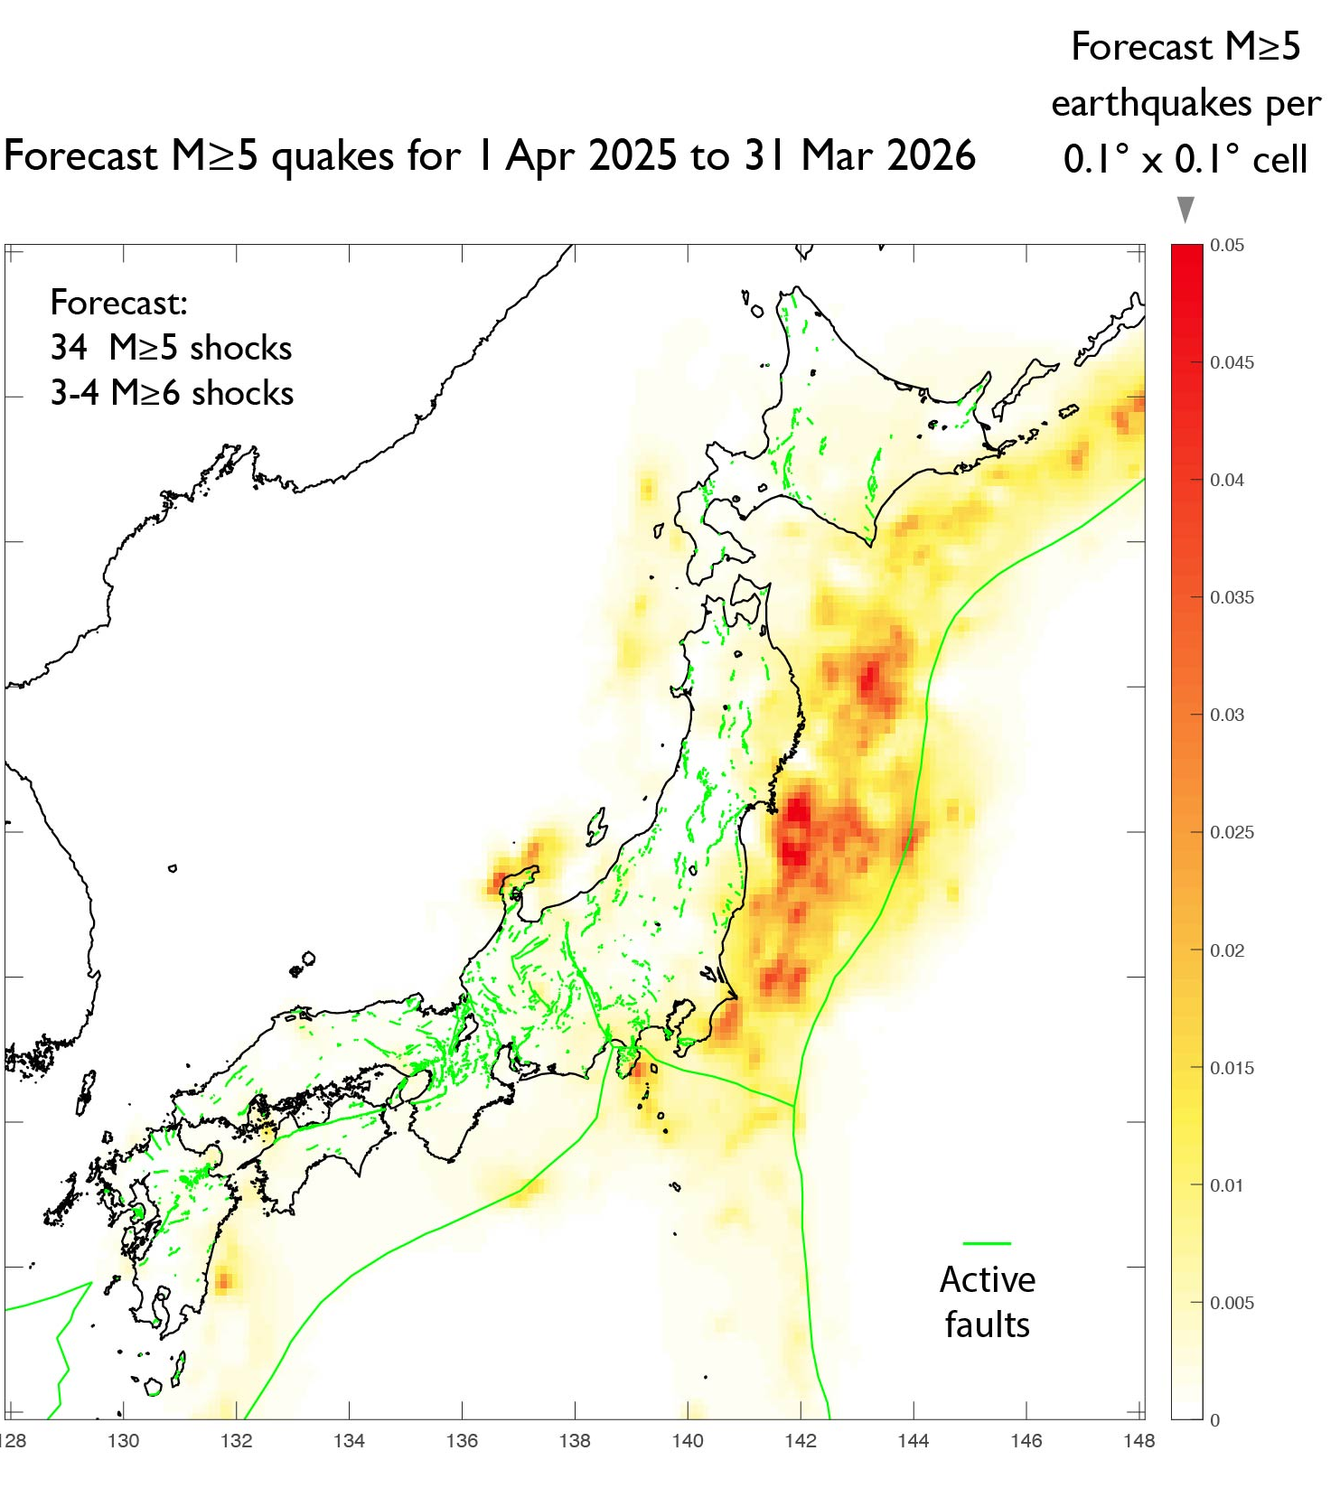
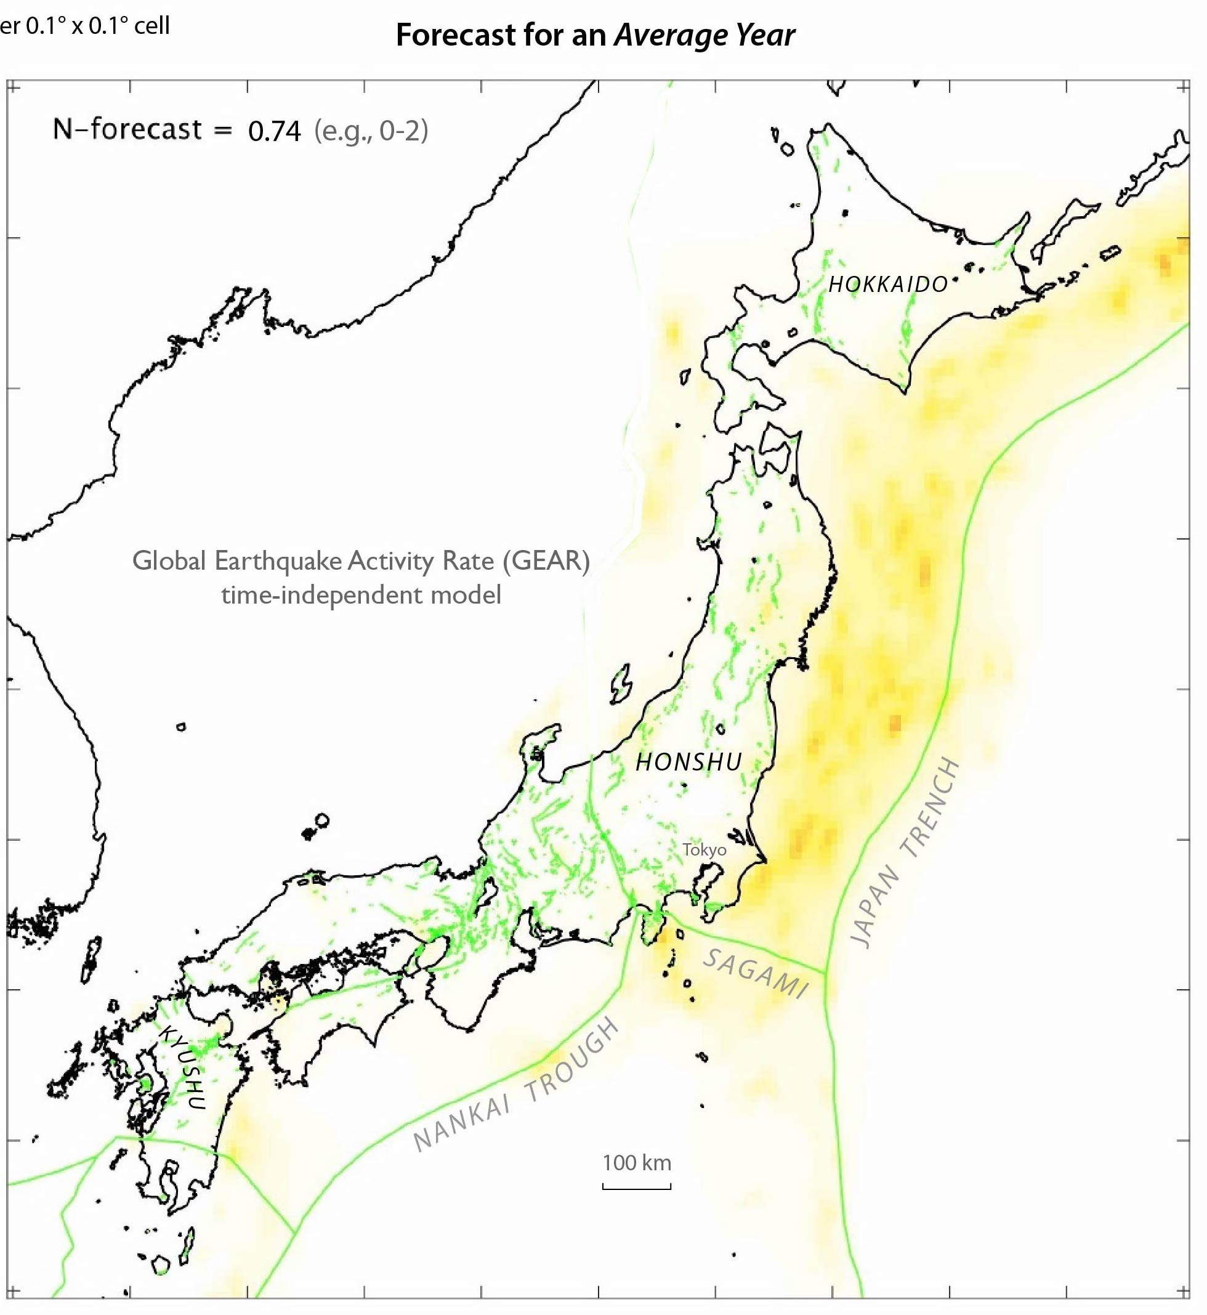
The forecast distribution is strongly influenced by the M 9 Tohoku that struck 15 yr ago
Quake locations during the blind forecast period are largely consistent with Realtime Risk
Forecast for an average year
(121)
(12)
Observed
M≥7
M≥6

Slide 11
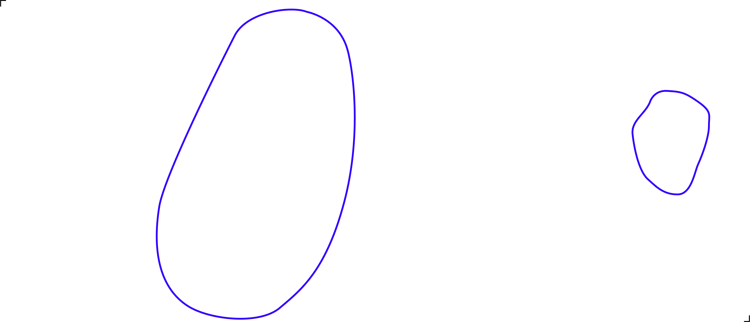
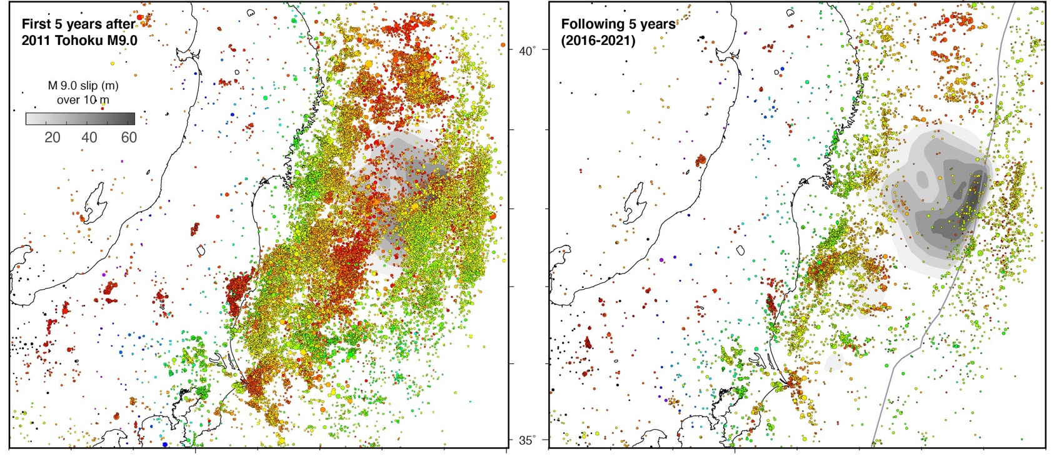
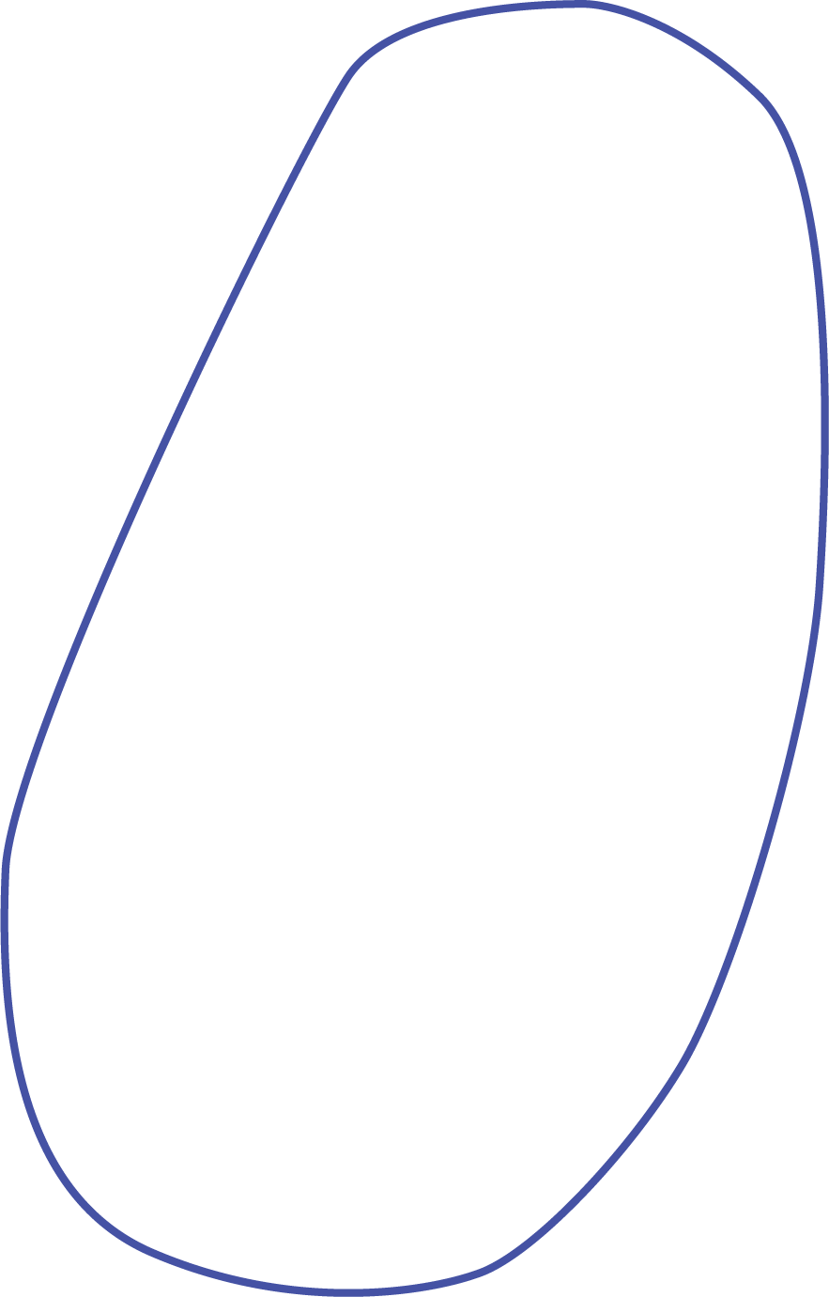
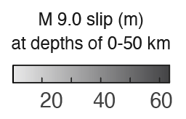
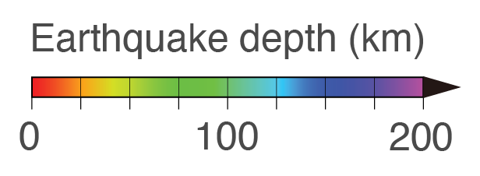
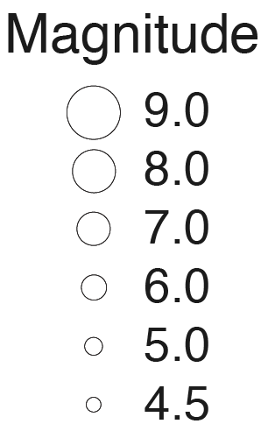
Both core and corona light up in first 5 yr after M 9 Tohoku, then core shuts down
Corona: Three times more M≥6.5 shocks have stuck in the 15 yr after M 9 Tohoku than before
First 5 years
Next 5 years
M≥3.0 quakes
from JMA
Core
Corona
Corona
Corona is six times larger than core
Core coincides with high slip
Toda & Stein
(Nature Geoscience
2022)

Slide 12
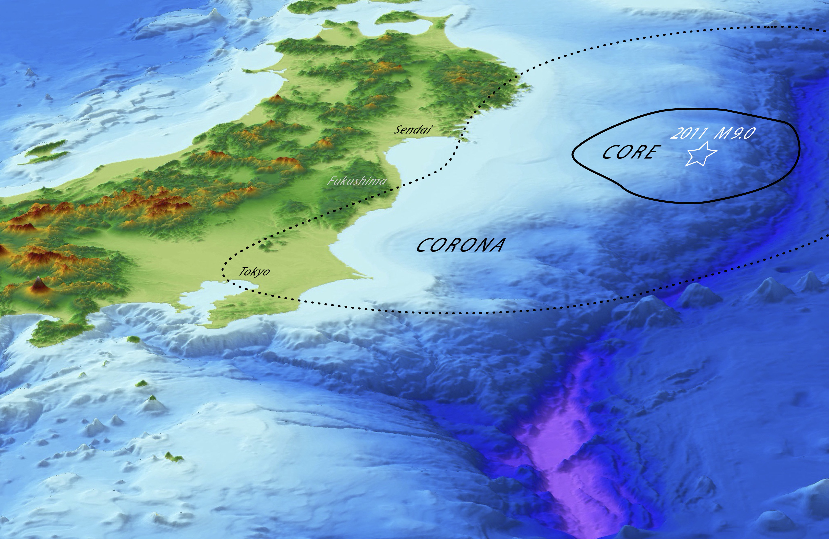

Stress triggers and shadows
are the most important
source of time dependence
Temblor
captures this
in Realtime Risk

Slide 13
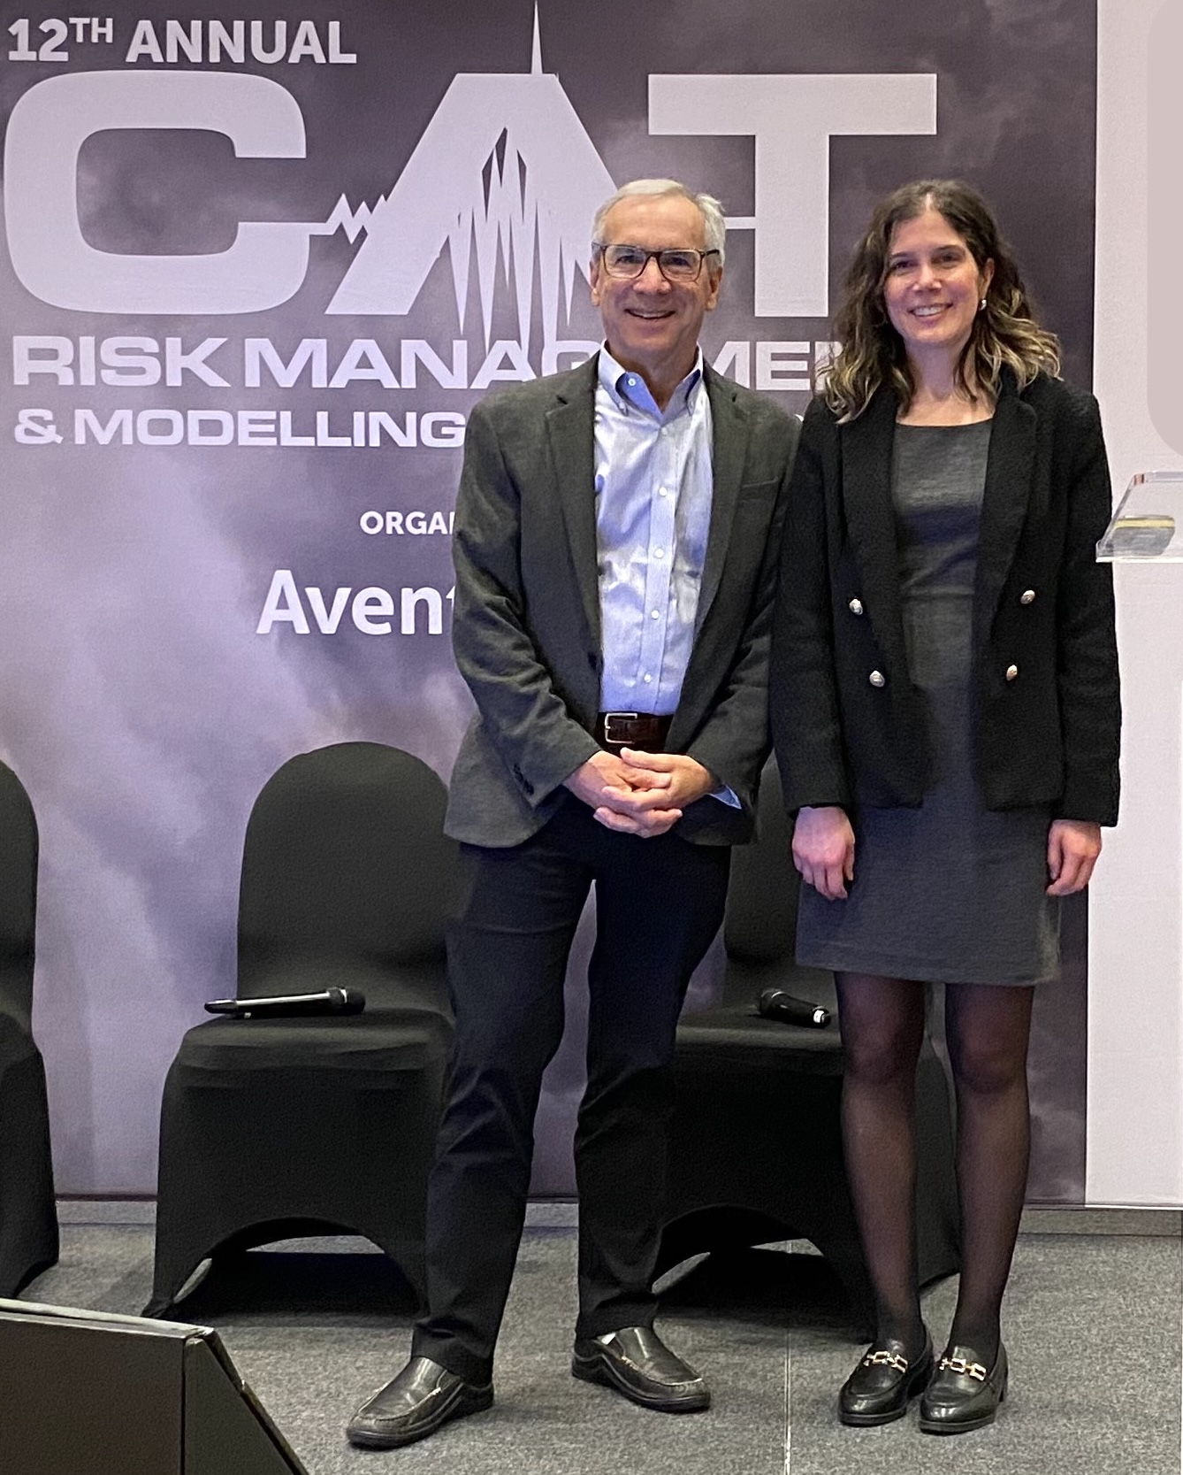
How to build into your workflow
HazIntel adjusts a legacy vendor Event-Loss Table as if it had been modeled with Temblor EventSet or EventSet modified by Realtime Risk
We can provide gridded quake rate changes to modify legacy vendor earthquake frequencies
You (or we) can run Temblor’s OASIS loss models using a Realtime Risk-modified event set
Last year, Alexandra Tsioulou and I showed how Gallagher Re harnesses Realtime Risk in Chile
They have
also used it
for Japan,
New Zealand, Turkey, and California

Slide 14
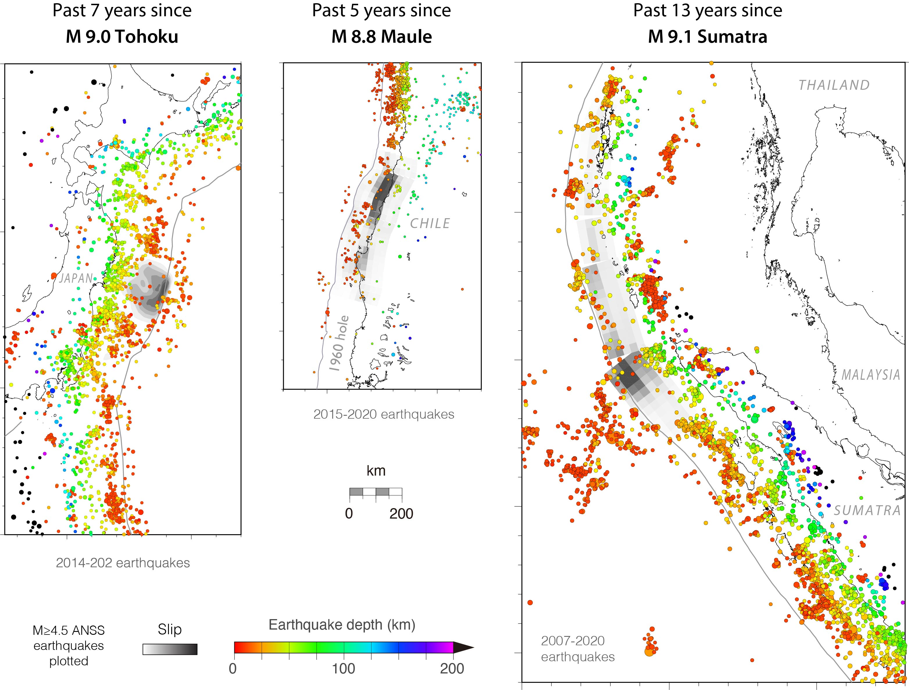
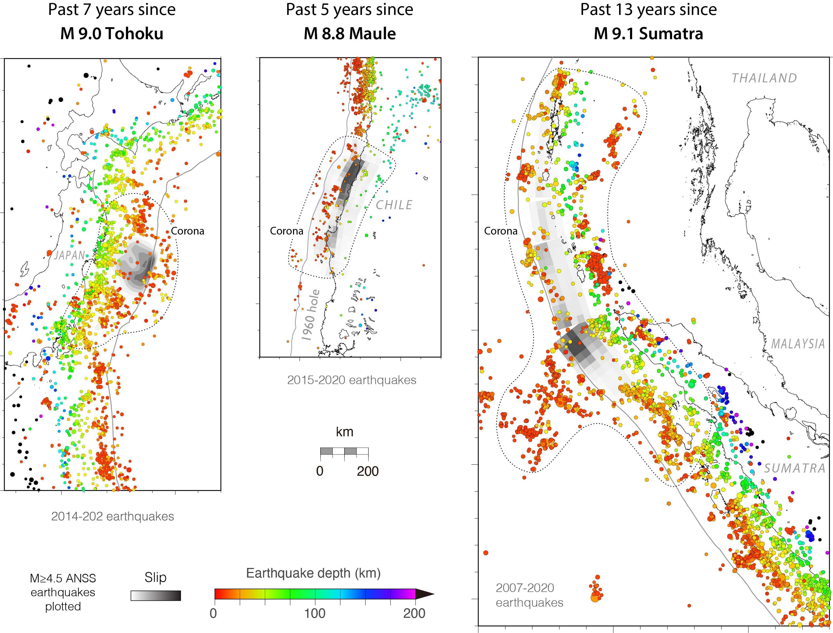
Starting 5 yr after
Starting 5 yr after
Starting 4 yr after
All megathrust ruptures since 1960 are seismicity holes today
Slip: Lorito et al (2011)
2014-2022 earthquakes
Slip: Iinuma et al (2012)
Toda & Stein
(Nature Geoscience
2022)
Slip: Banerjee
et al (2007)

Slide 15
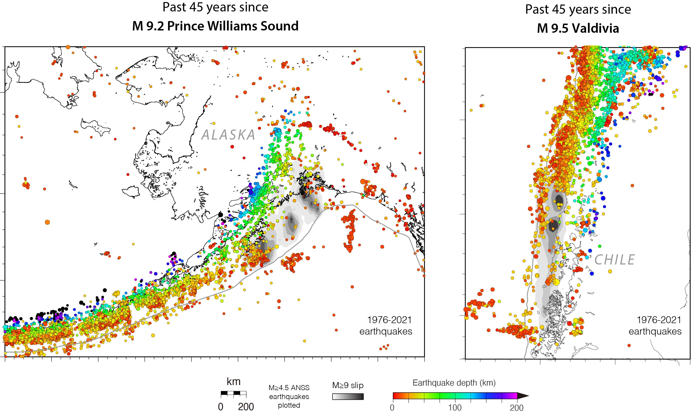

Starting 12 years after
Starting 16 yr after
All megathrust ruptures since 1960 are seismicity holes today
Slip: Barrientos and Ward (1990)
Slip: Ichinose et al. (2007)
Early aftershocks:
Page (1968)
Early aftershocks:
Cifuentes (1989)
Toda & Stein
(Nature Geoscience
2022)

