Slide 1
Unpicking the Pricing Landscape for European Windstorm

Slide 2
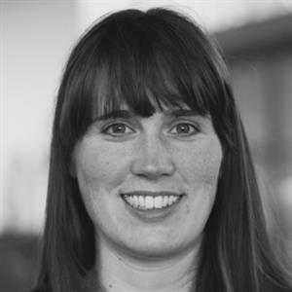
Meet the Speakers
Dr. Julia Lockwood
Senior scientist, Monthly to Decadal Variability and Prediction team at the UK Met Office.
Julia Lockwood is a senior scientist in the Monthly to Decadal Variability and Prediction team, specialising in wind predictability. Her work ranges from fundamental research in understanding the physical processes that lead to near-term climate predictability, to developing tailored products and services from the latest seasonal to decadal forecast models.
Current projects include, developing observed and synthetic European windstorm catalogues and decadal timescale hurricane forecasts.
Sandra Hansen MSc
Head of International Peril Advisory, Guy Carpenter
Sandra leads the International Peril Advisory team in London, and with her team, develops Guy Carpenter’s view of present-day and future natural catastrophe risk.
Sandra has over 15-years of experience in financial services. Sandra is a qualified actuary and has a first-class Masters degree in Mathematics from the University of Oxford and has a Masters distinction in Atmosphere, Ocean and Climate at the University of Reading.
Dr. Sagar Bora
Head of Model Evaluation, UK& EMEA – Aon
Sagar leads the Model Evaluation team at Aon, performing model evaluations, catastrophe research, and developing analytical solutions across the UK and EMEA region.
As a physicist and climate scientist, Sagar has 11 years of experience in catastrophe model development and research. He holds a PhD in Physics from the University of Bremen, Germany, focusing on paleoclimate ocean modelling.

Slide 3
Meet the Risk Carriers
Dr. Chris Webber
Senior Manager, Research and Development, Brit Insurance.
Chris leads the natural catastrophe risk research and development team at Brit Insurance, who are responsible for determining Brit’s View of Risk for natural catastrophe risk.
Chris has 7-years of experience within catastrophe risk research teams throughout London. Prior to which, he undertook a Post Doctoral research project on methane’s climate impact and completed his PhD in Air Pollution, Meteorology and Climate Change at the University of Reading.
Dr. Sam Phibbs
Head of Catastrophe Research, MS Amlin
Sam leads the catastrophe research team, which is responsible for MS Amlin’s View of Risk across all perils, from hurricanes to terrorism. He holds a PhD in atmospheric physics from Imperial College, where he focused on the impact of climate change on windstorms. Since entering the reinsurance industry, he has specialized in catastrophe model evaluation and quantifying physical risks driven by a changing climate. He has maintained strong ties with academia, participating in joint initiatives and co-authoring papers.

Slide 4
Session Aim
To discuss whether market pricing and technical pricing for European windstorm are complementary and appropriate.
Areas of focus:
Historical trends in loss and windstorm hazard.
Future trends in European windstorm risk.
Has Europe just been 'lucky’ over the past three decades?
Unpicking variance in vendor model projections.
Ambiguity in event definitions and uncertainty in windstorm clustering.
Ultimately, how might one suggest pricing/risk selection for European wind risk?

Slide 5
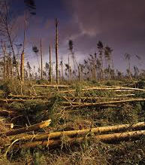
Overview of European Windstorm Market Pricing
The London market is quite reactionary, especially when considering the risk of high-impact low-frequency events occurring. This is no different for European wind risk, with the perception that high-impact wind risk has decreased since the 1990s.
Whilst the London market arguably hasn’t seen a notable windstorm loss since Kyrill in 2007, this peril remains one of two main perils capable of driving correlated losses on a large spatial scale (the other being earthquake).
London market pricing for European risk is influenced by highly correlated perils such as windstorm, however to a much greater effect by attritional losses (flood, SCS, freeze) and financial pressures (inflation). London market capacity is predominantly influenced by North American perils.

Slide 6
European windstorms
Julia Lockwood (Met Office Hadley Centre)
Oasis Insight Conference
May 2025

Slide 7
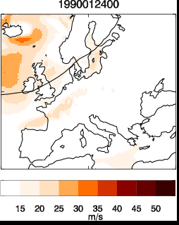
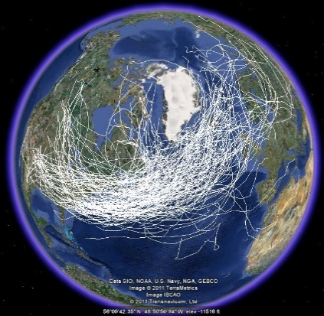
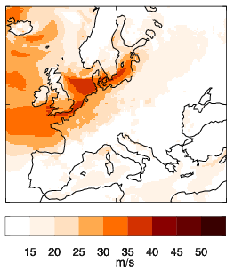
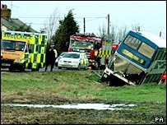
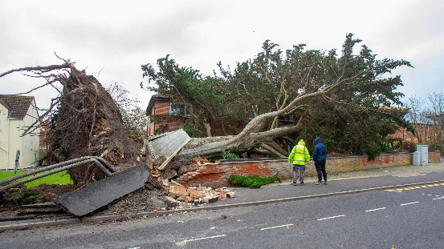
European windstorms
European windstorms = extra-tropical cyclones/mid-latitude cyclones
Synoptic (~1000s km) areas of low pressure
Can lead to large areas of damaging winds (gusts > 25 m/s)
Notable events:
Daria (January 1990)
’87J’ (October 1987)
Kyrill (January 2007)
Recently: storm Darragh (9th December 2024): ~100,000 homes lost power in Wales
Windstorm Daria (25th January 1990)
Kyrill (BBC news)
Storm Darragh (BBC news)

Slide 8
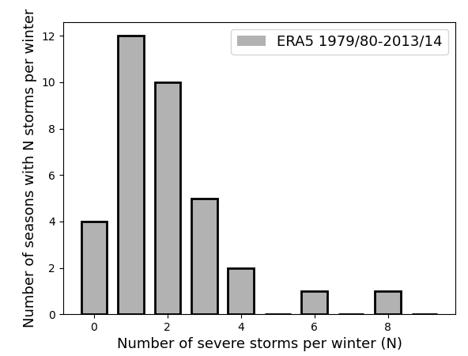
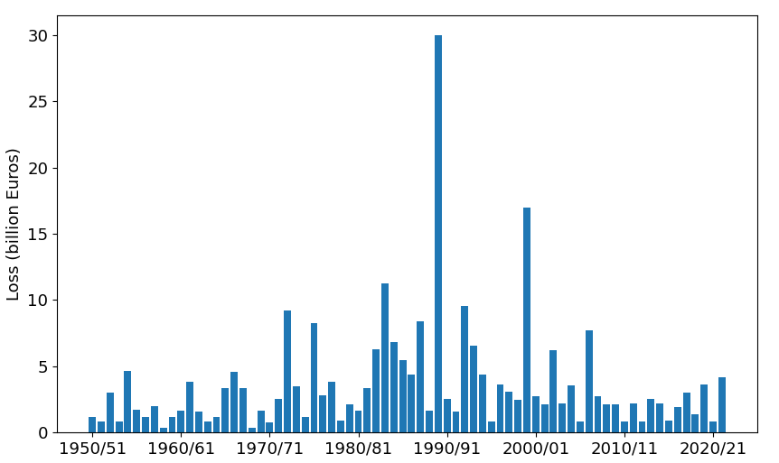
Most active in winter (October-March), when equator-to-pole temperature gradient is strongest
High variability in storm numbers and storm damage per season
Estimated European windstorm losses (Cusack 2023)
Cusack (2023) https://doi.org/10.5194/nhess-23-2841-2023

Slide 9
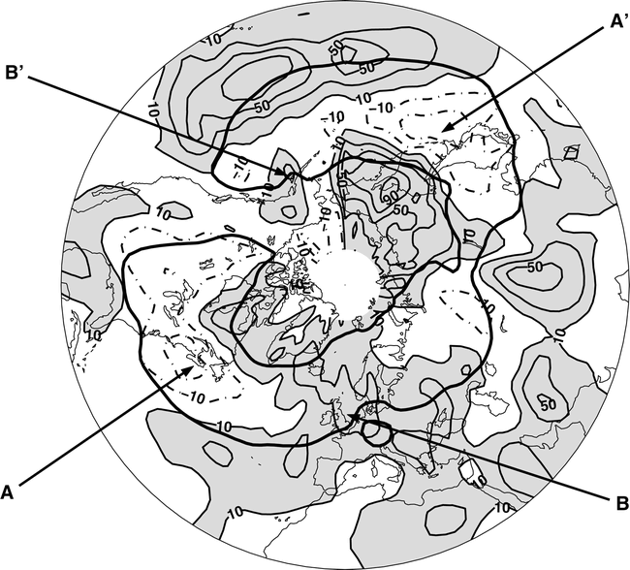
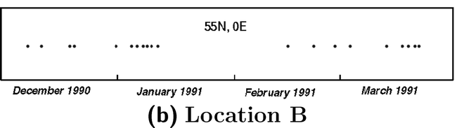
European windstorms are ‘clustered’ (Mailier et al. 2006)
Mailier et al. (2006) https://doi.org/10.1175/MWR3160.1

Slide 10
High variability partly linked to the North Atlantic Oscillation (NAO)
U.Miami https://cimas.earth.miami.edu/news-events/cimas-blog/seasoned-chaos-presents-nao/index.html

Slide 11
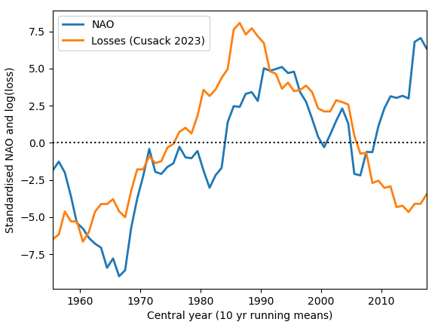
Decadal variability
High storm losses in the 90s corresponded to period of very positive NAO
10 year running mean NAO and losses
Cusack (2023)

Slide 12
Decadal variability
High storm losses in the 90s corresponded to period of very positive NAO
10 year running mean NAO and losses
Disconnect in more recent years
- partly down to negative trend in observed peak gusts at surface
Cusack (2023)

Slide 13
Decadal variability
High storm losses in the 90s corresponded to period of very positive NAO
10 year running mean NAO and losses
Disconnect in more recent years
- partly down to negative trend in observed peak gusts at surface
Cusack (2023)
Cusack (2023)

Slide 14
Projections for northern hemisphere winter cyclones
Complicated due to opposing factors:
Upper tropospheric tropical heating -> strengthen temperature gradient, jet, storm track
Polar amplification -> weaken temperature gradient, jet, storm track
Polewards shift of storm track and extension into Europe
Small decrease in overall cyclone numbers, but increase in number of intense cyclones
Area of extreme winds could be up to 40% larger by the end of the century
Historical model track density (1979-2014)
Projected 2080-2100 track density changes with increasing emissions scenarios (CMIP6 multi-model study)
Priestley et al (2022) https://doi.org/10.5194/wcd-3-337-2022

Slide 15
Projections
BUT…climate models fail to reproduce observed past variability in NAO
If this is taken into account, forced response to NAO (and therefore storm track) could be much larger than previously thought
Observed and modelled NAO (31 yr rolling means)
Historical period and model projections
Raw model data
Models corrected for water vapour error
Smith et al (2025) Nature Climate Change https://doi.org/10.1038/s41558-025-02277-2

Slide 16
Summary
EUWS highly variable on decadal timescales
Although there’s a disconnect between NAO and estimated EUWS losses in recent years, number of intense storms projected to increase, as well as travelling further into Europe
Current models have underestimated the observed positive NAO trend – they may underestimate forced response of NAO (and storm track)

Slide 17
Oasis conference
Placeholder for optional client logo
Do catastrophe models reflect today’s UK windstorm risk?
April 2025
Sandra Hansen, Head of International Peril Advisory, London

Slide 18
Please reach out to Sandra Hansen (Sandra.Hansen@guycarp.com) or your representative at Guy Carpenter for the content presented by Guy Carpenter at the Oasis Conference.

Slide 19
European Windstorm
Uncertainties in Climatology &
Differences between Vendor models

Slide 20
Please reach out to Sagar Bora (sagar.bora@aon.com) or your representative at Aon for the content presented by Aon at the Oasis Conference.

Slide 21
Ask the Risk Carriers (+Slido)
How reflective do you feel modelled views are of a ‘present-day’ view of risk for European windstorm?
Do you feel there is sufficient evidence for risk carriers to adopt a transient view of risk for European windstorm?

