Slide 1

Correlation Matters
Oasis Insight 2026
Modelling hurricane and flood in the US
Philip Oldham
Principal Model Developer
Notes:
Hi, I’m Phil from JBA and I’ll share a quick insight from our US Flood Model with you to show that loss outcomes depend not just on where a storm makes landfall, but on how wind, rainfall, surge, and catchment response interact through time and space.

Slide 2
1-in-3 US properties at risk to inland flood
Louisiana
Florida
Texas
North Dakota
Delaware
West Virginia
California
New Jersey
Washington D.C.
New York
Michigan
Montana
Nebraska
Illinois
Arizona
Non
HU
HU
20
40
60
% of properties at risk
Notes:
Based on FEMA’s US Structures dataset analysed against JBA’s high resolution flood maps 38m - nearly 1-in-3 - properties are at risk.
We can see from the plot that the proportion at risk varies per state. Blue states are those that experience hurricane activity, and orange don’t. We can see there are a mix in the top 15 riskiest states
With cross peril correlation of losses increasing it’s therefore important to consider not just inland flood but coastal and wind losses to get a full understanding of the risk in these states.

Slide 3
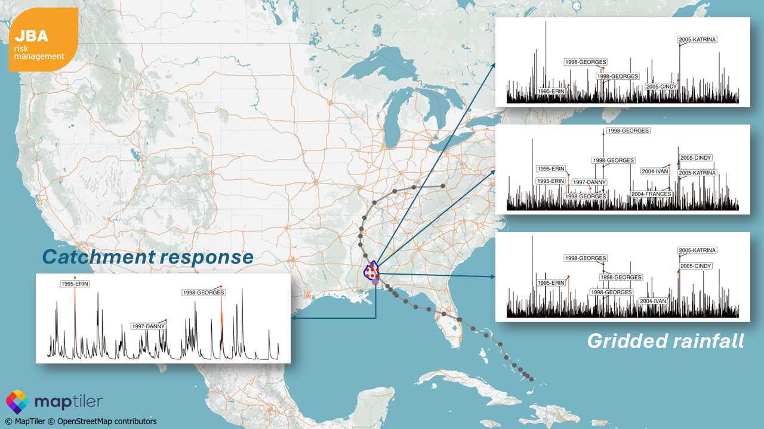
Physically correlated Hurricane and Flood
Notes:
That’s why we’ve partnered with ARA to give a unique view of physically correlated risk across fluvial, pluvial flooding and hurricane wind and surge.
We’re the flood experts; they’re the hurricane experts and our models are now correlated. To do this we simulated how rivers respond to rainfall fields from events in ARA’s hurricane model, as well as augmenting them with our own non-hurricane induced flood events.
This makes it possible to understand different cuts and slices of loss, regardless of the driving processes, opening up event-based views of risk.

Slide 4
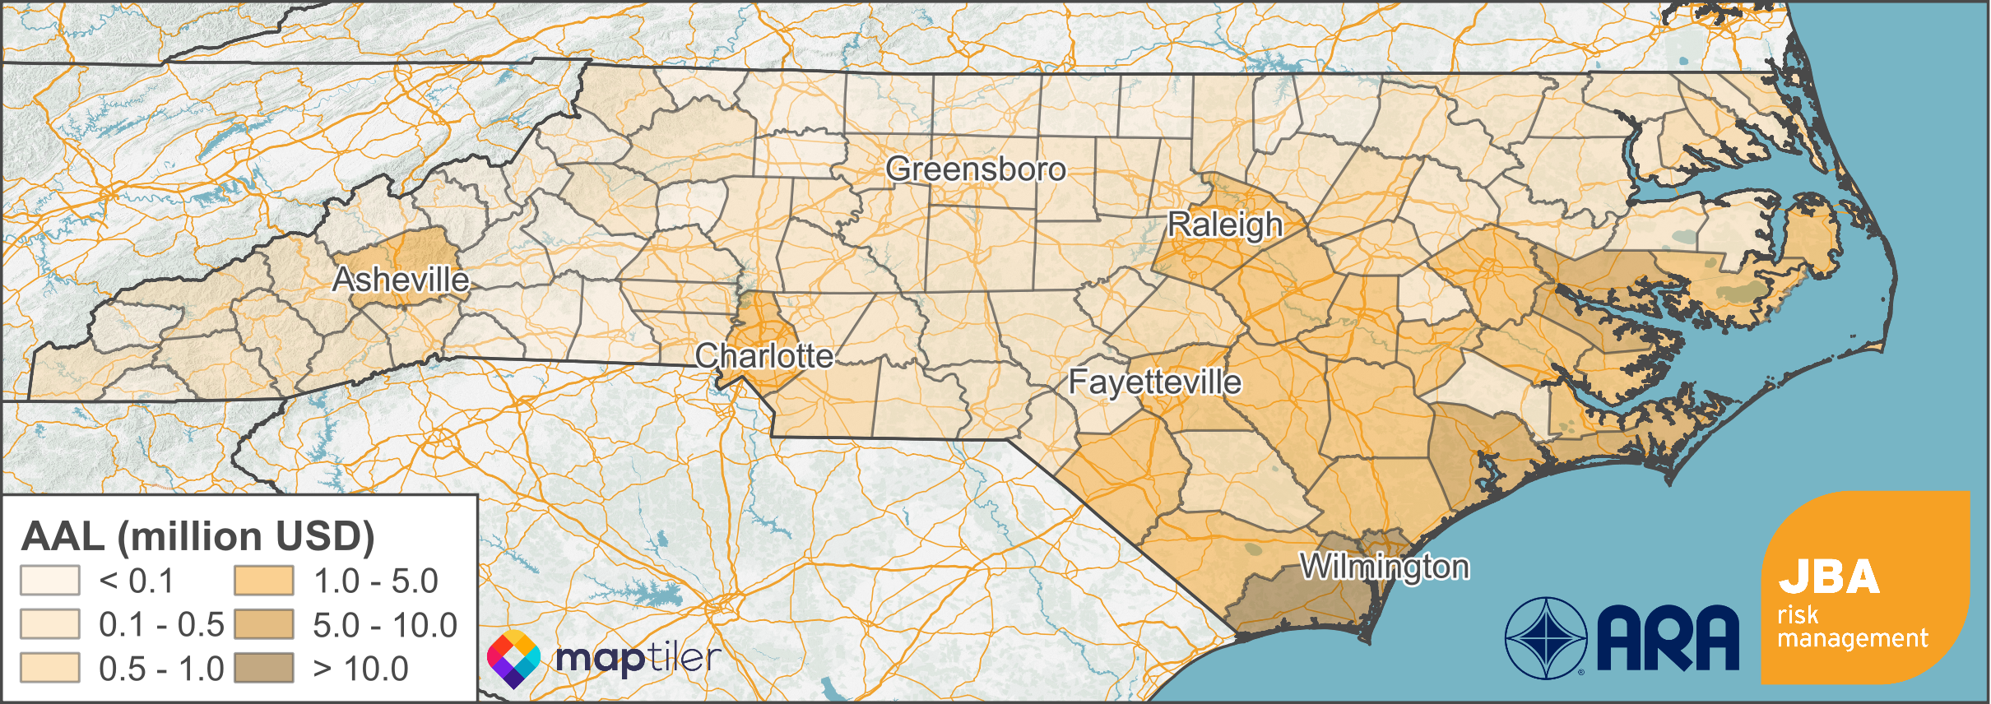
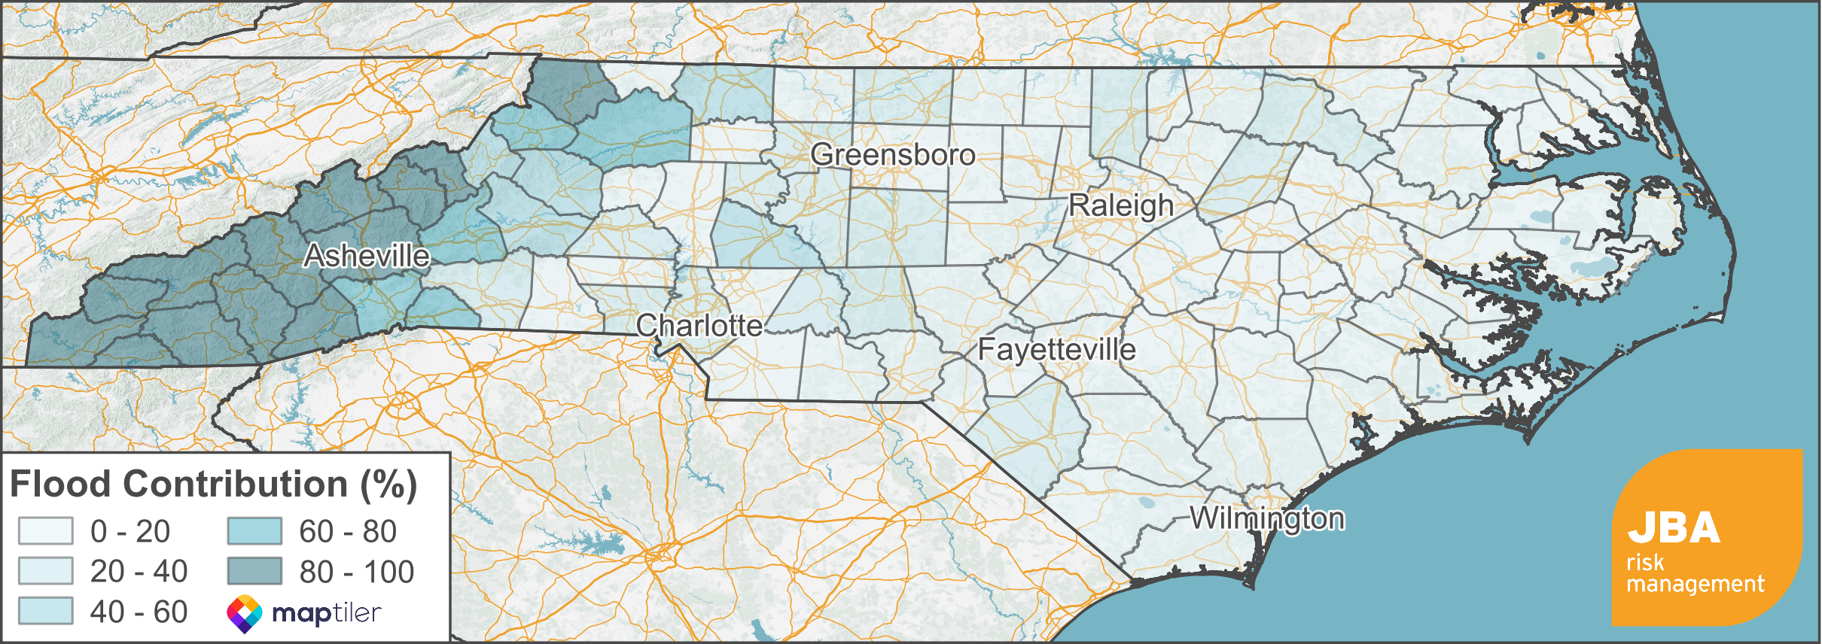
Distance from Coast
≠ Distance from Risk
Combined wind and flood AAL
Fluvial & pluvial flood contribution to AAL
Notes:
Here’s how the loss breaks down for a sample portfolio in North Carolina.
We see a clear shift in the dominant loss drivers as we move inland. Coastal counties are driven primarily by hurricane wind, with an additional contribution from storm surge. Then as we look inland, wind speeds typically decay and pluvial and fluvial flooding become increasingly important.
Inland flood losses can also emerge after landfall and away from the storm track. Hurricane Ida is a good example of this lagged response, first hitting Louisiana then progressing inland through to New York.
In many cases, these inland flood losses are either picked up by the NFIP or remain under (or un)‑insured. The hazard doesn’t disappear inland but insurance uptake does. This reinforces the need for models that properly capture peril interactions to help close that gap.
From a reinsurance perspective, capturing inland flood risk is important for aggregate losses. Inland flood events are more frequent than major hurricane events and can steadily erode aggregate cover, even when headline hurricane losses appear modest.
What we’re looking at here are compound losses that are only possible to capture with a correlated view across perils.

Slide 5
River Room Stand 9
(next to the coffee!)
ARA in the Court Room at Stand 14
Notes:
If you’d like to talk more about flood risk we’re, appropriately, in the river room on stand 9 which is next to the refreshments so come and grab a coffee with us in the break.

