Slide 1
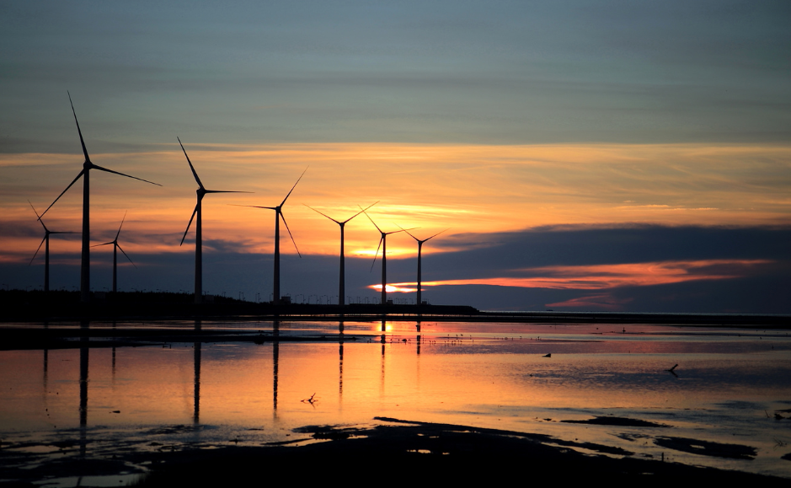


Lightning Round:
Introducing Renew Risk

Slide 2

Renew Risk provides world-class risk analytics and
modelling solutions for the finance and insurance of renewable energy assets globally.
Notes:
AARON SPEAKING: This is ALL WE DO
(handover slide)

Slide 3


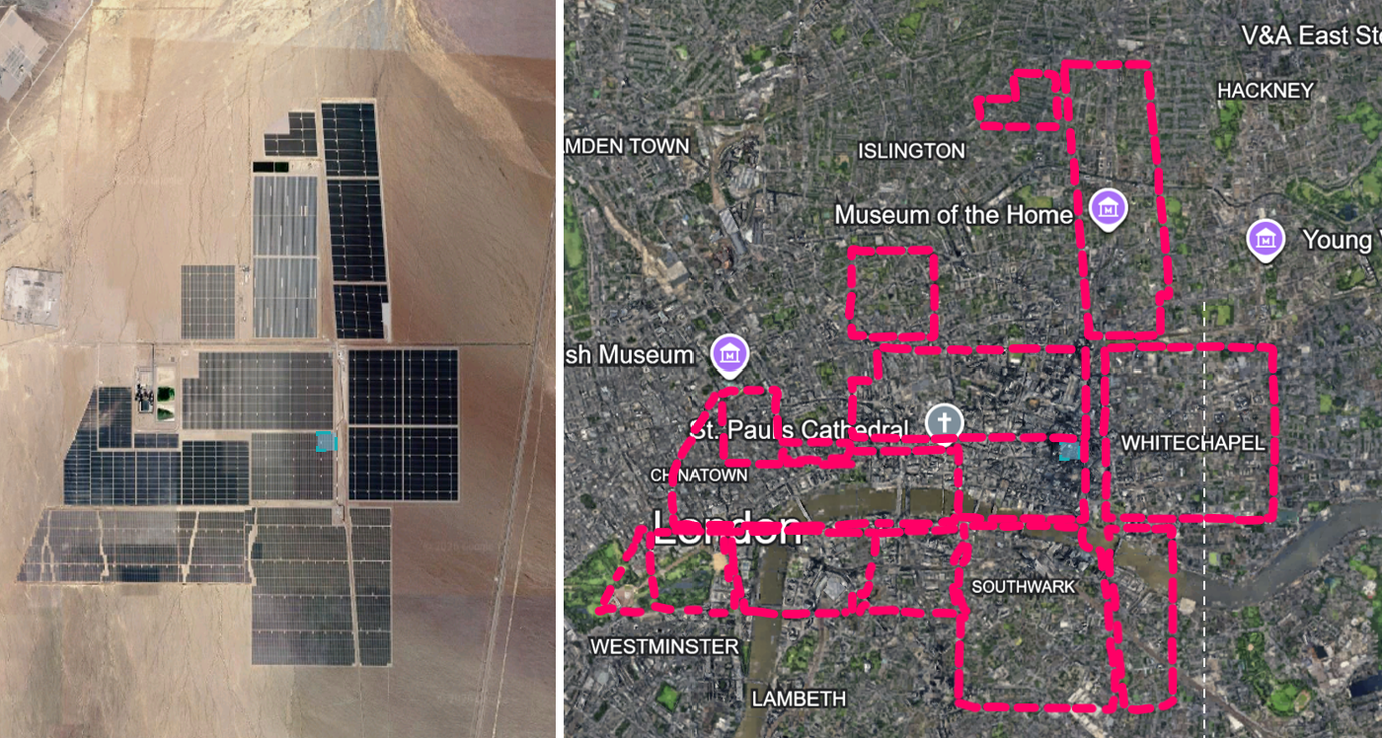
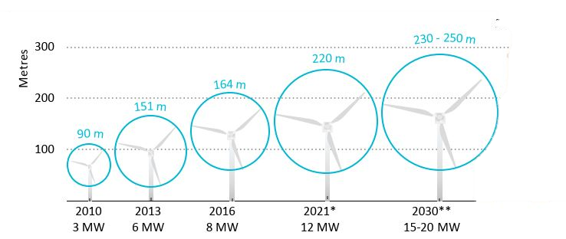
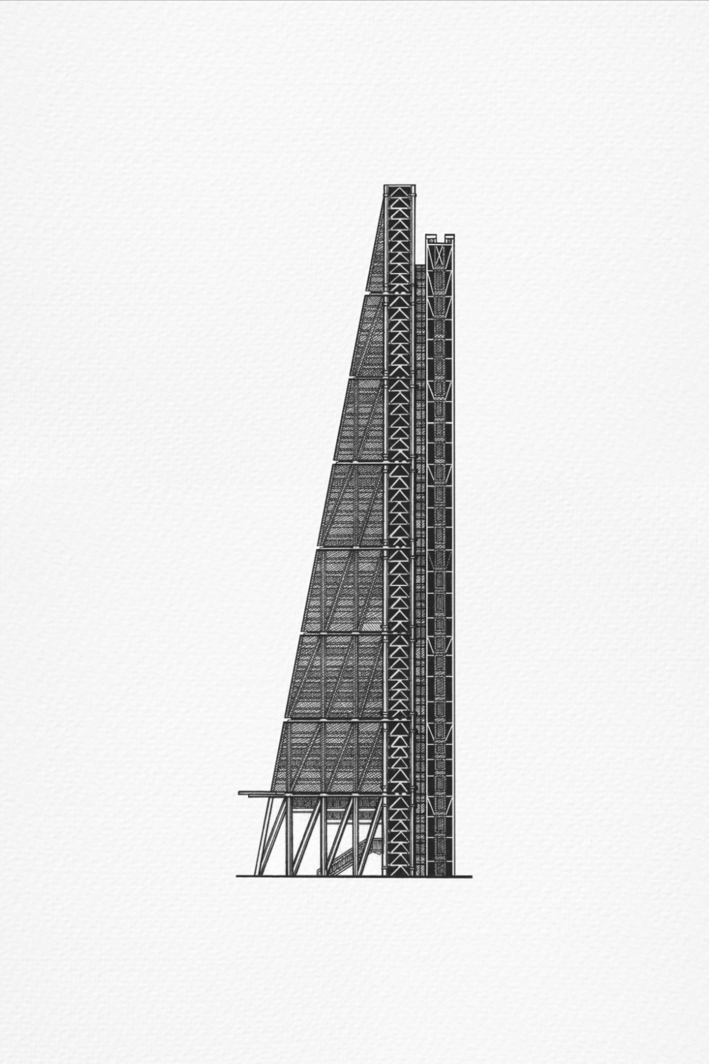
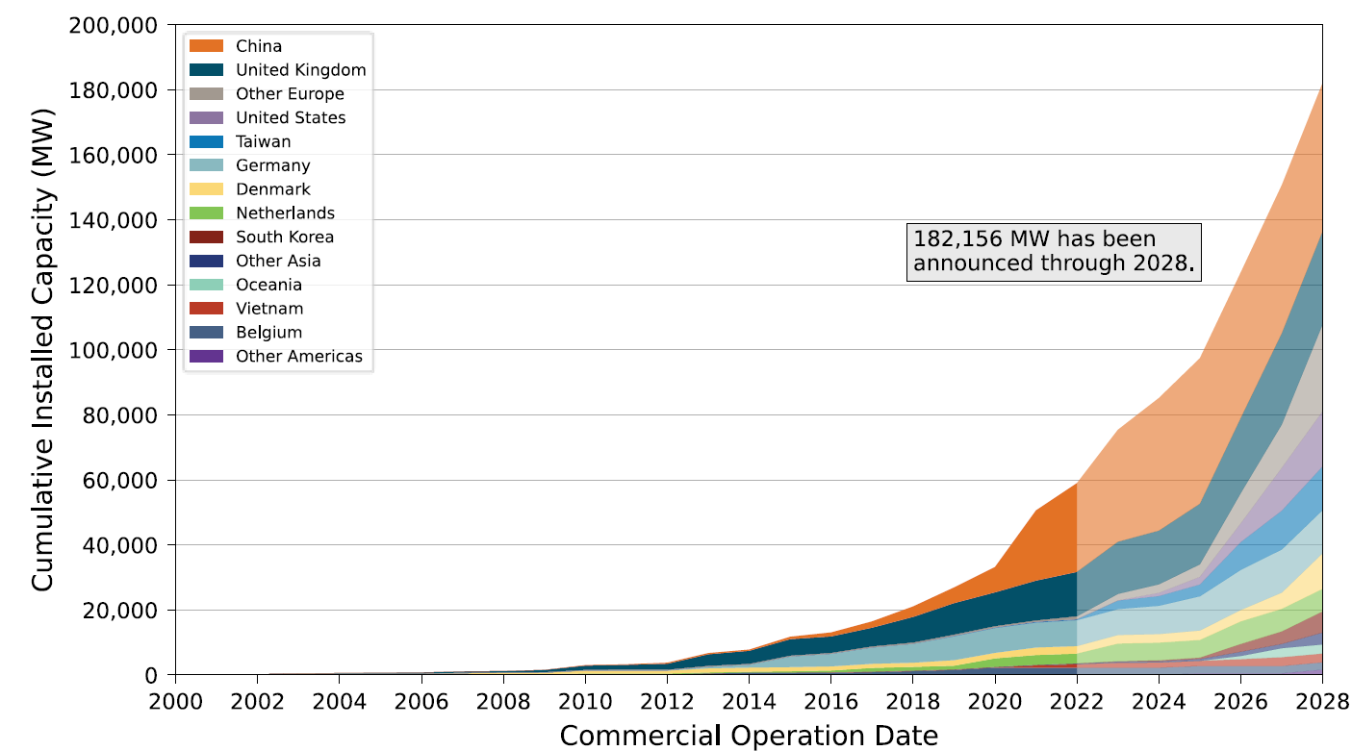
Opportunity: rapidly accelerating growth
The risks are getting bigger, more complex, and more valuable
The yellow box is the Lloyd's building…
Continued exponential growth globally
Solar output to double
In cat-exposed regions for the first time so minimal loss history
Leadenhall Building
(230m)
Notes:
Copper Mountain Solar - Nevada
Seeing more solar as you drive around Orlando…they don’t call it the sunshine state for nothing I suppose

Slide 4

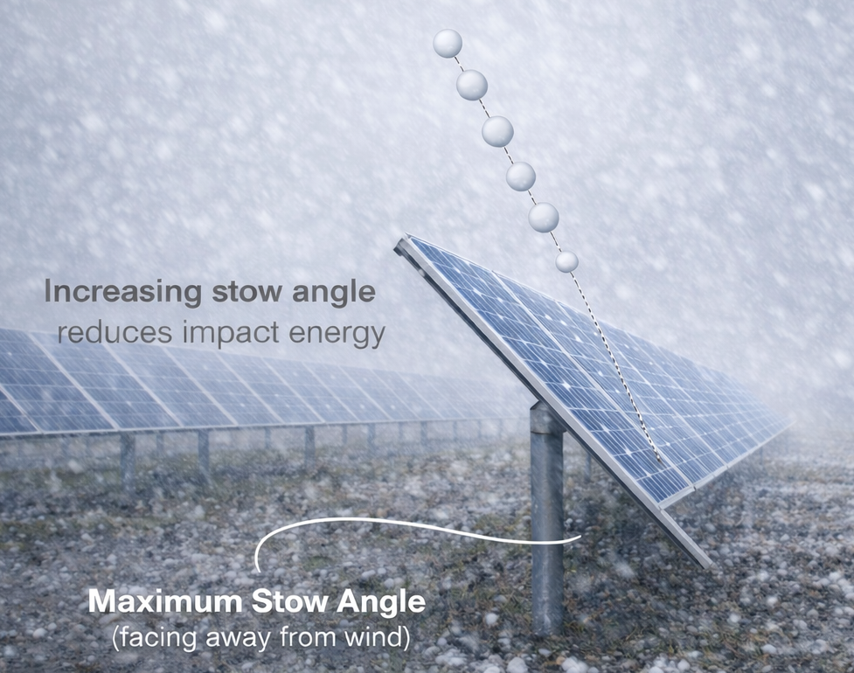
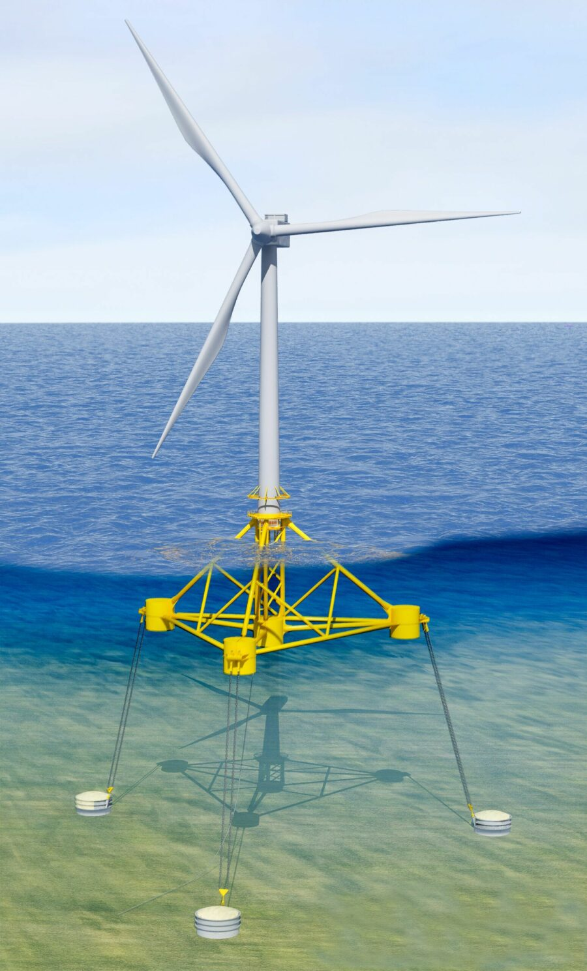
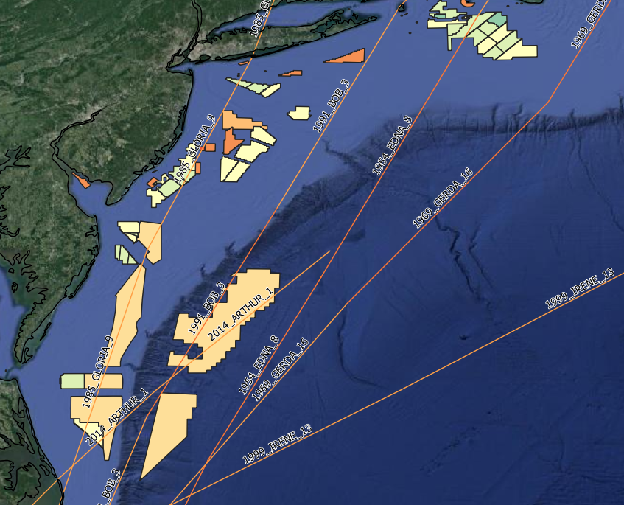
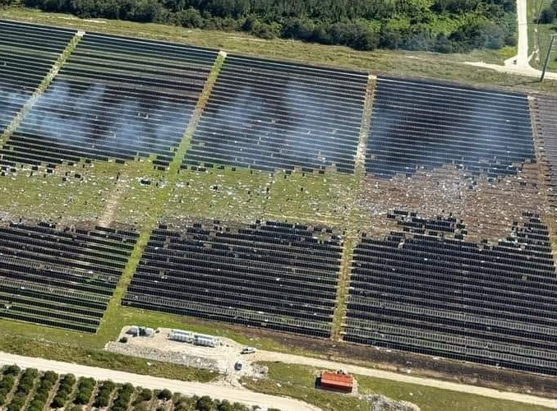
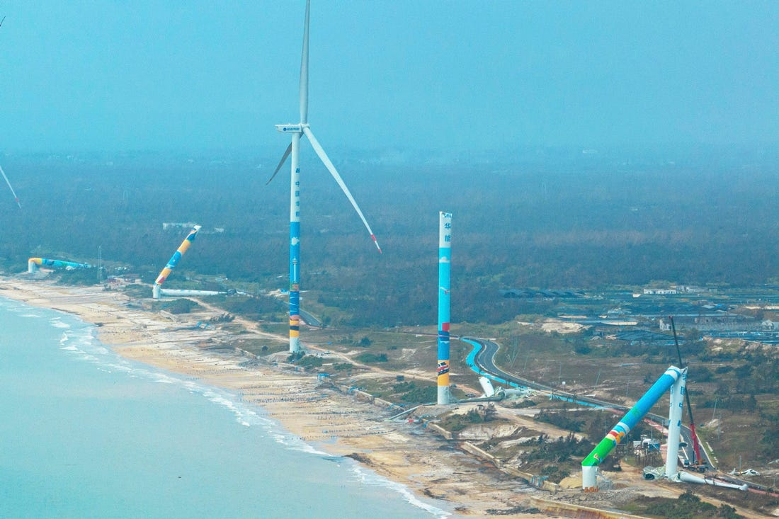
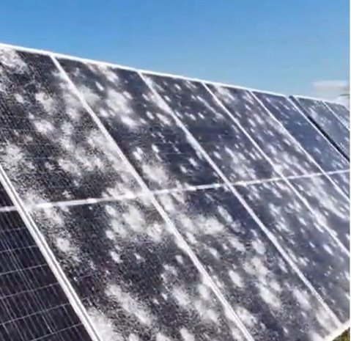
The challenge: non-specialist modelling
Existing models not for single location, specialist, high value assets
Minimal loss experience, but extremely costly and outside traditional modelled hazard areas.
Technology evolves faster than traditional risk models.
Inaccurate proxies:
  Wind modelled as an onshore factory onshore
  Solar modelled as a greenhouse
Florida – Tornado 17
China – Typhoon Yagi
Texas (Fighting Jays) – Hail 24

Slide 5
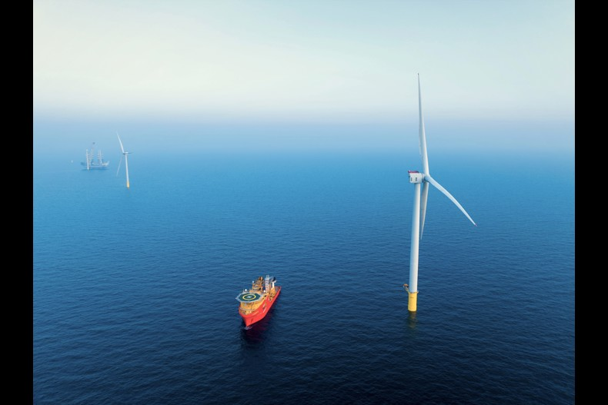
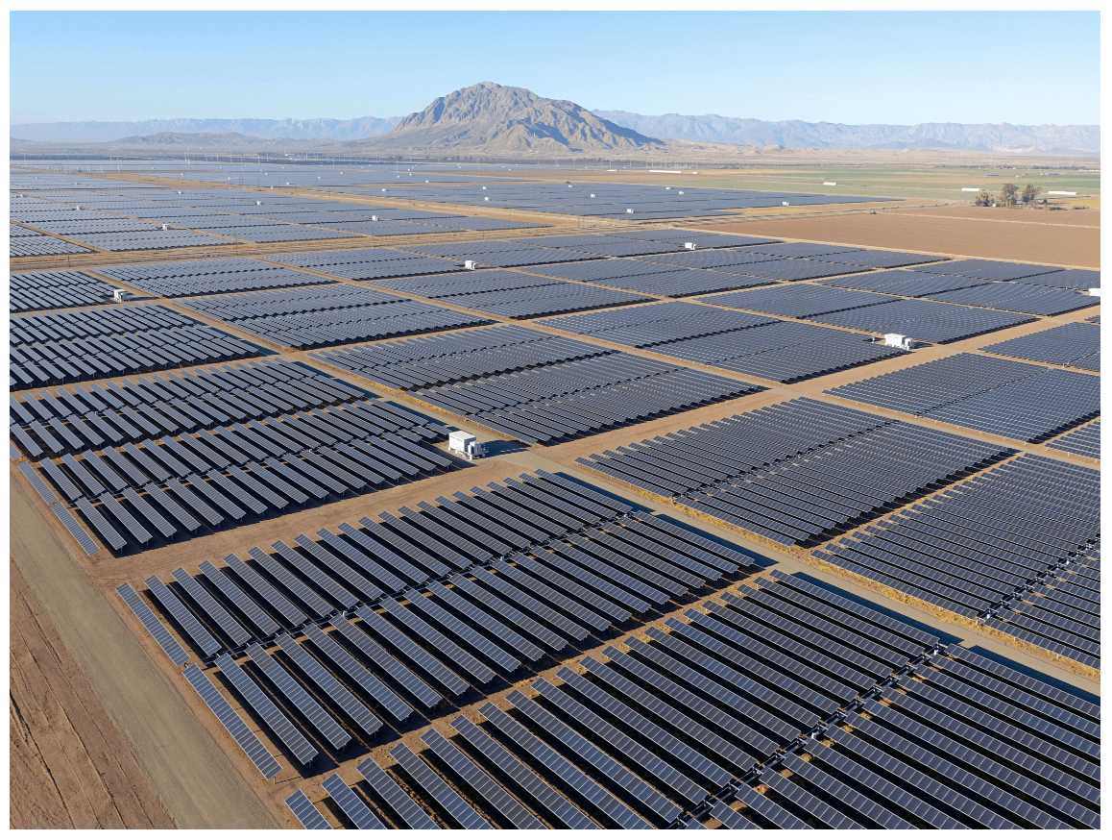
Moving assets onshore will increase uncertainty
Complex assets & global perils
The technological advancements in renewable energy asset construction and loss mitigation practices outpace traditional model development cycles.
Solar farms are not greenhouses
Extremely limited real-life claims data
Construction in areas of changing risk
Small details, big differences
Notes:
Offshore
- Construction
BI
Wind Wave Action
Scale
Repairs
Attritional losses

Slide 6
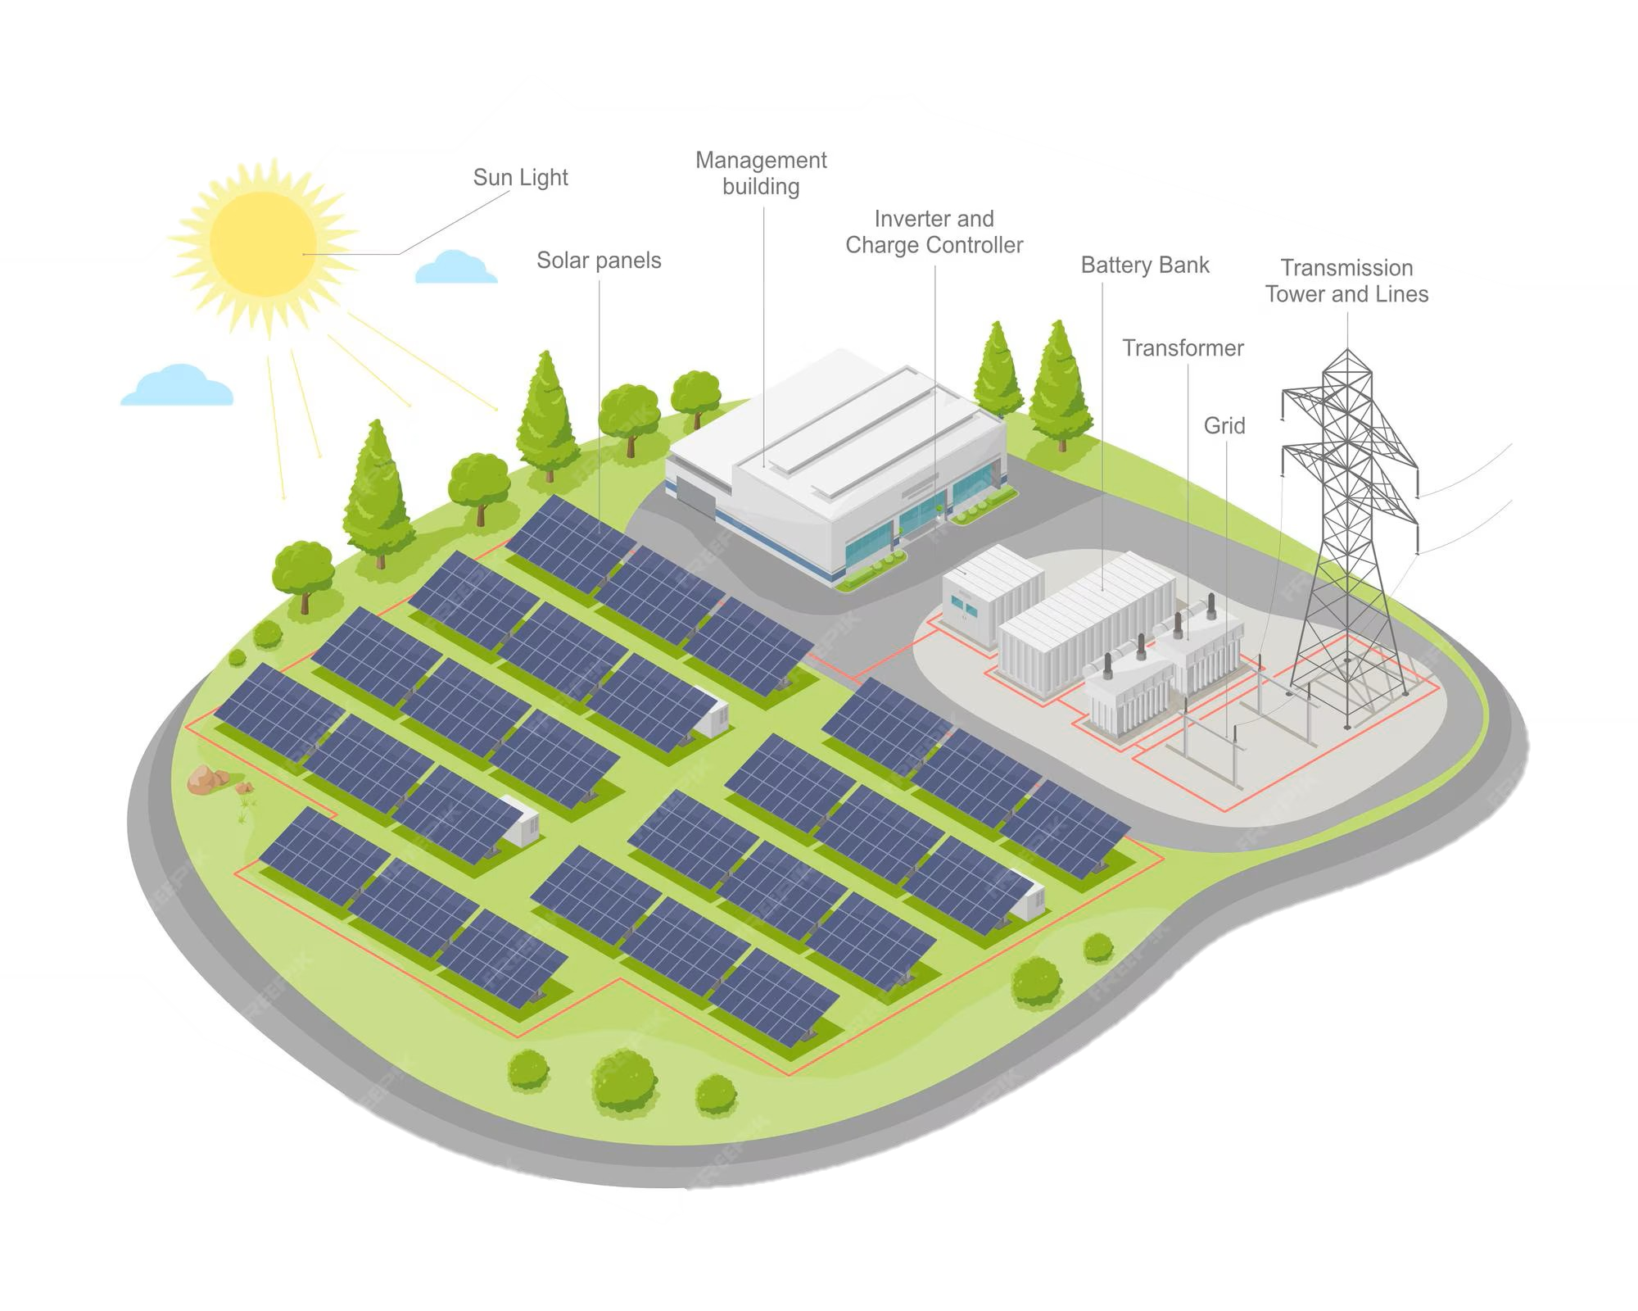
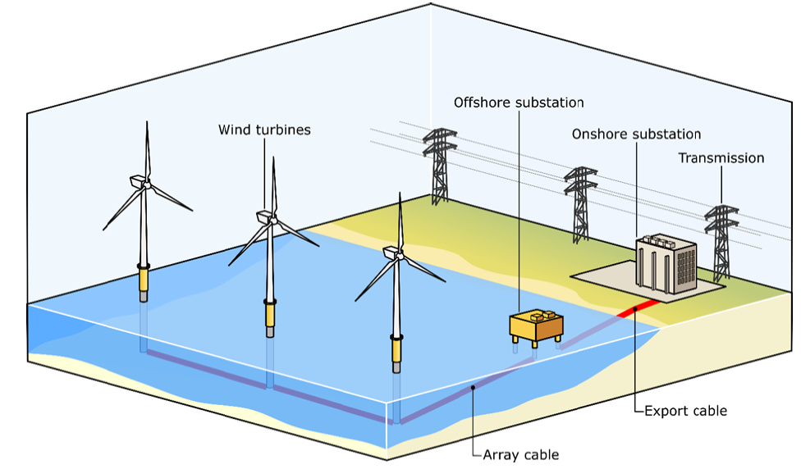

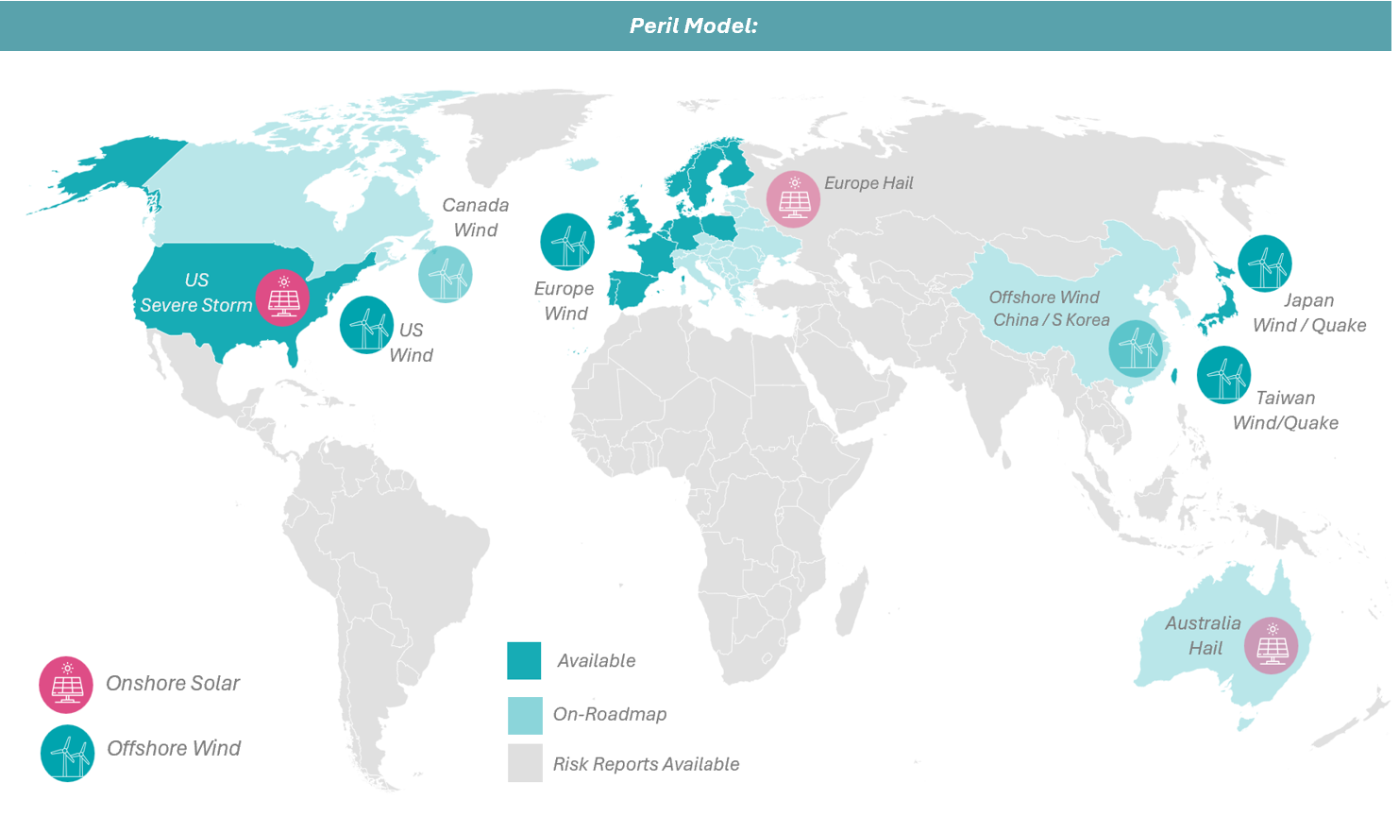










Renewables exposure
The better way to do it
Asset-led catastrophe models built only for renewables
Asset-specific characteristics
Roadmap – models, data, services
Offshore wind
Capacity (MW)
Foundation type
Age
Water depth
Cable protection
Operational, laydown area
World-class partners
Transmission
TBC
BESS
Solar PV
Capacity (MW)
Stowing (Auto / Manual)
Tracking / Axis
Max tilt angle
Glass thickness / type
Maintenance confidence
Onshore Wind
Bespoke risk reports (Nat Cat + Non-Cat)
TBC

Slide 7
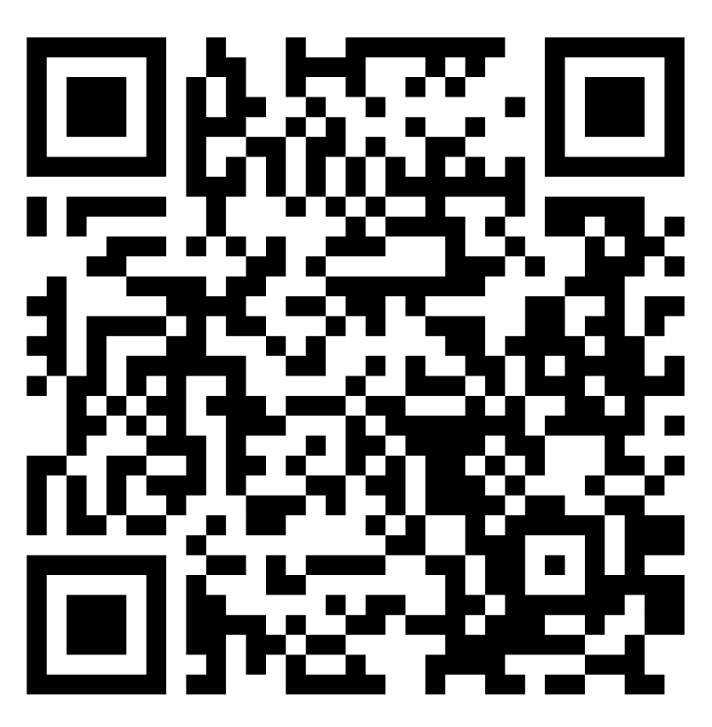
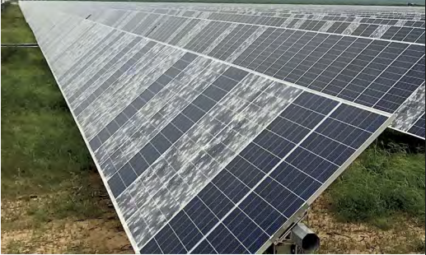
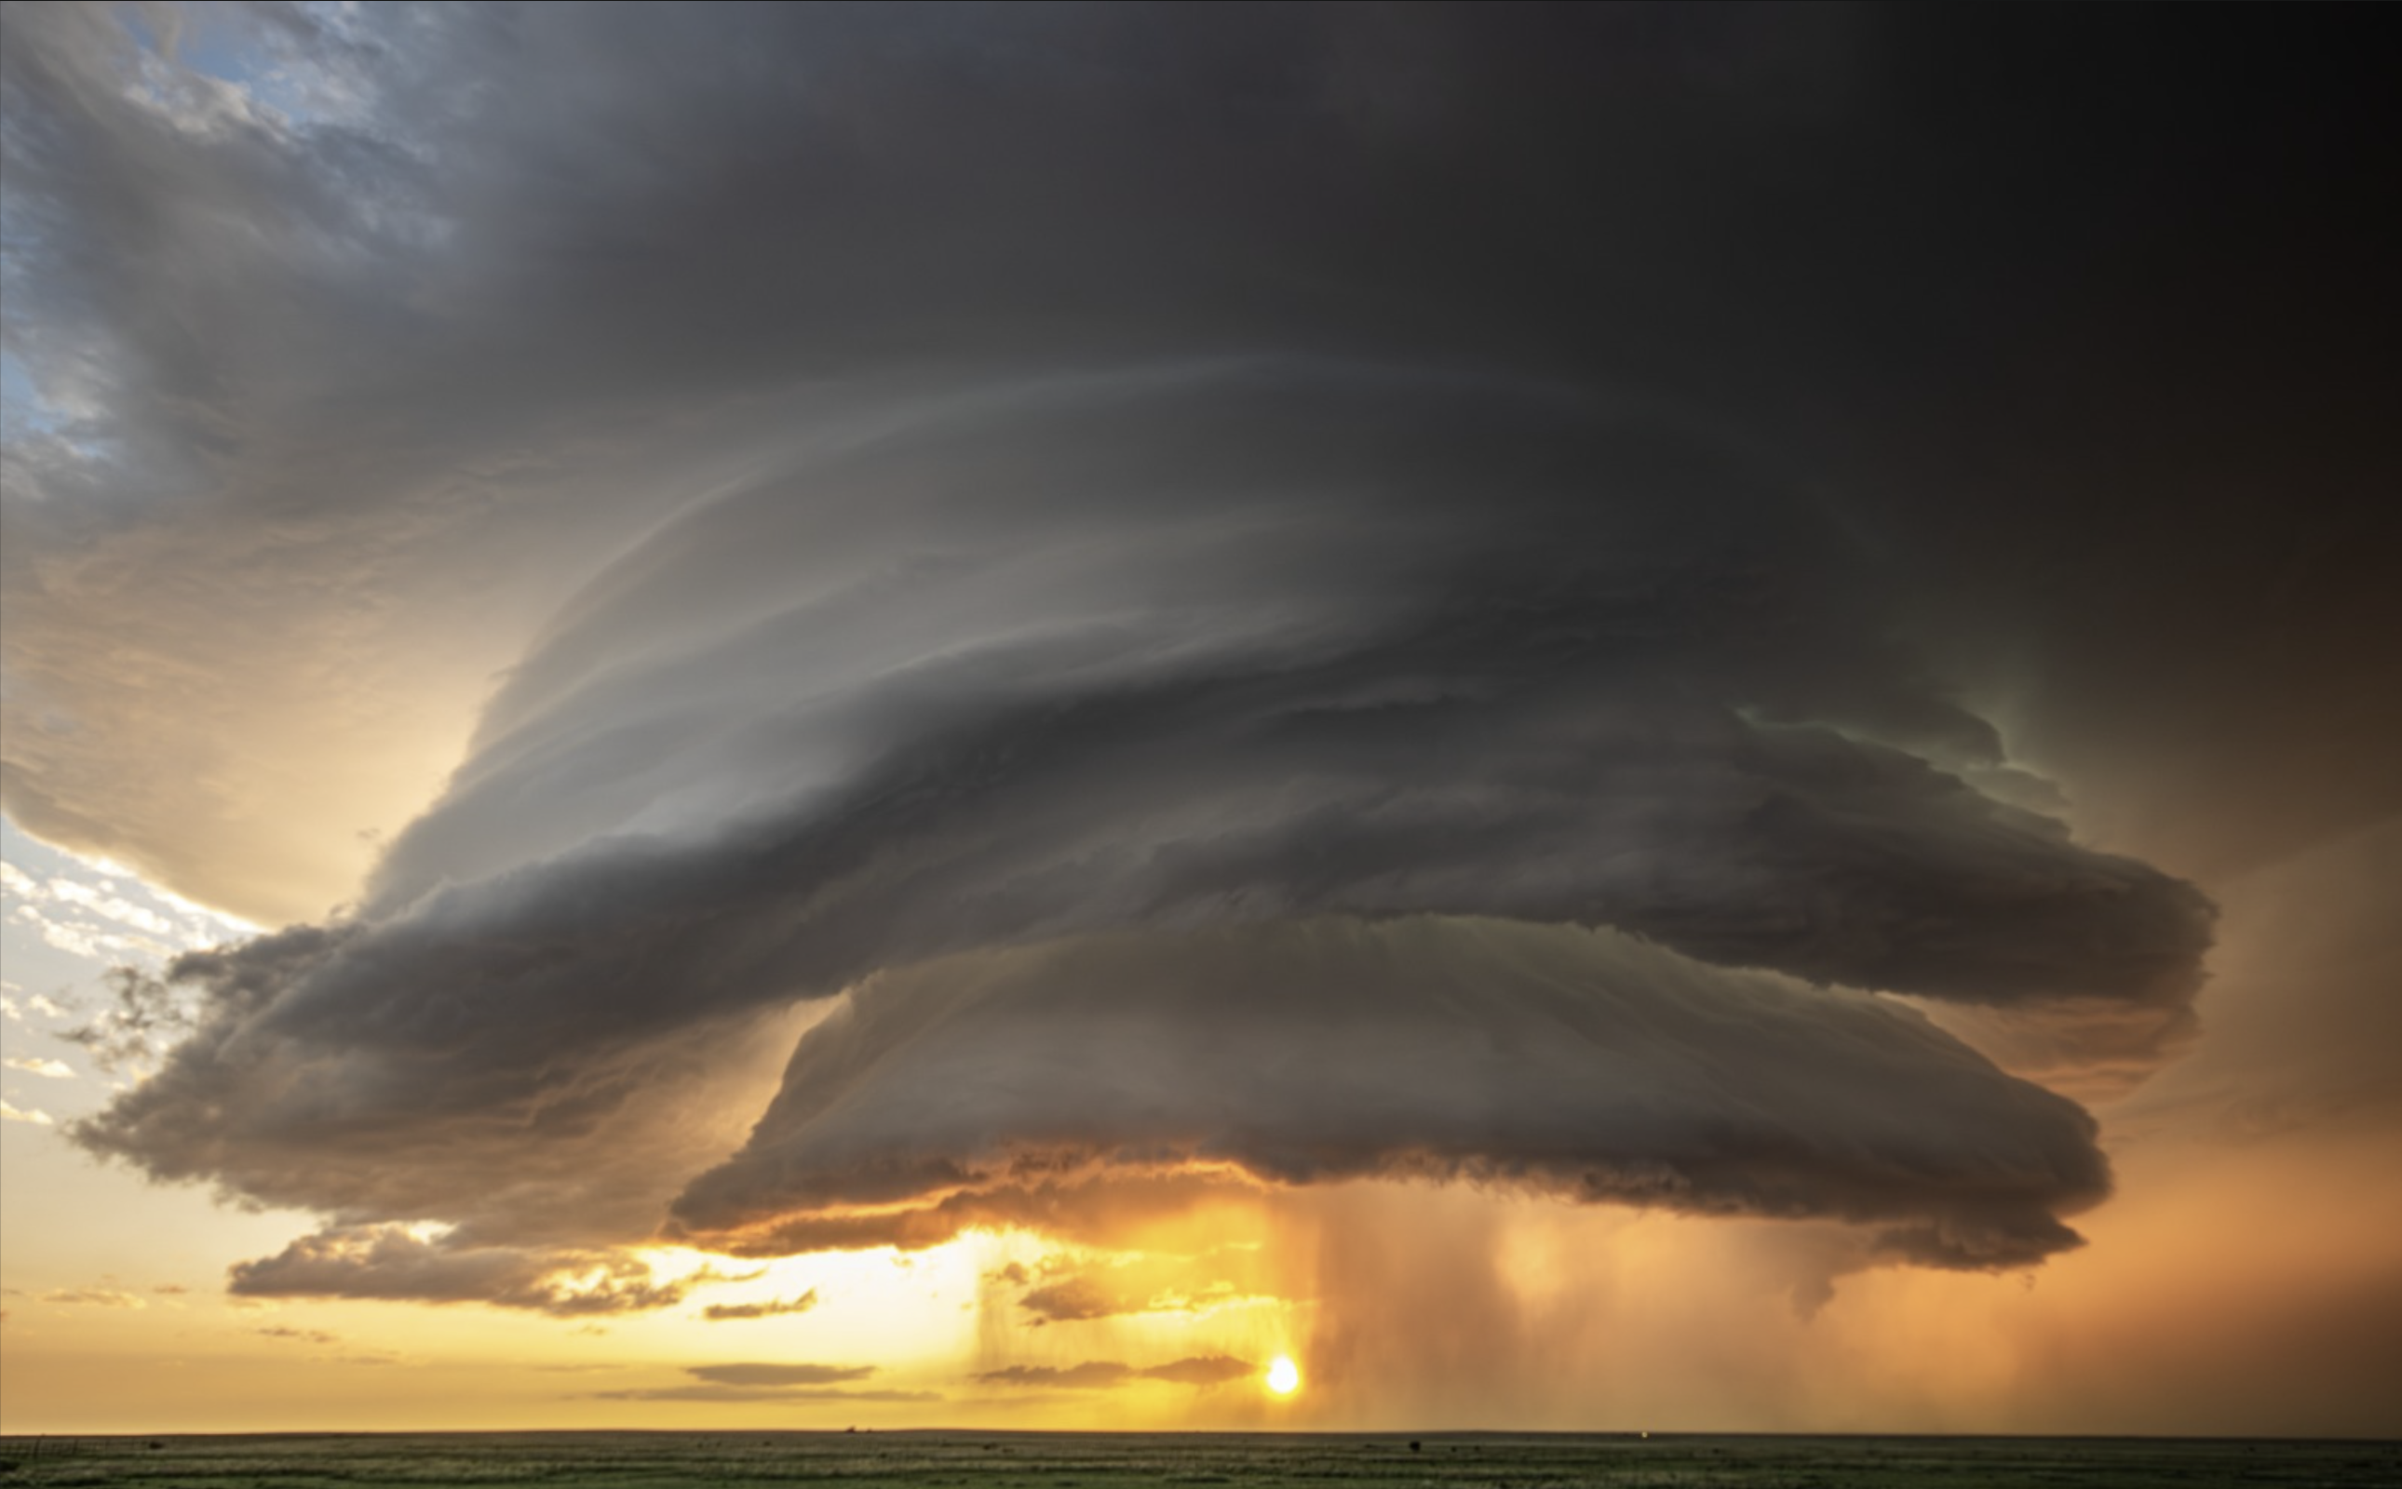
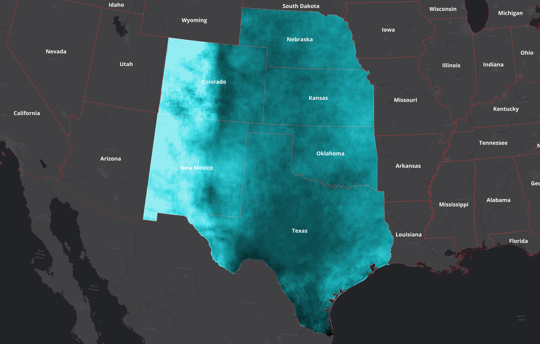
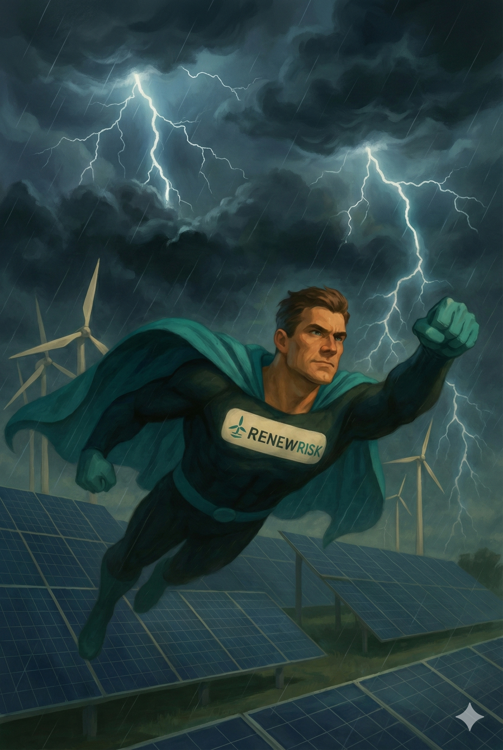
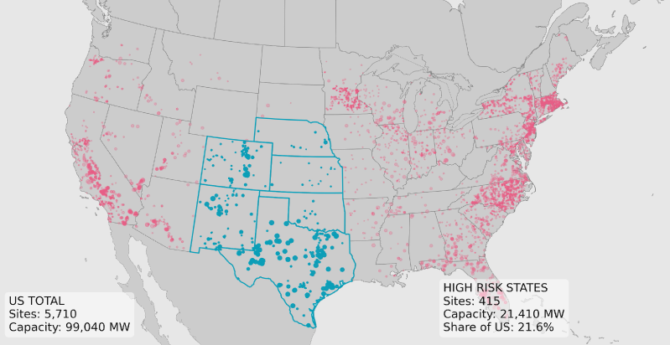
Reveal: US SCS for onshore solar
A next-generation model built from the ground up, focussing on asset class details combined with physics-based machine learning based event sets:
Get in touch to learn more about our upcoming US SCS Model for onshore solar: renew-risk.com/contact
Scan the QR code and tell us what to build next
What should we build next?
Provide your feedback...
Join us storm chasing – 2027!
Notes:
Modelling complex assets has its challenges but it also unlocks some massive advantages over other vendors

