Slide 1
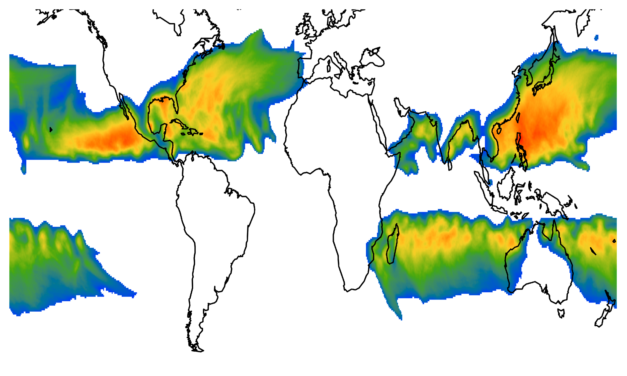

IRIS
Ralf Toumi
Nathan Sparks

Slide 2
Applications
Operations
Medium Term
Annual/
ENSO
IRIS
Climate
Change
Attribution
Climate
Change
Communication
Regulation

Slide 3
IRIS : A Statistical-Thermodynamic Model
Innovation- Focus on the "endgame" and drive by thermodynamics
Post-LMI Cat 1+ only
Decay focus
Counterfactual tracks
Global
Lifetime maximum intensity (LMI) constrained by potential intensity (PI)
Sparks, N., Toumi, R. Sci Data 11, 424 (2024). https://doi.org/10.1038/s41597-024-03250-y

Slide 4
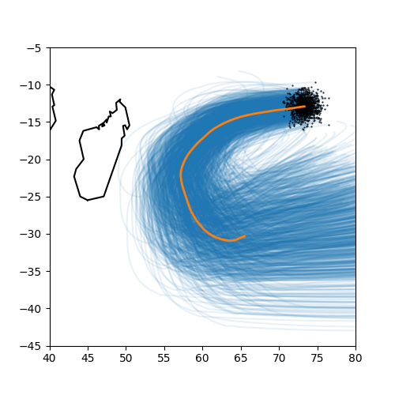
Track
Poisson count, N– independent, by basin - LMI Events
"Parent track" from observations
N tracks sampled per season, per basin.
Perturbation of LMI position
Extrapolation after parent track ends relaxes to monthly climatological steering wind
Backtrack parent to genesis point

Slide 5
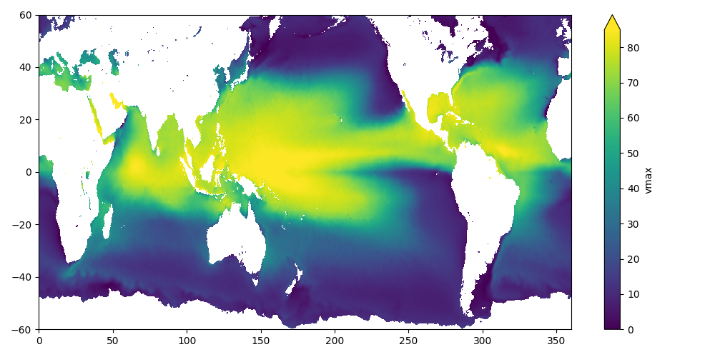
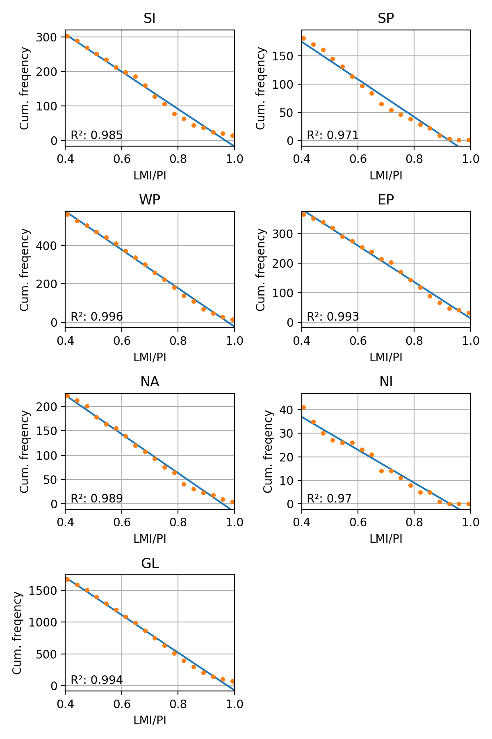
Lifetime maximum Intensity, LMI
Estimate potential intensity, PI, using monthly climatology
Draw relative intensity (LMI/PI) from uniform distribution
Calculate LMI = the initial intensity which is constrained by thermodynamics

Slide 6
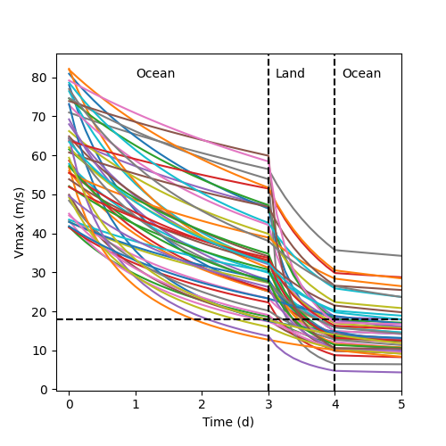
Decay
Decay is modelled as monotonic, algebraic:
v(t) = [1/LMI + κt]⁻¹
κ :
physical meaning derived from frictional decay of cylindrical vortex.
lognormal
depends land fraction in 300 km radius
different constant for each decay.
2

Slide 7
Current/Medium Term and Climate Change
Climatology
20 yr mean basin count & PI; tracks = 1950-2024
Climate Change (story line approach)
fix count & tracks
persist zonal mean trend of PI (+)
Medium Term (5 year mean)
weighted history of counts (+), tracks (Southward) and PI (+)
weights to optimise persitence skill
HurDI 2025 vs 2024: -10%

Slide 8
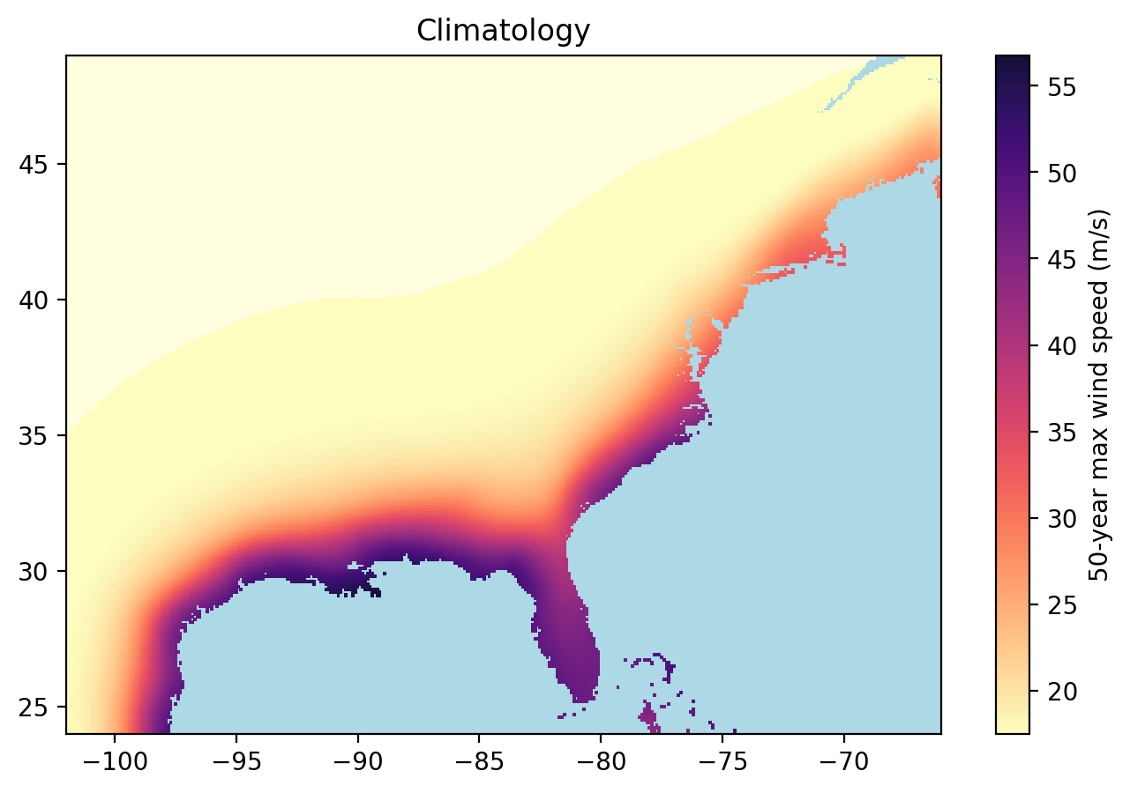

Slide 9
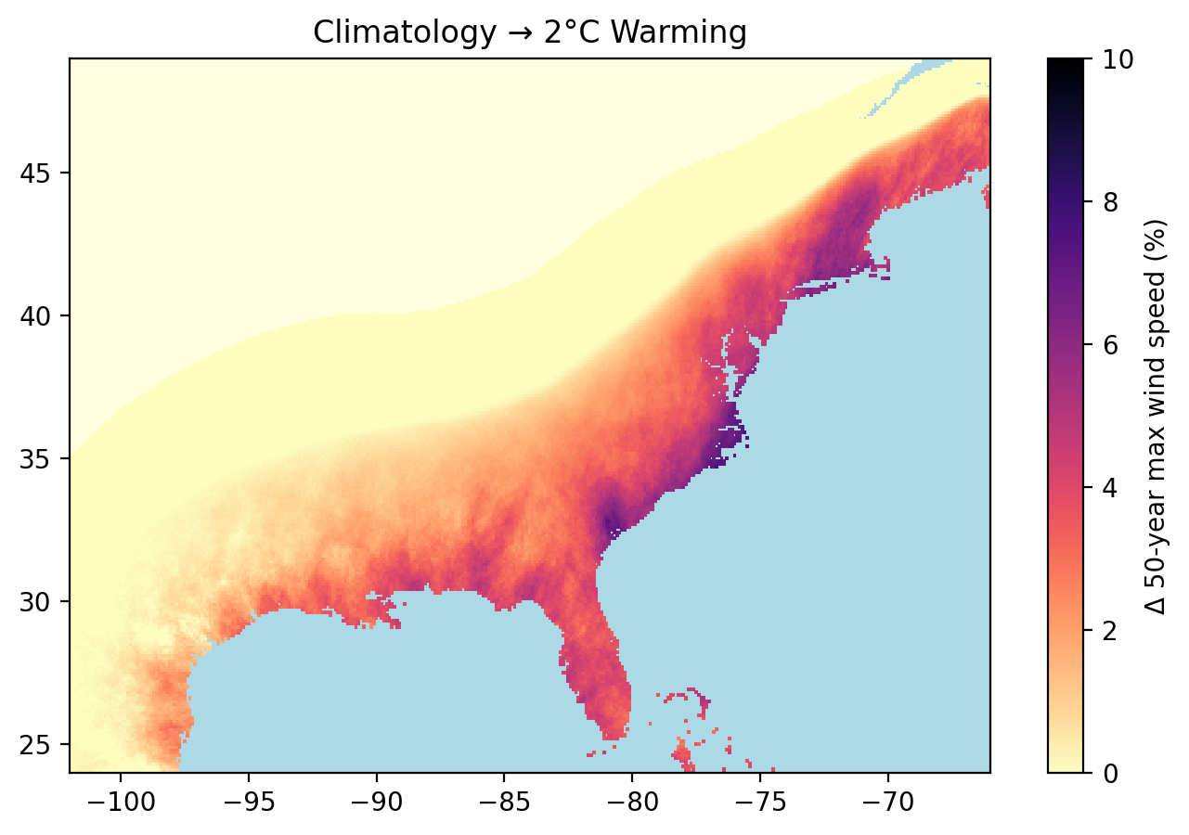

Slide 10
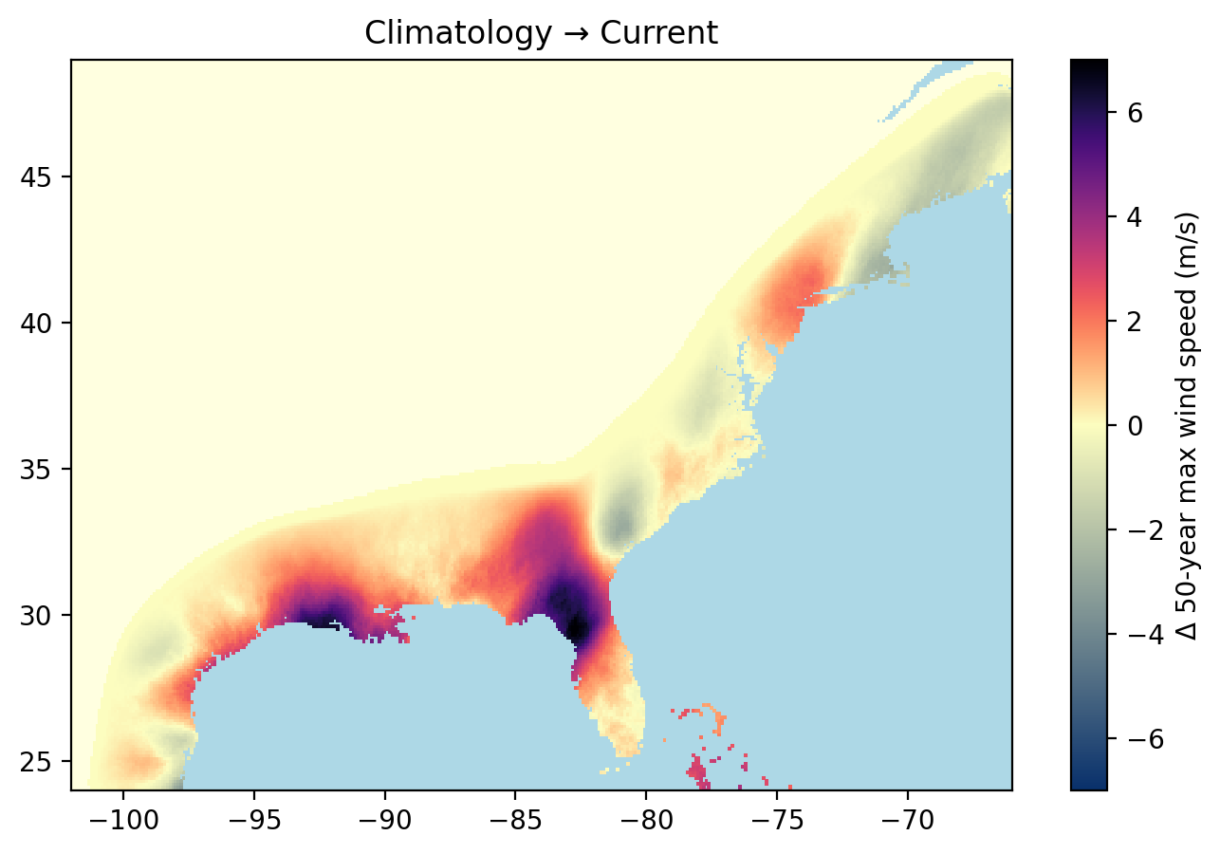
/Medium Term

Slide 11
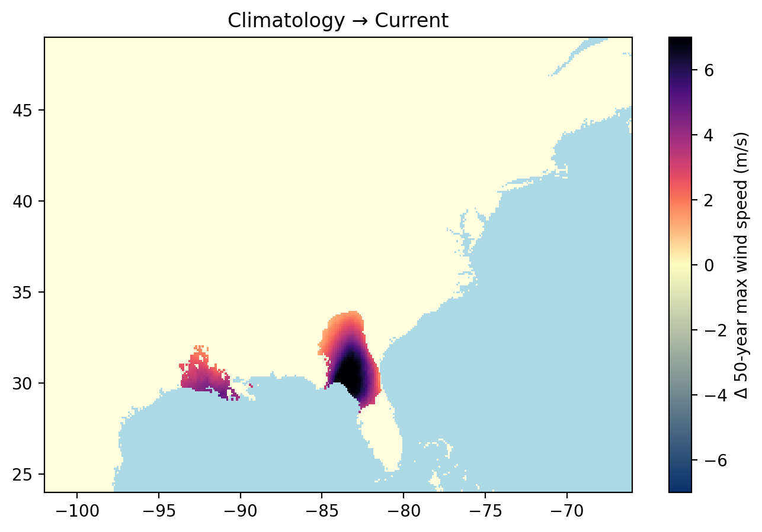
⅔ of 75-year samples have the same sign

Slide 12
IRIS Applications
Research and Innovation
Sparks, N., Toumi, R. Sci Data 11, 424 (2024). https://doi.org/10.1038/s41597-024-03250-y
Sparks, N., & Toumi, R. Atmospheric Science Letters, 26(1), e1285 (2025) https://doi.org/10.1002/asl.1285
Toumi, R., & Sparks, N., 2025. The Hurricane Damage Index (HurDI), Journal of Catastrophe Risk and Resilience, (2025). https://doi.org/10.63024/k2gm-2j0m
Sparks, N. and Toumi , R 2025, The impact of global warming on U.S. hurricane landfall: a storyline approach, Environ. Res. Lett. 20 114006
https://doi.org/10.1088/1748-9326/ae0956
Li, M and Toumi , R 2026 Attributing causes of increased intensity of North Atlantic hurricanes using a stochastic model (IRIS) Environ. Res. Commun. 8 011009. https://doi/10.1088/2515-7620/ae3898
Cat model adjustment
(additional risk view)
Parametrics
Loss and Damage
Medium Term
Annual/
ENSO
IRIS
Communication/
Global Media
Grantham Institute
Worldwide Weather Attribution
Climate
Change
Attribution
Climate
Change
Regulation
https://www.imperial.ac.uk/grantham/research/climate-science/modelling-tropical-cyclones/

Slide 13
















Insurance Sponsors

Slide 14











Partners

