Slide 1
Models and data and values in climate change risk assessments: an interdisciplinary, multi-company study
Marina Baldissera Pacchetti (UCL, BSC)
Erica Thompson (UCL, LML)

Slide 2
Agenda
Philosophical framework: values in science
Application to Re/insurance
  Cross-industry perspective
  In depth comparison: mental models and values
Lessons and open questions for regulation

Slide 3
Philosophical framework: values in science
Application to Re/insurance
  Cross-industry perspective
  In depth comparison: mental models and values
Lessons and open questions for regulation

Slide 4
Science and values: the received view
Science is valuable because it is “objective”.
Developed by individuals free from “emotional” and “partial” judgements.
Consisting of claims supported by uncontroversial evidence.
Developed by “standardized, repeatable, impersonal” methods.
Developed by community of experts with a certain pedigree.
Harding, S. (1995). “Strong objectivity”: A response to the new objectivity question. Synthese, 104, 331-349.

Slide 5
Science and values: current view
Depoliticization of science hides politics, assumptions, attitudes, aspirations and antipathies of scientists.
Science is not value-free (Levins and Lewontin 1993, Harding 1995, Longino 1996, Elliott and Steel 2017).
How does this affect the evaluation of quality of information derived from models and data and the decisions made from them?

Slide 6
Quality of scientific information for decision making
Credibility: scientific adequacy of the technical evidence and arguments.
Salience: the relevance of the assessment to the needs of decision makers.
Legitimacy: the perception that the production of information and technology has been respectful of stakeholders’ divergent values and beliefs, unbiased in its conduct, and fair in its treatment of opposing views and interests.
Cash, D. W., Clark, W. C., Alcock, F., Dickson, N. M., Eckley, N., Guston, D. H., ... & Mitchell, R. B. (2003). Knowledge systems for sustainable development. Proceedings of the national academy of sciences, 100(14), 8086-8091.

Slide 7
Quality of forward-looking climate science information for decision making
Quality dimension |  | What it does
Transparency |  | Assesses whether evidence and methodology are accessible and whether the other quality dimensions can be assessed.
Theory |  | Assesses the strength of the theoretical underpinning of the statement about future climate.
Diversity and Completeness | Independence | Assesses whether different types of evidence are independent from one another.
 | Number | Assesses how many different types of evidence are taken into account.
 | Comprehensiveness | Assesses whether individual lines of evidence are exhaustively explored.
Historical Empirical Adequacy |  | Assesses the empirical adequacy of the components relevant to the statement about future climate.
Baldissera Pacchetti, M., Dessai, S., Stainforth, D.A. et al. Assessing the quality of state-of-the-art regional climate information: the case of the UK Climate Projections 2018. Climatic Change 168, 1 (2021). https://doi.org/10.1007/s10584-021-03187-w

Slide 8
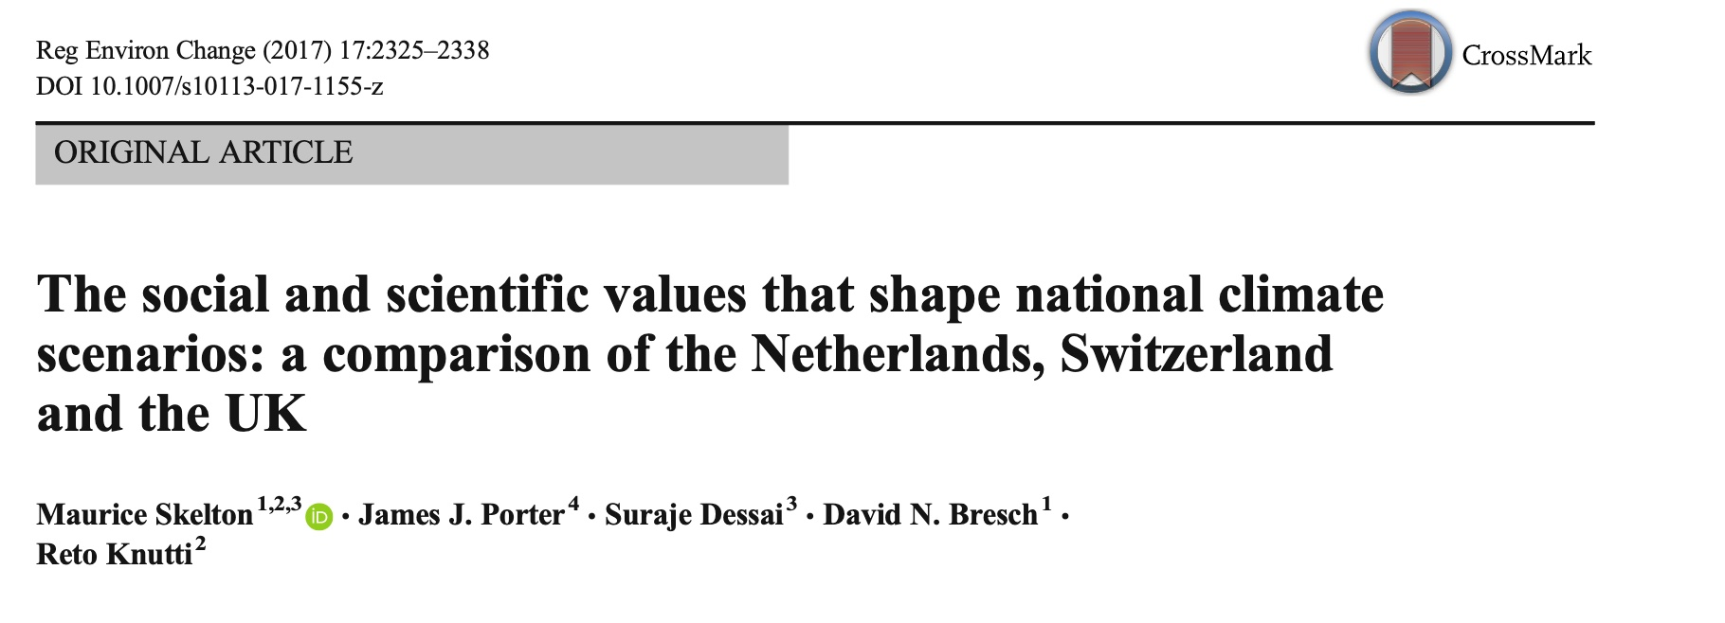
BUT:
Scientists from different institutions have different values about what counts as “good” science.
innovators, where the advancement of science is the main objective;
consolidators, where knowledge exchanges and networks are prioritised;
collaborators, where the needs of users are put first and foremost.

Slide 9
Science and values: examples

Slide 10
Applying this framework to re/insurance
Modelling and model evaluation is often based on scientific principles.
Modelling and model evaluation is not objective.
What values enter the modeling and information development process within and across firms? Are they homogeneous, diverse, and do they vary depending on expertise?
What are implications for regulation and information governance in the context of climate-related risks?

Slide 11
Philosophical framework: values in science
Application to Re/insurance
  Cross-industry perspective
  In depth comparison: mental models and values
Lessons and open questions for regulation

Slide 12
Cross-industry perspectives: valuing climate as a risk
Highly variable perceptions of the importance of climate risk within firms.
Analytics providers focusing mostly on climate analytics say market is not ready for expansion, some firms mentioning lacking capacity.
Existing practices for climate risk assessment quality are highly variable and fragmented. While many organisations apply scientific validation approaches (e.g. sensitivity analysis, stress testing, model calibration), others rely more heavily on expert judgement and internal processes.
Notes:
These are mostly views of cat modelers (both in vendor companies and firms)

Slide 13
Cross-industry perspectives: valuing climate as a risk
Methodological limitations
Existing tools are not always fit for forward-looking risk assessment. For example, cat models are sometimes adapted for future risk by adjusting hazard components without corresponding updates to exposure and vulnerability, resulting in inconsistent outputs. Limitations in representing tail risks were also noted.
Treatment of uncertainty
There is insufficient exploration, quantification, and communication of uncertainty, particularly in relation to emerging approaches such as AI and in the context of systemic, compound, and cascading risks.
Transparency and interpretability
A lack of transparency persists in both model design and the identification of appropriate expertise. Concerns were raised about “black box” models and limited visibility into assumptions and methodologies.
Notes:
These are mostly views of cat modelers (both in vendor companies and firms)

Slide 14
  In depth comparison: mental models and values

Slide 15
In depth comparison of model/data use in reinsurance underwriting: mental model A

Slide 16
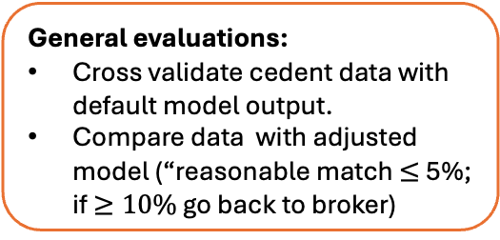
Treaty underwriter
General evaluations:
Cross validate cedent data with default model output.
Compare data with adjusted model (“reasonable match $≤$5%; if $≥10\%$ go back to broker)
General evaluations:
Brokers’ and cedents’ interests vs need to maintain trust and business relationship.
Data is assumed to be of “lowest acceptable quality”
Cedent submission data from brokers in RP slices (from 1 in 5 to 1 in 1000)
Cat modeling team
Standard vendor model output
Loss history
In house adjusted vendor model output
Pricing Platform
Experience Based Rating
Model Based Rating
General evaluations:
Predictability of fluctuations (check model assumptions)
Length of loss history
Rigidity of contract (qual T&C)
Actuary and Risk Manager evaluations:
Quality of risk
Proliferation of uncertainties
Limitations of model vs underwriters’ needs
Climate loading
Price
View of Risk
Market conditions
Cost of Capital

Slide 17
In depth comparison of model/data use in reinsurance underwriting: mental model B

Slide 18
Treaty, property class underwriter
Cat Modelling Team
Brokers
Model-based Data
Historical Actuarial Data
Risk type (Peril*Vulnerability*Exposure)
Client Benchmarking and Choice
Pricing Template
(Return Period * Profitability)
(Attachment Point * Cost of Reinsurance)
CRITERIA:
Hazard level * area exposed
Tight Policy
Proactive response to Climate Change
  Shifting from regional to global focus
  Higher attachment points for modelled RP – but top layers are more volatile/uncertain
  Separate out opportunistic portfolios [volatility + client relationship]
CRITERIA:
  Market performance
  Size
  Quality of capital and risk management
  Trustworthiness of loss est.
  Expert Judgment
  Relationship with client
always preferred over exposure
Exposure rating
Experience rating
Pricing and Portfolio Management

Slide 19

Reflections on mental models
Market pressures often overrule model-based pricing, and climate risk is accounted for by
Portfolio shape.
Risk management and in house expert judgement.
Company level view of risk and risk appetite.
Reliance on and trust of model-based data for pricing is dependent on background expertise in modeling.
Loss data valuation and trust in clients/brokers is varied across companies.
(Jarzabkowski et al. 2015)

Slide 20
In depth comparison: valuing climate risk
Underwriter Firm A | Underwriter Firm B
Our approach is to look at the most impactful [areas of business affected by CC], and if there’s any where we think that we have missed out, then we would explicitly add up some loading factors to account for the uncertainty [in CC]. | I’m not saying we discount the climate change but it’s not the sole focus […] you’ve got to have a big storm in the first instance, land falling in a bad place, and then you adjust whatever uplift you want to apply for climate change. It doesn’t change the maths of it much.
Exposure Manager Firm A | Exposure Manager Firm B
If you’ve got something from 1910 which you captured in there for example, does that mean that’s reflective of current day climate conditions? There’s always going to be that conversation between climate variability versus climate change. There were bad years in the past. Doesn’t mean that it was due to climate change. Could just have been, again, a bad year [due to climate variability]. | The return period language is a little unhelpful because we’re considering the next 12 months rather than sort of 1-in-5 or 10 years’ time, but the idea is that the modelling should be allowing for the present day slightly warmer temperatures,[..]the losses are higher because of climate change, essentially. [..] The extent to which that is climate change is difficult to assess.
Notes:
Firm A: somewhat systematic approach to look at impact of climate risk on pricing (important enough to do this), but the ability to measure it is questioned by Exposure manager (maybe not that important)
Firm B: more of an “expert judgement” approach and not that important compared to other lines of business. Exposure manager values CC but also notes its impact is hard to assess.

Slide 21
In depth comparison: valuing uncertainty for business decisions
Underwriter Firm A | Underwriter Firm B
I think by trying to reduce uncertainty from model insights will not always be 100% correlated with […] the price. Hard market or soft market cycles are not correlated with the underlying data. | What the underwriters will have is a target price they need to try and get their portfolio to run at, and within that they’ll be a [Firm B] view of risk, i.e. we’ve taken into account some climate change at the company level .
Exposure Manager Firm A | Exposure Manager Firm B
There are lots of assumptions that you have to be comfortable with… we’re trying to make judgement calls quite rapidly for the purpose of doing business. | We’re restricted in just amount we can do because you’re dealing with unknowns, and different types of uncertainty as well .. The fact is, we are driving business …we are restricted in terms of what we can do with data cleansing of the data and model adjustment in producing reports to the business.

Slide 22
Reflections on in depth comparison
Climate variability and change risk is taken into consideration, but it’s importance, technical evaluation and materiality for business decisions varies both across and within firms.
Model Uncertainty is valued very different within firms across different roles or expertise (even if e.g. underwriters have background in modeling).
In general, different approaches to climate risk and related uncertainty is seen as a source of competitive advantage.

Slide 23
Take aways for cat modelers
Talk about framing and context, not just the numbers
Your colleagues may think about climate risk and uncertainty in a fundamentally different way. Structured discussions of risk across job roles have been valuable for the companies we worked with
Make the case for relevance in business terms
The case for using cat models as a complement to historical data is clear (to you) in the context of scarce data and changing climate, but this can be obscured (for others) by competing priorities.
Contribute to discussions about quality of models and information
Without quality standards, there is a constant tension between modellers and non-modellers about the value of information, and this will be more acute as AI models become more widespread.
Today’s risk is already climate risk
Where this isn’t understood, definitions are unclear. Improve the field by setting clear references that are understood within and across firms.

Slide 24
Philosophical framework: values in science
Application to Re/insurance
  Cross-industry perspective
  In depth comparison: mental models and values
Lessons and open questions for regulation

Slide 25
Implications for regulation and information governance in the context of climate-related risks
Climate risk and uncertainty is not valued homogenously.
How can regulators promote its integration into business workflows?
How will this view evolve with increasing importance of compound/cascading risks?
The way climate risk is assessed within companies is very different, no “objective” method, values differ.
What are implications for assessing financial stability/resilience to climate shocks of the sector?
What are the implications for the increasing role of possibly even more opaque/black box AI tools?

Slide 26


Thank you!
If you’d like to connect:
Marina.Pacchetti@ucl.ac.uk
Erica.Thompson@ucl.ac.uk
Marina
Erica
Cool books plug:

