Slide 1
Cotality™ New d/b/a rebrand of CoreLogic® CoreLogic® acquired EQECAT in 2013 Oasis LMF Lightning Pitch – US Earthquake
Notes:
We are Cotality
Formerly CoreLogic, formerly EQECAT.
We are a data analytics company with the most complete data coverage on property assets in the US, we employ this data and more in our Cat Model building division.
We deploy two of of our 180+ country peril model regions in Oasis Loss Modeling Framework, Japan earthquake, and US Earthquake, which we’ll talk about some more today.

Slide 2
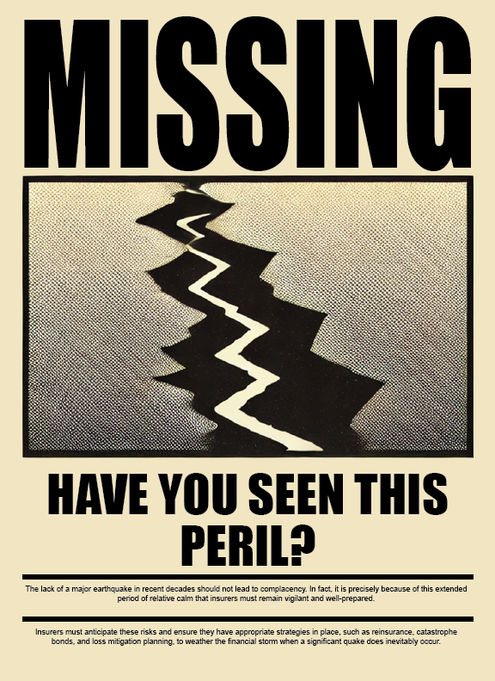
US Earthquake risk Why does it matter?
Lack of recent events.. Makes modeling complex
But:
Magnitude 6.7 Northridge Earthquake (1994)
195,000 claims
$40+ billion insured today
Modeled losses
US wide Gross AAL - ~$2Bn
1:200 year loss - $60+Bn Insured loss
Earthquake risk is complex
Science is constantly evolving
Earthquake risk is granular
Notes:
Earthquakes, have you seen this peril? A lack of recent events, and a flurry of events in other perils does mean that earthquakes, may not be front of an multi-peril insurers mind, of late.
From a modelling stand point, it’s exactly this that makes modelling them so complex. Yes, the first catastrophe risk models were earthquake models, and it’s easier to capture a view of risk, but earthquakes are a peril all about uncertainty, and capturing this uncertainty is essential to building a robust model, as we have a lack of real live events, compared to other perils.
The 1994 Northridge earthquake caused 195,000 property claims, and if recurred today would amount to $40+bn
That is why cat model vendors and the insurance industry relies so heavily on peer reviewed consensual based science, and namely, the USGS National Seismic Hazard Models (NSHMs) at the core of the modelling process. Earthquake risk is complex, granular and evolving.

Slide 3
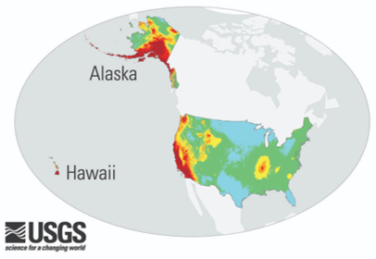
Cotality is consistent first adopter of model science USGS NSHM 2023 model update
Consistent first adopter of model science
USGS Model Update
CoreLogic Model Release Date
Version
2023
2025
RQE v25
2018
2022
RQE v22
2014
2016
RQE v16.1
Notes:
This leads us to developments on US earthquake. The last 10 years has seen two updates to the USGS NSHM.
These have led to large sweeping changes in the model science updates as new information is studies.
Cotality has been the consistent first adopter of these updates, being the first to bring the models to market, at least a year ahead of our peers, and looks to be the same this year, with out release of our latest update in line with USGS NSHM 2023. In fact, we are one of the few model vendors who adopted the 2018 USGS NSHM, and this had significant and material loss changes, aiding customers in understanding the risk, as well as providing a smoother change in loss changes, that is, moving 5 years of science introduces less uncertainty than 10 years.
We work with the USGS to understand the changes and the impact the changes may bring to the insurance industry.
That’s why the majority of the US earthquake admitted lines market trust Cotality to help them understand, and adapt to upcoming changes, including the California Earthquake Authority, where the Cotality model is exclusively used for rate setting.

Slide 4
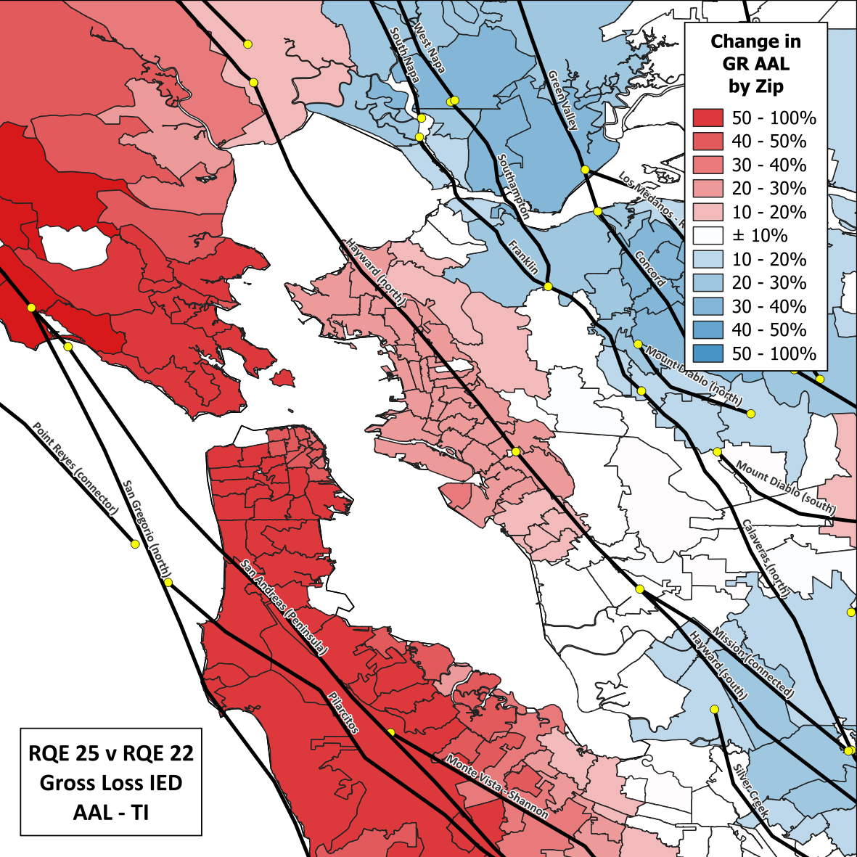
San Francisco Bay Area
1
The Peninsula is seeing large increases
The East Bay is seeing significant increases in/near Oakland, mostly moderate decreases elsewhere
2
Notes:
We help our clients understand the changes, both hazard and loss. Here is a Highlight of what we are seeing in the latest release: Gross Loss AAL as based on our IED, here’s the picture, for the San Francisco Bay Area.
The peninsula is seeing large increases in losses.
The east Bay is seeing material increases in / near Oakland, mostly moderate decreases elsewhere.
This is largely coming from fact that there is an increase in frequency of earthquakes Northern San Andreas fault sections, in the west of the map, and decreases in frequency of earthaquakes on faults in the east of this map.

Slide 5
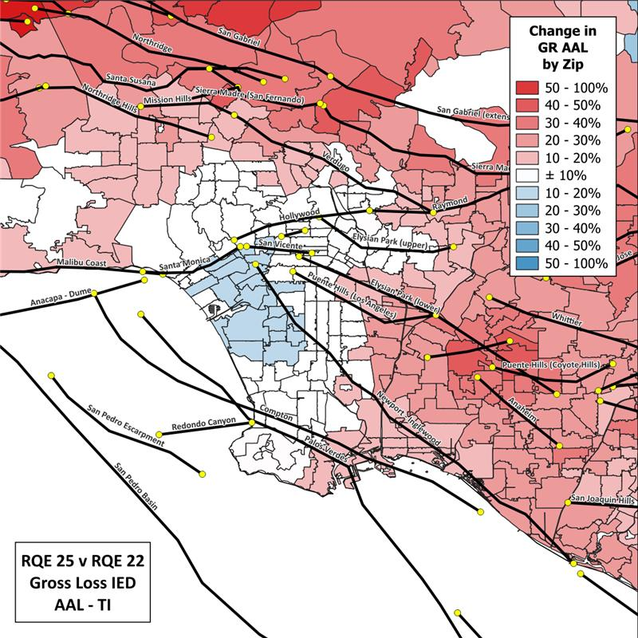
LA Basin
1
Granular changes
2
LA Basin fault frequency changes
3
Probability of segment that triggers has changed
Notes:
LA, we see more granular changes, with the LA basin area being driven by more, smaller faults, relative to the San Francisco Bay Area.
These changes are coming from LA Basin fault frequency changes.
But number 3, shows us the importance of changes not just in frequency, but which segments of the fault trigger.

Slide 6
Cotality
U.S. Earthquake
Model update
Summer 2025
Three views of risk
Time Independent view
Time Dependent
Time Dependent with Aftershocks
Notes:
A key item with the latest USGS model development is the inclusion of aftershock events in the catalog.
CoreLogic, for the first time, is releasing 3 views of risk, a main shock Time Independent view and Time Dependent views, which is what the industry is used to.
And a first for the US, a Time Dependent view of risk that includes aftershocks, limited to a 7-day aftershock window, that’s included in typical policies.
This employs the latest and best published research on the hazard side, where we consulted with the USGS on modelling approach, as well as engineering concepts to incorporate ‘vulnerability curves with memory’, that is, adjusting the vulnerability in a second event to reflect the buildings inherent change in vulnerability, from damaged components, through to damage acceleration.
Cotality is proud to release this this Summer, as our first model to incorporate an aftershock study at the probabilistic level, after collaborating with many peers and partners over the years on understanding aftershock earthquake risk in a deterministic fashion, including through the Shakeout consortium in California, the Bank of England Stress test scenarios, and individual client projects throughout US, Turkey and other high hazard areas.
At Cotality, we are here to help our clients understand how and why the model updates change losses. We are happy to help, come talk to us.

