Slide 1

Harnessing innovation in Cat Modelling: SCOR future vision
Simos Koumoutsaris
Global Head of Cat R&D
Oasis Insight Conference - Zurich 2025 in collaboration with Swiss Re

Slide 2
SCOR Cat Modelling workflow
Current and future vision
Strategy development and deployment of small models where the large vendors do not have a model representation or models with suboptimal performance.
  Example: SCOR in-house Oasis platform and California Wildfire model.
The current SCOR cat modeling workflow for Oasis models is manual, time consuming, and resource intensive.
The goal is to leverage automated API workflows through a Central Exposure Repository and a Model Execution tool.
The future vision will enable aligned automated processes and analytics for both Oasis and Vendor Catastrophe modelling.
SCOR Cat Modelling workflow for Oasis models
Current
Client Data provided to SCOR
California Wildfire
Manual Data Manipulation (SQL scripts)
Manual Data Review
Connect to SCOR Oasis Server
SCOR Wildfire Model
Manually Extract Output
RiskReveal (Scor VoR)
SCOR Data Platform
Utilise Internally
Client Data provided to SCOR
++ Perils
Data Auto manipulated
Augment, Enrich & Enhance
Central Exposure Repository
Model Execution
RiskReveal (Scor VoR)
SCOR Data Platform
Utilise Internally
Future vision
OASIS
Other platforms

Slide 3
SCOR Model Development workflow
Current and future vision
Developing models is currently a complex, time-consuming and tailored process.
  Example: Creating the California Wildfire model required significant effort to understand Oasis platform’s logic, develop the necessary files and codes, and conduct extensive testing and debugging.
An Oasis-curated Model Builder tool could streamline the development and deployment of catastrophe models on the OasisLMF platform.
  This tool would enable users to input data such as hazard footprints and vulnerability parameters, automatically constructing all the necessary components and datasets for running an Oasis model.
SCOR Model Development workflow
Census Data Blocks
Variable Grid Development
Built environment
Current
FSIM footprints
Hazard model files
Future vision
Testing
Hazard raster or shapefiles
OASIS Model Builder
UI
Vegetation, land use types, damage curves
Vulnerability model files
Oasis CAWF Model files
OASIS
Vulnerability parameters
Oasis Model Image
Deployment
OASIS
Codes
Keys Server
Debugging
Built environment
Parameters
Settings files
Parameters

Slide 4


Slide 5
Oasis conference
  Zurich
    19th June 2025

Slide 6
Impact Forecasting – Taking Part of Oasis Community
The
Model
Developer
The
Model
Deployer
The
3rd Party
Model
Deployer
The
Community
Member
    Using and enhancing the Oasis model definition format
    Using ODS to standardise property characteristics
    Our models deployed via Oasis LMF via different channels
    Not suing Complex Model Wrapper
    IF deploying Oasis compatible models to Aon and clients
    ERN, JBA and others
    IF involved in the Oasis community from the beginning
    Took significant part in Oasis Dynamic Footprint development

Slide 7

An Increasing Number of Ways to Access Catastrophe Models
Catastrophe Model
IF financial engine
Oasis financial engine
In ELEMENTS
In ELEMENTS
Verisk’s NRMC
Direct
(SaaS)
Via Moody’s IRP
On prem
On AWS
On prem
On AWS
Client’s own
On prem / SaaS
Other Oasis based
Other engines
SaaS
Other platforms
SaaS
Financial engine
Platform
Deployment
Engine provider
Platform provider
In production
Notes:
(IF, ERN, other 3rd party model)

Slide 8
Disclaimer
Legal Disclaimer
Aon’s Reinsurance Solutions business, part of Aon UK Limited (for itself and on behalf of each subsidiary company of Aon plc) (“Aon”) reserves all rights to the content of this report (“Report”). This Report is for distribution to Aon and the organisation to which it was originally delivered only. Copies may be made by that organisation for its own internal purposes but this Report may not be distributed in whole or in part to any third party without both (i) the prior written consent of Aon. and (ii) the third party having first signed a “recipient of report” letter in a form acceptable to Aon. Aon cannot accept any liability to any third party to whom this Report is disclosed, whether disclosed in compliance with the preceding sentence of otherwise.
To the extent this Report expresses any recommendation or assessment on any aspect of risk, the recipient acknowledges that any such recommendation or assessment is an expression of Aon opinion only, and is not a statement of fact. Any decision to rely on any such recommendation or assessment of risk is entirely the responsibility of the recipient. Aon will not in any event be responsible for any losses that may be incurred by any party as a result of any reliance placed on any such opinion. The recipient acknowledges that this Report does not replace the need for the recipient to undertake its own assessment.
The recipient acknowledges that in preparing this Report Aon may have based analysis on data provided by the recipient and/or from third party sources. This data may have been subjected to mathematical and/or empirical analysis and modelling. Aon has not verified, and accepts no responsibility for, the accuracy or completeness of any such data. In addition, the recipient acknowledges that any form of mathematical and/or empirical analysis and modelling (including that used in the preparation of this Report) may produce results which differ from actual events or losses.
The Aon analysis has been undertaken from the perspective of a reinsurance broker. Consequently this Report does not constitute an opinion of reserving levels or accounting treatment. This Report does not constitute any form of legal, accounting, taxation, regulatory or actuarial advice.
Limitations of Catastrophe Models
This report includes information that is output from catastrophe models of Impact Forecasting, LLC (IF). The information from the models is provided by Aon Benfield Services, Inc. (Aon) under the terms of its license agreements with IF. The results in this report from IF are the products of the exposures modelled, the financial assumptions made concerning deductibles and limits, and the risk models that project the pounds of damage that may be caused by defined catastrophe perils. Aon recommends that the results from these models in this report not be relied upon in isolation when making decisions that may affect the underwriting appetite, rate adequacy or solvency of the company. The IF models are based on scientific data, mathematical and empirical models, and the experience of engineering, geological and meteorological experts. Calibration of the models using actual loss experience is based on very sparse data, and material inaccuracies in these models are possible. The loss probabilities generated by the models are not predictive of future hurricanes, other windstorms, or earthquakes or other natural catastrophes, but provide estimates of the magnitude of losses that may occur in the event of such natural catastrophes. Aon makes no warranty about the accuracy of the IF models and has made no attempt to independently verify them. Aon will not be liable for any special, indirect or consequential damages, including, without limitation, losses or damages arising from or related to any use of or decisions based upon data developed using the models of IF.
Additional Limitations of Impact Forecasting, LLC
The results listed in this report are based on engineering / scientific analysis and data, information provided by the client, and mathematical and empirical models. The accuracy of the results depends on the uncertainty associated with each of these areas. In particular, as with any model, actual losses may differ from the results of simulations. It is only possible to provide plausible results based on complete and accurate information provided by the client and other reputable data sources. Furthermore, this information may only be used for the business application specified by Impact Forecasting, LLC and for no other purpose. It may not be used to support development of or calibration of a product or service offering that competes with Impact Forecasting, LLC. The information in this report may not be used as a part of or as a source for any insurance rate filing documentation.
THIS INFORMATION IS PROVIDED “AS IS” AND IMPACT FORECASTING, LLC HAS NOT MADE AND DOES NOT MAKE ANY WARRANTY OF ANY KIND WHATSOEVER, EXPRESS OR IMPLIED, WITH RESPECT TO THIS REPORT; AND ALL WARRANTIES INCLUDING WARRANTIES OF MERCHANTABILITY AND FITNESS FOR A PARTICULAR PURPOSE ARE HEREBY DISCLAIMED BY IMPACT FORECASTING, LLC. IMPACT FORECASTING, LLC WILL NOT BE LIABLE TO ANYONE WITH RESPECT TO ANY DAMAGES, LOSS OR CLAIM WHATSOEVER, NO MATTER HOW OCCASIONED, IN CONNECTION WITH THE PREPARATION OR USE OF THIS REPORT.

Slide 9
Thank You

Slide 10
Harnessing Innovation in Catastrophe Modelling
Oasis Conference, Zurich
June 19, 2025

Slide 11
In early April 2025, Verisk acquired Nasdaq Risk Modelling for Catastrophes

Slide 12
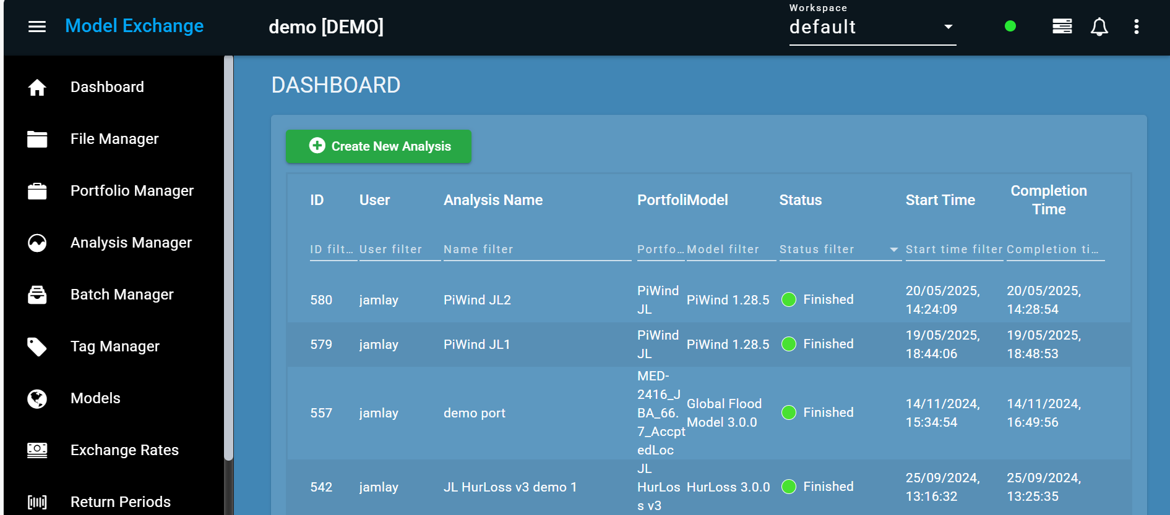
What’s Changed?
Nasdaq Risk Modelling for Catastrophes is now Model Exchange

Slide 13
What’s Changed?
Nasdaq Risk Modelling for Catastrophes is now part of Verisk
All cloud systems and services are transitioning to Verisk
Former NRMC employees are now Verisk employees
Oasis Loss Modelling Framework technology is now utilised directly by one of the world’s biggest modelling companies
Model vendors that develop their models in Oasis format have access to a bigger market
The product, now Model Exchange, is owned by a company whose core business is catastrophe modelling
Verisk has made a strategic investment to support and grow the open data and alternative modelling landscape

Slide 14
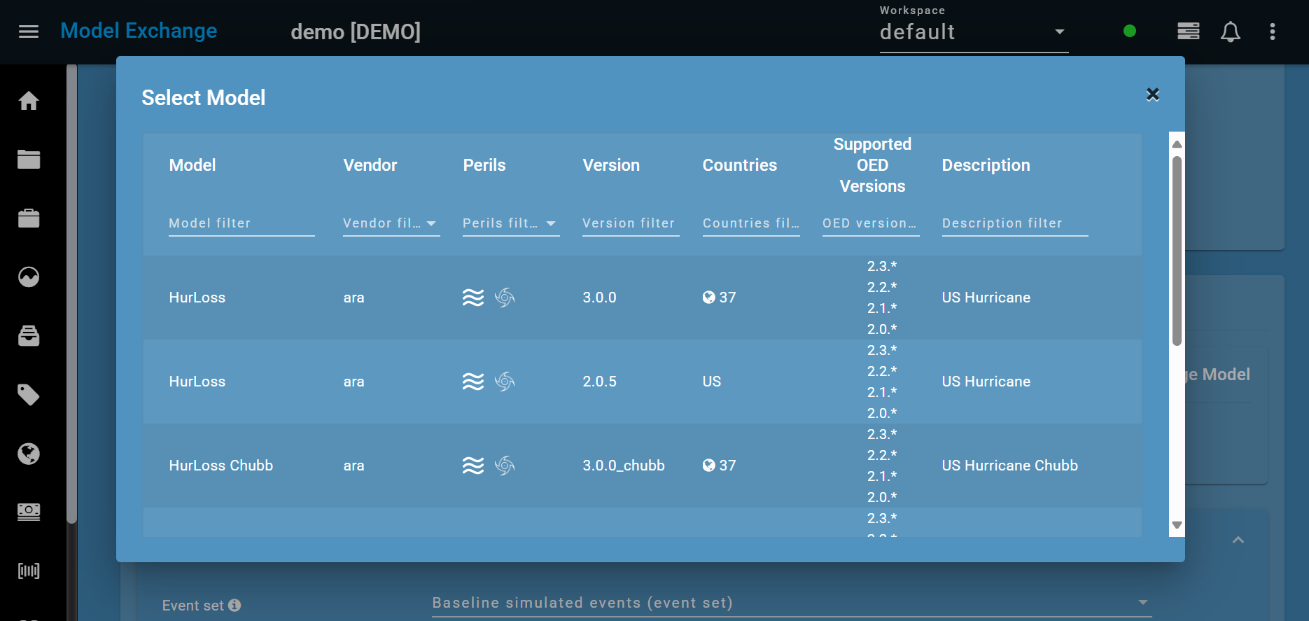
What Hasn’t Changed?
Clients of Model Exchange have access to a vibrant community of model vendors via a single platform

Slide 15
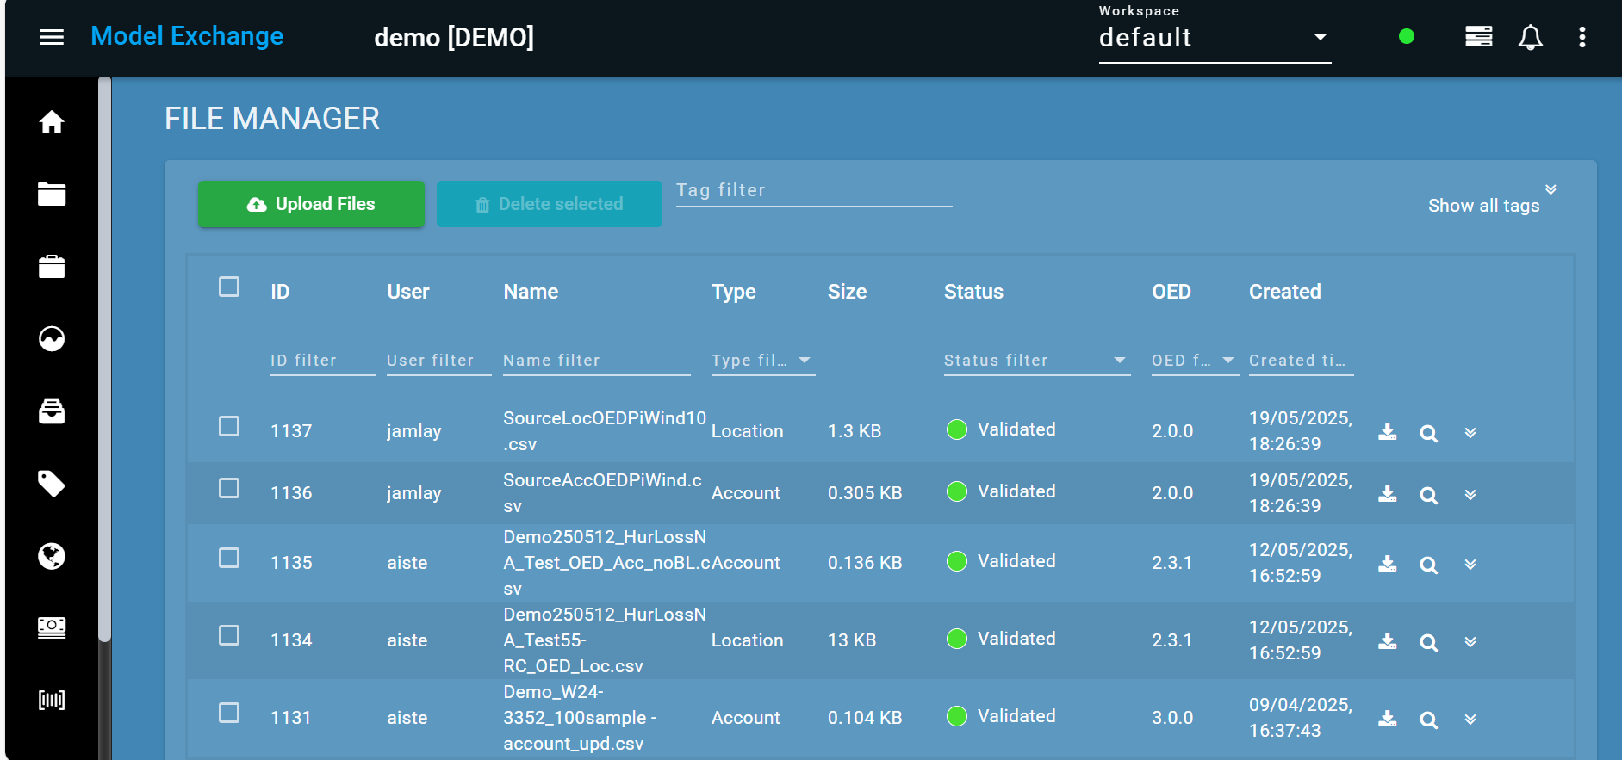
Easy to use, Intuitive User Interface
Upload exposure data individually or in bulk
Exposure files are validated by Model Exchange

Slide 16
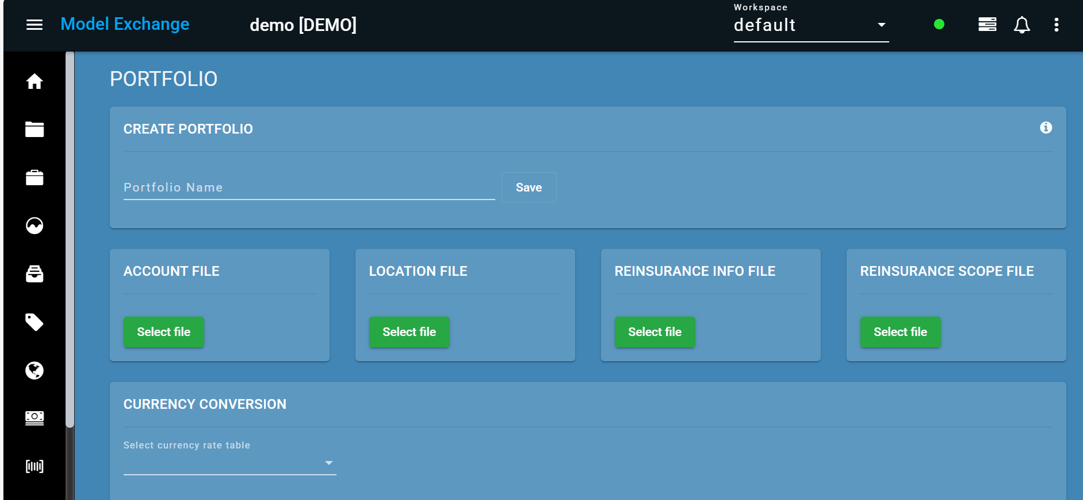
Easy to use, Intuitive User Interface
Create Portfolios in one simple to use form
Add currency conversion table for each portfolio

Slide 17
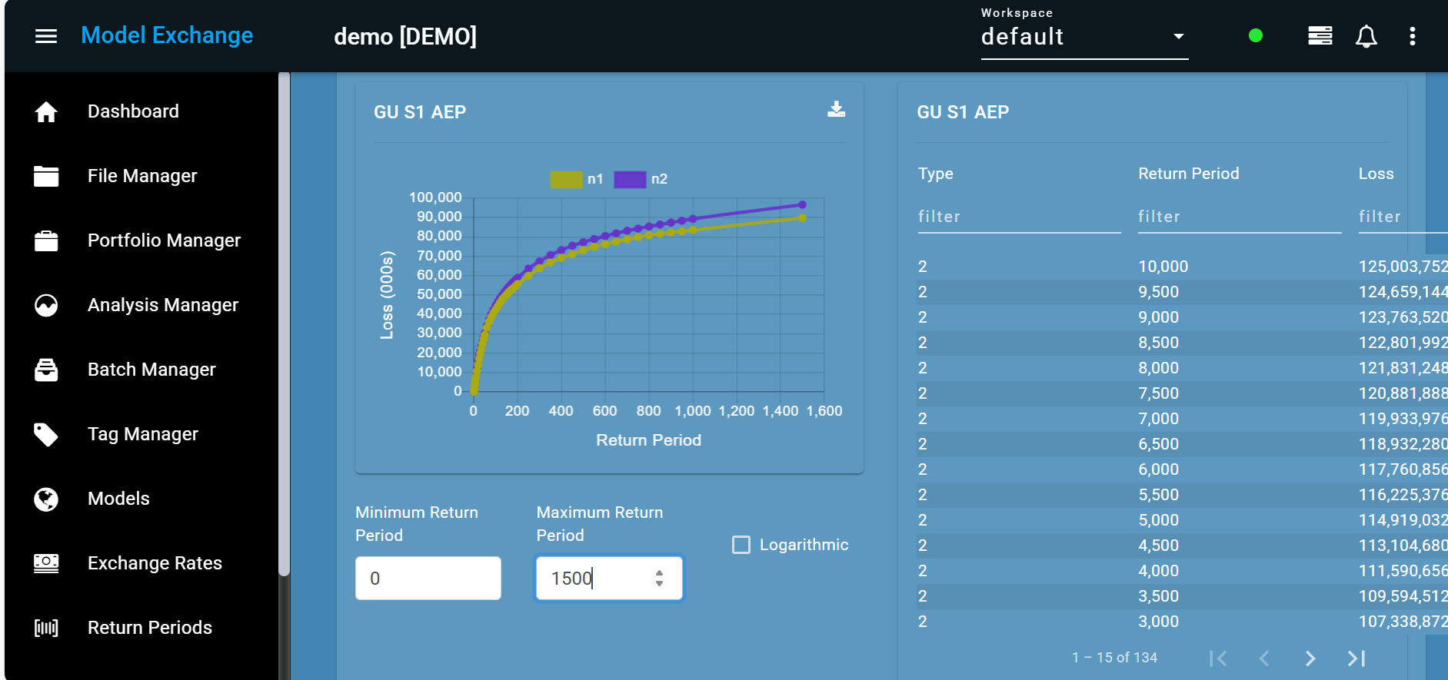
Easy to use, Intuitive User Interface
One system, multiple workspaces.
Visualise and download model results

Slide 18
Working with Model Vendors
What makes our platform a success will continue to be our focus:
We will continue to work with any model vendors that have a model in Oasis format
The Model Exchange team will continue to promote models on the platform
Wider Verisk teams will have the information they need to help promote the platform with their clients
Although we are part of Verisk, there will be controls in place regarding model IP:
Model data is held in separate systems with strict access controls
Processes are in place to protect the commercial IP of model vendors

Slide 19
What Next for Model Exchange?
Model Exchange will continue to be developed as a standalone platform
We are growing the number of models and model vendors available via the platform
The Model Exchange team and Verisk team are working on a robust method to convert data between OED and CEDE exposure formats
We will look to integrate Model Exchange with Synergy Studio so clients can gain the benefits of a seamless workflow

Slide 20
Thank You

Slide 21
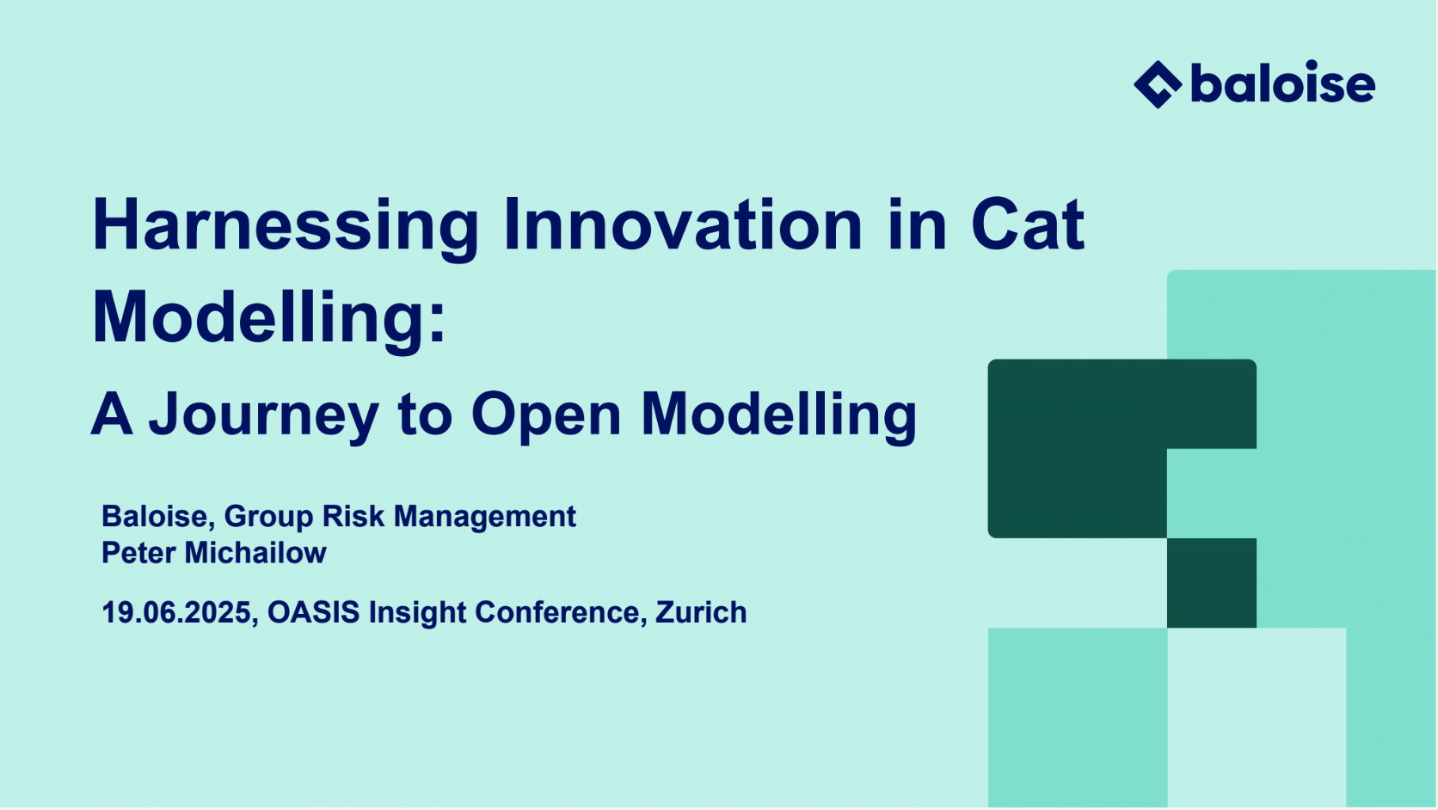

Slide 22
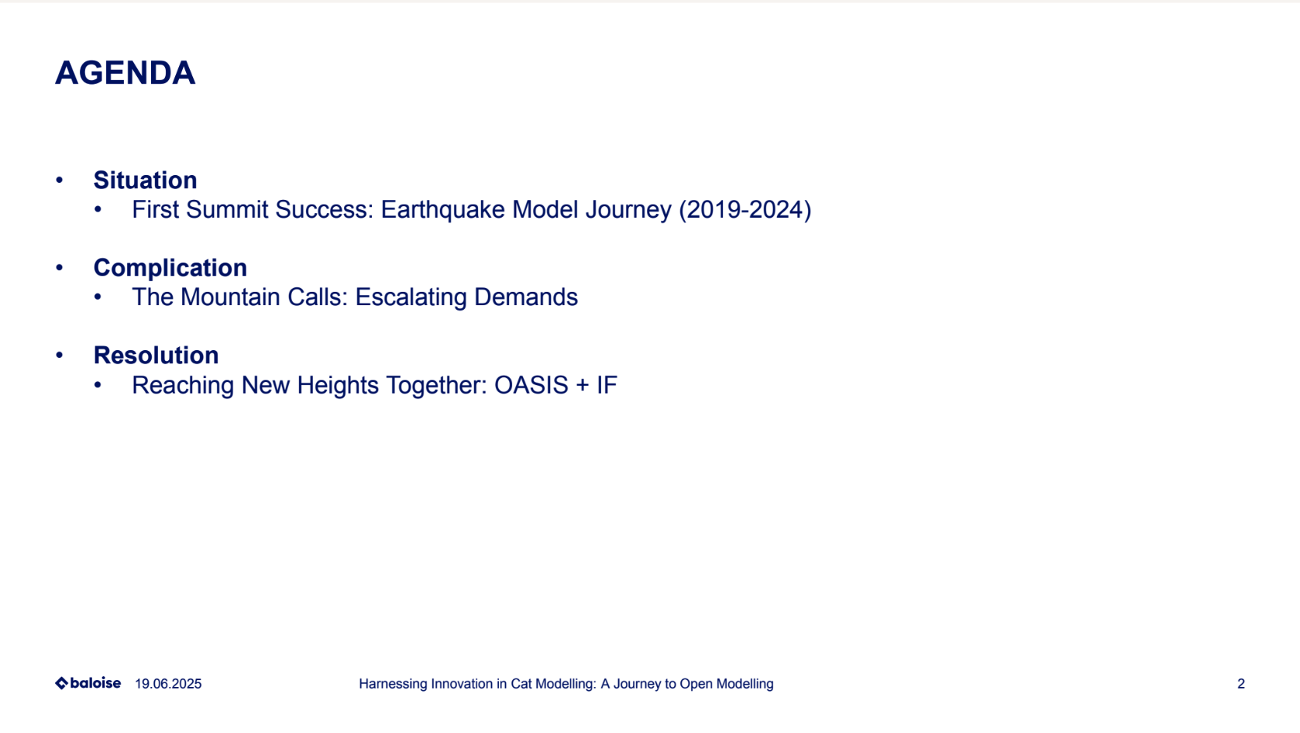

Slide 23
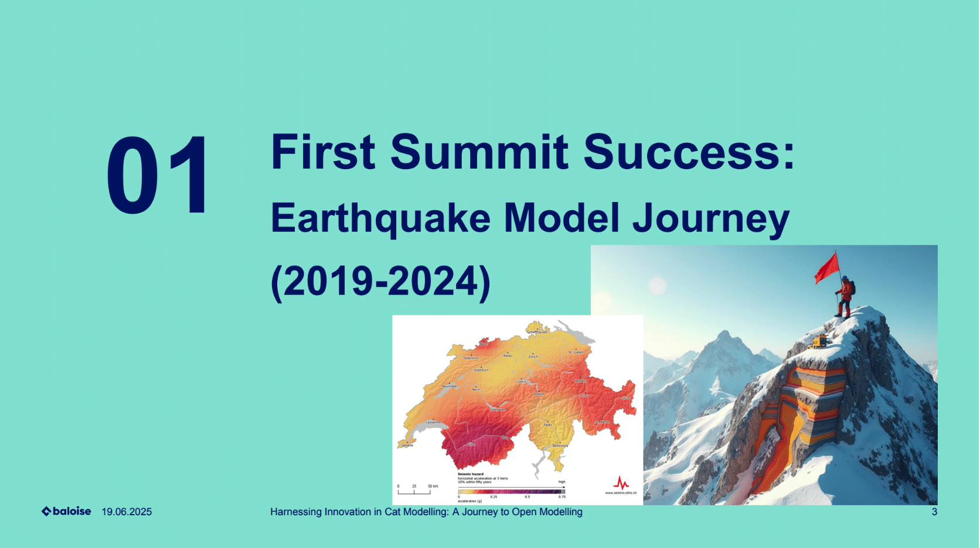

Slide 24
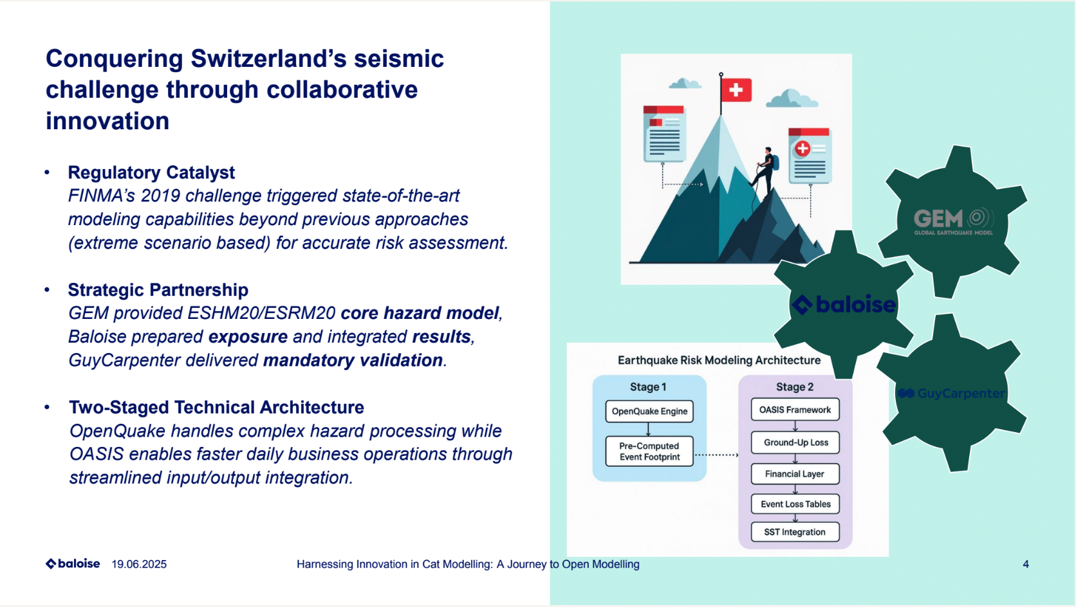

Slide 25
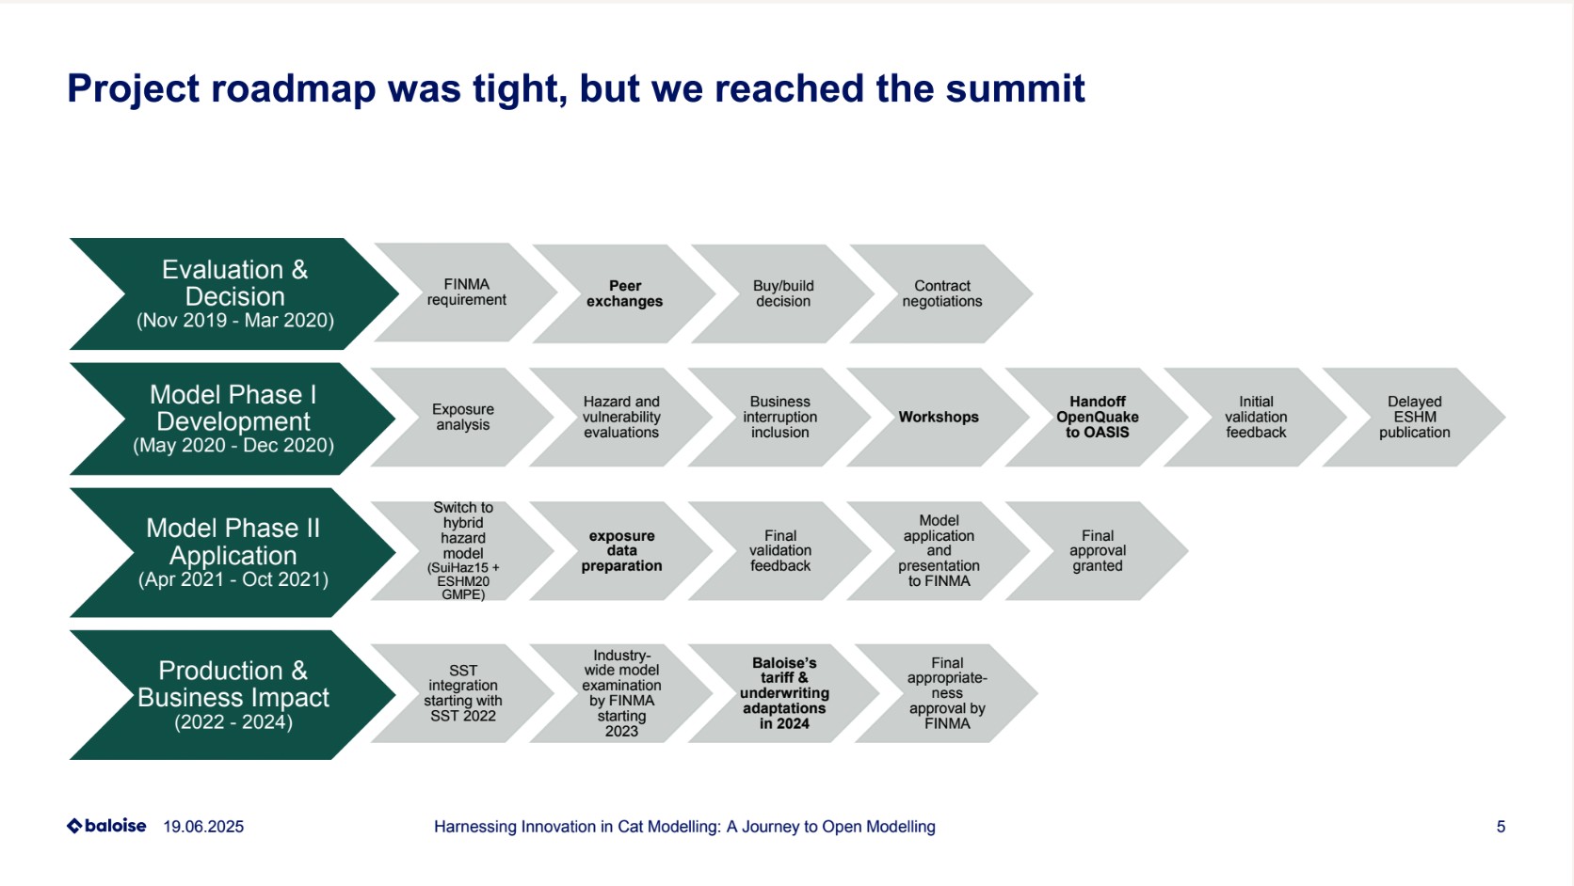

Slide 26
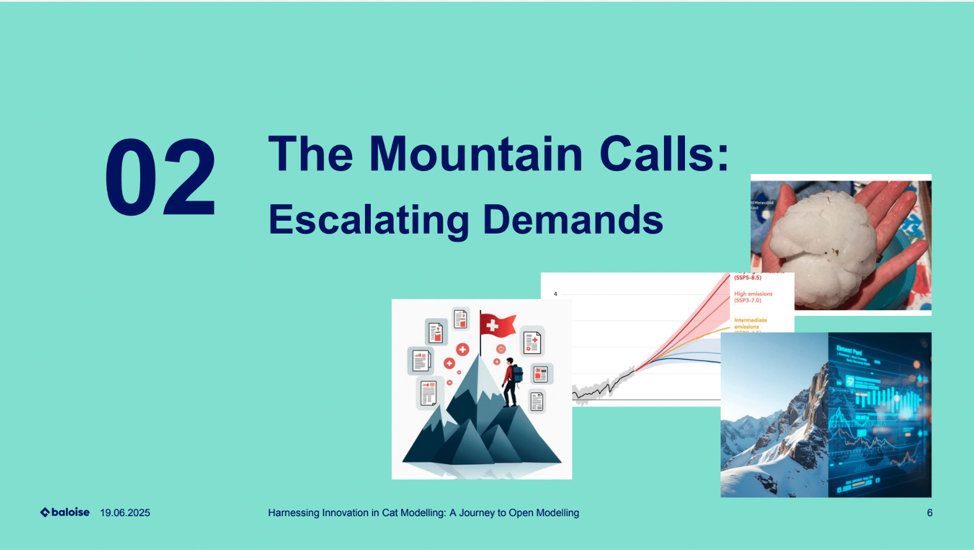

Slide 27
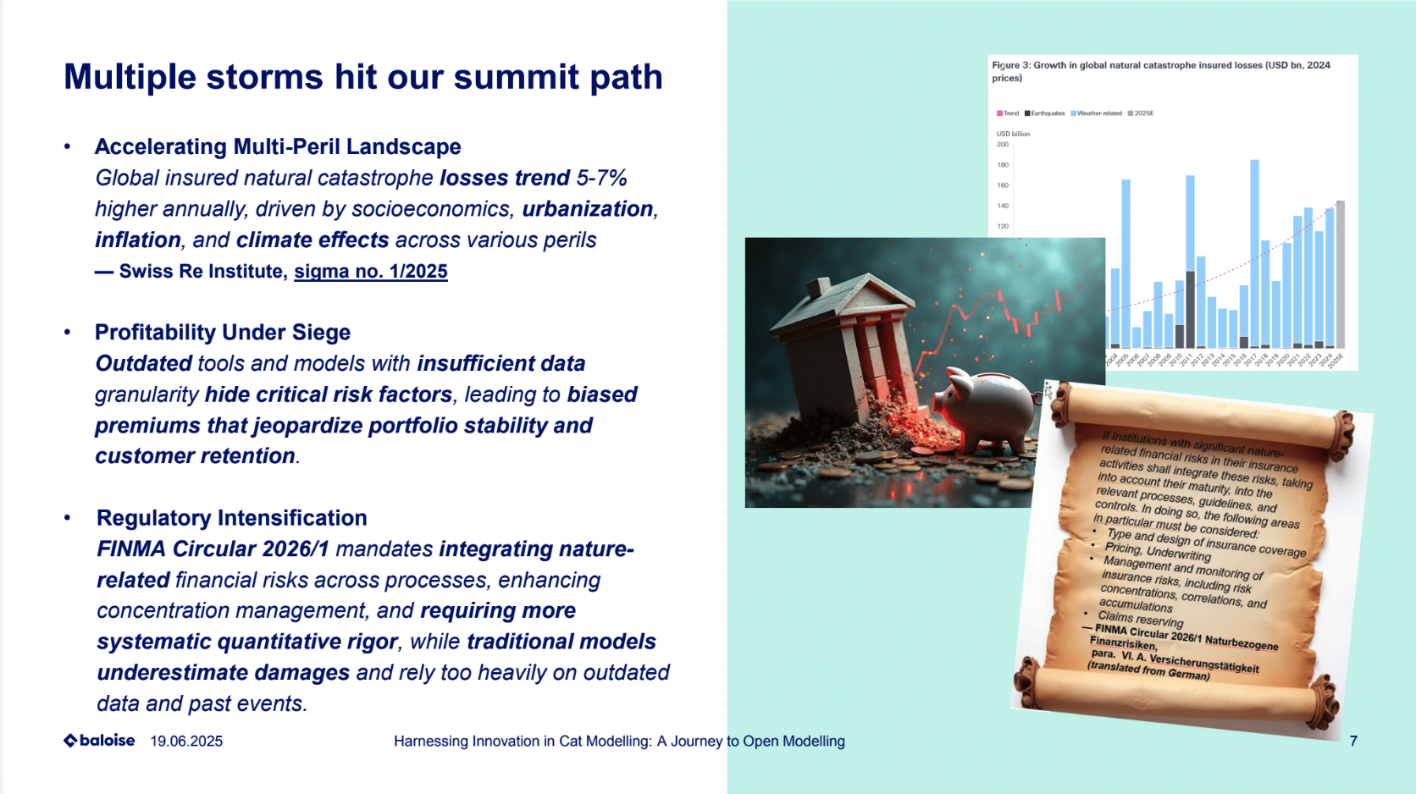

Slide 28
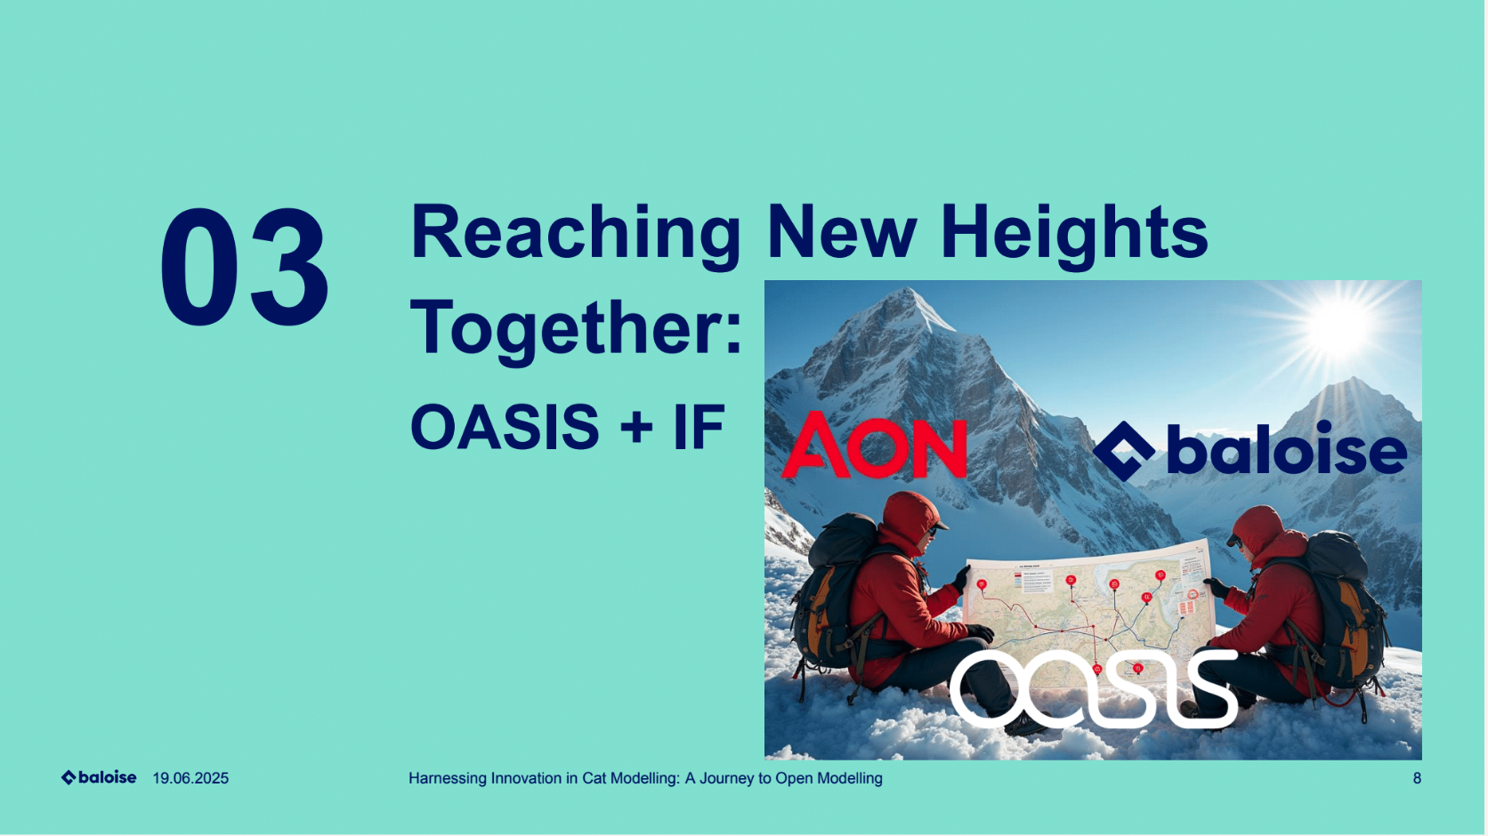

Slide 29
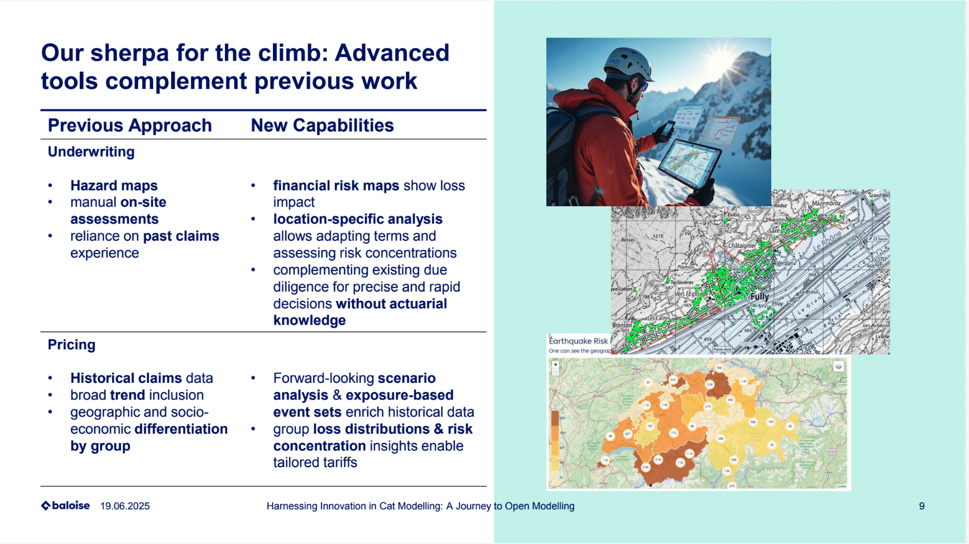

Slide 30
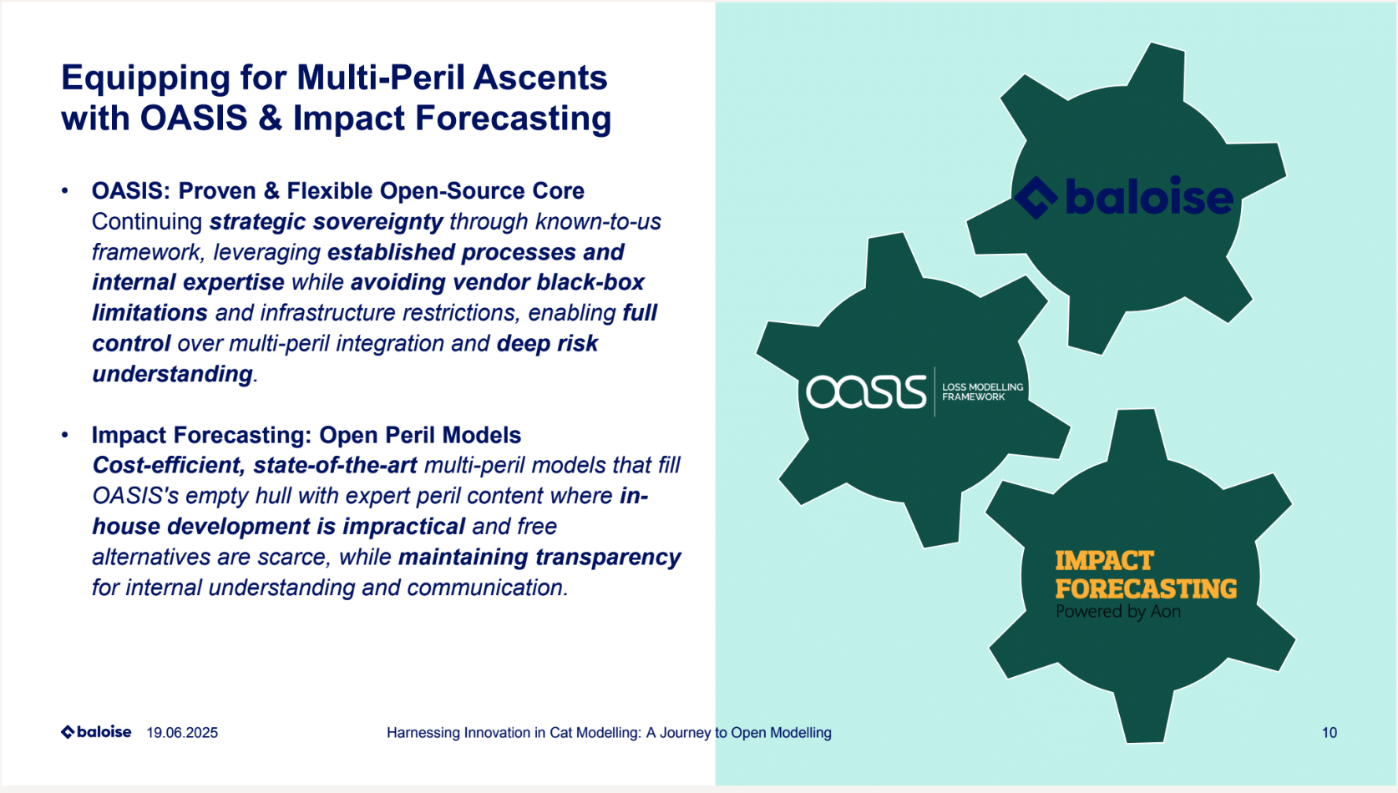

Slide 31
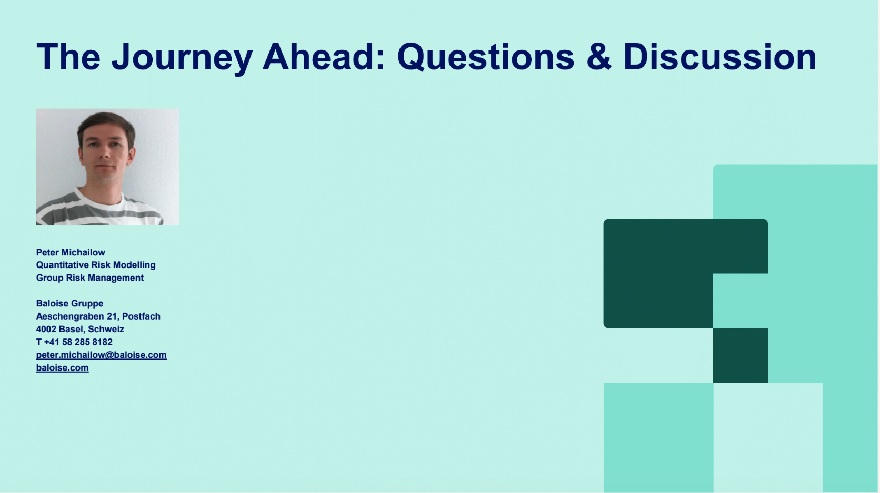

Slide 32

Accelerating Innovation At Aviva with OASIS
Tom Hughes

