Slide 1
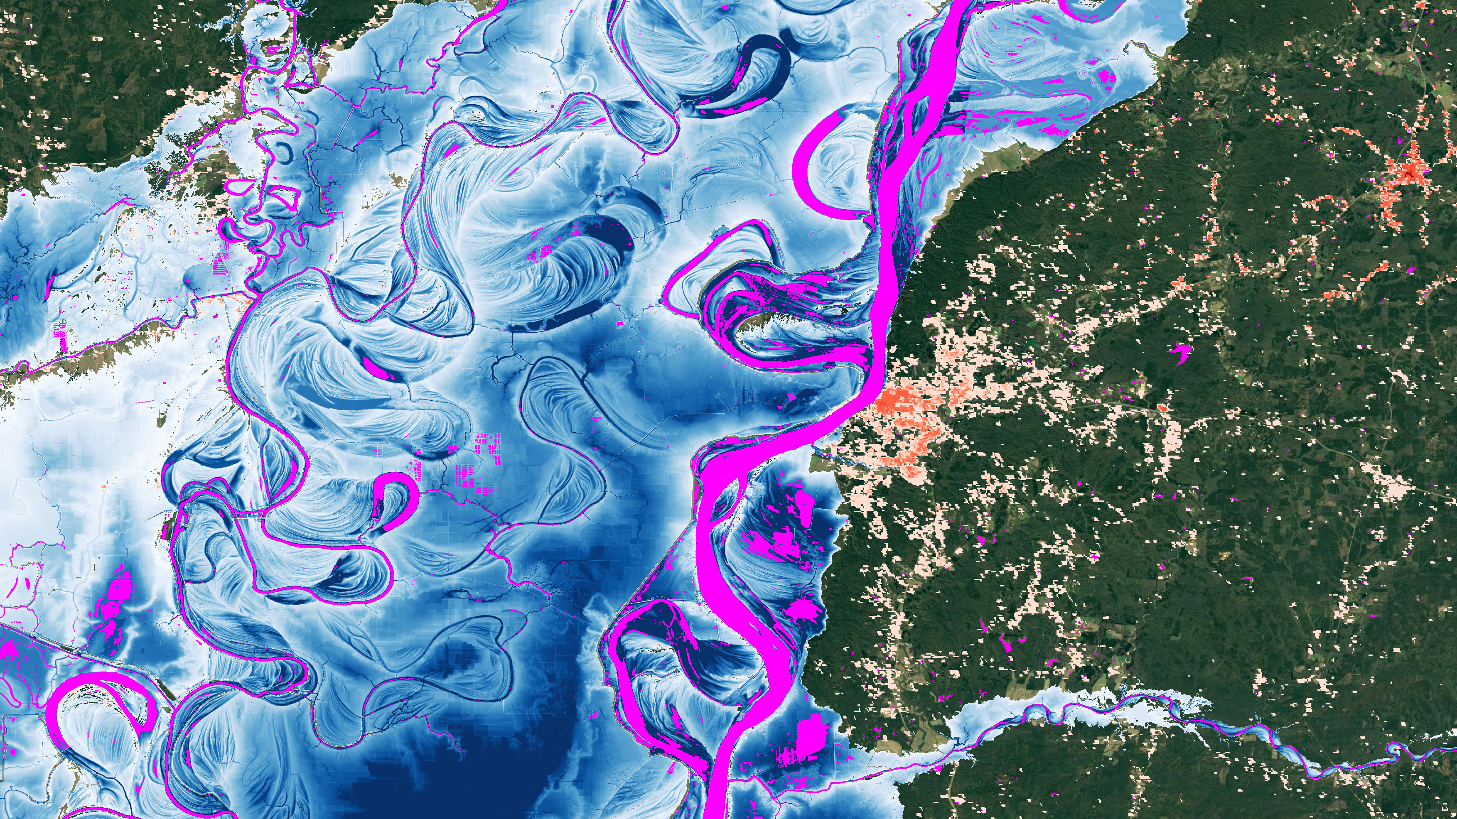
Global Flood Risk Intelligence
© Fathom

Slide 2

Global Flood Cat product
What is Global Flood Cat?
Global Flood Cat allows you to:
Quantify financial risk across all major flood perils. | Understand drivers of risk accumulations. | Customize to your own view.
© Fathom

Slide 3
Fathom's Global Flood Cat — The first truly global flood catastrophe model to consider both inland and coastal perils under current and future climate conditions.
Globally consistent
Major asset types / coverages
  30m resolution for all major flood perils
Residential, commercial and industrial
Buildings, contents and BI
Sophisticated risk differentiation
Aggregated data and coarse geocoding
Including custom flood defenses and risk modifiers
Using different spatial distributions for different asset types
Transparent and customizable
Comprehensive uncertainty representation
Download hazard and vulnerability Use your own vulnerability
Detailed Monte Carlo sampling
Nil and total losses
‘within-event’ uncertainty correlation

Slide 4
Custom vulnerability
Custom vulnerability curves
Location specific vulnerability scaling
Portfolio level vulnerability scaling

Slide 5

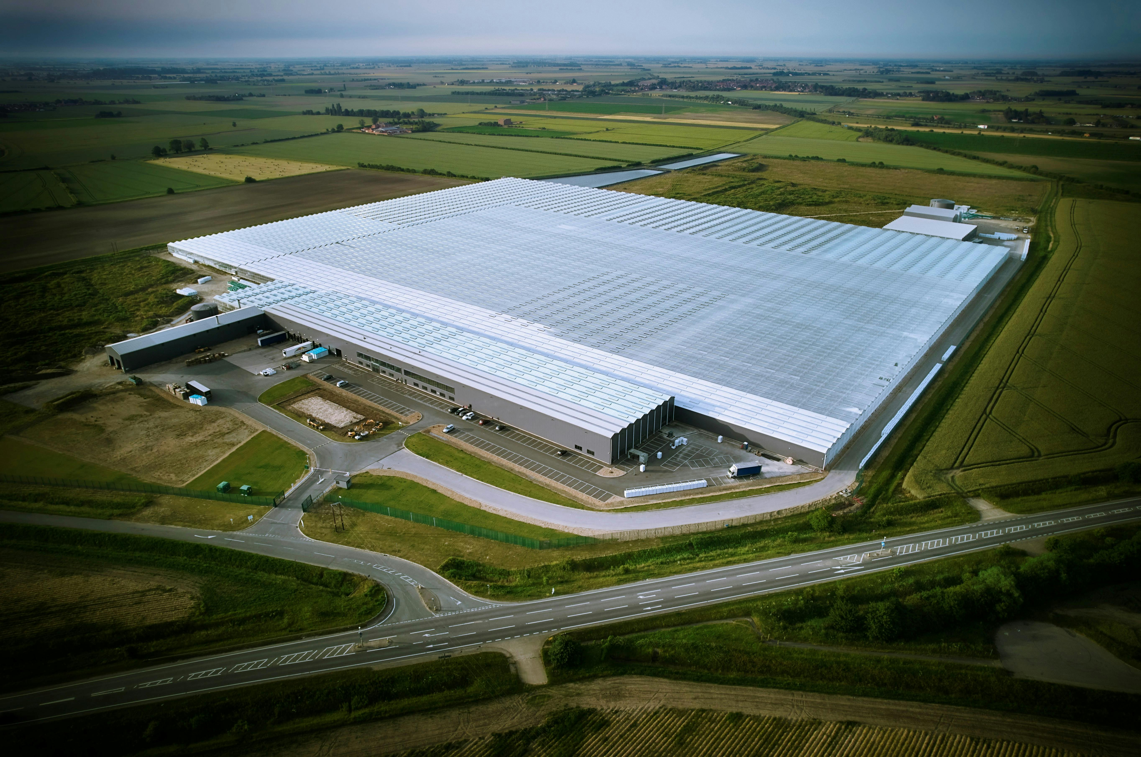
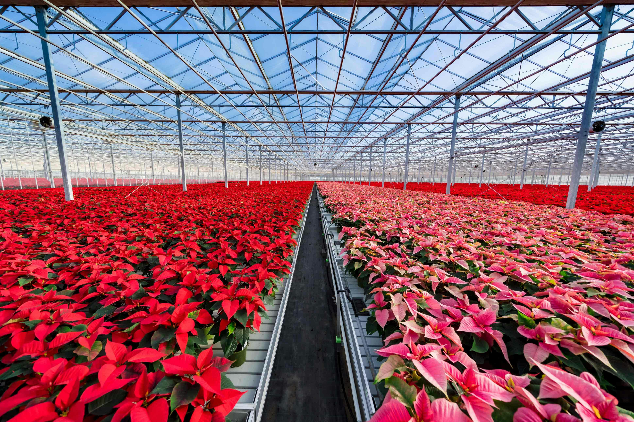
Custom vulnerability
Transport, flooding and resilience:
Unique assets:

Slide 6
Custom defenses
Location specific defenses – height or SoP
Undefended or defended hazard maps can be used with custom defenses

Slide 7
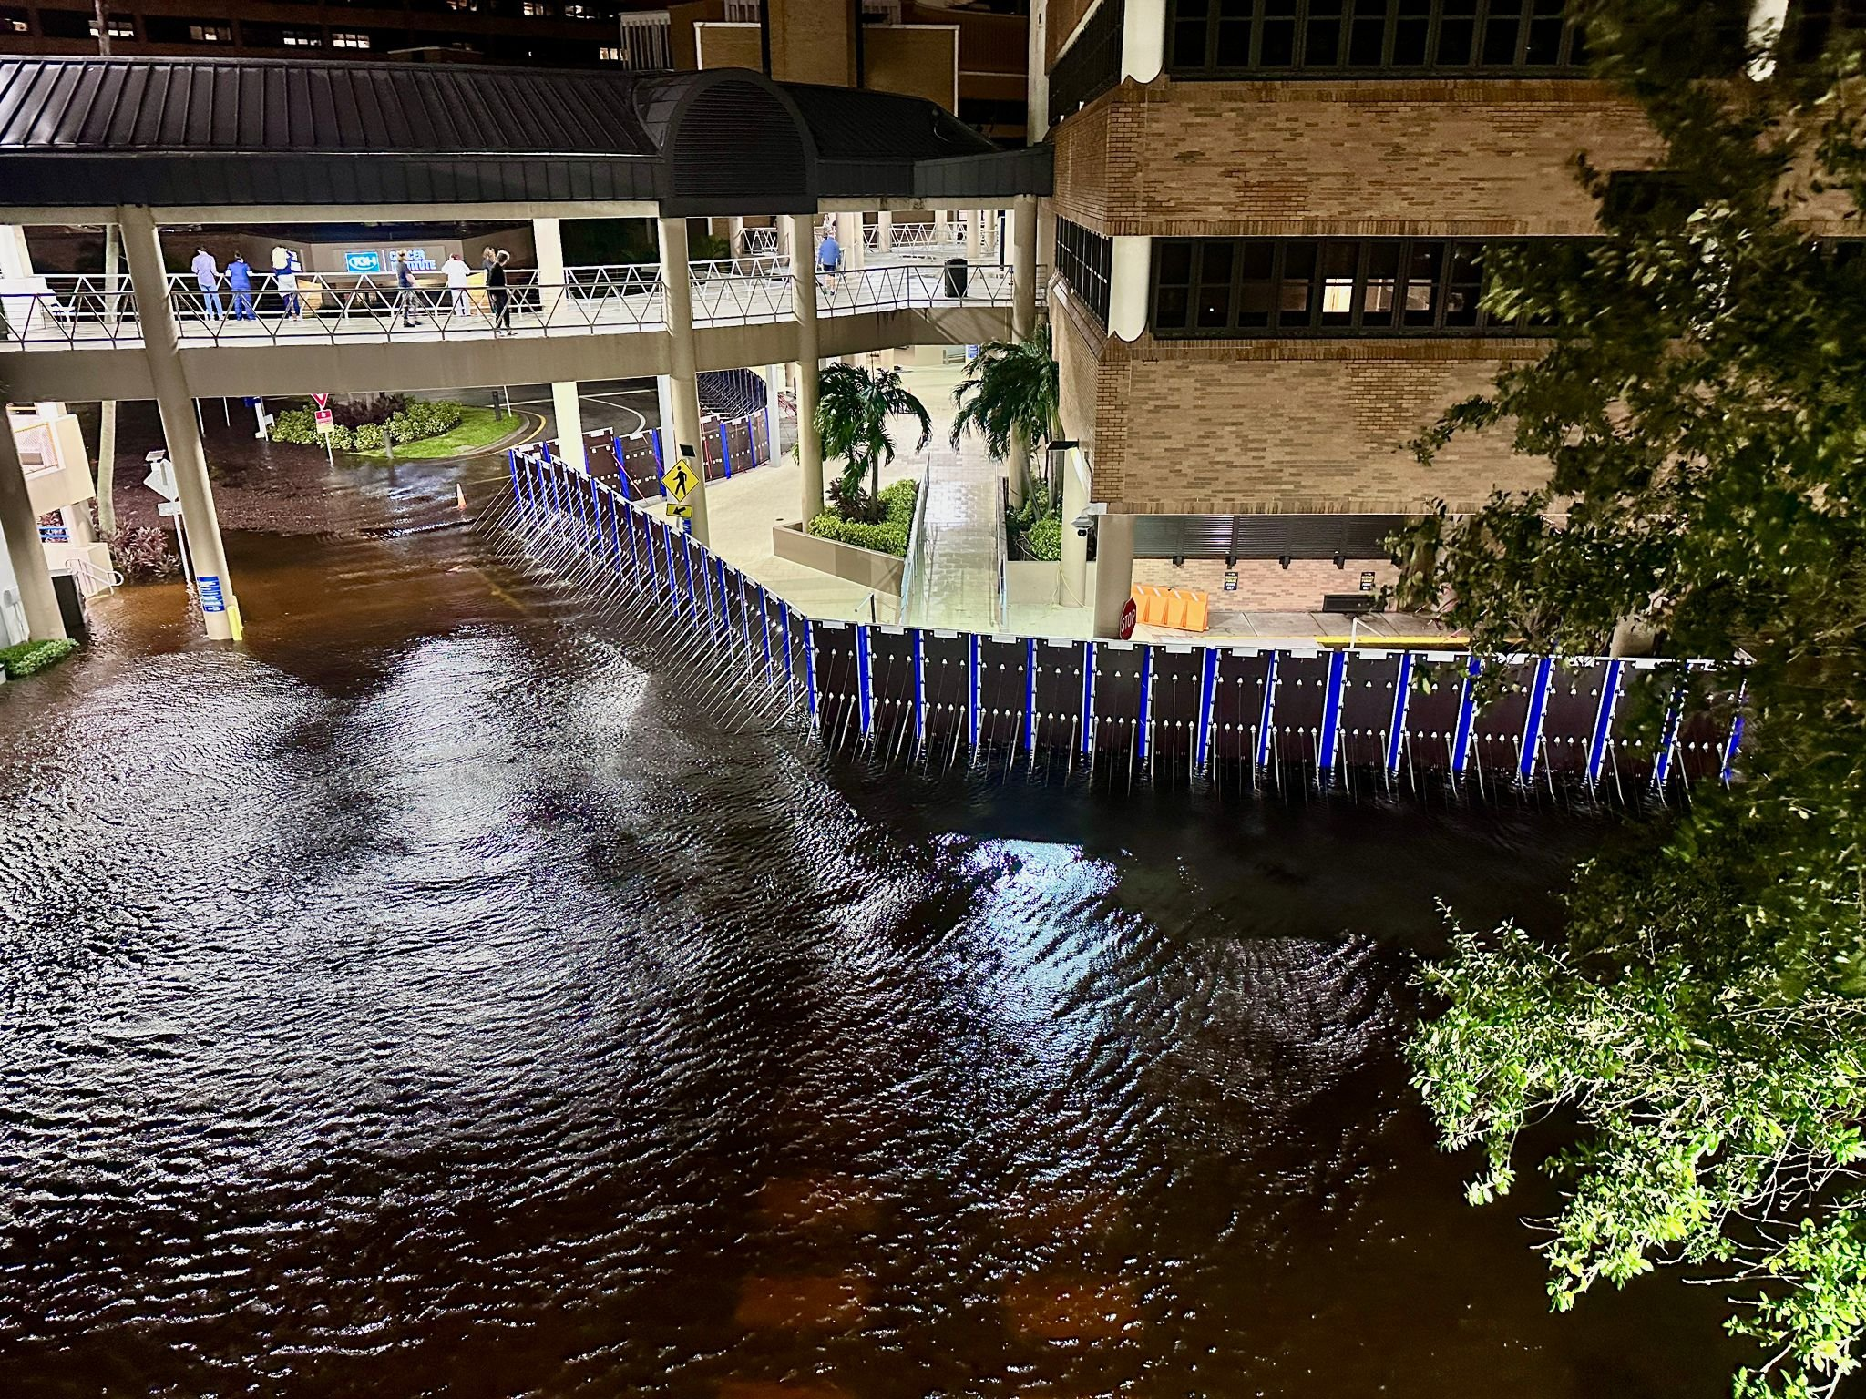
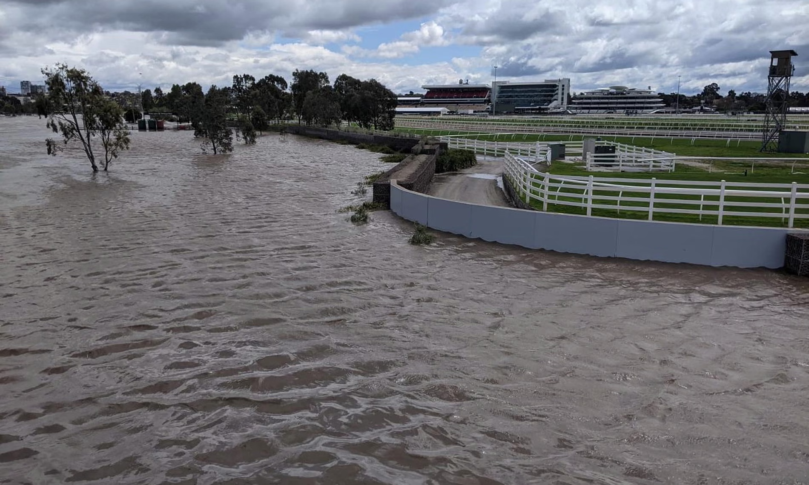
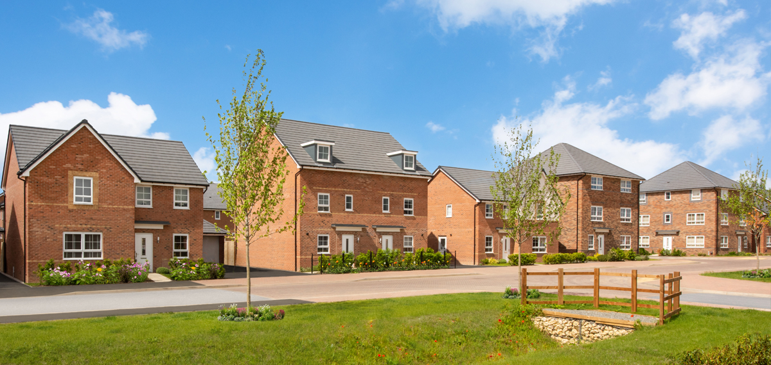
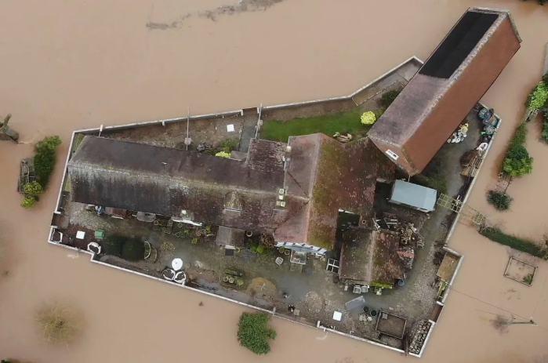
Custom defenses
Stress test design standards:
Incorporate brand new defenses:
Notes:
https://www.aquafence.com/projects/protecting-tampa-general-hospital
https://www.theguardian.com/australia-news/2023/oct/11/flemington-racecourse-flood-wall-served-its-purpose-victoria-racing-club-boss-tells-inquiry
https://www.bbc.co.uk/news/av/uk-67888641https://www.bbc.co.uk/news/av/uk-67888641
https://www.barratthomes.co.uk/

Slide 8
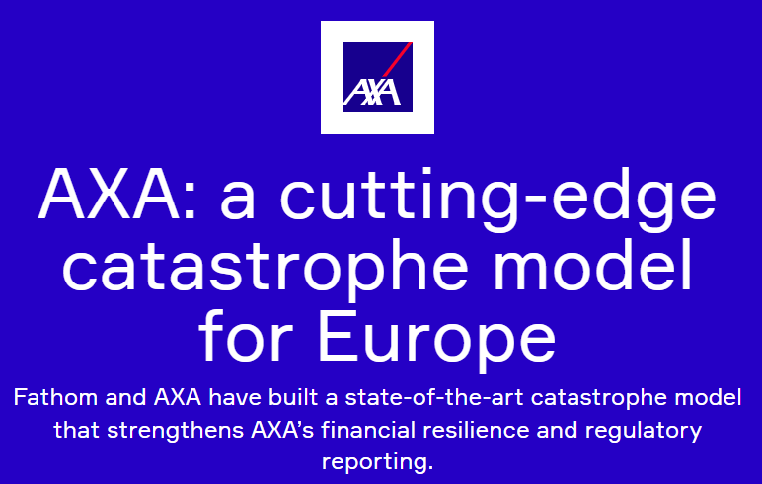
AXA:
Provided weather data
Validation against claims
Fathom:
Sourced Europe specific data for defenses, gauges and elevation
Developed vulnerability curves
Deltares:
Led the hydrological modelling
Notes:
https://www.fathom.global/case-study/axa-catastrophe-model-europe/

Slide 9
Any questions?
Visit us on stand 2.
© Fathom

