Slide 1



Slide 2


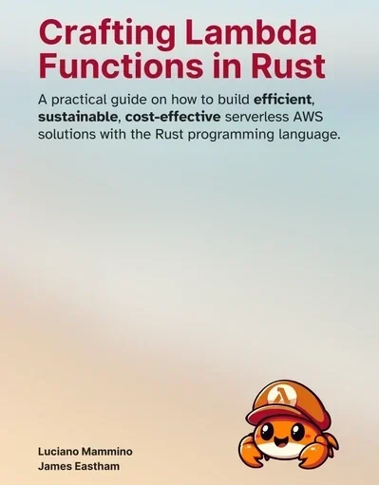
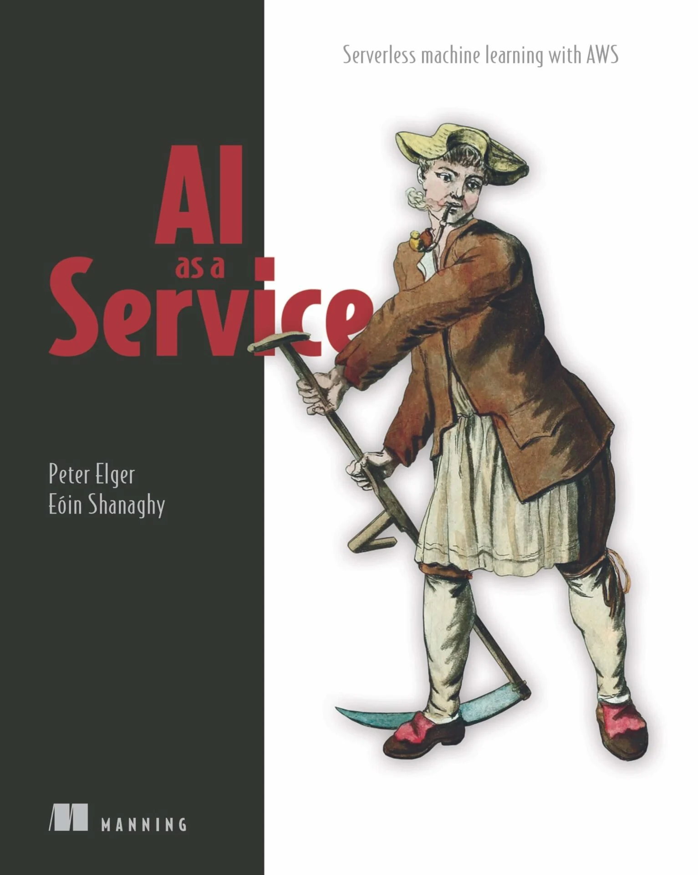


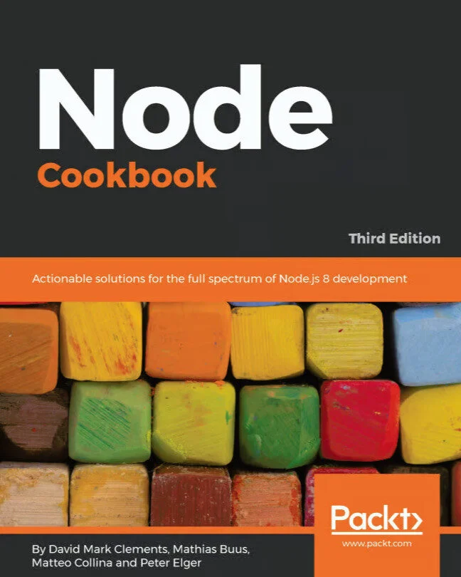
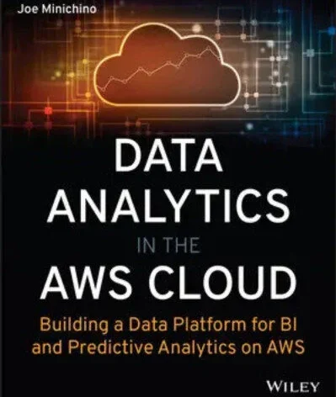


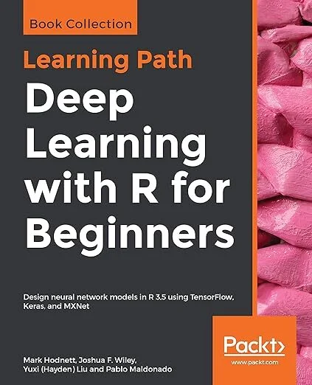



Hello!
The Podcast for Cloud Practitioners
Every second Friday, we share insights, real-world case studies, and candid opinions about the fast-paced world of cloud computing.
awsbites.com

Slide 3


Cloud Engineering Excellence for (re)insurance
Rollup, Financial and catastrophe modelling
High Performance Compute solutions on cloud
Migration and modernisation at pace and scale
Data strategy, engineering and risk analytics
As used by

Slide 4

Modelling Accelerator
Unconstrained Parallel Execution
Remove resource contention issues and capacity planning.
Improved Rollup Efficiency, Elastic Scaling On Demand
Compute resource scales in line with business needs.
Reduce TCO
Transparent insights into costs; optimise price/performance and only pay for what you use. No Servers to manage.
Dramatically Reduced Code & Infrastructure
Less code, fewer bugs, reduced maintenance overhead.
Scale to Zero
Reduced run cost and carbon footprint by moving from always on grids to compute on demand.
fourtheorem.com/modelling-accelerator

Slide 5

Data Platform Accelerator
Move from stagnant data silos to a self service data platform where your underwriting and actuarial experts own their data products.
Agility & Scale: Devolve Ownership
Empower domain experts—not central IT—to manage their own risk data to remove bottlenecks. A decoupled architecture allows your platform to flex and scale instantly as new exponential risks emerge.
Data Integrity: Provenance & Governance
Improve Model Quality with lineage tracking and expert-led publishing. Ensure robust Security via automated, central access policies that satisfy audit requirements.
Operational Efficiency: Real-Time Risk Signals
Eliminate data silos with Zero-ETL Integration (consume in-place). Gain total visibility through integrated Observability metrics across your entire risk portfolio.
AI Ready: Accurate, accessible & trusted
A pragmatic data strategy aligned to business goals and backed by the appropriate technology. Ensure the accuracy, consistency, and contextual relevance of data to enable machine learning, inference, and automation use cases.
fourtheorem.com/data-platform-accelerator

Slide 6

Modernisation Factory
Transform legacy application portfolios at pace and scale
Proven results in the (re)insurance industry, delivering:
Agility, Speed and Innovation - accelerating feature development
Efficiency and Cost Optimization - Reduce infrastructure and license costs
Performance and Resiliency - Improved system throughput and reliability
https://fourtheorem.com/
modernisation-factory/

Slide 7

Thanks!
Contact: hello@fourtheorem.com

