Slide 1
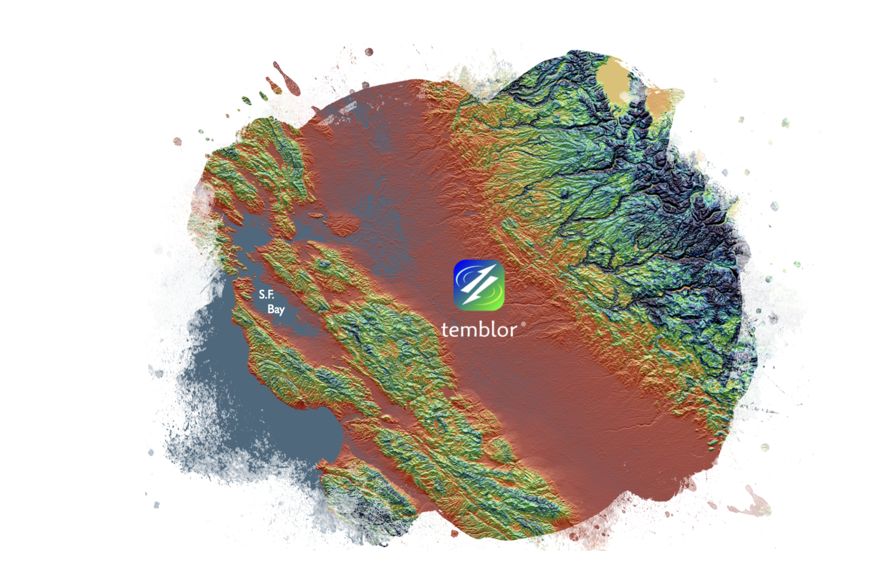
A Globally-Consistent Independent View of Earthquake Hazard and Risk
Volkan Sevilgen
volkan@temblor.com
Notes:
Temblor developed the first globally consistent seismic risk model. Today, we are making it available as a service via the integration to SpatialKAT. If you are already Katrisk client with SpatialKAT, you are ready to use our earthquake model.
In the figure you are seeing our 100 m worldwide-resolution site amplification model in an art form. This model has been tested by Fermat Capital management and it outperformed the USGS vs30 model in Japan.

Slide 2
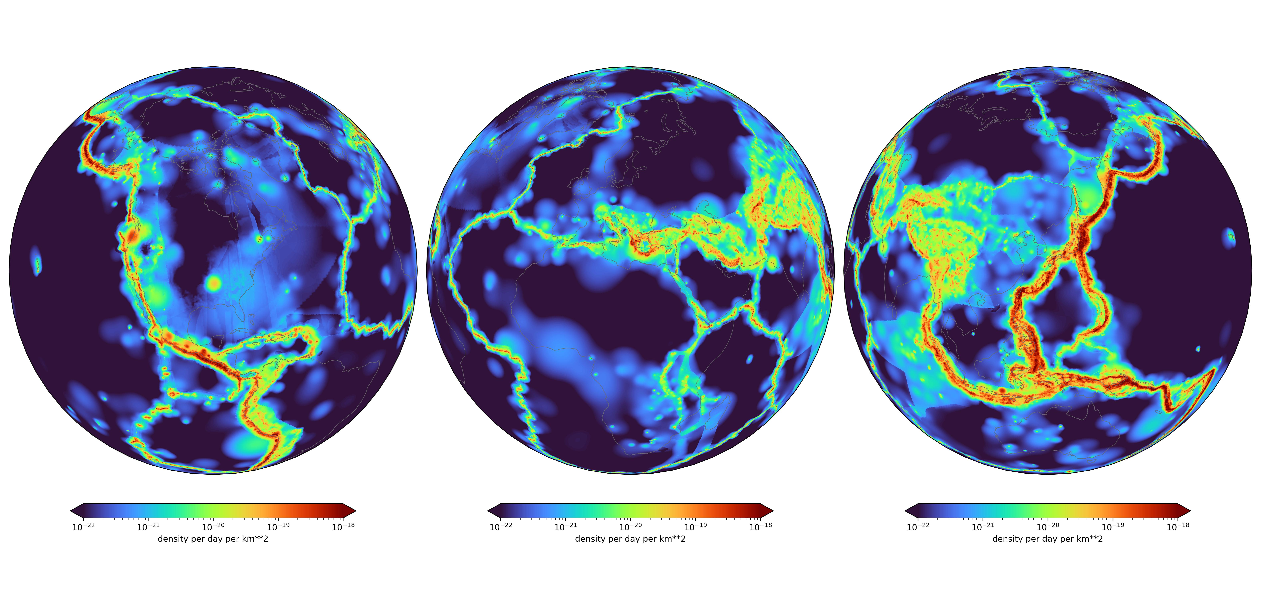
EventSet: Globally-consistent stochastic event set for 50,000 years
0.00003
M≥6 quake rate
0.3
3.0

Slide 3
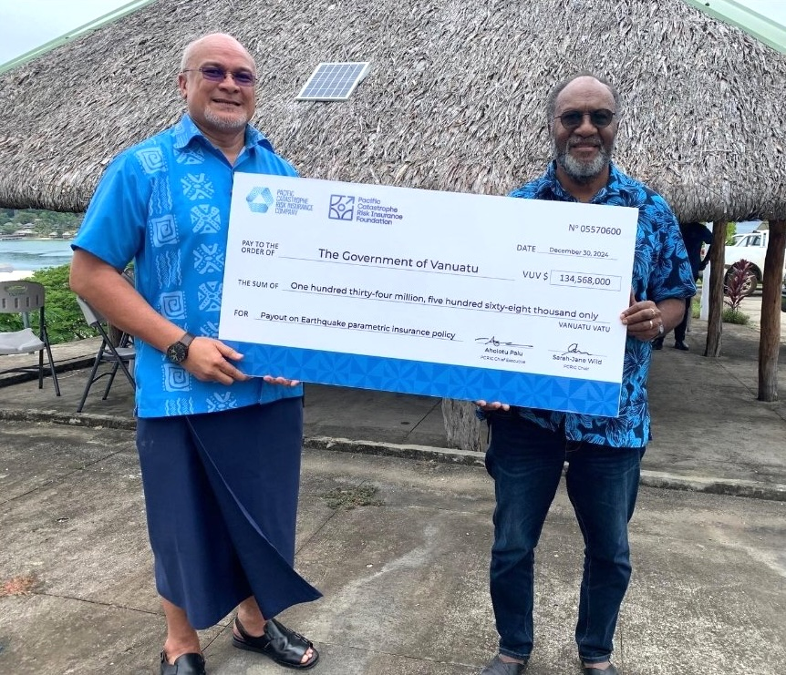
Insurer CEO
Vanuatu
Prime
Minister
How do insurers and the insured benefit from this?
We built parametric shaking and tsunami covers for Pacific Island nations

Slide 4
How do insurers and the insured benefit from this?
Last month, Alexandra Tsioulu presented how Gallagher harnesses our models for
their clients
Ross Stein
Alex-andra

Slide 5
EventSet API:
Filter our 70 million quakes with any shape file or polygon in 10 sec

Slide 6
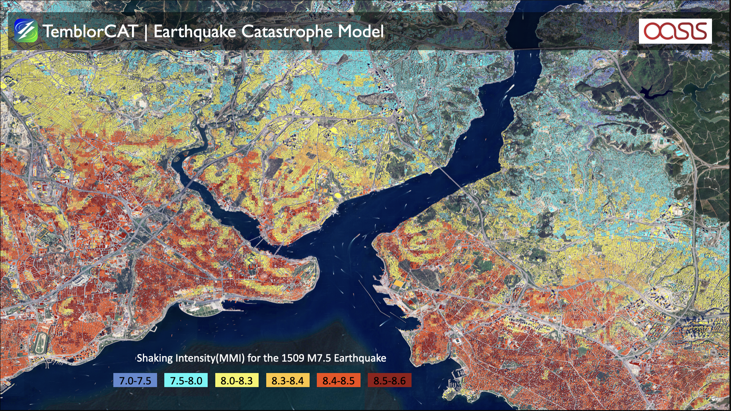

Slide 8
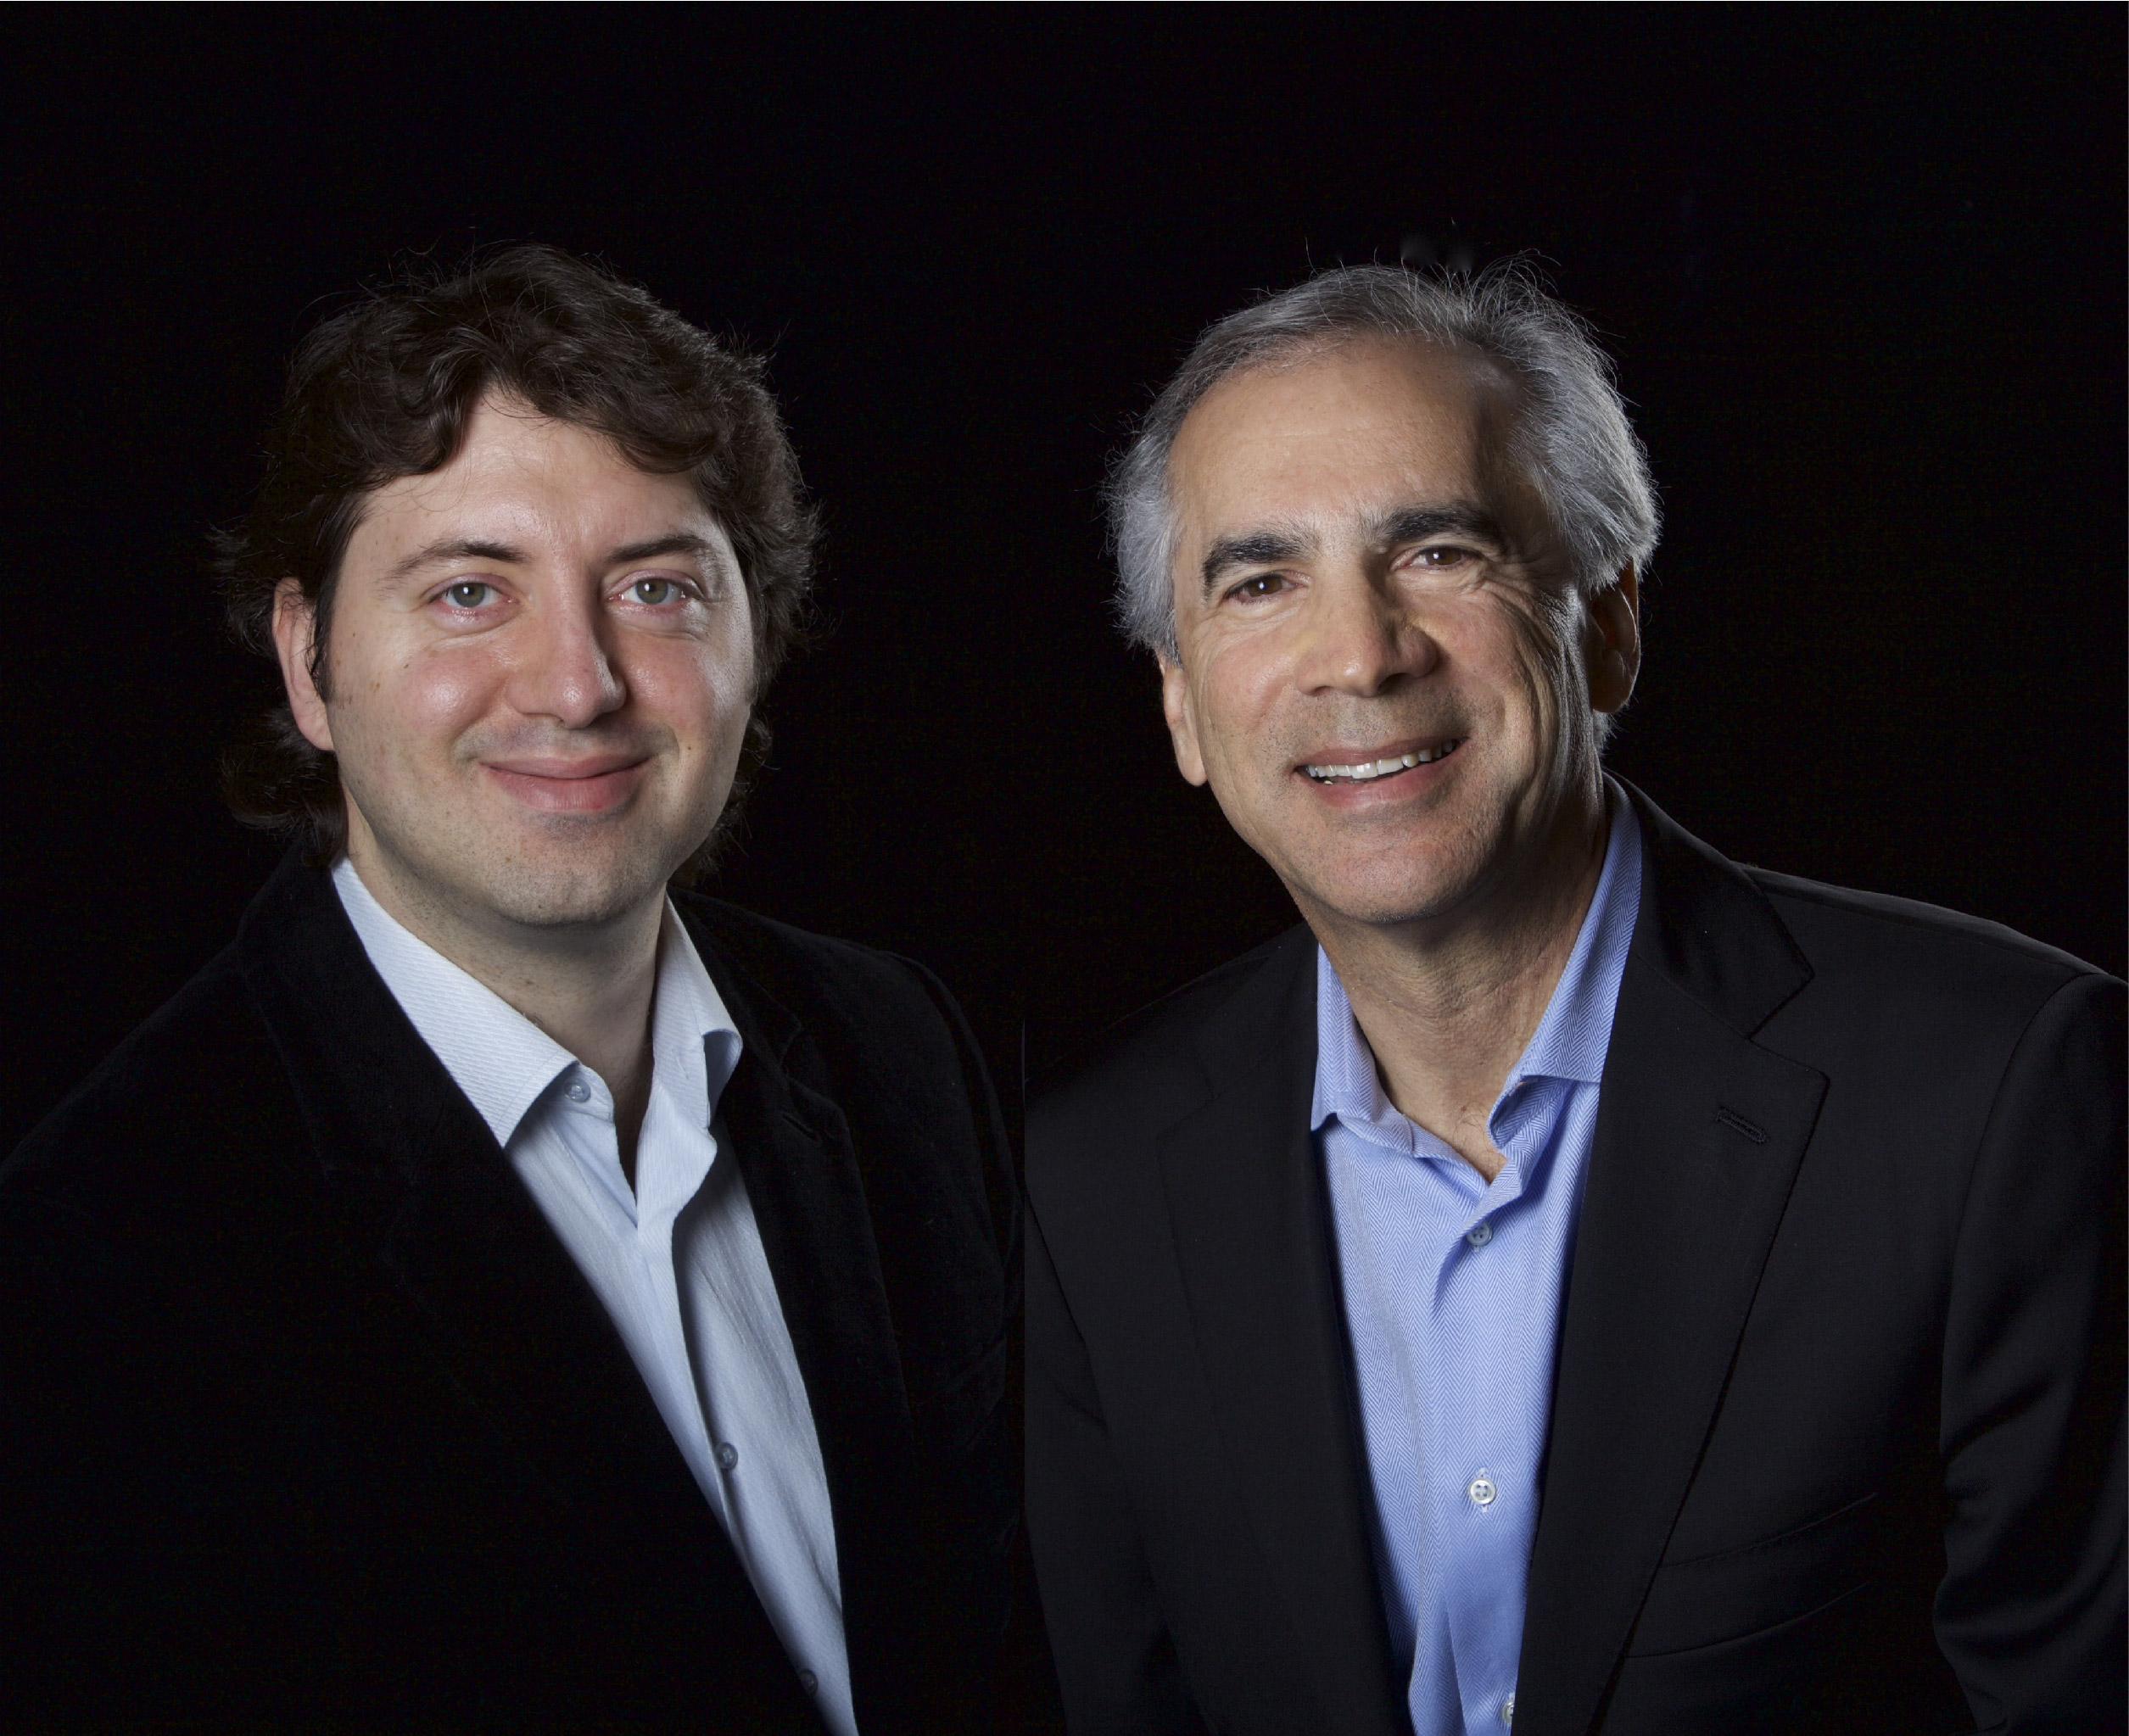
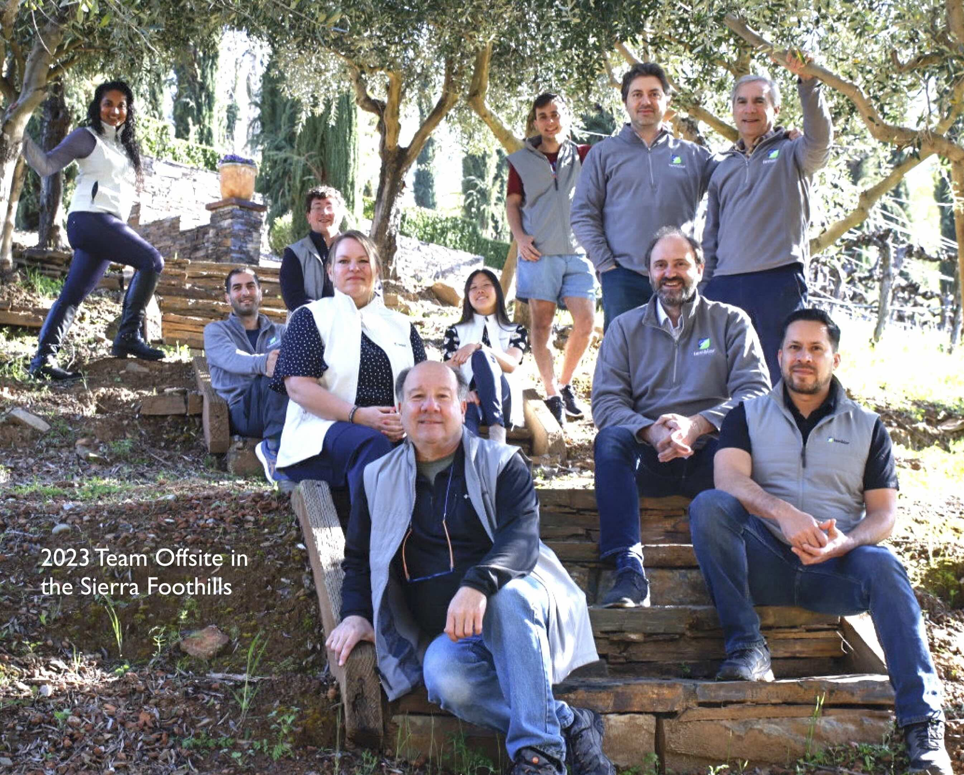
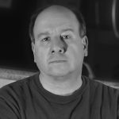
Ten-year-old S.F. company
12 globally distributed people
10 Ph.D scientist/developers, one MBA
Company
Cofounders and co-owners
Volkan Sevilgen & Ross Stein
CTO
CEO
Andy Castaldi, Business Strategist

Slide 9
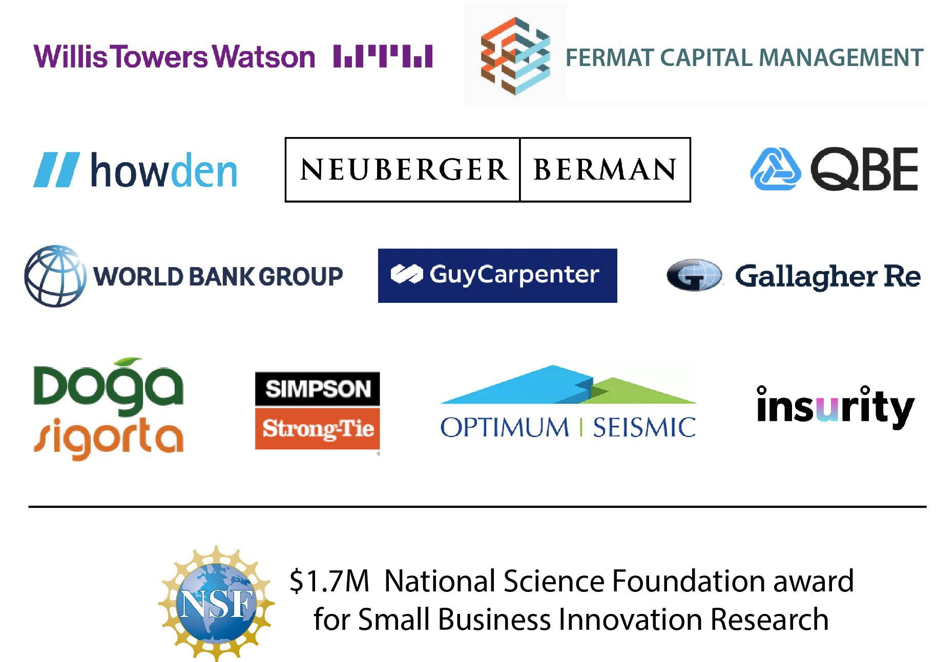
Clients

