Slide 1
Stepping up to Challenges and Opportunities – Navigating Flood Risk
Jane Toothill (JBA), Malcolm Haylock (Fathom), Petr Puncochar (Impact Forecasting), Paul Della-Marta (PartnerRe, moderator)

Slide 2
What is state-of-the-art in flood modeling today?
Data Collection and Assessment
Hydrological Modeling
Hydraulic Modeling
Flood Mapping

Slide 3
How do you model uncertainty in flood models?

Slide 4
How do you model uncertainty in flood models?

Slide 5
Machine learning: an opportunity for further advances?

Slide 6
How to meet the challenge of a changing climate?

Slide 7
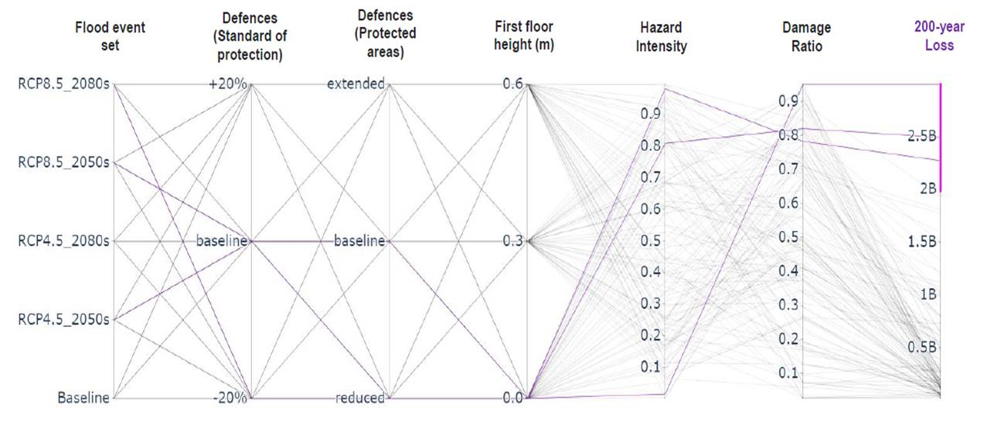
How can users be helped with model evaluation?

