Slide 1


"In today's complex and fast moving world, what we need even more than foresight or hindsight is insight"
Established as a not-for-profit Company in 2012

Slide 2

Welcome
Harriet Smith​
Head of Community Engagement
Wifi: Glaziers-Hall-Wifi
Passkey : event123
Exhibitor booths
Food and Refreshments
Emergency Exits
Toilets
Slido
Chatham House Rules
Anti- competitive trust policy
https://oasislmf.org/anti-competitive-trust-policy)

Slide 3


We live in a challenging world..
Notes:
Data , poor, at source and inconsistent standards, still a shortage of models and a challenge to validate them ….we still are challenged in handling decision making under uncertainty, we don’t capture enough and collapse it to quickly in the decision chain…. And too many think that there is safety in numbers.

Slide 4

Break away from the herd.
“If everybody is thinking alike, then somebody isn't thinking.”
― George S. Patton
Notes:
So Oasis and this event are an opportunity to not have to follow the herd , to think independently and critically to do something about it.

Slide 5




100+
22
1
Nat-Cat Global Risk Models
Model providers
Data Standard
One open exposure data standard for all modellers.
Notes:
In the 12 years since we started Oasis we have over 100 models from 22 and one data standard

Slide 6
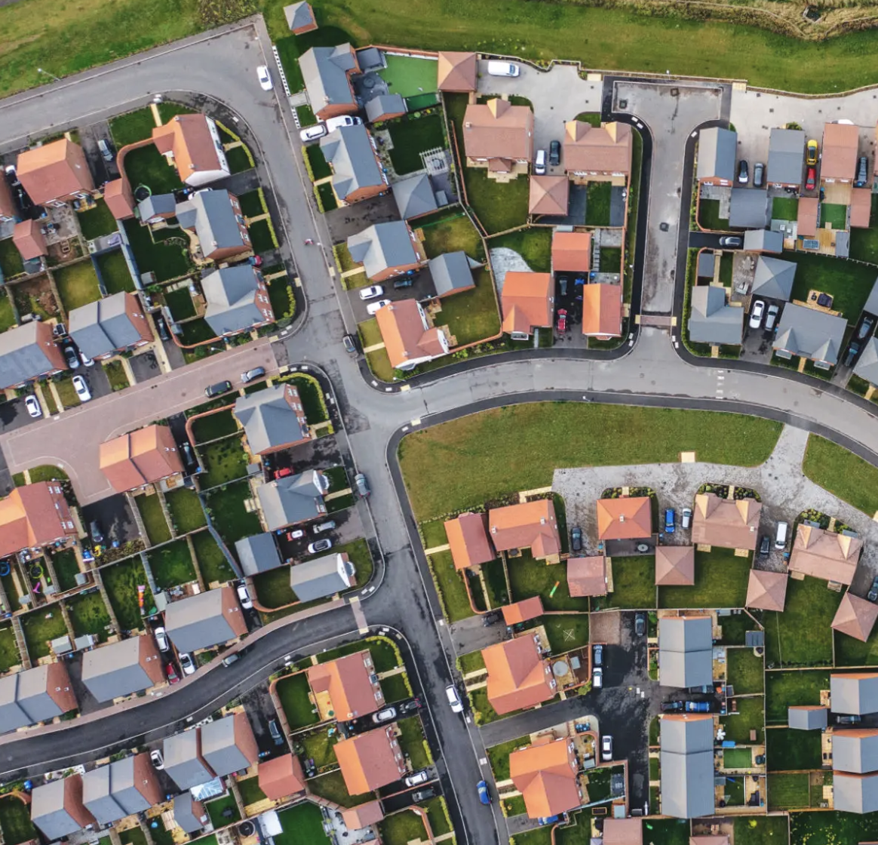




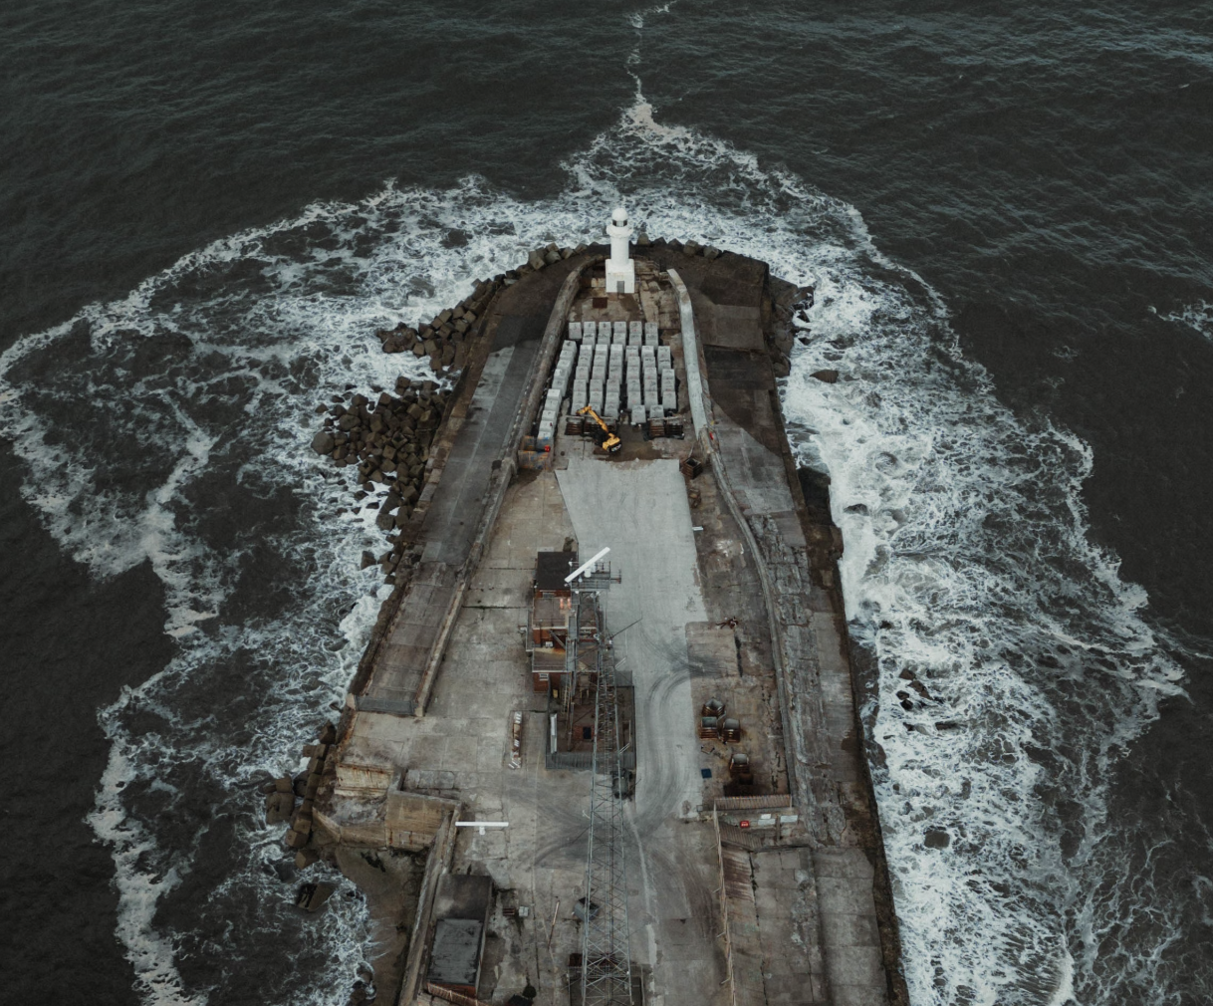

ODS Lines in progress..
Members benefit from innovation projects…
Property
Liability
Model evaluation ; creating useful and comprehensive standards
Global Exposure Model, offering worldwide coverage
Cyber
Marine
Academic Collaborations; improved problem solving & access to resources

Slide 7










There are many options to deploy models in Oasis..
NRMC
CLOUD
HOSTED
LOCALLY
ON -PREMISE
Software is installed on individual computers - often used by developers or academics
Software is installed and runs on servers located within the organization's premises, managed internally by IT
Software and data are hosted on cloud provider servers (like AWS, Azure, or Google Cloud). Same architecture as on premise but scalable
The software is hosted, maintained, and operated by an external provider. Users access the software via a web browser.
Notes:
Flexibility and its great that both Moody’s and Verisk are supporting the independent modellers that use Oasis.

Slide 8





















Oasis Members..

Slide 9
Changing the landscape of catastrophe modelling
OASIS MEMBERSHIP
Established as a not-for-profit Company in 2012

