Slide 1
Generating event sets with Earth-2
David Wood, JBA Risk Management

Slide 2
NVIDIA’s Earth-2 Long Rollouts with SFNO

Slide 3
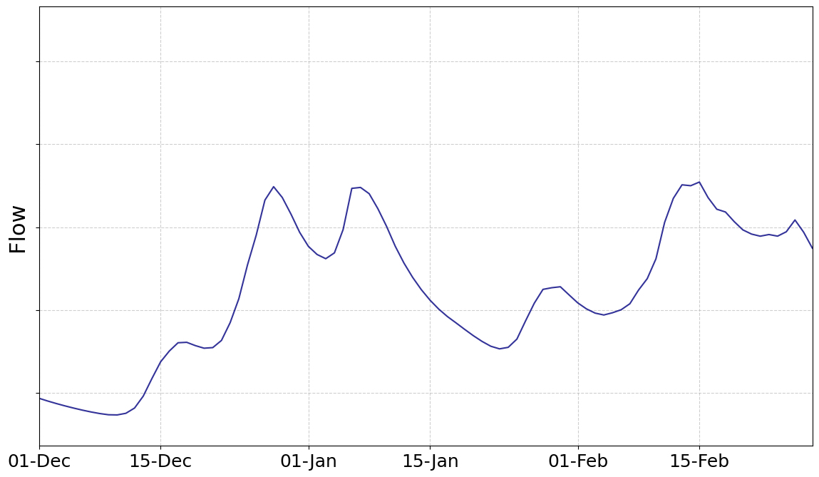
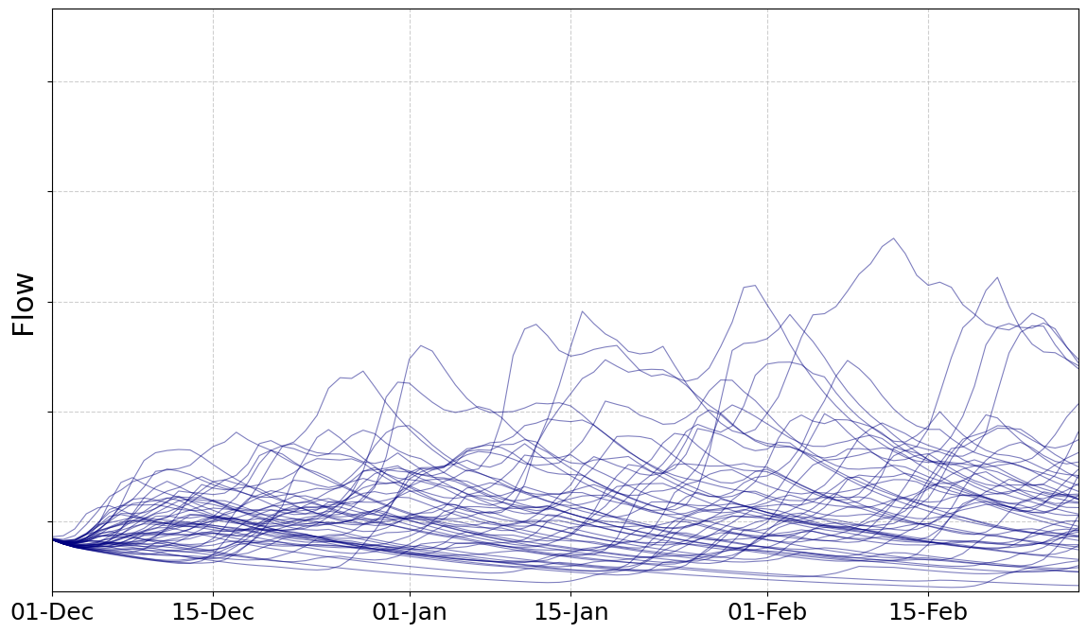
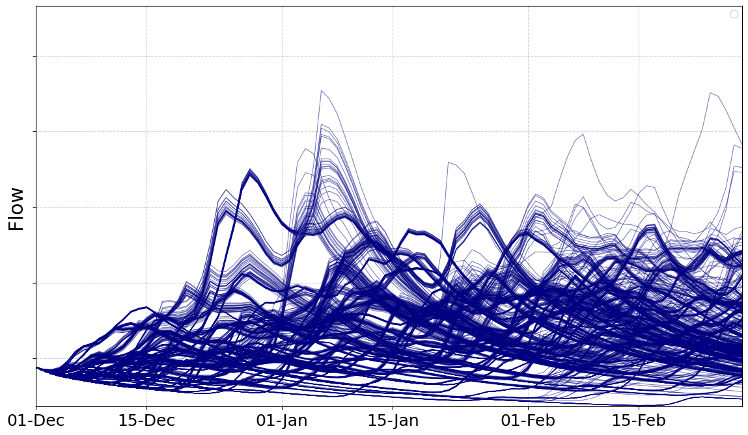
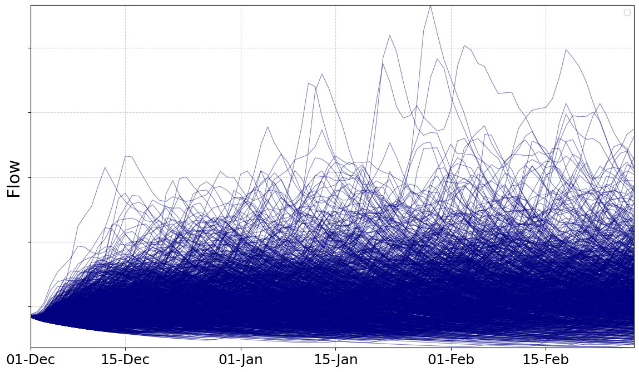
Plausible new river flows?
Observed Record
Numerical Weather Prediction
Statistical Extrapolation
Earth-2 FCN-SFNO

